Slide 1

Pivot Point Executive Program
7-Steps to Success

Slide 2

STEP #1: Create A Safety Net
GOAL:
What’s In It For Me
Expose Fear
Create Plan ”B”
Instill Confidence
Attain Fearlessness

Slide 3
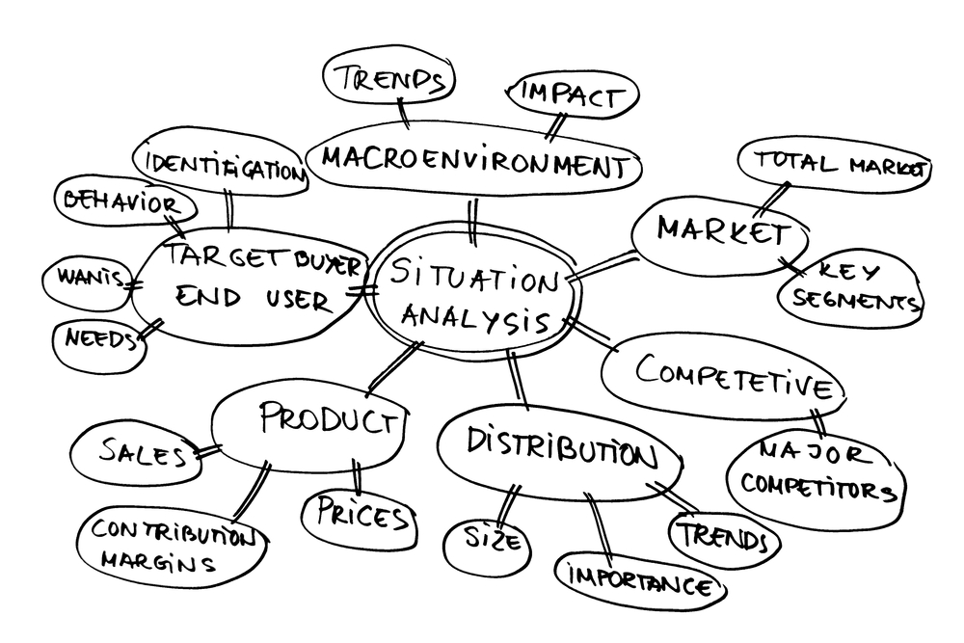
STEP #2: Evaluate the Current Situation
Goal:
Separate Symptoms from Causes
Get a multi-dimensional view
Construct a clear visual representation of what is and is not working

Slide 4
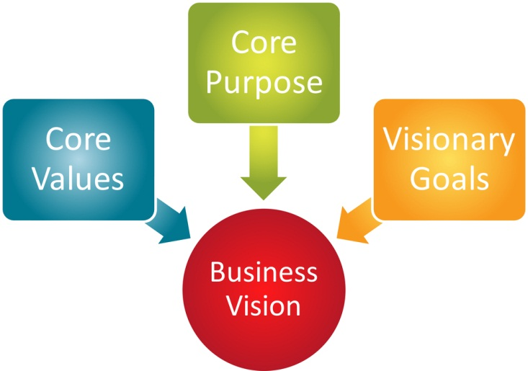
STEP #3: Assess Core Beliefs, Driving Values and Stress Response
Goal:
Raise individual awareness and appreciation for personal responsiveness
Provide team with understanding of how they interact under normal and stressful circumstances.

Slide 5

STEP #4: Achieve Common View and Alignment
Goal:
Attain consensus view of situation
Align Personal and organizational beliefs and values
Begin to consider initial steps forward

Slide 6
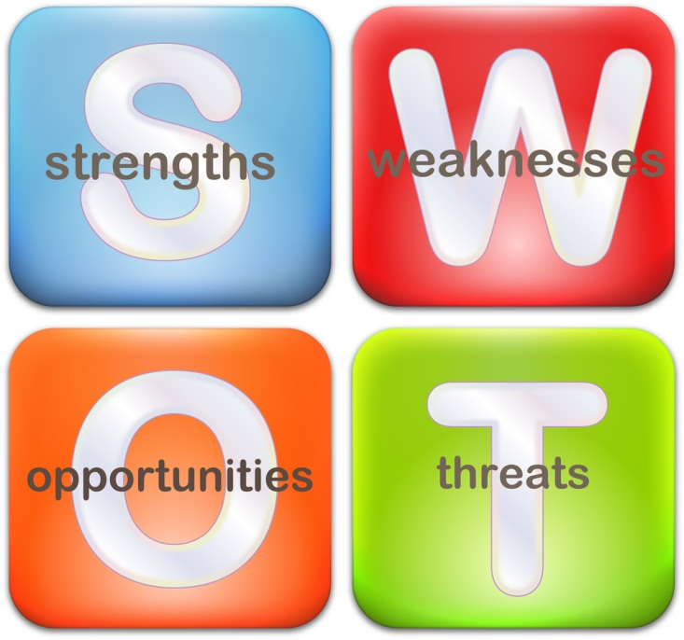

STEP #5: S.W.O.T. and Block Assessment
Goal:
Conduct S.W.O.T and Block Analysis
Articulate Strengths from customer’s perspective
Identify internally created obstacles to success.

Slide 7
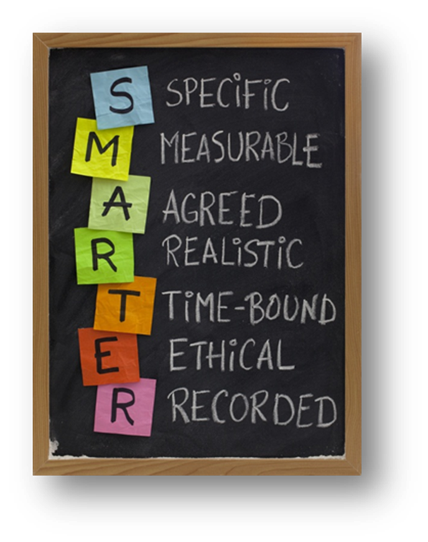
STEP #6: Goal Setting and Attainment Planning
Goal:
Set specific goals using AIM SMART process
Develop goal attainment plan
Prioritize goals and set implementation schedule

Slide 8

#7 Implementation and Mentor Coaching
Goals:
Implement goal attainment plans
Mentor coach those associated with each goal
Identify opportunities for adjustment

Slide 9
Program Deliverables and Investment
Up to 5 individual ELI Assessments and 1-hour 1:1 debriefs conducted by an ELI Master Practitioner
5 1-hour situation analysis interviews with senior management team
Up to 10- ½ hour situation analysis interviews with other stakeholders
Comprehensive Mind-Map delivering a visual representation of situation analysis
2, 5-hour management group sessions to present findings and build go-forward goals and plans
26 weekly 1-hour 1:1 mentor coach sessions with each senior executive.
                Investment: $ 31,550.00*
                * When purchased as a program.

