Slide 1
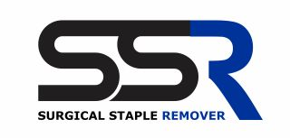
SINN RX, LLC
4308 Alton RD Suite 780
Miami Beach, FL 33140
305.535.7554

Slide 2
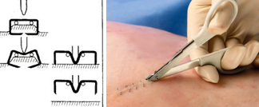
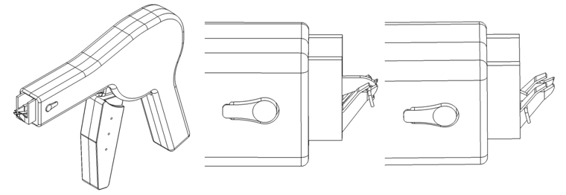
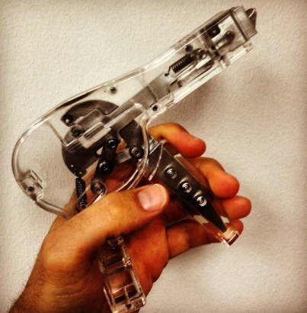
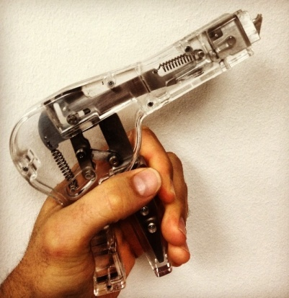

General
Overview
Figure 1A
The SSR is the first device to successfully automate the hygienic removal of surgical staples.
Problem: Surgical wounds and lacerations are closed in multiple fashions and often surgical staples are used to reapproximate the edges. Upon wound healing, the current method of removal of the staple is suboptimal and potentially dangerous. The process requires the doctor or nurse to deform the staple from a ”U” shape to a “W” shape (Fig 1A). Each deformation requires focus on the wound, only to be diverted for subsequent disposal into a container or receptacle away from the wound, and then subsequent refocus on the site.
This process is inefficient and unsanitary. The removal of the staple creates a “sharp”, which can transmit disease and/ or injury, through inadvertent puncture of a Healthcare or Sanitation worker.
Solution: The SSR deforms the staple in the same manner as the aforementioned; however, it then automatically places the bio hazardous removed staple into a self contained isolated compartment within the device for safe and hygienic disposable at the completion of the removal procedure (Fig 2B).
Figure 2B
SINNRX, LLC | 4308 Alton Rd Suite 780 Miami Beach FL 33140 | 305. 535.7554

Slide 3
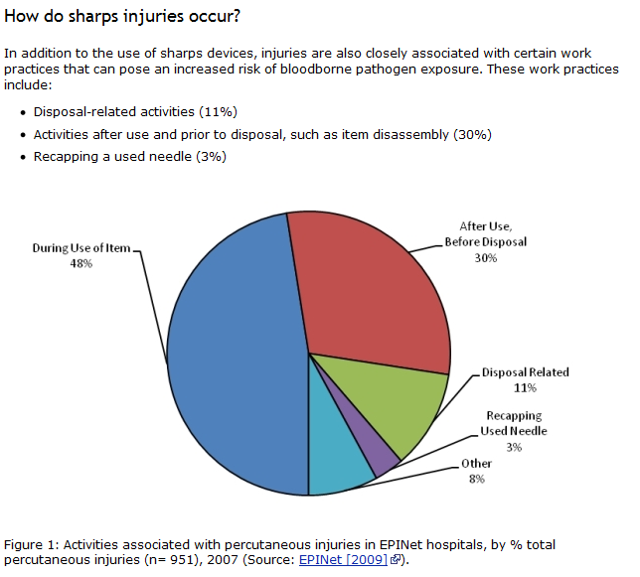
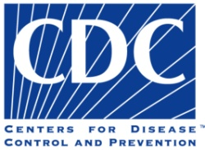
The
Facts
Center for Disease Control and Prevention Statistics
385,000 percutaneous injuries occur in US hospitals annually.
It’s documented that half or more injuries go unreported.
Those injured include: nursing staff, laboratory staff, physicians, housekeepers, and other health care workers.
Center for Disease Control and Prevention defines a “Sharps Injury” as a penetrating stab wound from a needle, scalpel, or other sharp object that may result in exposure to blood or other body fluids.
A report from the Exposure Prevention Information Network (EPINet) found that nearly half of all sharps injuries occurred during use of the sharp, and of the nearly 40% of needle injuries which involved a safety designed needle, the majority occurred before activating the safety device.
24% of injuries caused by a suture needle.
22% of Sharps injuries are caused by surgical staples or like sharps.
SINNRX, LLC | 4308 Alton Rd Suite 780 Miami Beach FL 33140 | 305. 535.7554

Slide 4

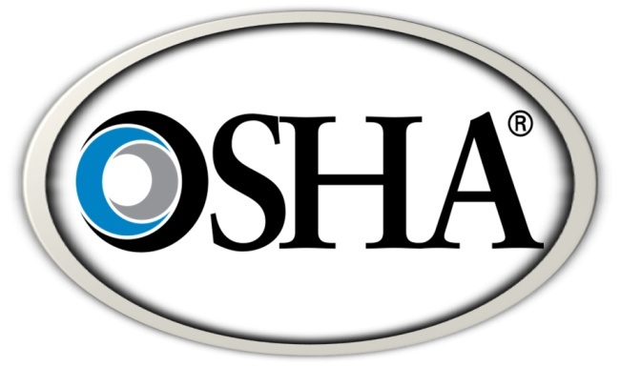
The
Business
Demand & Necessity: November 6, 2000 The Needlestick Safety and Prevention Act was passed to reduce injuries and prevent the transmission of bloodborn pathogens that result in viruses and disease.
The law requires employers to use work practice controls and safer devices that are engineered to eliminate or minimize exposure to bloodborne pathogens resulting from needlestick/sharp injuries.
Employers must:
  Demonstrate that they are reviewing new technology that can reduce risk of exposure to bloodborne pathogens by updating exposure control plans and documenting the decision-making process on implementing such technology.
  Maintain a sharps injury log to track the type and brand of device used, the department or area where the incident occurred, and an explanation of the incident. The log must be maintained in a manner to protect the confidentiality of the injured employee.
  Solicit input from employees responsible for direct patient care in the identification, evaluation and selection of effective safety devices and work practice controls, as part of the ongoing exposure control plan development process. Efforts to encourage staff input must be documented in the plan.
This means that when the SSR is available it must be used.
  The cost of a sharps injury can be a compelling reason to use safer sharps practices. One sharps injury can cause a number of direct and indirect costs for the health care facility, including:
    Loss of employee time
    Cost of tying up staff to investigate the injury
    Expense of laboratory testing
    Cost of treatment for infected staff
    Cost of replacing staff
SINNRX, LLC | 4308 Alton Rd Suite 780 Miami Beach FL 33140 | 305. 535.7554

Slide 5
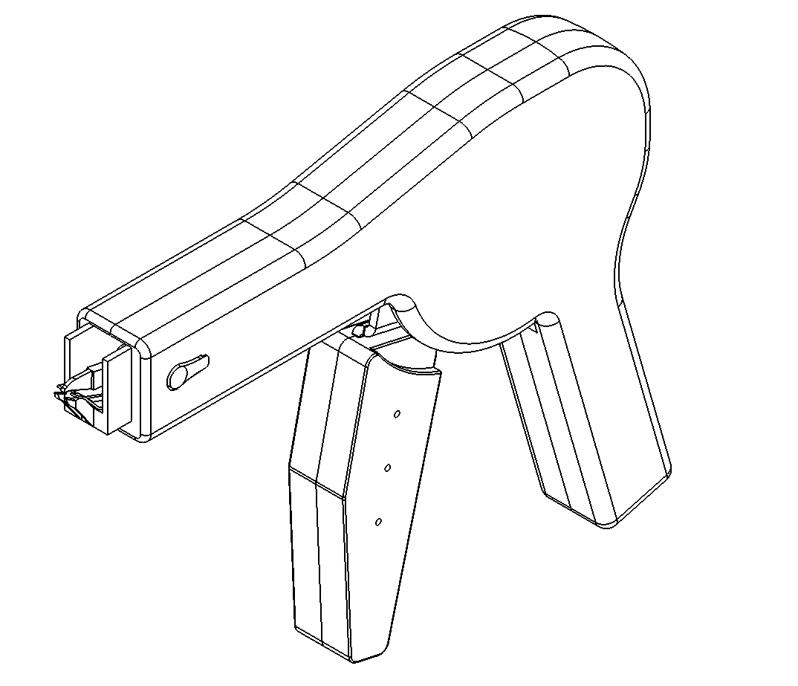
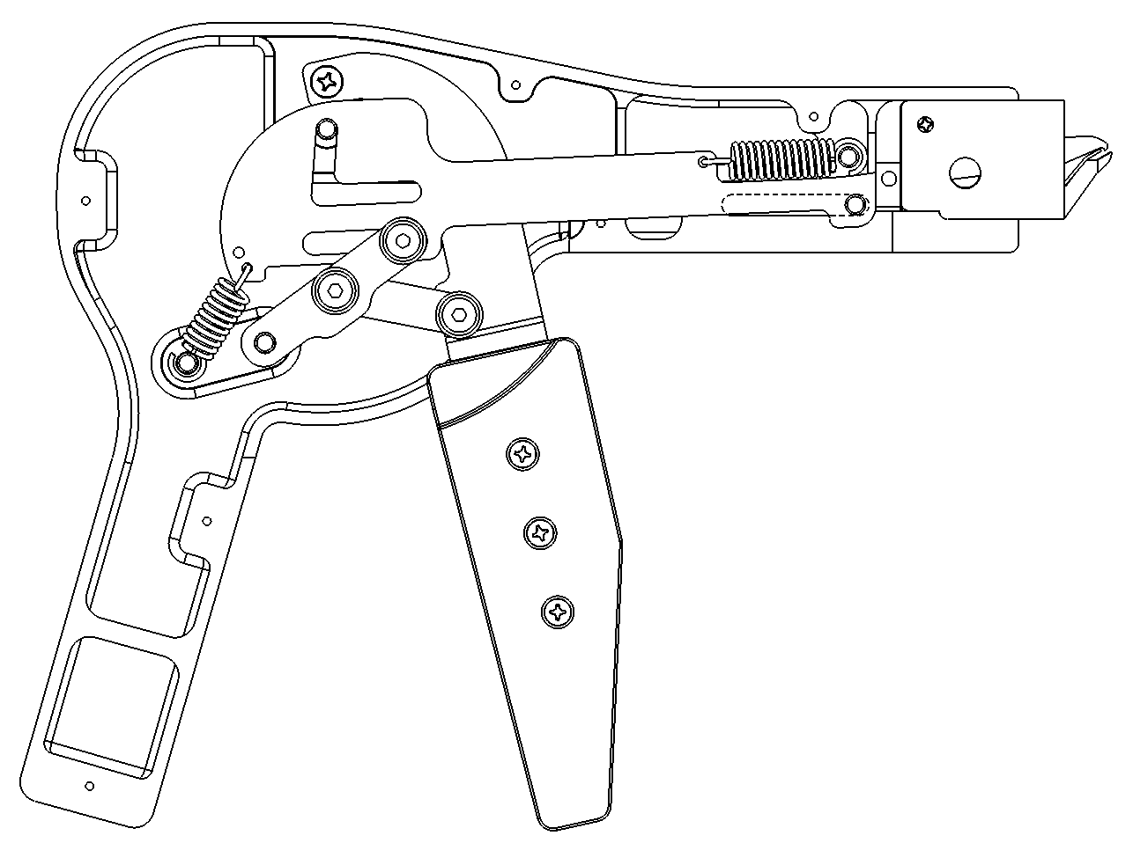
The
Business
Company facts:
SINNRX, LLC is the owner of this device and all of its intellectual property.
There are currently two issued patents and five patents pending:
    Patent 1: 8241303
    Patent 2: 8177793
    All other patents applications are pending as of February 2013.
There is a working prototype that is one hundred percent efficient.
This is an FDA Class I/II device.
The device has not yet been FDA approved. However, SINNRX’s engineers have all the documentation for the filing and are experienced in the FDA approval of medical devices.
SINNRX, LLC | 4308 Alton Rd Suite 780 Miami Beach FL 33140 | 305. 535.7554

Slide 6
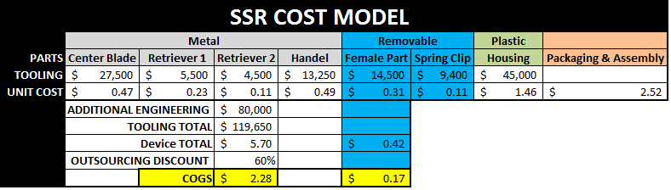
The
Business
COGS
What’s it cost to make?
These are the actual numbers to create a production model and produce 100,000 units.
**Cost estimates by MJM Manufacturing, INC 5205 NQ 161st St. Hialeah, FL 33014 | 305.625.3342
SINNRX, LLC | 4308 Alton Rd Suite 780 Miami Beach FL 33140 | 305. 535.7554

