Slide 1


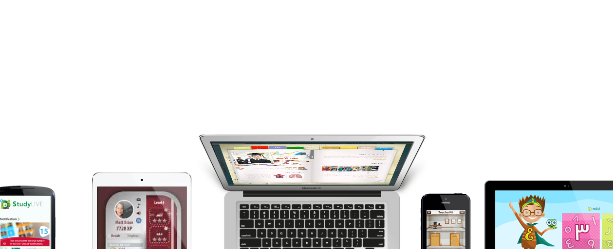
Student Success
Enjoy learning
Presented by: Ahmed Medhat
Notes:
When add image, you must sent it to back! Right Click on Image -> Send to Back -> Send Back

Slide 2
The Right Learning Management System
Managing teaching and learning workflows has never been smoother with ITWORX Education LMS.

Slide 3
CUSTOMER OPPORTUNITY

Slide 4
Customer Qualifying Questions
4
Customer Qualifying Question one goes here ?
4
Customer Qualifying Question one goes here ?
4
Customer Qualifying Question one goes here ?
4
Customer Qualifying Question one goes here ?
4
Customer Qualifying Question one goes here ?
4
Customer Qualifying Question one goes here ?
4
Customer Qualifying Question one goes here ?
4
Customer Qualifying Question one goes here ?
…

Slide 5
SOLUTION VALUE

Slide 6
Who?
K-12 schools, network of schools, districts, and states.
What?
Manage teaching and learning workflows.
Aspects
Assignments
Lesson Planning
Individual Learning Plan
Gradebook
Assessments
Behavior
Attendance
Content Library
Virtual Classes
e-Portfolio
Calendar
Communication & Collaboration
Parent Portal
Administration

Slide 7
Why?
A unified system for digital work exchange that provides students and teachers with a single, easy, and dependable solution to manage academic and administrative needs.
Other tools/systems
e.g. plagiarism
LCMS
SMS
LMS
Website

Slide 8

Proven platform, nation-wide deployments
11,000+
Students
1000+
Teachers
123
Schools

Slide 9
SOLUTION DETAILS

Slide 10



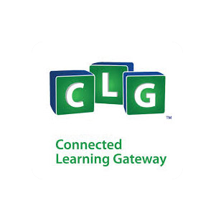

Solution Overview
Integrates with O365 SharePoint Online
Integrates with O365 Exchange Online
Provide staff, faculty, and students at your school with free email, sites, online document editing and storage, IM, and web conferencing.
For schools that want to modernize their communications and productivity infrastructure on their terms.
What is CLG ?
What is Edu Share?
Is an engaging and multilingual web-based social e-learning environment that is designed to enhance the teaching process for teachers, make learning fun and insightful for K-12 students, facilitate communication between school administrators, teachers and parents
Is a digital content repository that houses teaching and learning resources like lesson plans, lesson content, research, multimedia, and all other types of e-learning content or learning objects. It’s an online platform that avails publishing, rating and reviewing around learning resources as well as certifies user-created content.

Slide 11
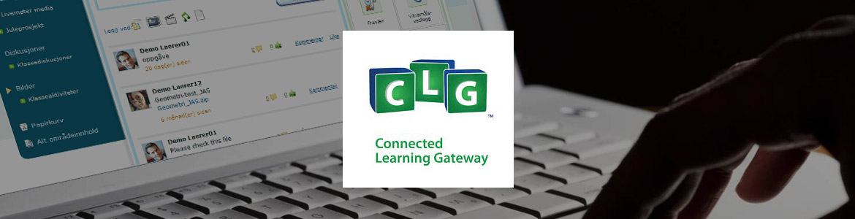

Slide 12
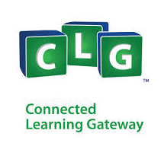










CLG
Assignments
Attendance
Assessments
Class Performance Reports
Question Banks
Goal Planner
Upload as
SCORM for
Interactive
Assignments
Goal Planner
Virtual Classrooms & Lesson Plans
O365
E-Portfolios
Time Table
Grade book
Publish
Corners & Collaboration
Email Integration (SSO)
Online
Teachers
Students
Offline
Interactive Content

Slide 13

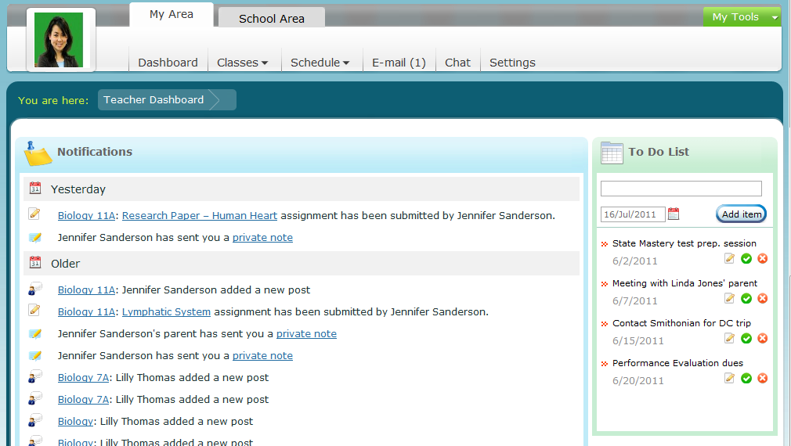
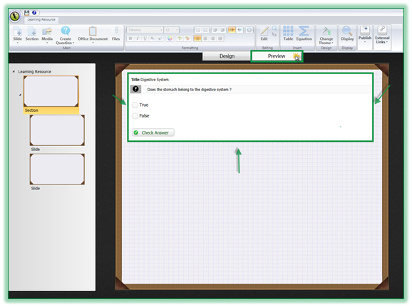
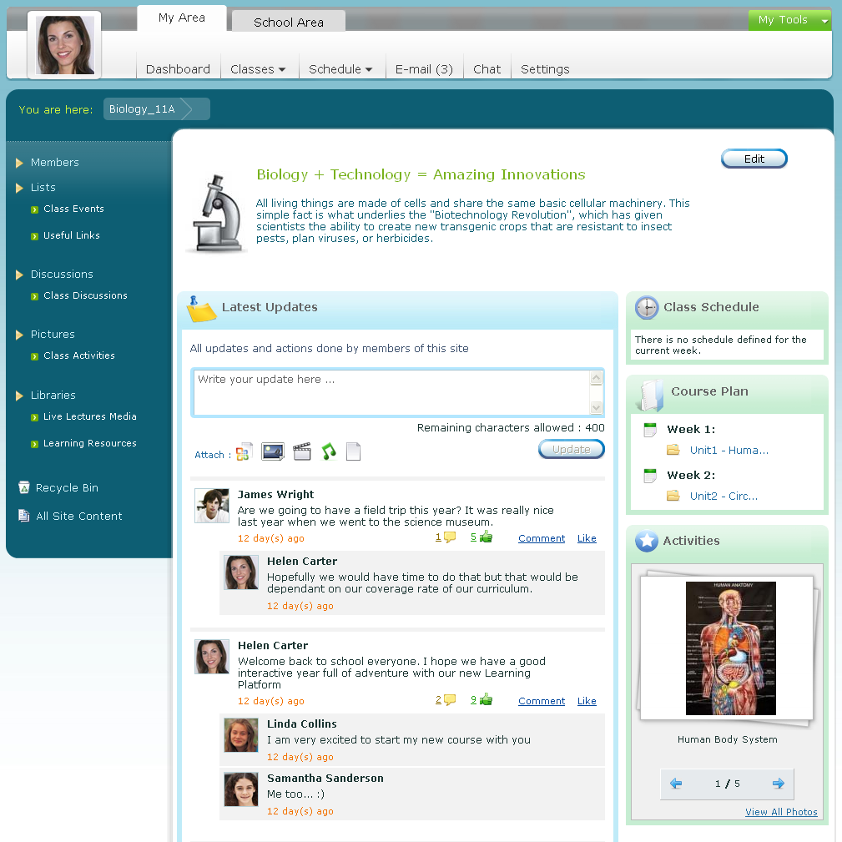
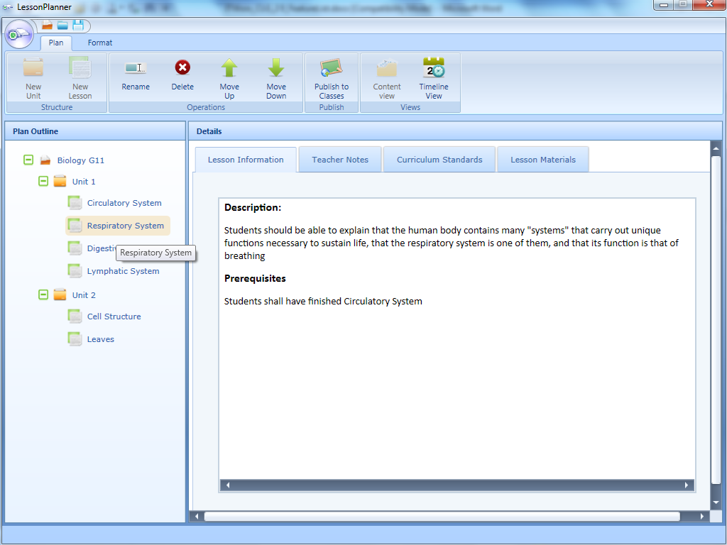
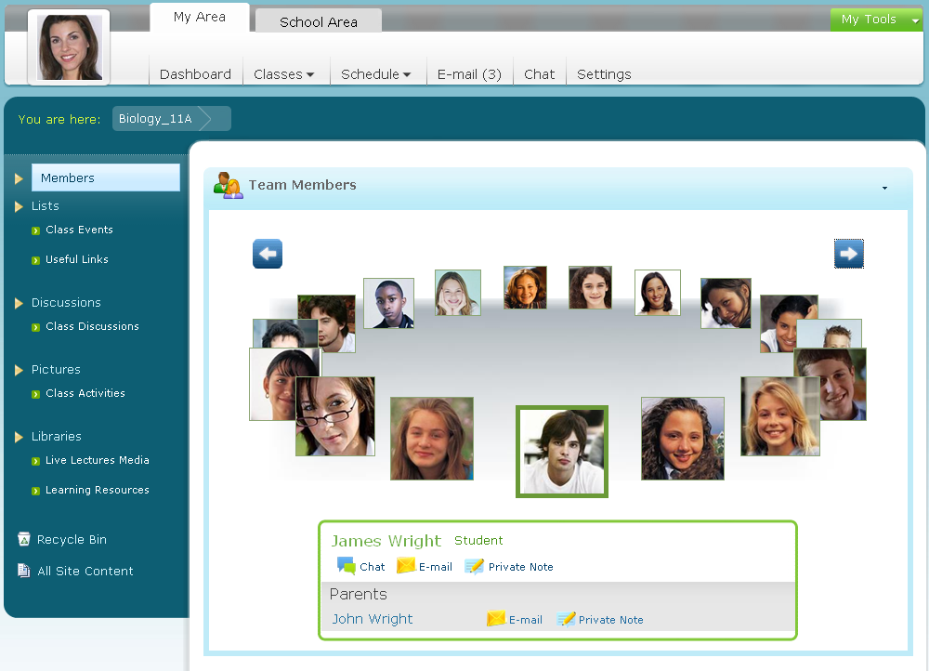
CLG for Teachers
Personalization
Teaching Desktop Tools
The dashboard is the landing page for the teacher, student, and parent users. It offers a consolidated view of the recent activities, reminders, and To-do items in addition to access to the various tools and components of the system.
AuthorKit is a desktop application that provides many display options for the learning content that pave the way for the teachers to capture the attention of their students and achieve the goals of the educational process.
Classrooms and Collaboration
The class site acts as the centralized collaboration environment between the teacher and the student of a specific class.
Through Classrooms Teachers can manage:
Assignments
Assessments
Question Banks
Attendance
Behavior
Class Reports
Lesson Plans
Collaboration
CLG Lesson Planner is a desktop application that helps teachers to effortlessly write their lessons, share course plans with other teachers, align them to standards, check standards coverage, continuously improve lessons and publish them to class students.

Slide 14

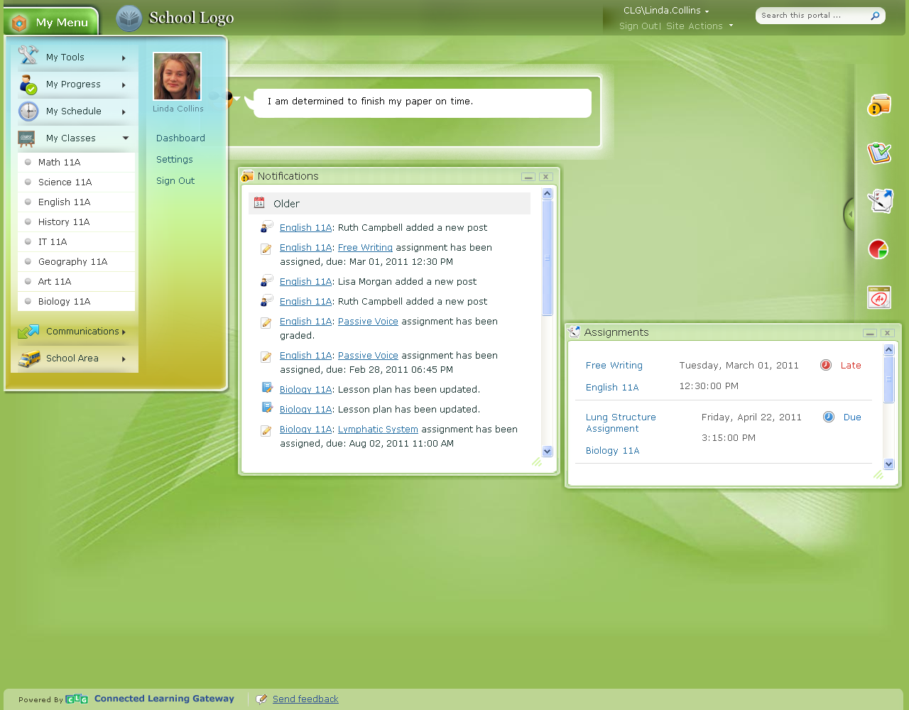
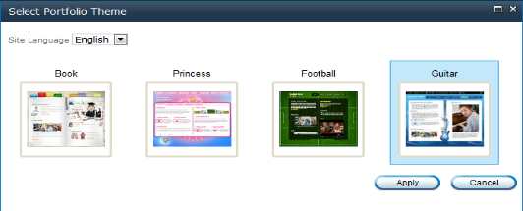
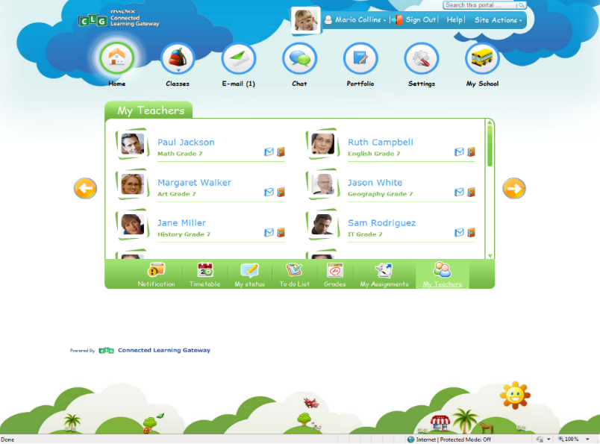
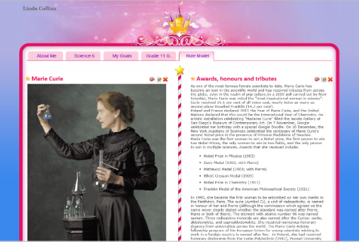
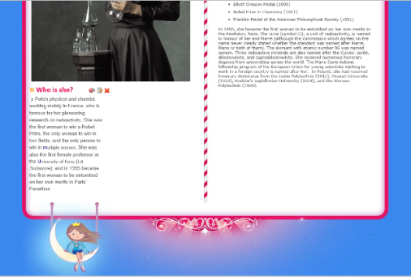
CLG for Students
Personalization
Student Innovation Tools
The dashboard is the landing page for the teacher, student, and parent users. It offers a consolidated view of the recent activities, reminders, and To-do items in addition to access to the various tools and components of the system.
ITWorx e-PortfolioTM creates a learner-focused and competence-oriented learning environment for students. The student e-portfolio allows for public access. Students can select the portfolio site template among different templates defined in the system according to their preference.
Students can customize the items that will be displayed in the portfolio homepage.
Each user role will have a different theme for the dashboard page. Students have different designs for their dashboard based on their ages so that secondary school students have different dashboard design than primary students.
Student portfolio also provides Portfolio Assets library in which student can store documents, videos, audio files, or any learning resources.

Slide 15

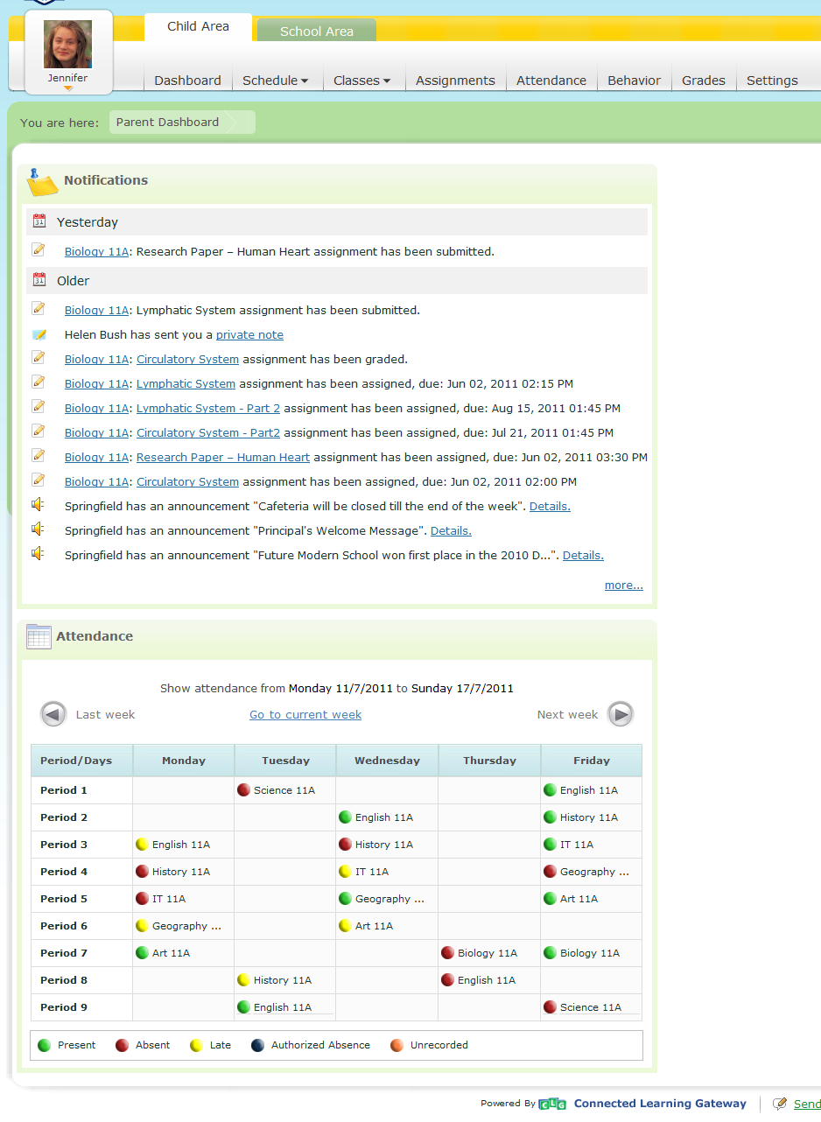
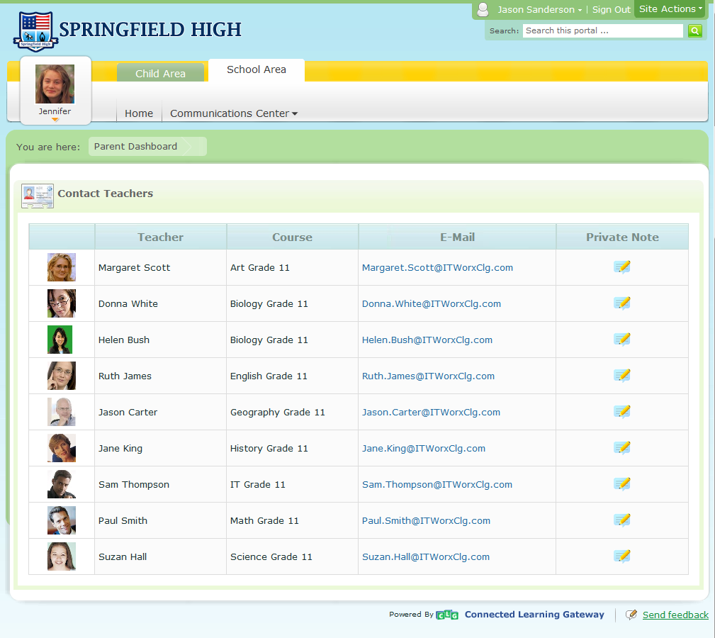
CLG for Parents
Child Progress
One of the real benefits of CLG is to engage parents in their children education, to show them what is happening within school, to keep them updated with their children academic progress, and to establish active communication channels with school teachers and school management.
Being an important part of school community, Parents have access to school portal so that they stay engaged regarding school announcements and events.
Contacting Teachers
Parents can communicate with teachers of their students as well as school administration through communication center.
Private note tool is available for parents to communicate with teachers while maintaining history of communication for both teacher and parent reference.

Slide 16




Scenario
=
LEARN
Author
Plan
Share
Study
Assess

Slide 17


Slide 18


Edu Share
Shared Content
Curriculum Standards
Downloads
Meta Data
Content Approval
Social Tags
Accredited Resources
Advanced Search & Filters
O365
Featured Resources
Ratings & Comments
Favorites
Online Preview
Web Based
App Based
Teachers
Students
Exposes Info
According to User
Role
Cross Platform
APP
APP

Slide 19
Adoption Stages
Managing teaching and learning workflows has never been smoother with ITWORX Education LMS.

Slide 20





Adoption Stages
Utilization
Re-Orientation
Familiarization
Integration
Evolution
Familiarization
Utilization
Integration
Reorientation
Evolution

Slide 21
PRICING
BASIC
SILVER
GOLD
Unlim+
One Month Package
One Month Package
One Month Package
One Month Package
50MB Bandwidth
200MB Bandwidth
500MB Bandwidth
Unlim Bandwidth
1 E-mail Account
25 E-mail Account
50 E-mail Account
Unlim E-mail Account
2 MySQL Database
10 MySQL Database
50 MySQL Database
Unlim MySQL Database
100MB Space
500MB Space
1000MB Space
Unlim Space
No Ads
40$ Ads
100$ Ads
500$ Ads
$20/YEAR
$40/YEAR
$60/YEAR
$90/YEAR

Slide 22
CUSTOMER TARGETING

Slide 23
TARGET MARKETS AND ACCOUNTS
А
Unde omnis iste natus error sit voluptatem accusantium doloremque laudantium, totam rem aperiam, eaque ipsa quae ab illo inventore veritatis.
E
Unde omnis iste natus error sit voluptatem accusantium doloremque laudantium, totam rem aperiam, eaque ipsa quae ab illo inventore veritatis.
B
Oiste ramondos natus error sit voluptatem accusantium doloremque laudantium, totam rem aperiam, eaque ipsa quae ab illo inventore veritatis.
F
Oiste ramondos natus error sit voluptatem accusantium doloremque laudantium, totam rem aperiam, eaque ipsa quae ab illo inventore veritatis.
C
Rote ramondos natus error sit voluptatem accusantium doloremque laudantium, totam rem aperiam, eaque ipsa quae ab illo inventore veritatis.
G
Rote ramondos natus error sit voluptatem accusantium doloremque laudantium, totam rem aperiam, eaque ipsa quae ab illo inventore veritatis.
D
Rote ramondos natus error sit voluptatem accusantium doloremque laudantium, totam rem aperiam, eaque ipsa quae ab illo inventore veritatis.
H
Rote ramondos natus error sit voluptatem accusantium doloremque laudantium, totam rem aperiam, eaque ipsa quae ab illo inventore veritatis.

Slide 24


WHO TO TALK WITH
Clive’s strong background in the education space and sales team building brings huge opportunity to ITWorx to develop it’s customer and partner base in the UK and Europe.
Clive’s key strength is the ability to establish and secure long term customer and partner relationships through open and consistent communication backed by excellent customer service.
Magdy has extensive experience in developing and maintaining relationships with ITWORX Education customers building on his successful track record in growing business and revenue for the organization. He has also managed some of the most strategic partners for the organization such as Microsoft and Pearson
Magdy has successfully lead teams across multiple geographies and, as the Education Sales Manager, he will continue in his role as the main driver for sales-driven revenue
Clive Wright
Magdy El Komy
Sales Manager- EU
Sales Manager

Slide 25

Thanks for Watching
STRATEGY PRESENTATION TEMPLATE
Notes:
When add image, you must sent it to back! Right Click on Image -> Send to Back -> Send Back

