Slide 1
The Director Group
Achieve More

Slide 2
About Us
Nationwide (Pre-Planning) Consulting Firm
Partner exclusively with Funeral Directors
Provide Free, Professional Consulting for Funeral Home’s Pre-Planning Services
Goals:
  Assist in increasing your customer base and maximizing your revenue streams
  Work to provide you with more affordable pre-planning options to offer your customers

Slide 3
What We Offer
Free, Customized Consultation Services
Affordable Pre-Planning Options
Risk Free Portfolio of Products which run Parallel to your Existing Pre-Need Options
One-on-One Training
24/7 Local, Personal Support
Simplified Writing Packets
Bonus and Incentive Programs

Slide 4
Benefits to your Funeral Home
Increased Number of Pre-Planned Funerals through your Funeral Home
Increased Profitability with Bonus Potential
Increased Customer Satisfaction
Increased Reputation within the Community
Access to Our Support, Training, and Bonus Systems
Zero-Risk, Parallel Running Services

Slide 5
Benefits to your Customers
Wider Range of Pre-Planning Options
Customized Pre-Planning Options to Fit Each Specific Customers Needs
Better Value on Pre-Planning Options
Lower Payment Schedules
Tax Benefits
Word of Mouth Customer Referrals
Piece of Mind and Trust in your Funeral Home

Slide 6
Final Expense Options
Portfolio of Whole-Life Products
Significantly Cheaper Payment Schedule Compared to Pre-Need Options
Runs Parallel to Your Current Pre-Planning Options
  Offer Pre-Need Options to your Higher Income Customers
  Offer Final Expense Options to your Middle and Lower Income Customers
Competitive Commission Structure

Slide 7
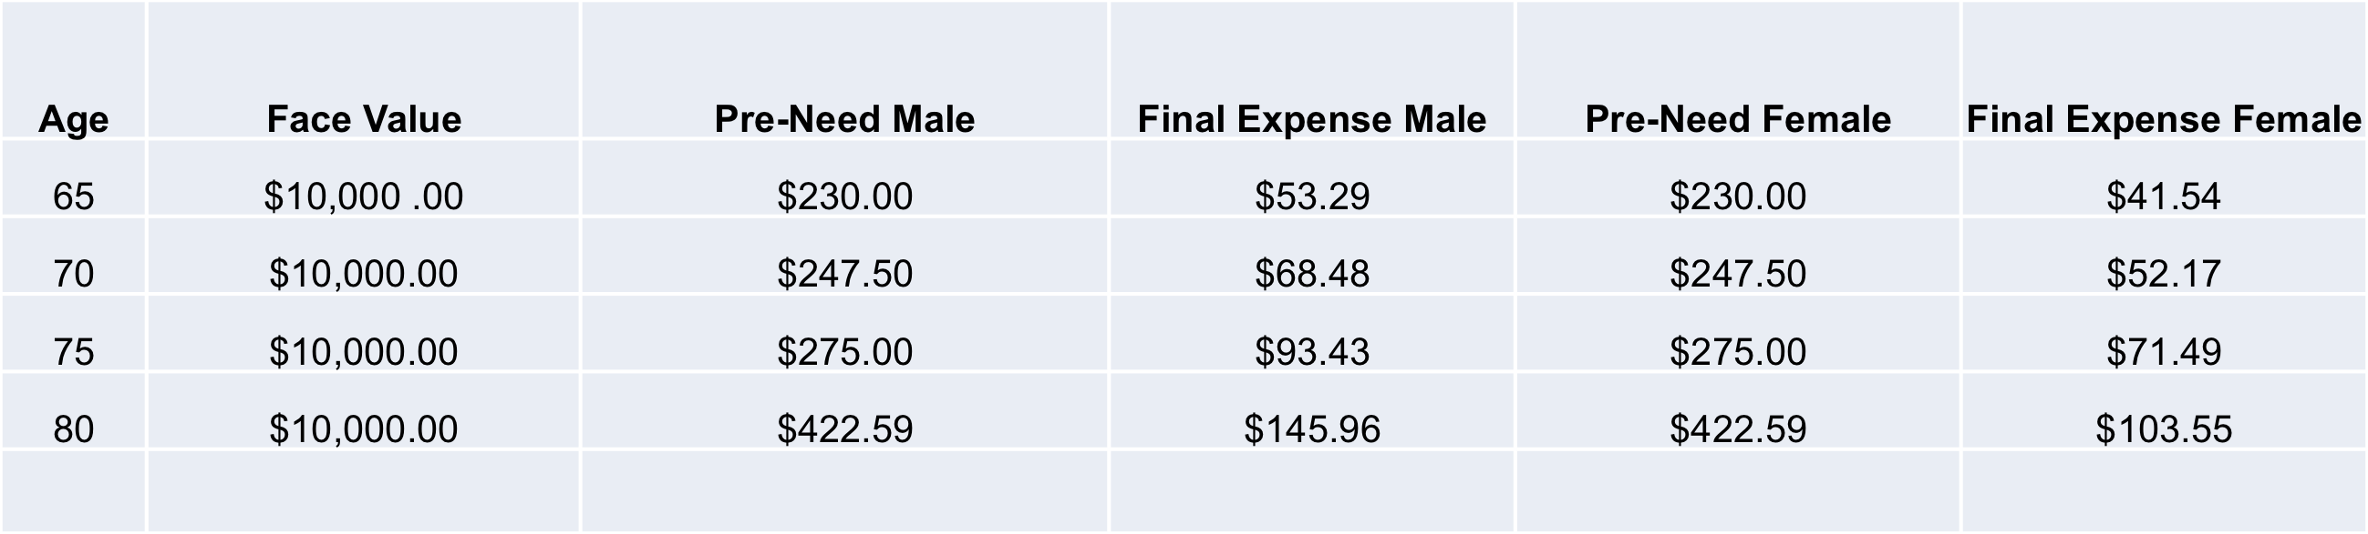
Rate Chart Comparison
If Pre-Need monthly payments are too expensive for your customers, chances are they will leave to consider other options without pre-planning through your funeral home.
Let us help you keep the revenues in house and offer your customers more affordable Final Expense Options.

Slide 8
Partners
Oxford Life
  Instant Approval
  Competitively Low Rates
Standard Life
  Relaxed Approval
Americo
  Single Premium
National Guardian
  Single Premium
We will assist you in matching a single provider to each customer’s specific needs.

Slide 9
Additional Revenue Streams
Commissions
Production Bonuses
Referral Bonuses
Advanced Wealth Transfer

Slide 10
Production Bonus
Bonuses Paid to Your Funeral Home by Offering our Products to your Customers
Additional 5% Commission
  Increased Commission for the Next Six Months
Requirement:
  Reach $15,000 in Annual Premium for Two Consecutive Months
Paid in Addition to Regular Commission Rate

Slide 11
Referral Bonus
Bonuses Paid by Referring Funeral Directors, (Pastors, Cemetery Directors) in your Network
Earn 5% of Your Referral’s Annual Premiums
  5% Bonus Lasts 12 Months for EACH Referral you Submit
Referral Bonus starts immediately after they contract with The Director Group
10 Referrals writing 2 policies a week will generate an additional $52,000 per year for your business

Slide 12
Advanced Wealth Transfer
Free Support on Assisting Customers with Advanced Wealth Transfer
Offer Your Customers Options to Establish:
  Trusts
  Annuities
  Wealth Management Options
Assist Customers
  Avoid Probate
  Avoid Taxes
Serve Clients on a Personal Level, Leading to Higher Client Satisfaction
High Commissions (%)

Slide 13
Next Steps
Today:
  Contracting with Our Carriers (10 Minutes)
Next Appointment:
  Welcome Packet Information (10 Minutes)
  Training (20 Minutes)

Slide 14
Contact Information
Ben Ulin
(515) 555 - 5555
BenUlin@TheDirectorGroup.com
www.TheDirectorGroup.com

