Slide 1

Andy Davis
July 10, 2014

Slide 2
Andy Davis
Managing Director Takeda UK
CEO Virgin Health Co
Managing Director Medical and Scientific
Director Sanofi Market Access/HE/BD/NPP/BI/Training/GA/PA/KAM

Slide 3
Mission
Deliver cutting edge performance with our clients through the best relationships with customers that influence access to products and services

Slide 4
Values
Energy
Intensity
Fun
Determination
Fortitude
Credibility
Expertise
Experience
Professional
Constant learning
Relationships
Networking
Trust
Influencing at the top

Slide 5
Proposition
Prometheus Director Team
Prometheus Academy
Value Proposition Build

Slide 6
VP Builds
Heart Matters
Outcomes Guarantee
Candesartan/RADs

Slide 7
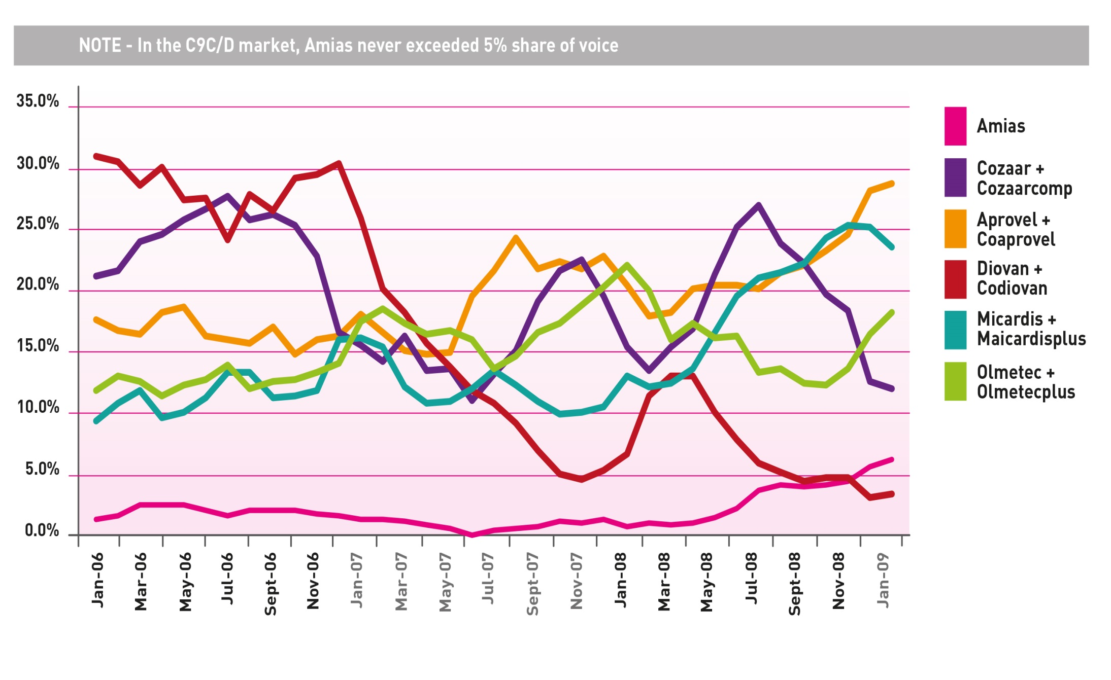

Slide 8
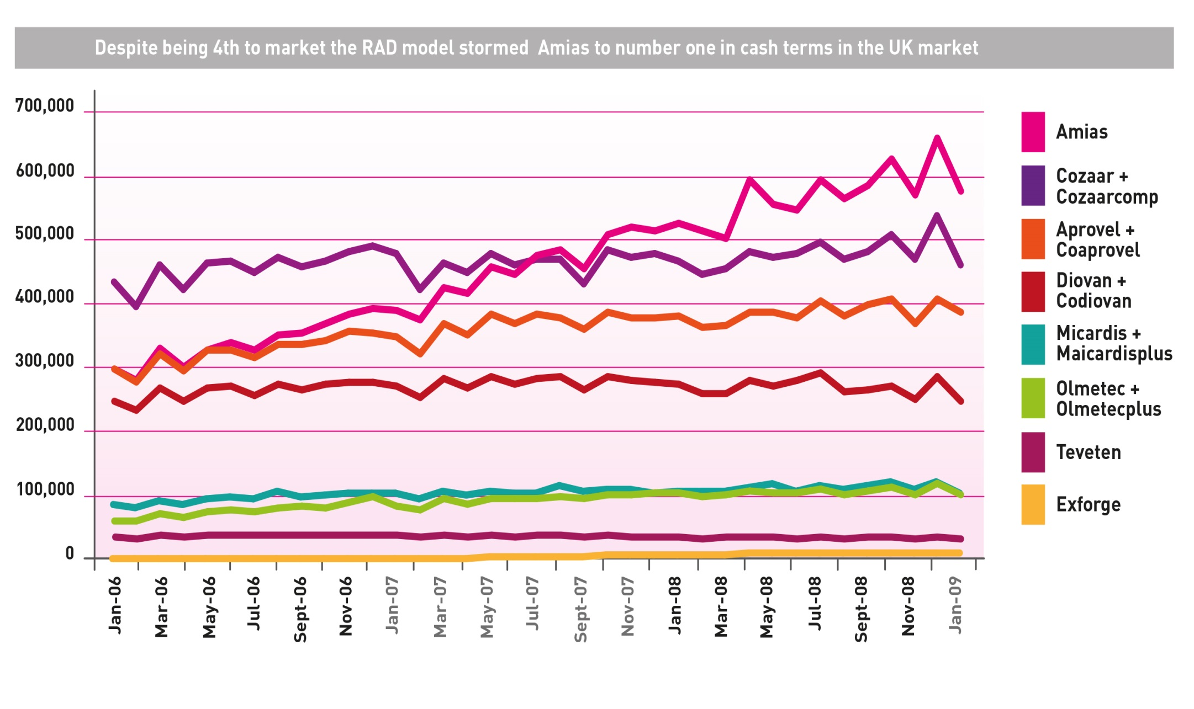

Slide 9
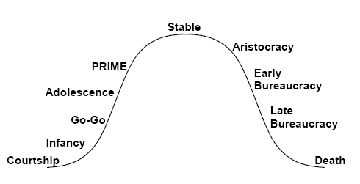
Isaac Adizes Lifecycle –
Where Is The Pharmaceutical Industry?
83% of respondents think the Pharmaceutical industry is in Late Bureaucracy
Notes:
A simple process to follow, when questioned most respondents see their company or industry in either early or late bureaucracy. This is when an organisation becomes internally focused and loses sight or wide made it successful in the first place.

Slide 10
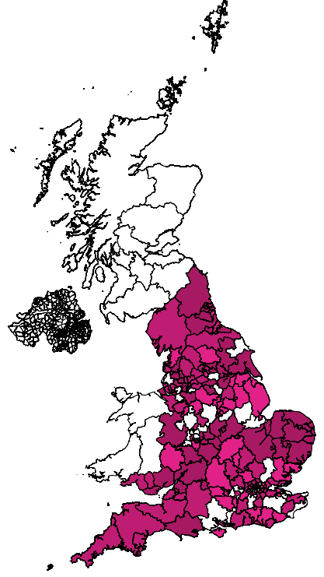
Medicines Management Engagement Map
Month 1
Based on Prometheus Teams engagement rates in current and past projects
Month 2
Month 3

Slide 11
Training Programme
Client Orientation
Mind Set
Customer Orientation
Personal Engagement
Planning
Pitching
Leadership
Implementation
Sharpening the knife
Development plans
Remote conversations
mentoring

Slide 12
We widen access and potential giving the competitive edge
You
NHS
Sweet Spot
Competitors

