Slide 1

Market Intelligence Modules
Where Big Data Meets Commercial Real Estate
Reporting Capabilities Overview- 2014

Slide 2
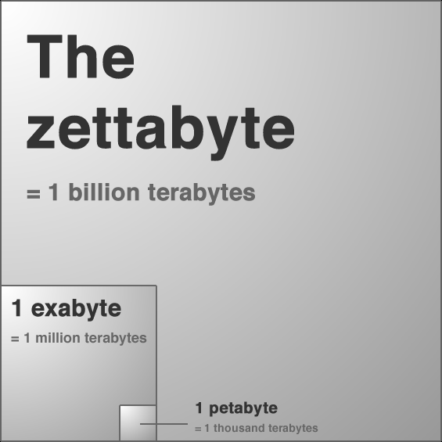
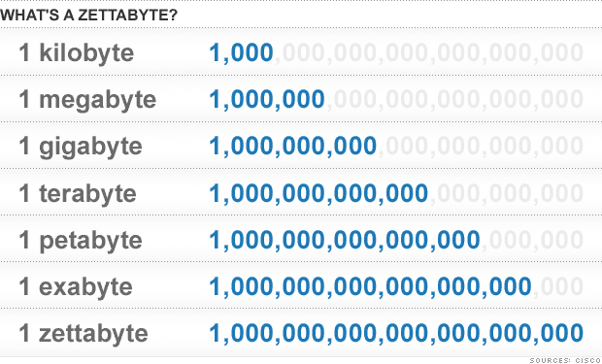
The Zettabyte Era
What is a zettabyte?
  One zettabyte of data allows you to stack books from Earth to Pluto 20 times (72 billion miles)
  If one gigabyte of data were a cup of coffee a zettabyte would equal the Great Wall of China
  In 2015 all internet traffic will exceed one zettabyte of data - 540,000 time increase from 2003

Slide 3



Real World Data Environment
Overload
Unorganized
Disperse
Quantitative
Qualitative
Relevance
Trends
Timeliness

Slide 4

The Interpretation Process
Database Integration
Quantitative Research
Qualitative Research
Indexes & Reports
Time Stamped Market Updates

Slide 5

Index / Report Objectives
Indexes - Report
Trending
Consolidated
Timeliness
Relevance
Consolidating information in formats that are understandable, meaningful and actionable

Slide 6


Market Intelligence Modules - Indices & Reports
Indices
Reports

Slide 7
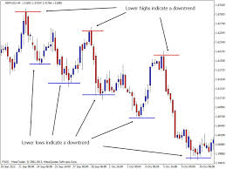

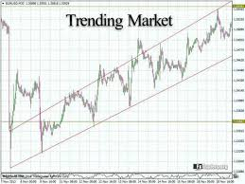
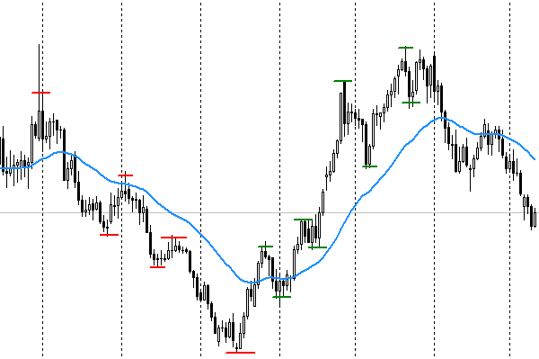

Indices
Commercial Real Estate Index
Credit Market Index
Housing Market Index
Employment Index
Income Index
Inflation Index
Consumer Confidence Index* (As per UM)
Retail Sales Index

Slide 8
Indices – Graphic Trending Data

Slide 9
Indices – Detailed Trending Data

Slide 10
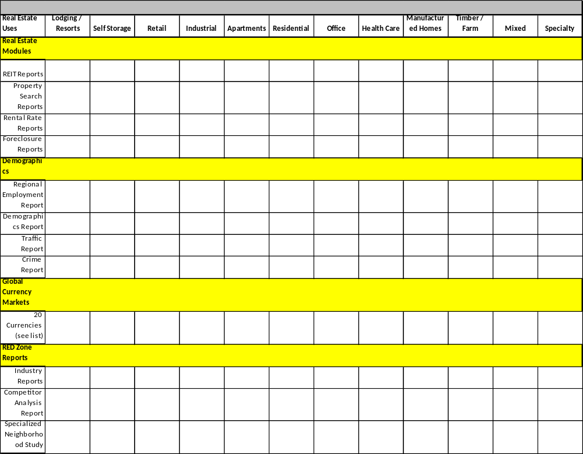

Modules – Data Reporting Structure (DRS)

Slide 11
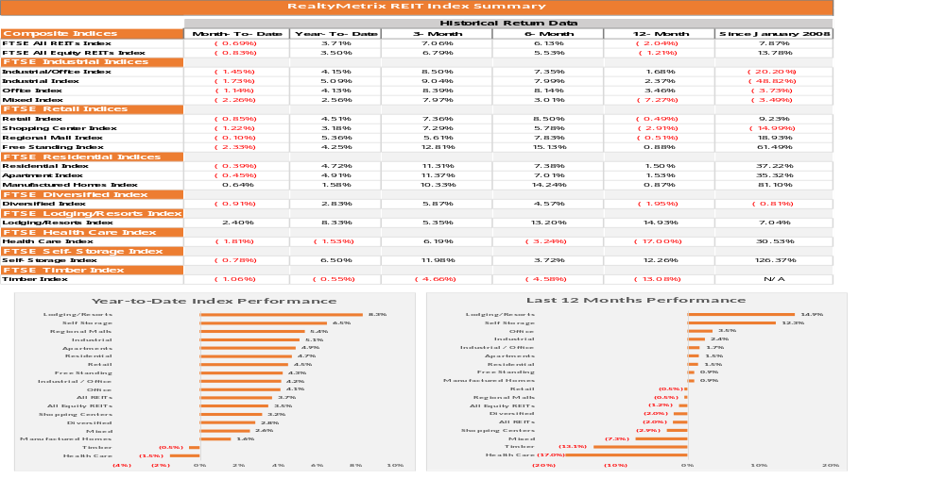

REIT Report (SAMPLE)

Slide 12
Global Currency Markets – Heat Map (SAMPLE)
Changes in Currency Values vs. The US Dollar
As of 05-16-2014 | 3-Month | 6-Month | 12-Month | 18-Month | 24-Month | 30-Month | 36-Month | 48-Month | 60-Month
British Pound | 1.90% | 4.80% | 10.30% | 5.67% | 5.96% | 6.75% | 3.31% | 15.02% | 9.44% | Investors whose currencies have appreciated versus the US Dollar might be interested in buying US Real Estate.
S. Korean Won | 4.41% | 3.46% | 8.33% | 5.93% | 12.73% | 10.47% | 5.68% | 13.53% | 22.25%
Swiss Franc | 1.19% | 3.36% | 8.21% | 6.30% | 6.24% | 2.80% | -1.04% | 27.89% | 25.41%
Euro | 1.05% | 2.35% | 6.35% | 7.56% | 7.82% | 1.84% | -3.68% | 9.91% | 1.19%
Danish Kroner | 1.01% | 2.26% | 6.20% | 7.48% | 7.40% | 1.53% | -3.75% | 9.61% | 0.97%
New Zealand Dollar | 4.33% | 4.81% | 4.93% | 5.63% | 11.72% | 12.21% | 8.76% | 23.94% | 43.93%
Swedish Kronor | -0.65% | 0.78% | 0.98% | 2.61% | 7.54% | 3.10% | -4.33% | 17.89% | 18.74%
Hong Kong Dollar | 0.08% | 0.00% | 0.12% | -0.02% | 0.15% | 0.37% | 0.29% | 0.43% | -0.01%
Singapore Dollar | 1.26% | -0.20% | -0.12% | -2.15% | 0.95% | 3.08% | -0.91% | 11.51% | 16.88%
Japanese Yen | 0.26% | -1.76% | -0.93% | -20.45% | -21.79% | -23.86% | -20.36% | -9.71% | -5.12%
Taiwan Dollar | 0.58% | -2.04% | -1.18% | -3.38% | -2.21% | 0.30% | -4.67% | 5.65% | 9.08%
Chinese Yuan | -2.48% | -2.30% | -1.52% | -0.04% | 1.41% | 1.93% | 4.16% | 9.48% | 9.42%
Norwegian Kroner | 3.21% | 2.72% | -1.76% | -3.49% | -0.16% | -3.11% | -7.56% | 6.12% | 8.87%
Mexican Peso | 2.49% | 0.69% | -5.17% | 0.73% | 5.01% | 5.60% | -10.14% | -1.88% | 1.69% | Investors whose currencies have lost value versus the US Dollar might be interested in selling property they currently hold in the US due the appreciation of their investments versus their home currency.
Australian Dollar | 4.07% | 0.16% | -5.85% | -10.25% | -6.42% | -7.64% | -12.52% | 7.18% | 22.11%
Canadian Dollar | 1.36% | -3.85% | -6.51% | -8.58% | -7.42% | -6.03% | -11.24% | -4.61% | 5.70%
Indian Rupee | 4.07% | 4.66% | -7.95% | -8.28% | -9.04% | -15.16% | -24.83% | -23.38% | -18.79%
Brazilian Real | 7.24% | 3.48% | -8.21% | -6.87% | -10.71% | -19.48% | -27.27% | -18.23% | -6.75%
Thai Baht | 0.48% | -2.58% | -8.31% | -5.44% | -3.62% | -4.71% | -6.90% | -0.30% | 6.66%
South African Rand | 5.25% | -1.96% | -10.14% | -15.43% | -21.66% | -21.68% | -34.11% | -26.46% | -19.51%
If you are a Japanese investor that bought property in the US 3 years ago, you have seen over 20% return due to the decline in the Yen versus the dollar.

Slide 13





















Source Synopsis

Slide 14
Contact Information
RealtyMetrix – Downtown Chicago
564 West Randolph Street
Suite 200
Chicago, IL – 60661
RealtyMetrix – North / West Suburbs
2390 Esplanade Drive
Suite 201
Algonquin, IL – 60102
www.realtymetrix.com

