Slide 1

GMI
COMMUNITIES
BE PART OF THE CONSUMER CONVERSATION

Slide 2


BE PART OF THE
CONSUMER
CONVERSATION

Slide 3

PEOPLE ARE
TALKING ABOUT
YOUR BRAND.
WE HELP Y0U
HEAR THEM.

Slide 4

A TOOL USED BY BRANDS TO
ENGAGE IN RESEARCH-BASED CONVERSATIONS WITH PEOPLE ON AN ONGOING BASIS IN A ‘FAST’ AND ‘INEXPENSIVE’ WAY.
An Online Research Community is a dedicated platform for a brand to interact with a specific target audience on an ongoing basis.
WHAT IS A RESEARCH COMMUNITY?

Slide 5

THE OFFER
We make community based research more accessible.
We removed the high cost of entry that has often limited brands being able to enjoy the benefits of this type of research.
This helps you know what people want from your brand, and what you’re actually delivering.

Slide 6



ENGAGE
WITH YOUR AUDIENCE WHEN,
WHERE AND HOW YOU WANT
COLLABORATE
WITH CONSUMERS TO DISCUSS,
DEVELOP AND DEBATE IDEAS
DISCOVER
ROBUST, ACTIONABLE INSIGHTS TO DRIVE INFORMED DECISIONS
Notes:
Design: Could we make these icons more appropriate. The sellsheet had some good speakerphones, rings around heads, speech bubbles etc

Slide 7






BEST OF BOTH WORLDS
COMBINING QUALITATIVE AND QUANTITATIVE
Build brand LOYALTY by giving users the inside story
Encourage free-flowing DIALOGUE and ideas
Create your own
CUSTOM environment
Reach
members
FASTER than
face-to-face
focus groups
VALUE FOR MONEY to
free up your budget for activity
Harness MOBILE to reach respondents ON-THE-GO
Notes:
Create relevant icons for these points also.

Slide 8







BEYOND A SURVEY
VARIED ACTITIVITIES TO INCREASE ENGAGEMENT
Video and image uploads
Quickpolls
Games and group activities
Discussion boards
Diaries
In-the-moment
Notes:
Create relevant icons/ visual support for these points also.

Slide 9





ADDING VALUE
WE SUPPORT YOU IN THE FOLLOWING WAYS
BUILD a community to meet your exclusive needs
RECRUIT from a pre-profiled panel, customer lists or target audience
HOST your platform
and tailored activity
CONSULT on best practice, engagement and question design
REPORT data in a timely, ready to use format

Slide 10
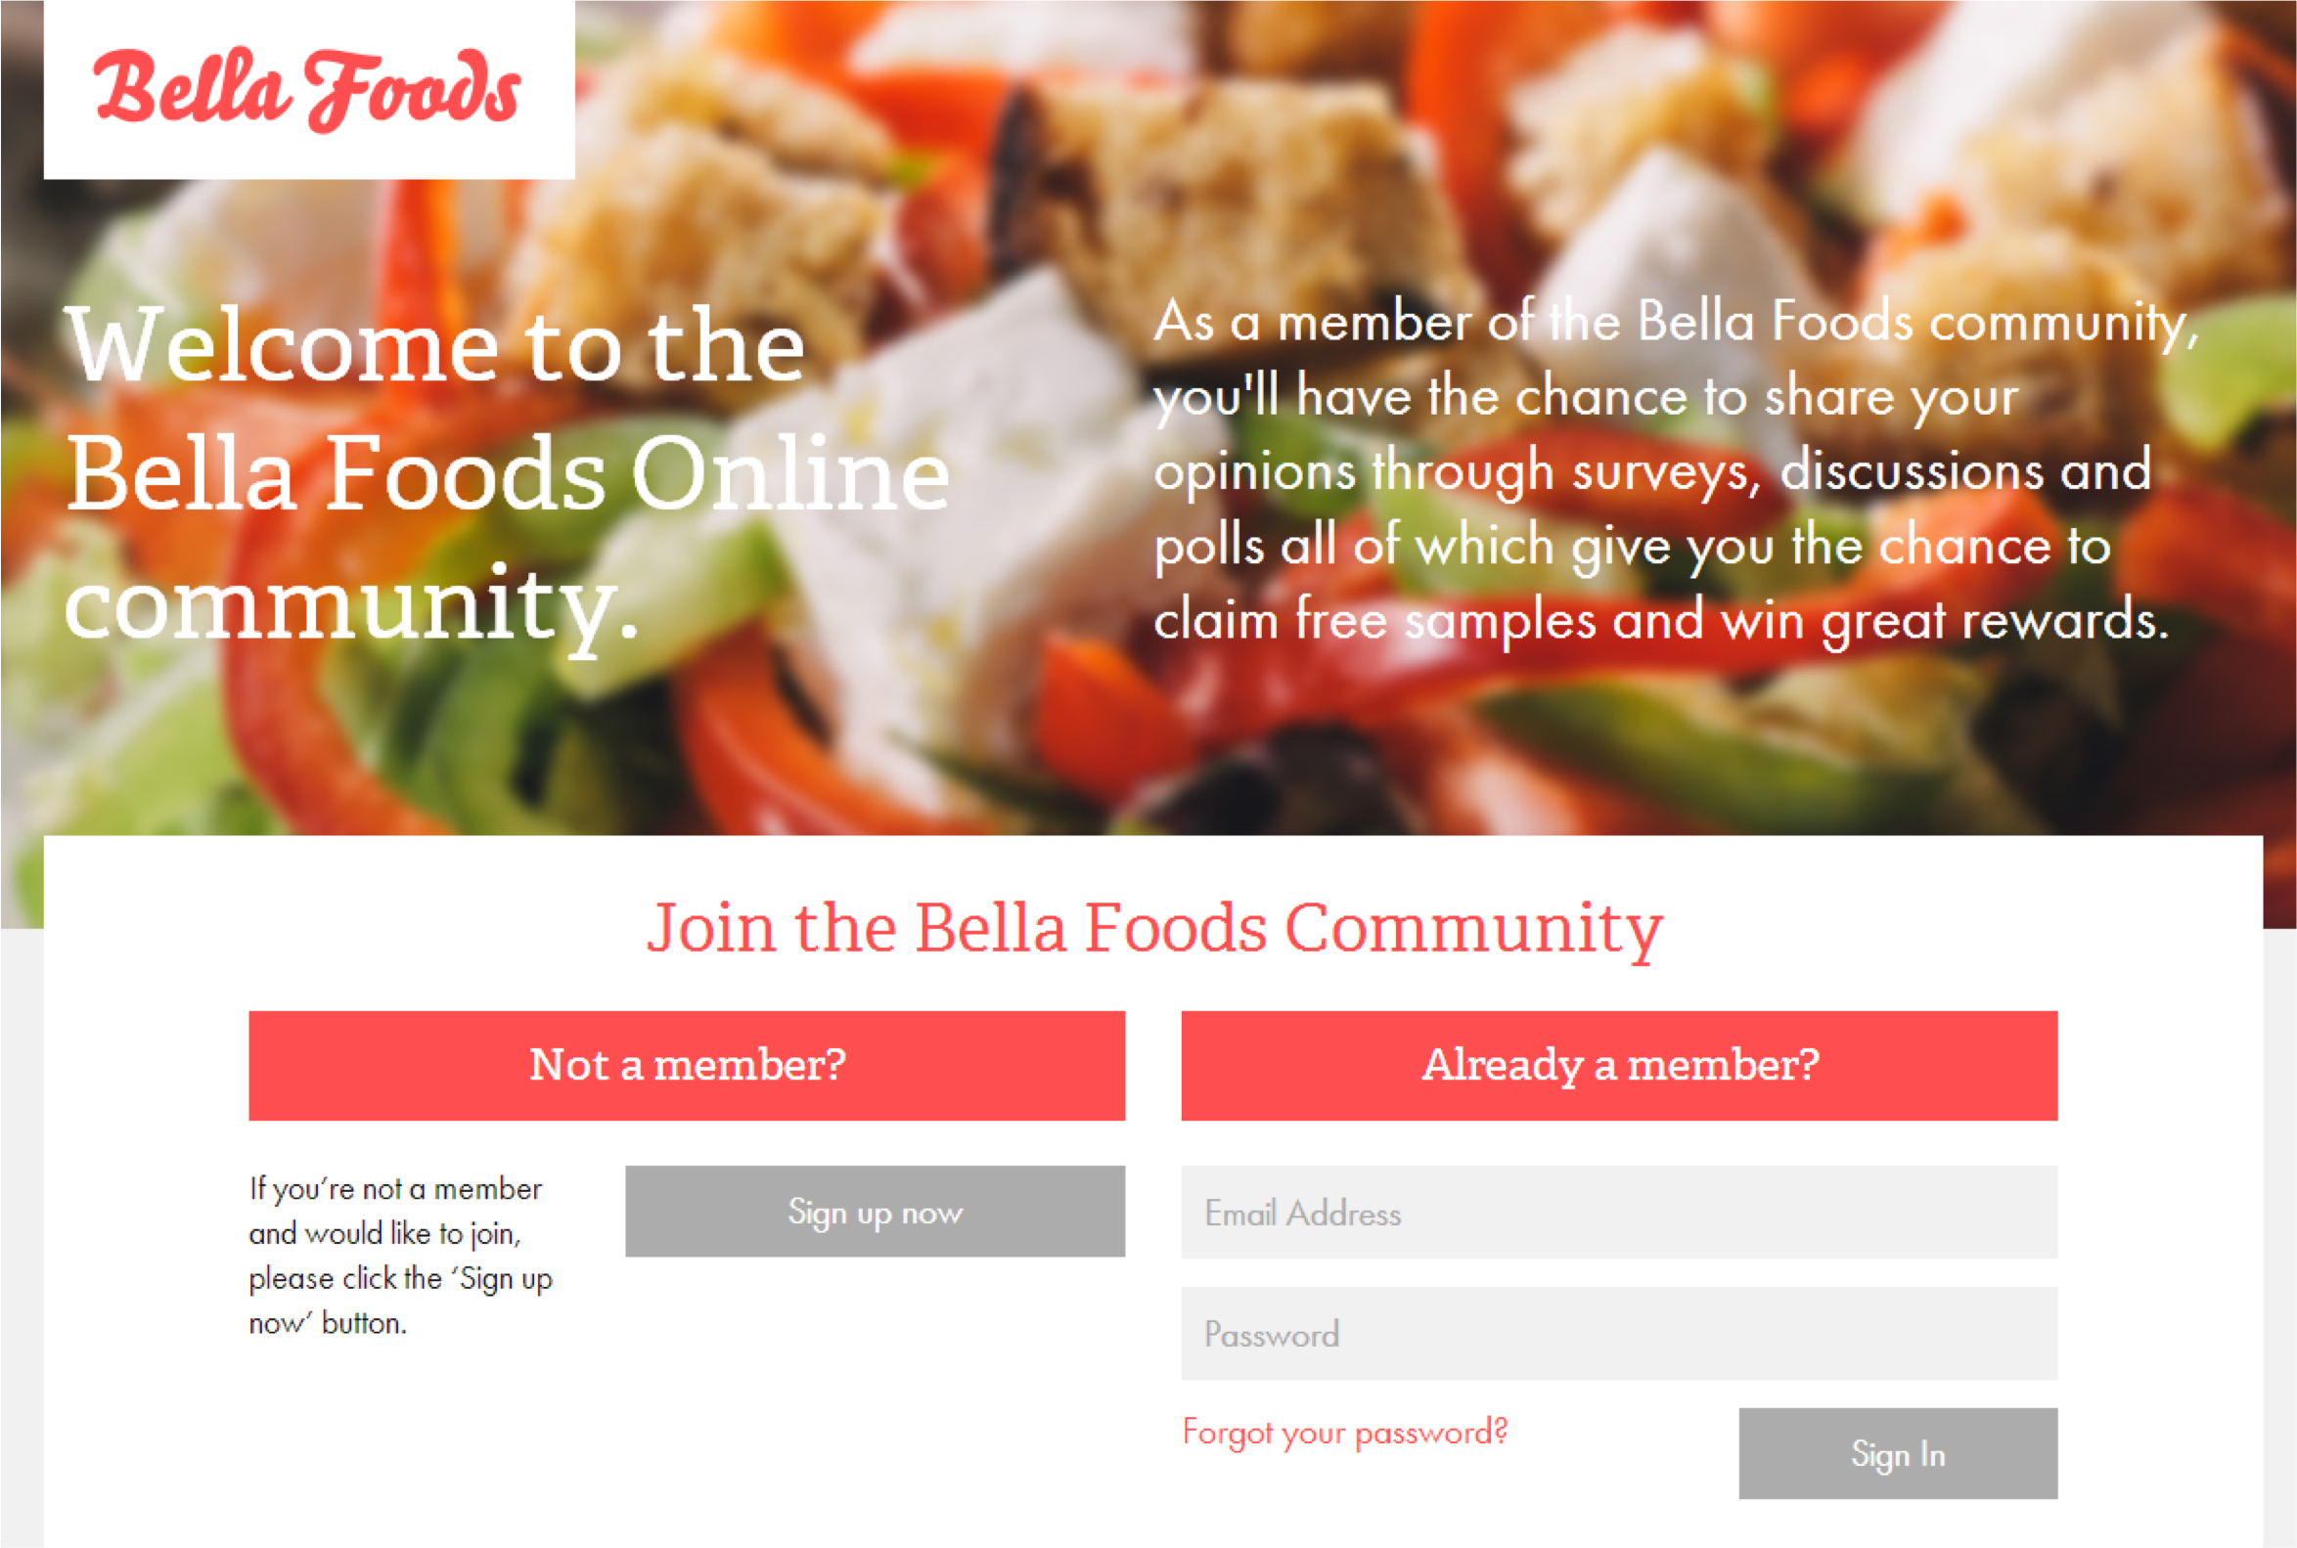
WHAT DOES IT LOOK LIKE?
(CUSTOMISE PRE-MEETING- DEMO VIDEO TO FOLLOW)

Slide 11
WE MAKE RESEARCH EASY
At GMI, we provide the tools and expertise needed to generate high quality, efficient and dependable research results.

Slide 12
THANK YOU
For more information, please contact:
Sales Rep Name
Sales Rep Phone
Sales Rep Email

