Slide 1
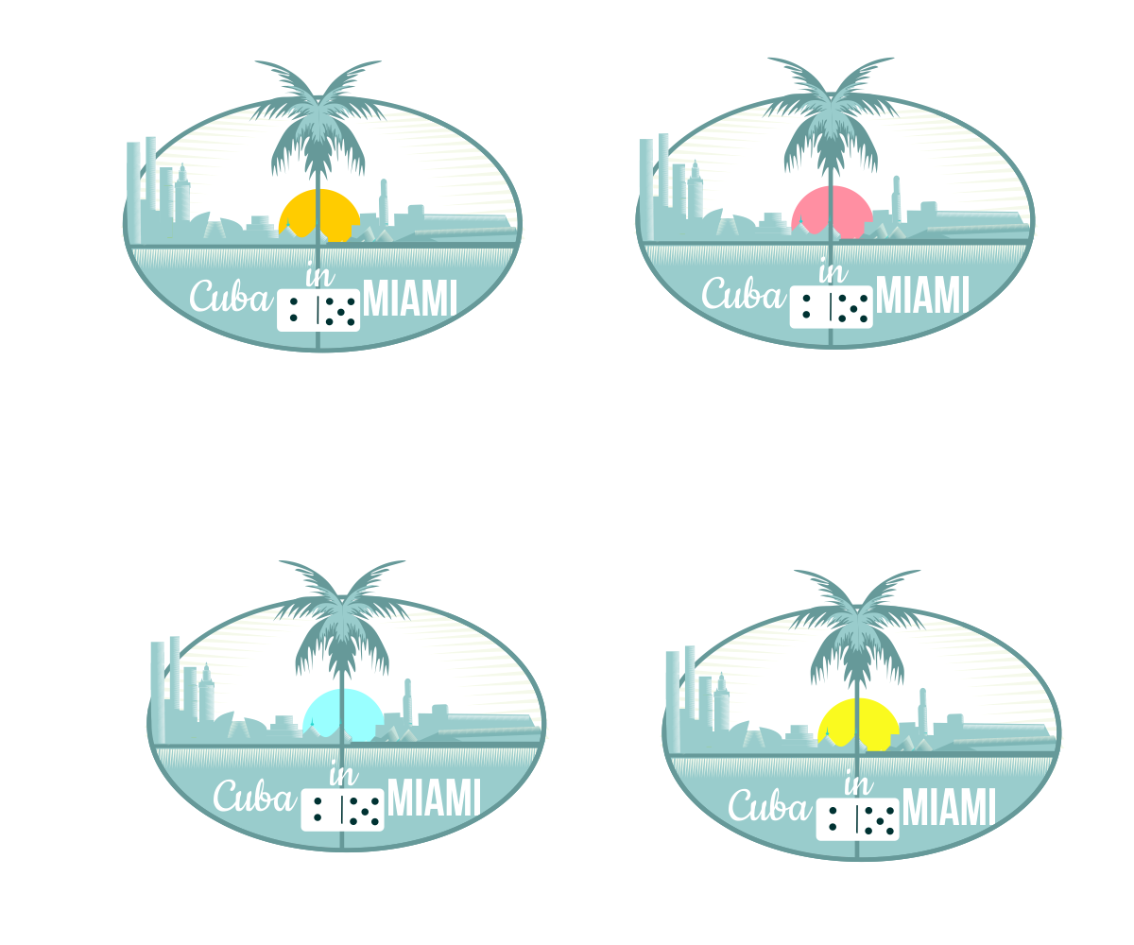
CUBA IN MIAMI
Where Sights encounter Flavors and meets Sounds and creates the Culture of the People

Slide 2
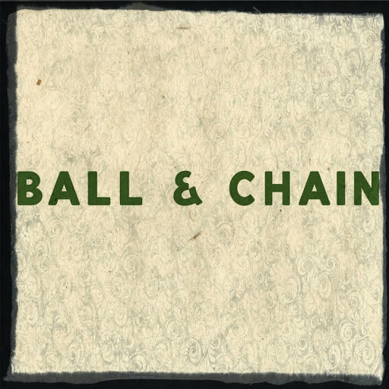
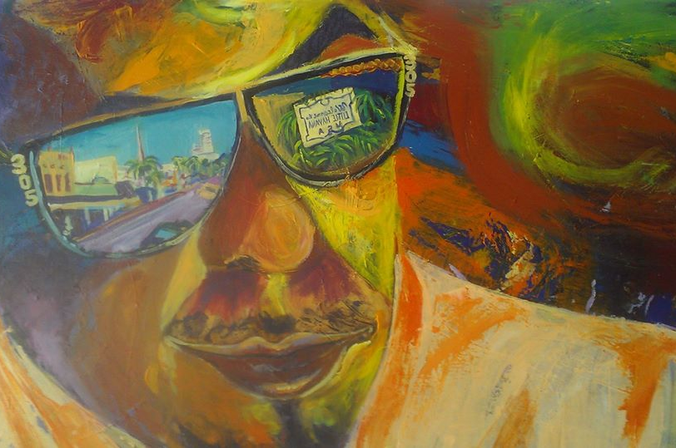
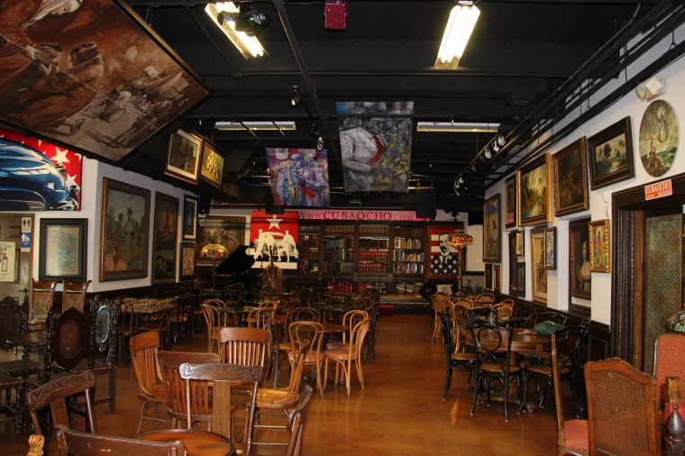
Tour Experience – the SIGHTS
Ball & Chain Bar & Lounge
CubaOcho Art & Research Center
Katie Penner’s Pitbull
Enjoy the cool bar, and let the live Cuban music take over, as you learn a new step from our own dancers in brilliant costumes, socialize with our local artisans displaying their talents
A hip museum & bar housed in a sprawling colonial style setting with a complete spectrum of Cuban art created between 1850 and 1958 including works from Cuban masters
Visit Katie, Futurama 1637 Galleries’ first “Artist in Residence” and visit other artists influenced by the culture of Little Havana

Slide 3
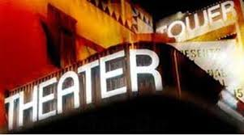
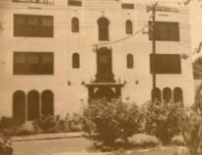
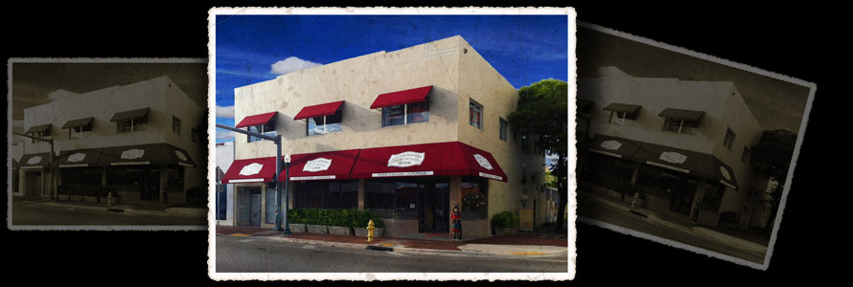
Tour Experience – the SIGHTS
Tower Theatre
Tower Hotel
Little Havana Cigar Company
One of Miami's oldest cultural landmarks. When it opened in December of 1926, it was the finest state-of-the-art theater in the South, located on Calle Ocho
Originally opened in 1920, the stomping grounds of Jazz greats: Count Basie, Billie Holiday, Dizzy Gillespie, to name a few. The past is being reborn in the present
Inspired by classic 1950’s Cuban cigar clubs, and where expert staff will be conducting ongoing lectures on the art of the cigar

Slide 4
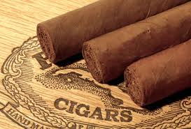
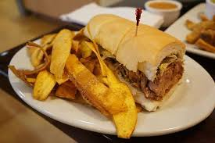

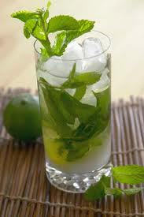
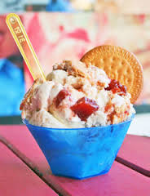
Tour Experience – the FLAVORS
We invite you!
Come see, smell, and taste… Finish it all off with a must have “Cafecito” our robust Cuban coffee!

Slide 5
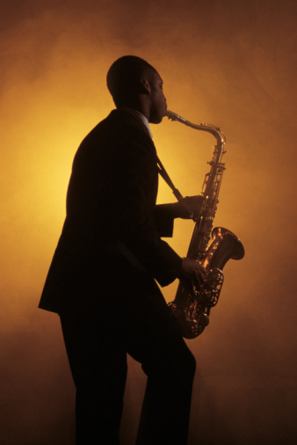
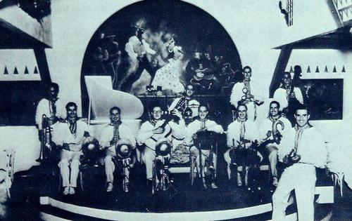
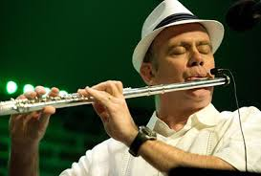
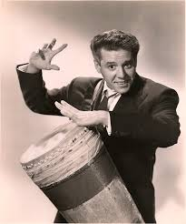
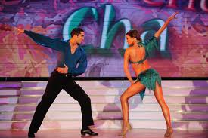
Tour Experience – the SOUNDS
Sounds of Cuba!
MUSIC is inseparable from Cuban daily life and its history, Rumba, Bolero, Danzon, Cha-Cha-Cha, Guaracha, Mambo, Salsa…Cuban rhythms fill the air!

Slide 6
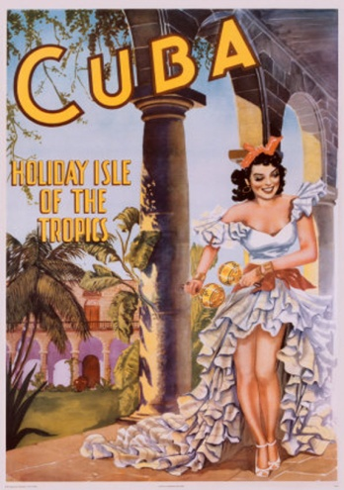
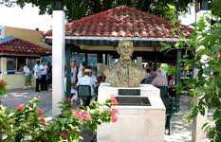
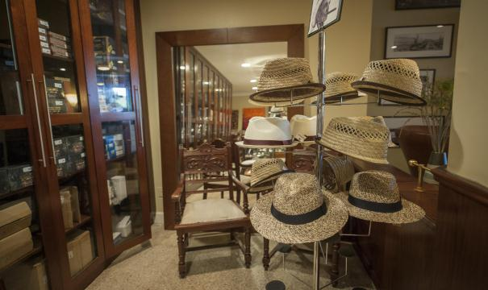
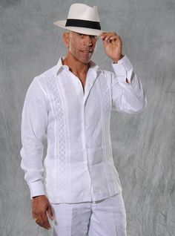
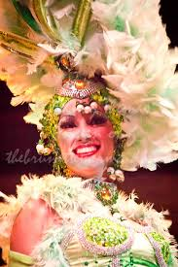
Tour Experience – the CULTURE
Experience the Culture!
Hear anecdotes of Cuban life and history told by charming Cuban storytellers. Sneak a peek at original Cuban film clips, listen in as cigar aficionados share what makes a great cigar. Enjoy the Tropicana themed costumes and learn how to wear a Guayabera with style!

Slide 7
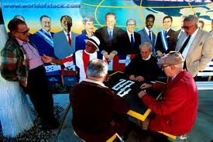
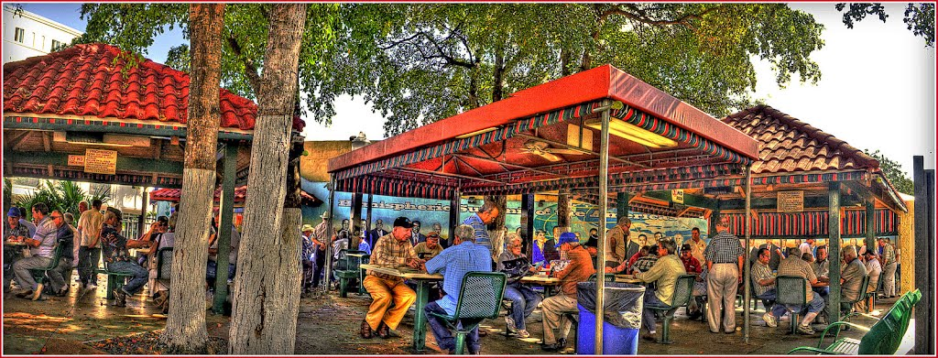
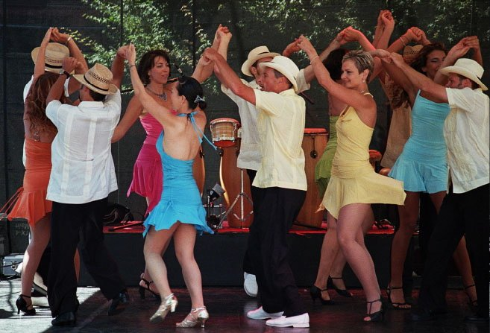
Tour Experience – the PEOPLE
Meet the People!
…the people of Cuba…observe a game of Domino and meet the passionate players, visit with artists and admire their works, listen to live music and allow musicians to share Cuban musical history, learn a few steps with our captivating dancers and let local artisans display their exquisite Cuban themed creations.

Slide 8
Tour Description – CUBA IN MIAMI
Sample Timing
10:30 Depart PortMiami, pass Freedom Tower, Miami AA Arena, travel up historic Brickell Avenue, and scenic Coral Way, arrive at 17th Avenue and 8th Street “Calle Ocho” – the heart of Little Havana, where Cuba in MIAMI tour excursion begins
11:00 Start walking tour at Futurama for an “Artists Welcome“
11:30 Walk towards “Ball and Chain” for lunch, entertainment and on-site shopping
12:30 Walk towards CubaOcho Art and Research Center to listen to traditional Cuban folkloric music and dances
01:00 Join a lecture and cigar rolling demonstration at the Little Havana Cigar Factory
01:30 Tour “Domino Park” and the Tower Theatre featuring historical Cuban films
01:45 Head to Azucar Ice Cream Company for homemade Cuban ice cream tasting
02:00 Complete tour, embark bus
02:30 Arrive at Miami International Airport
Duration: 3.5 Hours
Departure: 10:30am - 11:30am, at 15 minute intervals
Maximum: 500 max
Minimum: 100

Slide 9

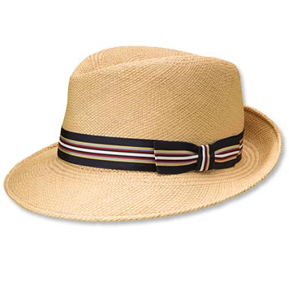

Tour Brand Image - Transportation
Your experience begins as we escort you on board our modern coaches with high back reclining seats, TV monitors, Public Announcement systems, Wi-Fi, bathroom, luggage storage, air conditioning, custom uniformed drivers.
Travel past historic points of interest significant to the Cuban experience in Miami.

Slide 10

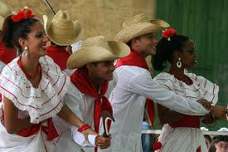


Tour Brand Image - Uniforms
As you interact with our Tour Guides don’t miss the subtle vintage details throughout their attire.

Slide 11
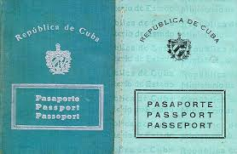
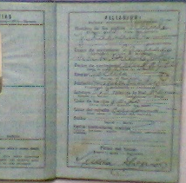
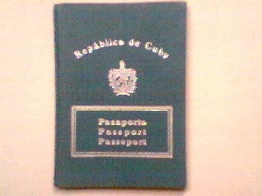
Tour Brand Image - Passport
“Creating unforgettable memories, fill your heart with happiness.”
Enjoy your keepsake Cuban Passport itinerary for the Cuba in MIAMI tour!

Slide 12
CUBA IN MIAMI
Y ahí estará. Como dijo alguien, esa triste, infeliz y larga isla estará ahí después del último indio y después del último español y después del último africano y después del último americano y después del último de los cubanos, sobreviviendo a todos los naufragios y eternamente bañada por la corriente del golfo: bella y verde, imperecedera, eterna.
Guillermo Cabrera Infante, Vista del amanecer en el trópico
English translation:
And there will be. As someone said, that sad, unhappy and long island will be there after the last Indian and after the last Spaniard and after the last African and after the last American and after the last of the Cubans, surviving all shipwrecks and eternally bathed by the Gulf Stream: beautiful and green, everlasting, timeless.
Guillermo Cabrera Infante, View of Dawn in the Tropics
A Cuban novelist, essayist, translator, screenwriter, and critic; in the 1950s he used the pseudonym G. Caín. Cabrera Infante went into exile to London in 1965. Movies produced: The Lost City, Vanishing Point, Wonderwall

