Slide 1
This is the copy for the three boxes that say “put copy from accompanying file here”
Copy for “Science” Section:
We know that the habits of successful employees are different. Science has proven that habits can be changed by completing new practices that lead to new behaviors. New behaviors transform your enterprise.
Copy for “Personalized & Mobile” Section:
Yoi intelligently delivers daily practices via mobile that are personalized and optimized to each individual based on their role and required competencies. Practices are delivered quickly and easily in small, easy-to-complete actions.
Copy for “Measurable” Section:
Yoi tracks, adjusts, and measures people’s improving habits continuously over time. Yoi’s analytics engine knows which practices drive the highest returns for your business. Manager dashboards give you real-time visibility into your organizations performance.

Slide 2
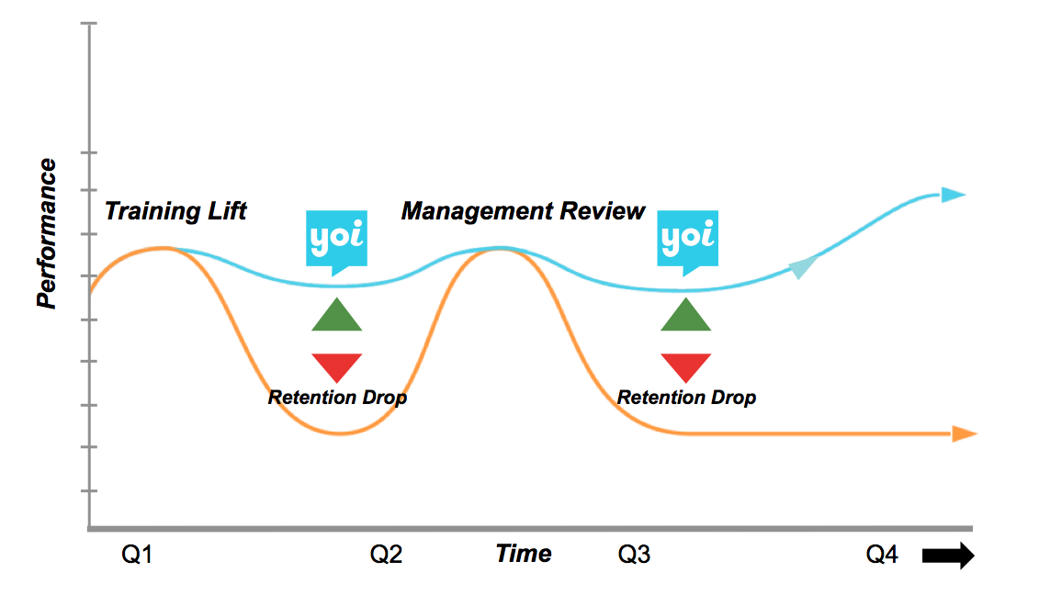
This is one version of the graph image

Slide 3

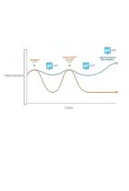
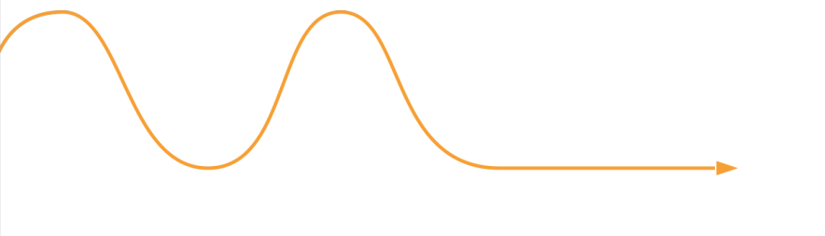
This is an editable version of the graph image if you need to change the colors
Training Lift
Management Review
Performance
Retention Drop
Retention Drop
Q1
Q2
Time
Q3
Q4

Slide 4
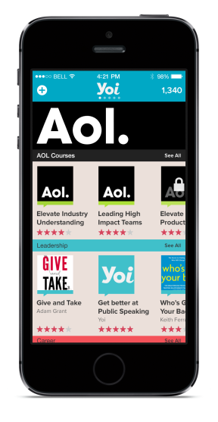
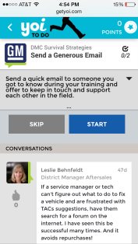
This is the product screenshot to include

Slide 5

Here’s our logo file. Please remove the tagline

Slide 6


Here’s the customer quote
“I have 10k financial advisors and I have three strategic priorities this year. Yoi is one of them.
- Robert Holcomb, President, First Allied Securities

