Slide 1

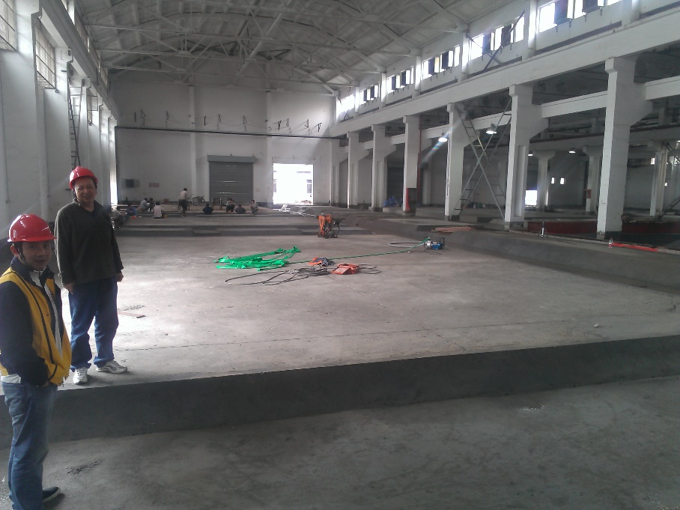
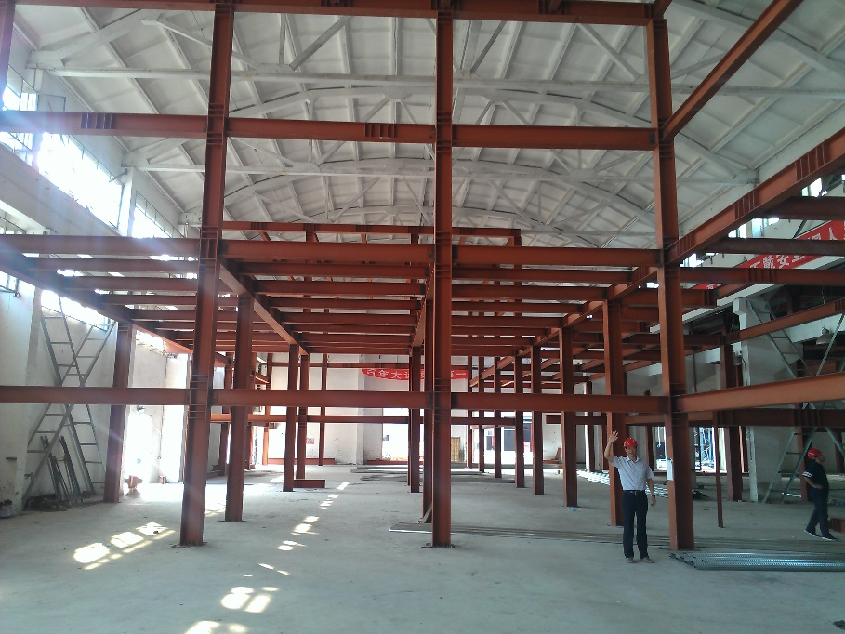
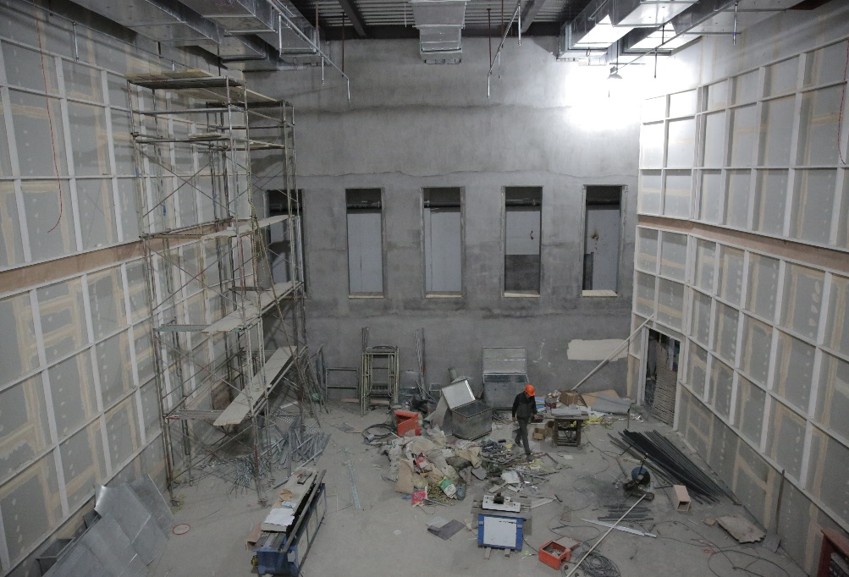
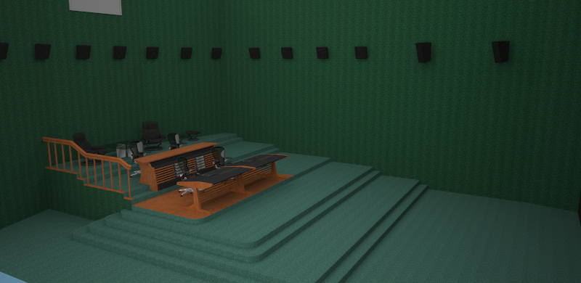
LEADING DIGITAL POST
DUBBING STAGE – DOLBY ATMOS PREMIERE
Physical Dimensions
50’ Deep x 37’ Wide x 34’ High(15.5 m x 11.5 m x 10.4 m)
Monitoring Formats
Atmos
7.1
5.1
5 JBL 4732T Mains
4 JBL 4645C Subs
4 JBL 9320 Forward Surrounds
28 JBL 8350 Surrounds
2 JBL 4645C Surround Subs
Crown Dsi Series Amps
Projection
Screen Size 16.8’ High x 30’ Wide(5.1 m x 9 m)
Barco 20C
Audio Playback Source
2 Pro Tools 11 HDX2
Each capable of over 500 tracks
4 Avid HD MADI
Dolby CP850
Dolby DAC3201
Portable Workstation Support
Video Playback Source
Avid Video Satellite
Media Composer 7
Avid Nitris DX
Recording Devices
1 Pro Tools 11 HDX Recorder
128 Inputs via MADI
1 Avid HD I/O
Console
2 Avid S6 M40 24-5-D
Expandable
Mix Plugins to include
Cedar DNS-One
Dolby Atmos Panner
Altiverb 7
Pheonixverb Surround
Waves
McDsp
Izotope
Zynaptic
Many more.
Server Support
Storage Server Network
Sound Effects Server Support
High Speed Internet Access
Contact:
Fannie Dai | Executive VP
o: 86 21 6333 7097
c: 86 186 1681 1505
e: fanniedai@leadingdigitalpost.com

Slide 2
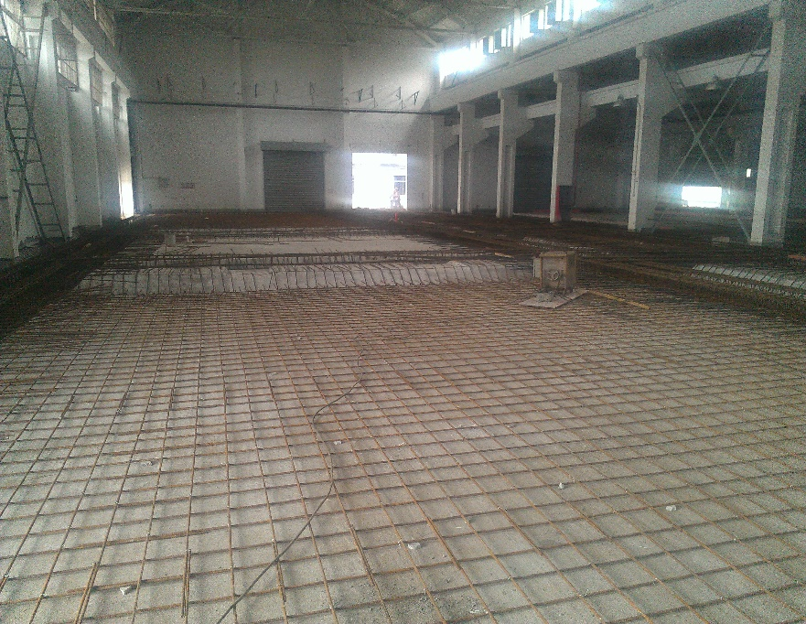
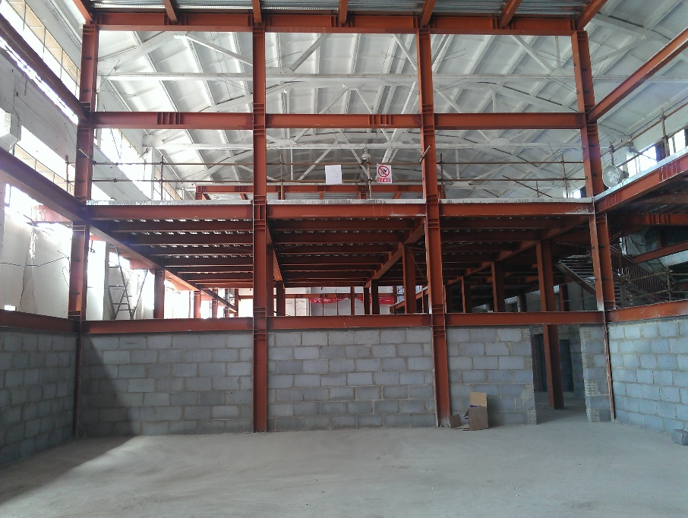
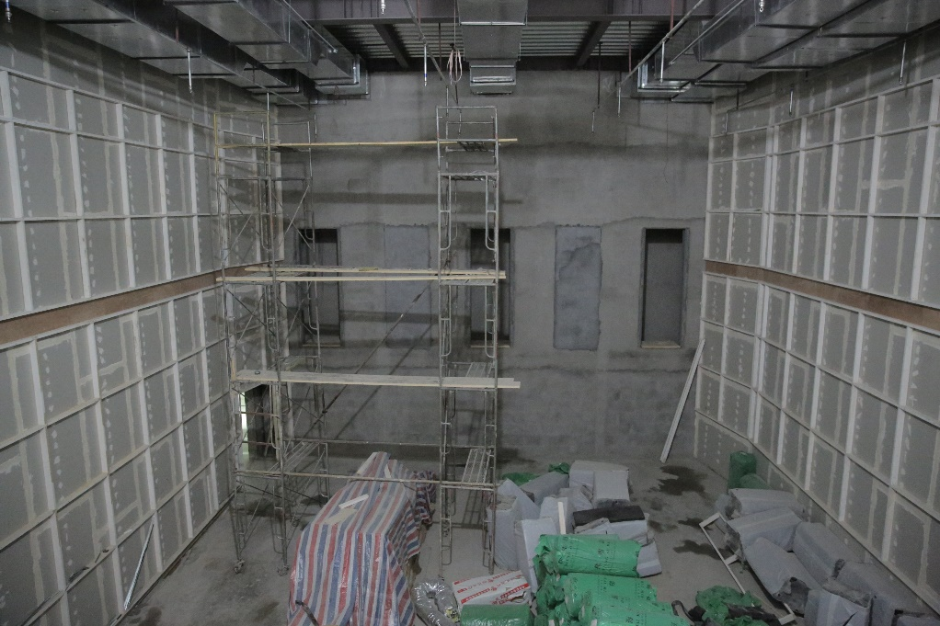
LEADING DIGITAL POST
DUBBING STAGE – DOLBY 7.1
Physical Dimensions
50’ Deep x 37’ Wide x 34’ High(15.5 m x 11.5 m x 10.4 m)
Monitoring Formats
7.1
5.1
3 JBL 4732T Mains
4 JBL 4645C Subs
16 JBL 8350 Surrounds
Crown Dsi Series Amps
Projection
Screen Size 16.8’ High x 30’ Wide
(5.1 m x 9 m)
Barco 20C
Audio Playback Source
2 Pro Tools 11 HDX2
Each capable of over 500 tracks
4 Avid HD I/O
Dolby CP850
Portable Workstation Support
Video Playback Source
Avid Video Satellite
Media Composer 7
Avid Nitris DX
Console
2 Avid S6 M40 24-5-D
Expandable
Recording Devices
1 Pro Tools 11 HDX Recorder
48 Inputs
3 Avid HD I/O
Server Support
Storage Server Network
Sound Effects Server Support
High Speed Internet Access
Mix Plugins to include
Cedar DNS-One
Altiverb 7
Pheonixverb Surround
Waves
McDsp
Izotope
Zynaptic
Many more.
Contact:
Fannie Dai | Executive VP
o: 86 21 6333 7097
c: 86 186 1681 1505
e: fanniedai@leadingdigitalpost.com

Slide 3
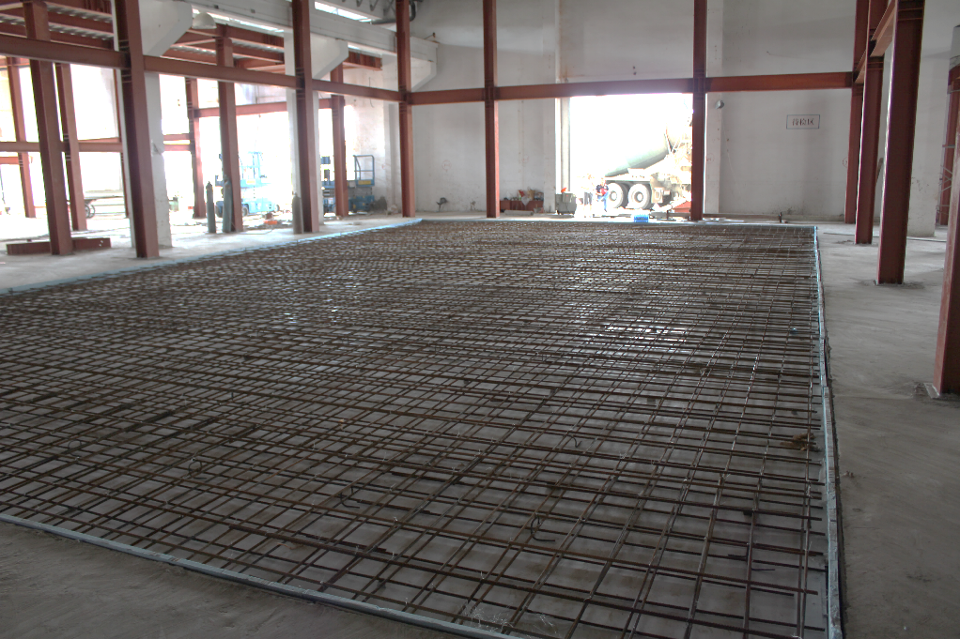
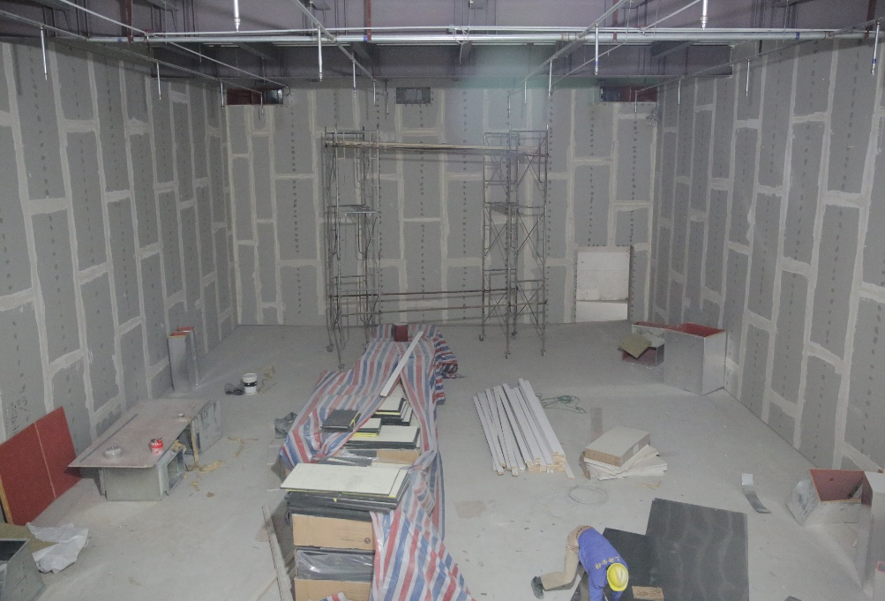
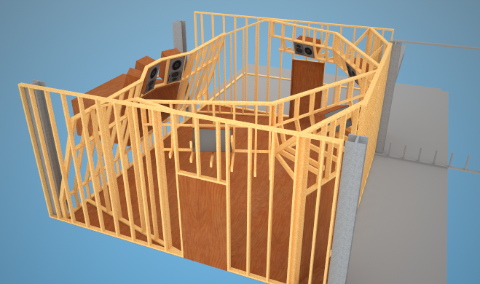
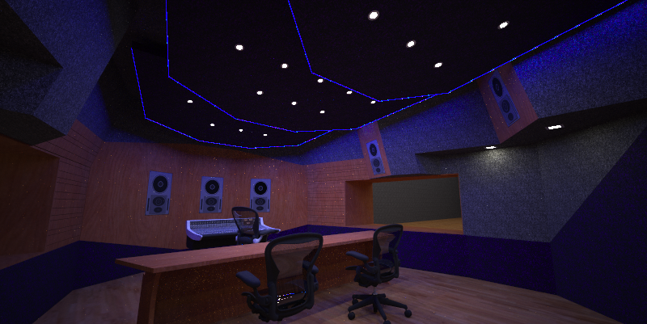
LEADING DIGITAL POST
SCORE STAGE
Physical Dimensions
66’ Deep x 39’ Wide x 23’ High(20 m x 12 m x 7 m)
Monitoring Formats
7.1
5.1
Genelec 1038B Mains
Genelec 1037C Surrounds
Genelec 7071A Subwoofer
Nearfield to be decided
Projection
Screen Size 16.8’ High x 30’ Wide
(5.1 m x 9 m)
Barco 20C
Audio Recording
ProTools HDX2
Portable Workstation Support
Video Playback Source
Avid Video Satellite
Avid Nitris DX
Avid Media Composer 7
Console
To be decided
Microphones: To include:
Neumann
Sennheiser
Coles
AEA
Royer Labs
Schoeps
Preamps: To include:
Millennia
Grace Designs
Server Support
Storage Server Network
Sound Effects Server Support
High Speed Internet Access
Contact:
Fannie Dai | Executive VP
o: 86 21 6333 7097
c: 86 186 1681 1505
e: fanniedai@leadingdigitalpost.com

Slide 4
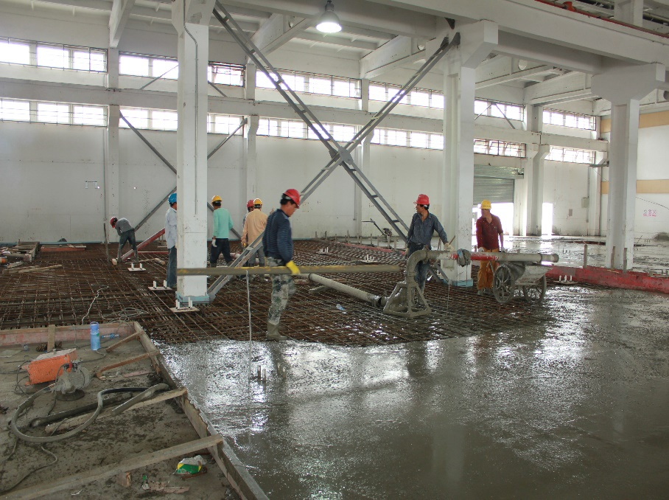
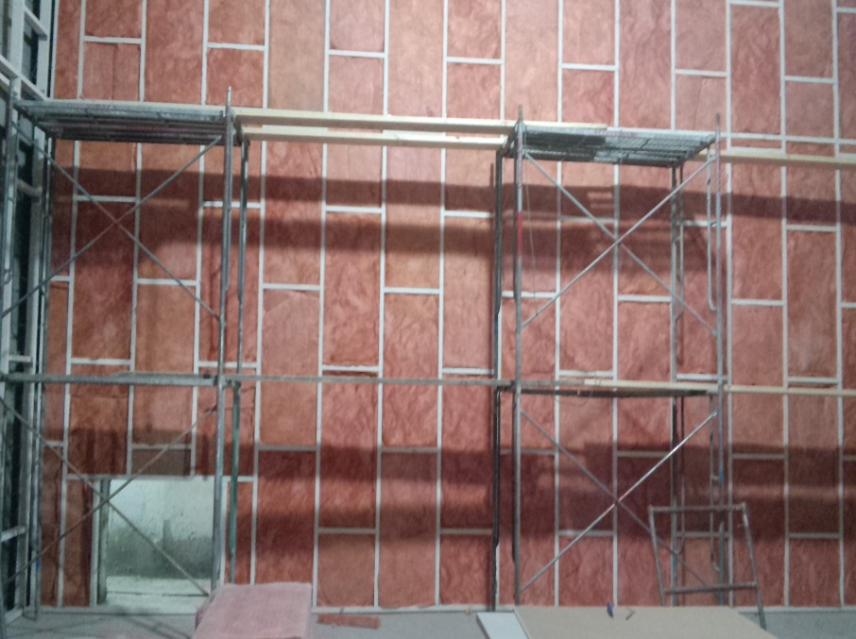
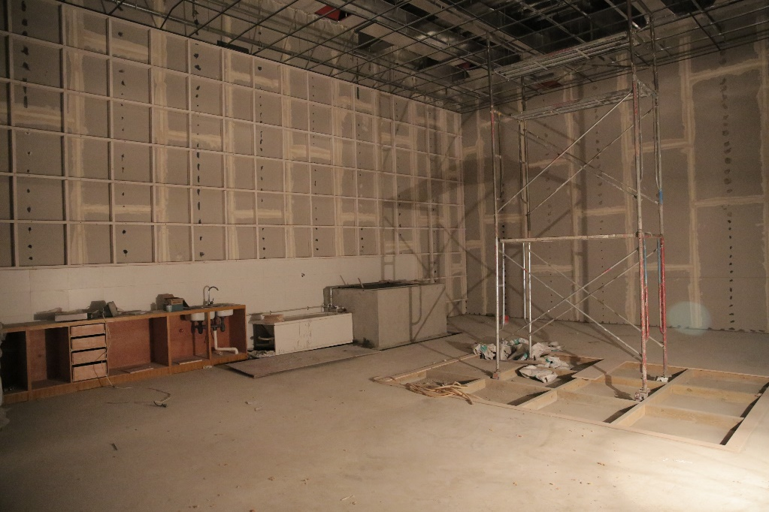
LEADING DIGITAL POST
FOLEY STAGE
Physical Dimensions
38’Deep x 27’ Wide x 21’ High(11.7 m x 8.3 m x 6.4 m)
Monitoring Formats
3 JBL LSR4328P
Headphone Amplifier
2Q for Source Talkback
Audio
Pro Tools 11 HD
Avid HD Omni
Source Connect Pro
Source Talkback
Avid Artist Mix Control Surface
Custom Designed Mic Preamps
Video
Avid Video Engine
Sound in Sync EdiPrompt Cueing Software for overlays
Server Support
Storage Server Network
Sound Effects Server Support
High Speed Internet Access
Microphones
Sennheiser MKH 416
Sennheiser MK 4
Others as required
Contact:
Fannie Dai | Executive VP
o: 86 21 6333 7097
c: 86 186 1681 1505
e: fanniedai@leadingdigitalpost.com

Slide 5
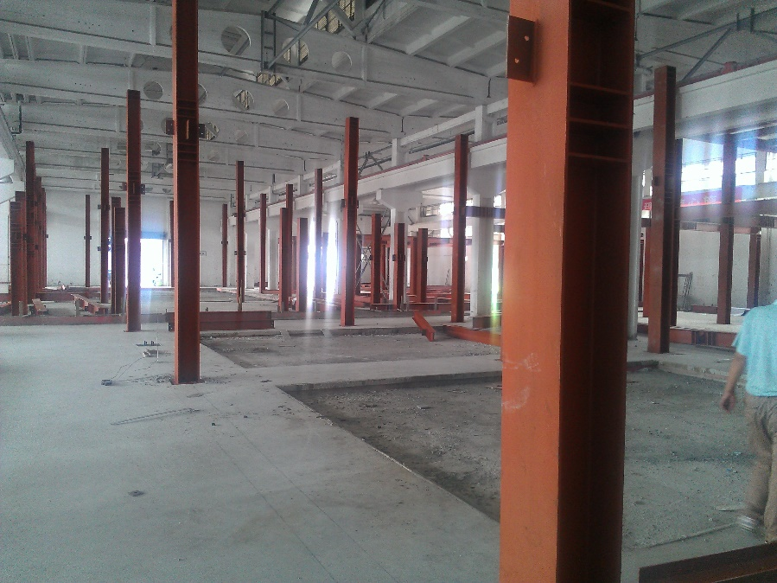
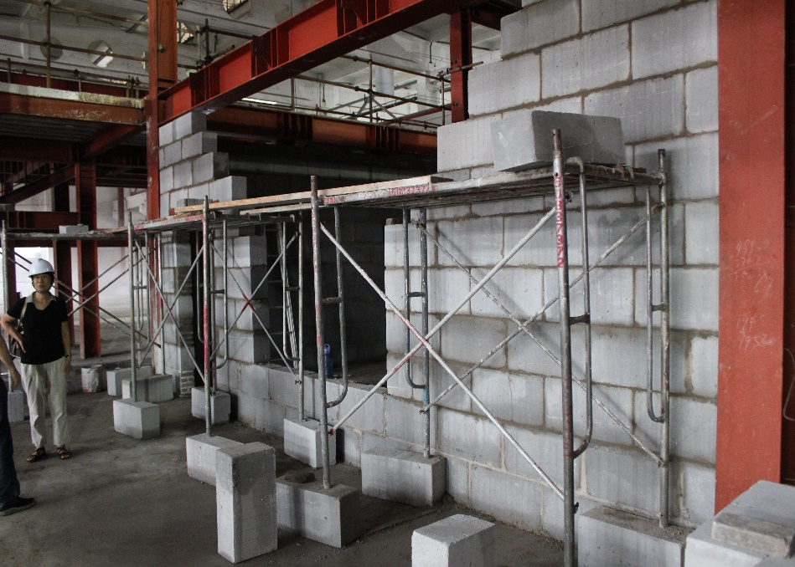
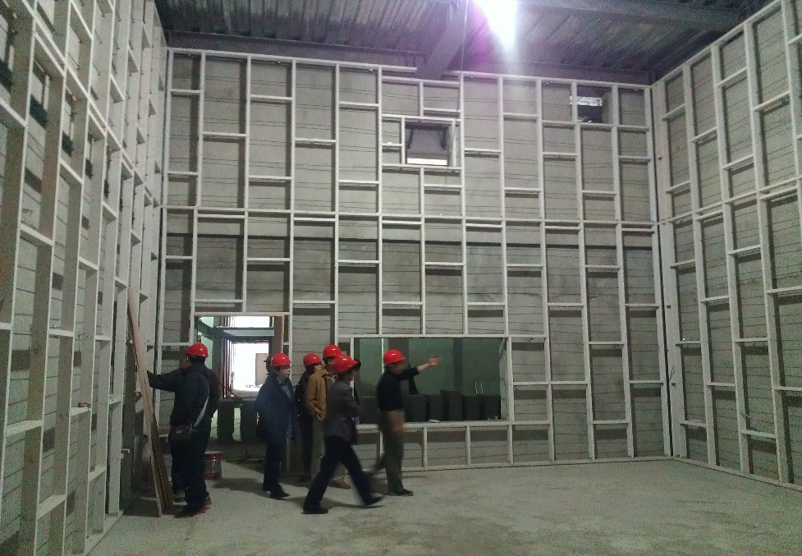
LEADING DIGITAL POST
ADR STAGE
Physical Dimensions
29’ Deep x 22’ Wide x 21’ High(9 m x 6.9 m x 6.5 m)
Monitoring Formats
3 JBL LSR4328P
Headphone Amplifier
2Q for Source Talkback
Audio
Pro Tools 11 HD
Avid Artist Mix Control Surface
Source Connect Pro
Source Talkback
Avid HD Omni
Custom Designed Mic Preamps
Video
Avid Video Engine
Sound in Sync EdiPrompt Cueing Software for overlays
Microphones
Neumann KMR 81
Sennheiser MKH 60
Sennheiser MKH 416
Sennheiser MKE 2
DPA 4071 FMK
Sanken Coss-11D
Neumann U-89
Sennheiser MK 4
Server Support
Storage Server Network
Sound Effects Server Support
High Speed Internet Access
Contact:
Fannie Dai | Executive VP
o: 86 21 6333 7097
c: 86 186 1681 1505
e: fanniedai@leadingdigitalpost.com

Slide 6
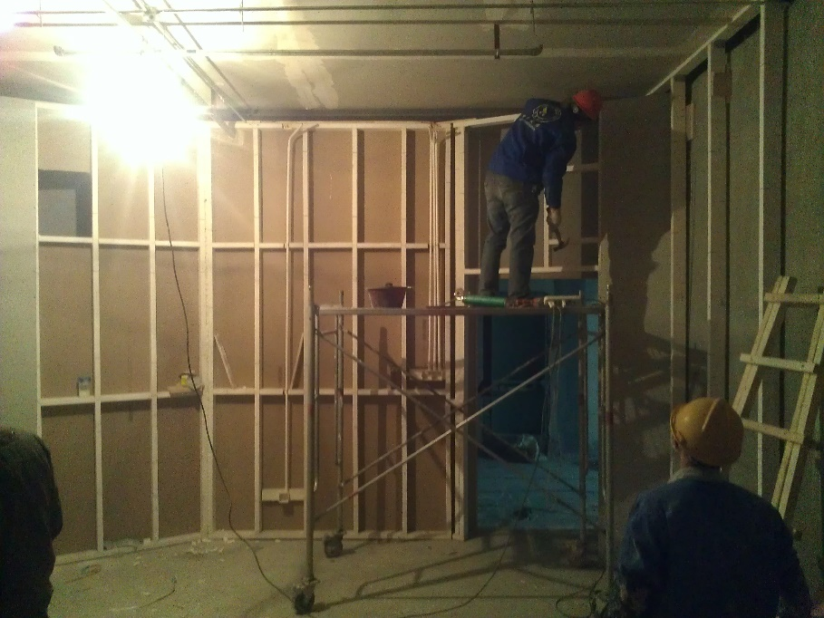
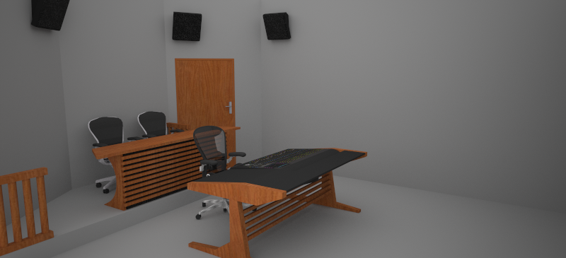
LEADING DIGITAL POST
MIX SUITE
Physical Dimensions
19’ Deep x 16’ Wide x 11’ High(5.8 m x 4.9 m x 3.4 m)
Monitoring Formats
7.1
5.1
3 JBL 9320 Mains
JBL 4641 Sub
4 JBL 8350 Surrounds
Crown Dsi Series Amps
Audio Playback Source
Pro Tools 11 HDX2
Avid HD I/O
Portable Workstation Support
Video Playback Source
Avid Video Satellite
Avid Video Engine
Console
Avid S6 M10 24-5
Mix Plugins to include
Cedar DNS-One
Altiverb 7
Pheonixverb Surround
Waves
McDsp
Izotope
Zynaptic
Many more.
Server Support
Storage Server Network
Sound Effects Server Support
High Speed Internet Access
Contact:
Fannie Dai | Executive VP
o: 86 21 6333 7097
c: 86 186 1681 1505
e: fanniedai@leadingdigitalpost.com

Slide 7

工作环境 | Amenities
Amenities include:
-Executive business services with office assistance
-Unlimited worldwide calling
-Hi-speed internet and wireless network
-On-site massage therapy
-Entertainment and workout area
-Coffee bar and wine lounge
-Access to well-appointed full-service kitchen
-Shower and laundry facility
But if that isn’t enough, Leading is located less than a half mile from downtown Shanghai. This is a thriving metropolitan center, featuring Art Museums, bars and many world class restaurants. No matter what your tastes, you can eat in-house, or easily take a wonderful and relaxing lunch hour in Shanghai.

Slide 8
安保措施 | Security Policy
Leading Digital Post is committed to improving its security, privacy protection and anti-piracy efforts. We have plans and policies
covering the following aspects:
Customer Media Asset Management and Protection
Information Security Policy
Physical and Personnel Security
Access Controls
Internal Inventory Asset Tracking and Management
Business Continuity Planning
System Deployment
Emergency and Security Incident Management Procedures
Communications Management
Compliance
Leading Digital Post plans to conform with MPAA's practice and seek other industrial standard certification and conformations. During the build up of our facility, we could also accommodate more specific needs and requirements from our customers.

