Slide 1
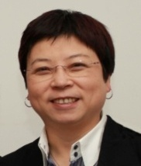
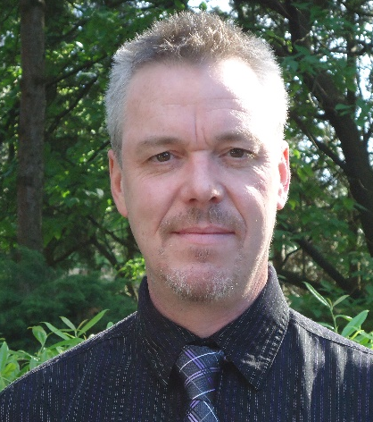

团队 | TEAM
曹玛丽 MARY CAO – CEO/Co-Founder / Producer
Mary is the co-founder of Leading Digital Post and a 15 year veteran in the film industry. She is an accomplished producer who has been involved in co-productions both locally in Asia and internationally. She has developed and implemented several outstanding film projects whilst acting as the sole representative of the renowned European producer Mario Cotone in Asia.
MI3 China Part; La Stella che non c'è(Italy); Two Tigers(Italy); K-20(Japan); Vision Beijing by Giuseppe Tornatore.
伊恩 IAIN PATTISON – Re-Recording Mixer / IMDB#：nm0666510
Emmy Awards – nominated / Outstanding Sound Mixing for a Miniseries or a Movie
Tin Man (2007)
Gemini Awards – Nominated /Best Sound in a Dramatic Program
Riverworld (2010)
Leo Awards / Best Overall Sound in a Motion Picture
Assault on Wall Street (2013)

