Slide 1
Lifeboat - The Original Idea
Get Well Card Initiative
Removing Stigma
Providing a connection between sufferers and loved ones
Started with an idea to make and give away (or sell for charity) get well cards for people suffering from mental health concerns like depression, anxiety and bipolar.
There’s such a stigma around these illnesses that friends and family sometimes don’t recognise that they are indeed illnesses.
Get well cards would remind both the giver and the receiver that (despite biopsychosocial causes) mental illness is a real medical concern, and deserves social support.

Slide 2
Lifeboat - The Original Idea
Whole –Person Model
Activity Groups
Support Groups
Connection with Resources
Mentors
Volunteer Help
Respite
Realised that the important part – to me – was actually the social support.
I also liked the ‘whole person’ approach of places like the Asylum Seeker Resource Centre and MS Australia.
I suffer from a mood disorder and an anxiety disorder, and social support (or lack thereof) has been a major factor in my wellness over the years.
Recently, I “mentored” a friend of mine who was just recently diagnosed with anxiety, and it helped her a lot.

Slide 3
Lifeboat - The Evolved Idea
Mood Disorder Resource Centre
Activity Groups
Support Groups
Connection with Resources
Mentors
Get Well Card Initiative
Respite
Clients
Carers
Fundraising
Communication
Stage 3 only
beyond blue
legal, medical
art, exercise...
CVs, cover letters
Special training
Connection with lifeline
Role is just talking
I thought of a model like this:
Get well cards become a PR as well as a fundraising activity. (Maybe balloons, flowers, etc later on)
Includes mainly social support, but also connections with other services

Slide 4
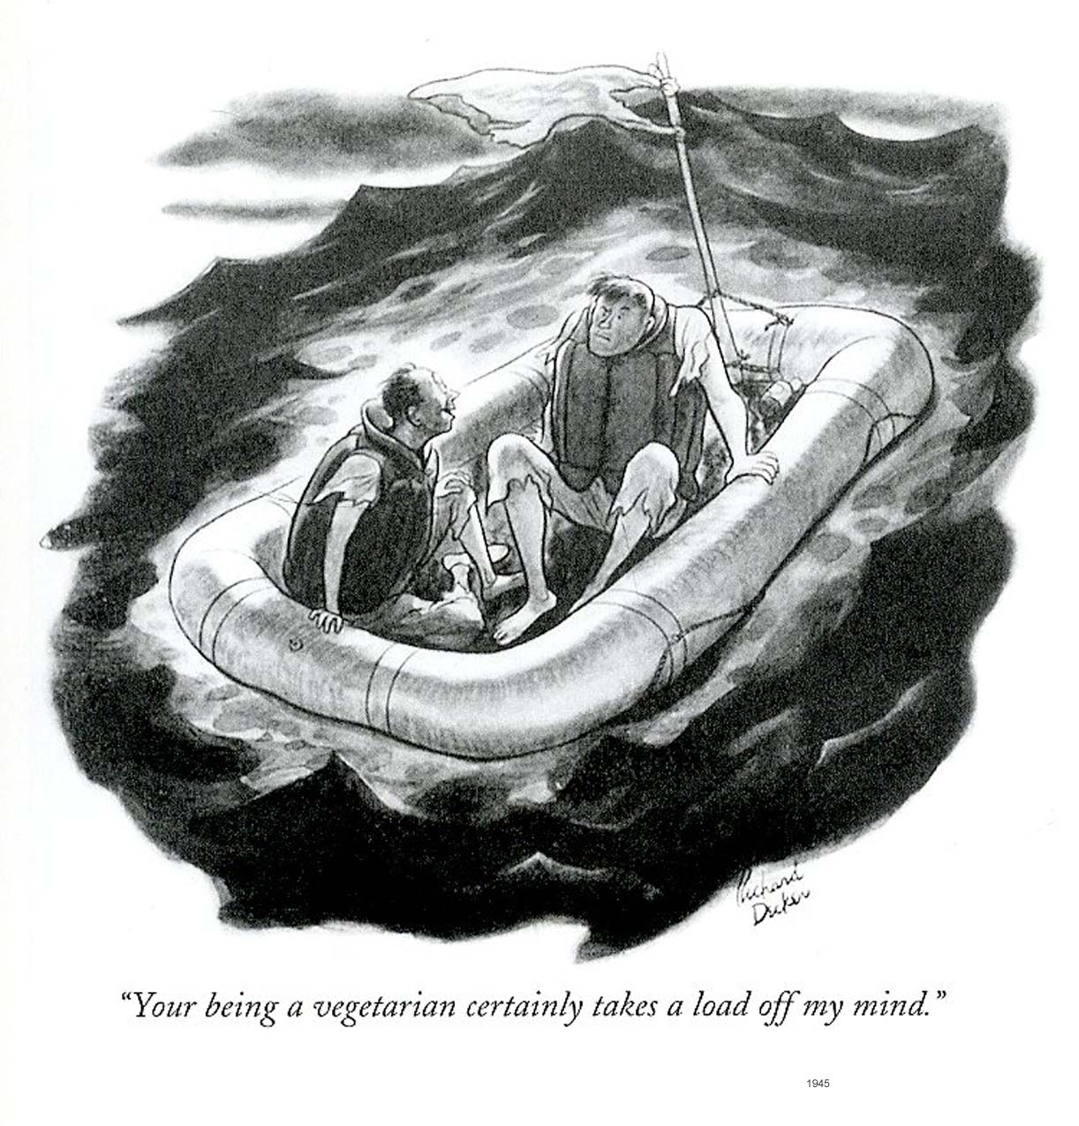
Why I’m Calling it ‘Lifeboat’
I like the idea of ‘being in it together’ – even though it’s a tough situation, you’re not alone.
There’s a safety theme, an idea of something that picks you up when you’re in trouble
The lifeboat isn’t the full solution (like therapy, medication, and so on); it’s just there to help
I like the idea of ‘unsinkable’ – tenacity has gotten me through my illness, and I like the idea of being unsinkable

Slide 5
Three Stages
I knew it would need to be rolled out in phases:
1. Mood Disorder Support Group
2. Expand Services
Offer connections to resources online
3. Get Premises
Support groups meet at premises
Meetup.com group
Gold coin donation for Meetup.com listing and room rental, coffee
Start website
Risk analysis, insurance and legal advice
Planning
Offer match-up with mentor
Start additional activities: gardening, art, exercise...
Get-well card initiative
Carer support group
Activity groups at premises
Employees and volunteers
Change in legal status - new risks
Change in ATO status for donations
Real fundraising - donor and crowdfunding

Slide 6
Risks
But then I thought of the risks that exist – even for Stage 1:
Clients who are a danger to themselves
Clients who are a danger to others
Leak of confidential information
Abusers of clients who are a danger to themselves or others

Slide 7
Risks = Costs
So legal advice and insurance would be a must.
… And those things cost money.
… Which means fundraising.
… Which means having a “product” to fundraise for.
Or at least a brand, so that it looks like there’s a product

Slide 8
Costs
And there are a lot of things that need funds:
Legal Advice
Large, once-off layout
Insurance
Annual Cost
Incorporation
Small, once-off fee
Ongoing Reporting Fees
Graphic Design and Web Hosting
Fundraising Costs
Business Name
Logo
Branding / Letterhead
Small but necessary fees
To file compliance reports
Public Liability as a minimum
Equipment and insurance for sausage sizzle
Fees for Indiegogo
May need a video camera
Renting Space
Check community centres, councils and churches
Budget in tea and coffee
Get Well Cards
Hopefully will net profit
Materials and labour
Possibly balloons and flowers
Incorporated Association
Incorporated Association

Slide 9
Early Steps
So, it’s a matter of reversing the logical steps. First, branding – then, service delivery.
Graphic Designer - Logo, Character, Fonts, Colours
Social Media Strategy / Policy
Scope out initial budget; write plans
Website; get-well card store
INDIEGOGO CAMPAIGN
Once you have enough followers
Mailchimp account – (1-2 emails)
Other fundraising: sausage sizzle, get-well cards
Get well cards
Set up for real
Legal and insurance advice
Set up incorporation / legal entity; get insurance
Referral fliers / reach out for contacts
Scope out locations and set first meetings
Name, Logo and Social Media

Slide 10
I’ve done heaps of research….
What type of legal entity to be
Incorporated Association
Big plus: The association is a legal person
Big minus: Need at least 5 members to incorporate in Vic
Administration: accounting, auditing and annual reporting requirements
Administration: must have a dispute resolution procedure (there’s a model to use)
Costs: fees for lodging some forms and financial reporting
Meetings: must have an annual general meeting with financial report
Unincorporated Association
Not a legal person
Can’t open its own bank account or own property
Can’t accept gifts or bequests
Can’t apply for grants
DGR Status
fall within a general DGR category as set out in the income tax law
have an Australian business number (ABN) (incorporated associations *can* have those)
have an appropriate dissolution/revocation of endorsement clause or clauses
maintain a gift fund (if seeking endorsement for the operation of a fund, authority or institution)
be in Australia (with some exceptions).
Conclusions
Need to be incorporated.
Need an ABN.
Therefore, need to get 4 more members
Need to get head around the requirements (consumer.vic.gov.au)
Confirm with legal advice after Indiegogo campaign

Slide 11
How to get Deductible Gift Recipient (DGR) status
Welfare and rights category
Need ABN
Registered charity
Registered public benevolent institution
Need “an appropriate dissolution/revocation of endorsement clause or clauses” (?)
Need a gift fund (if seeking endorsement for the operation of a fund, authority or institution)
Application at ato.gov.au
Social Media Policy
http://mashable.com/2009/06/02/social-media-policy-musts/

Slide 12
What insurance to get
Conclusions
At least public liability
Will need professional advice
What legal risk mitigations to be in place
Brain Dump
Have an emergency / crisis plan for: Meetings, members and social media
Disclaimer on website and written that this is not health care – rather, it’s information and support (cf ADAVIC site)
Disclaimer of reliance on information
Gain clients through referral rather than online (think: psych services)
Vetting process?
Confidentiality protections – anonymous sort of setting; discuss confidentiality in meetings and on website
Conclusions
Get legal advice

Slide 13
Which referral services to use for clients
Brain Dump – Desired Referrers
Psych practices – community psychology / psychiatry / similar
Psychs who work for charities – possibly Asylum Seeker Resource Centre, possibly drummond street queerspace, MS Australia….
Brain Dump – Desired Referees
Low-risk individuals – preferably with access to psychological care, not in immediate danger from suicidal thoughts, mania or abusers
Individuals who may need some social support
Starting with 25-34 age range
Diagnoses in the area of depression and anxiety (mild manias, some OCD– we’re just not going for high-risk or extreme personality disorders)
All ethnicities, religions, political views, sexualities and genders / gender identities. (I will need some practice in facilitation.)
Preferably someone who would participate constructively in a group setting

Slide 14
How does the Bunnings sausage sizzle work?
A written request on the organisation’s letterhead
Then wait for Bunnings to agree to set a date
Bunnings will provide with an information pack that will detail:
  Items that Bunnings will provide (normally BBQ, gas, and shade cover)
  Items that you need to provide (such as gloves, serviettes, wipes, disinfectant spray, BBQ tools etc)
  Catering requirements (suggested amounts of sausages, bread, sauce and drinks) and
  Logistical needs (OHS guidelines, council food handling requirements, insurance)
There’s quite a wait list.
They may put a limit on the number of people who can safely work in the BBQ area
They may set prices for sausages and drinks so that regular shoppers have a fair expectation of what to pay
What we will need:
  3-4 people or so per day*
  Gloves, serviettes, wipes, disinfectant spray, BBQ tools*
  Sausages, bread, sauce and drinks*
  OHS guidelines
  Possibly food serving licence* - some kind of food handling compliance
  Possibly insurance*
  Money box

Slide 15
How does Kickstarter work? What other sites are there?
NB: Kickstarter prohibits fundraising for charity
Think Indiegogo, Pozible….
Pretty straightforward in mechanics, but making a good campaign is an involved process. See below.

Slide 16
How best to use crowdfunding sites
Have 500-1000 followers on Facebook or similar first
Use humour, products, and a relatable character to build audience
Try for “boosts” from sites with big followings like: Equal Marriage Australia, BeyondBlue, ASRC, George Takei, Esther the Wonder Pig, Men’s Shed….
Blog outreach, publication outreach (press release is valuable, even if lightly picked up)
Have a logo, a name, a strapline, and a sleek look – be branded.
Try to have at least two people running the project – they’re much more successful that way.
Create a pitch video – try for funny, engaging, different… 2-3 mins max. Yes, I have to be in it. Warm setting, good lighting, good production.
Pitch: Make it about the funders. Being a part of something. Be passionate.
Gather photos, infograms, cartoons, stats, videos, timelines – Media. Light on writing.
Use a specific objective. Something concrete that people want to contribute to. (Get us to that first support group meeting; Fund our first six months….)
Launch on a Monday or Tuesday.
40 days or less
Come up with some good perks: $25 perks are most claimed; $100 perks make the most money. Consider entire cost to deliver.

Slide 17
So, what I need to do now…
Things I can do (or at least start) myself:
Things I’ll need help for:
1. Business/ Management Plan
2. Risk register
3. Competitor matrix
4. Donor profiles
5. Messaging strategies
6. Website
7. Contact lists
8. Blog entries
10. Service delivery structures
11. Gantt chart
12. Referral fliers
9. Meeting-theme handouts
Logo
Possibly a better name
Branding
Social Media: Cartoons
Social Media Strategy
Indiegogo Pitch (?)
Eventually, legal advice
Eventually, insurance

