Slide 1
HOTEL
L’ATELIER
***
VILLENEUVE-LEZ-AVIGNON
OBJECTIVE: Design a new logo for a 3 stars hotel

Slide 2
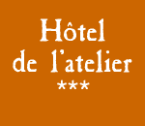
Context: Old logo
Logo:
This is a logo for a 3 stars hotel in France
L’Atelier means Workshop or Studio or Factory in French, as the building used to be a silk factory in the XVIe century.

Slide 3
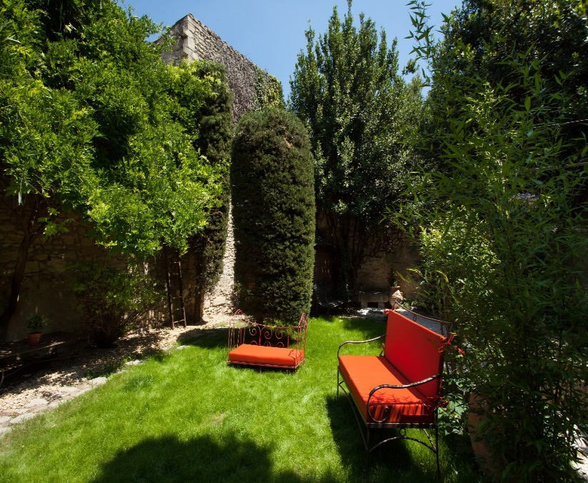
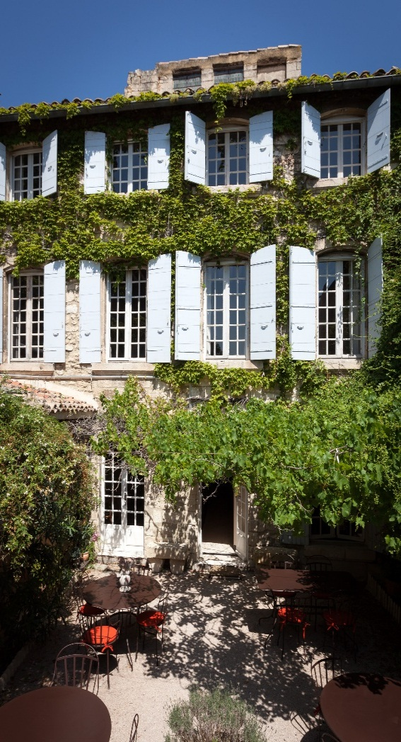
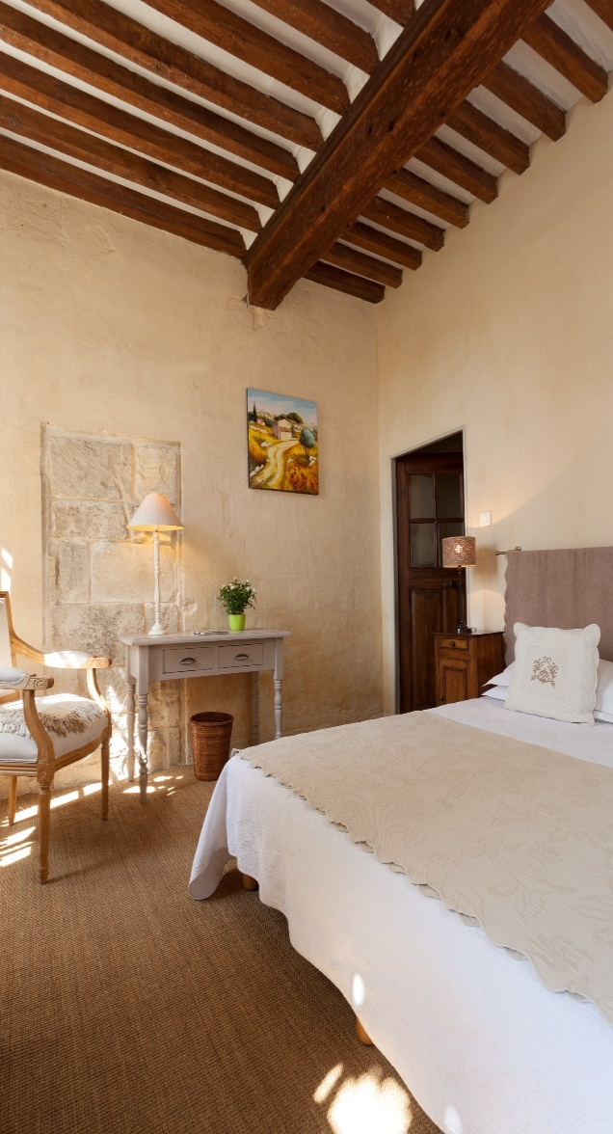
Context: small charming hotel 3* in Provence
XVI th century building
22 bedrooms
Breakfast, no restaurant
Patio, terrace, garden
Historic city in Provence (France)

Slide 4
Context: a new hotel owner and a new concept for the Hotel
HOTEL CONCEPT : More than a hotel, a true stop-off during your travel in Provence.
Your travel in Provence starts in L’Atelier. Have a break in this authentic guest house from the XVIth century. Discover Provence like nowhere else and explore the hotel and all its nooks and crannies :
  our lounge L’Atelier du Voyage, dedicated to make you discover Provence
  our 22 bedrooms all different, charming, calm and elegant,
  our sunny patio to have a tasteful breakfast
  our garden smelling herbs (thym…) and flowers from Provence to relax,
  our comfortable furniture close to a stone made fireplace to share a friendly break.
L’Atelier welcomes you to make you live Provence like a local.
Our Values : Authenticity, Welcoming, Sharing, Generosity and Passion to make you discover Provence.

Slide 5

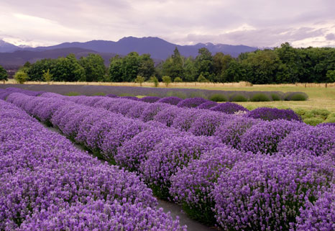
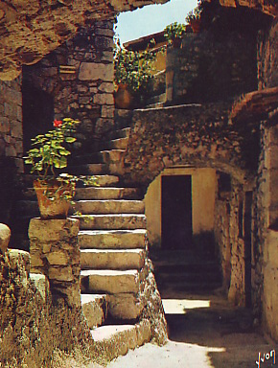
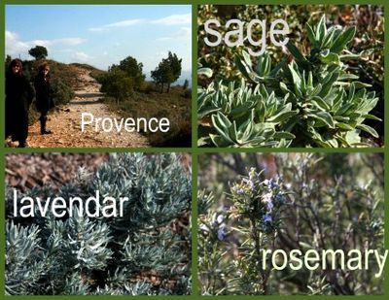
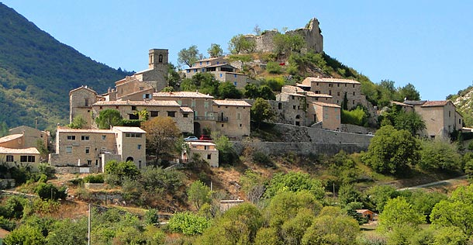
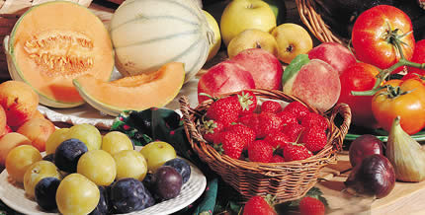
What is Provence ?

Slide 6
Objective: Design a new attractiv and more contemporary/ today’s logo
The logo has to mention HOTEL, the name of the hotel “L’ATELIER” and 3 stars ( ).
The style of the logo :
  Distinguishing / different,
  Elegant,
  Simple and easy to read.
The logo has to evoke Provence.
Components of the logo :
  a font,
  a symbol or a graphic signature to make this logo different/ to point it out and to evoke provence,
  one colour.
Need a vector logo. Logo to be used on website, flyers, business cards, posters

