Slide 1
KungFuCloud Pages Design
www.kungfucloud.com

Slide 2
1
Design Requirement
1.1
Requirement
2.2
Pages Design Template
2
Page content Requirement
2.1
Home Page Design
2.2
Solution Page Design

Slide 3
1.1 Website design requirement
Website Type
KungFuCloud position on Cloud (IAAS ) solution and Integration provider, including Consulting, Deploying and Integration.
Reference Website
www.onapp.com
www.hosterpoint.com
www.justaddcloud.com
Design Page
Home page and Product page
Site Features
Static Site, the content of each page is fixed and rarely updated.
Edit files/Content directly.
The Structure of the content is text and some images/graphics.
All contents stand in the middle of the page.
Color
Background : Light Grey
Contents: Black , White and Light Blue

Slide 4
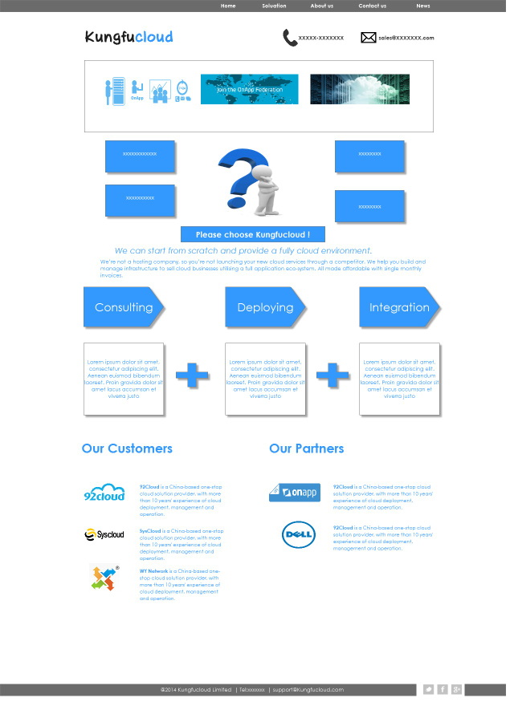
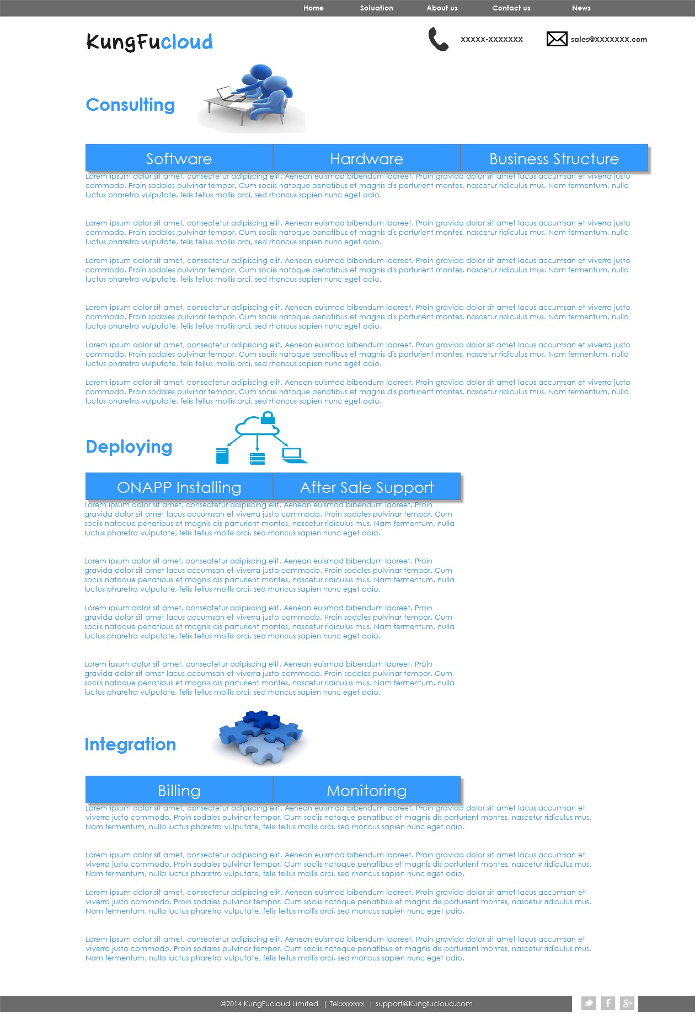
1.2 Home Page and solution page Templates

Slide 5
1
Design Requirement
1.1
Requirement
2.2
Pages Design Template
2
Design Requirement
2.1
Home Page Design
2.2
Solution Page Design

Slide 6
2.1.1 Home Page Design Requirements--Overall
Navigation
Logo and Contact information
Three rolling pictures Sliders
Some Pictures and some frames including text
Some icons and texts

Slide 7
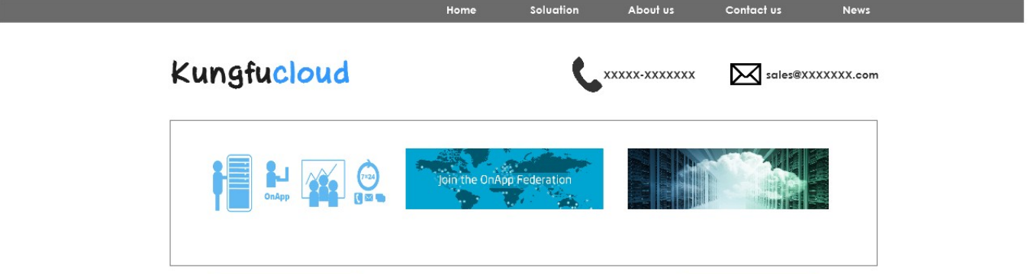
2.1.2 Home Page Design Requirements--Navigation, Logo and sliders
Navigation on the right side and News right justify with pictures.
Left justify with Pictures
Right justify with Pictures, Mail and Phone Icons needs to be redesigned.
Three full size pictures need to be redesigned and can changed by sliders.
Picture 1: Servers we can provide: Software + Hardware + Additional Tools+ 7*24 support.
Picture2: You can join KungFuCloud Federation and share cloud resource with Others users.
Picture 3: Focus on Data Center users ,help them transfer to IAAS providers.

Slide 8
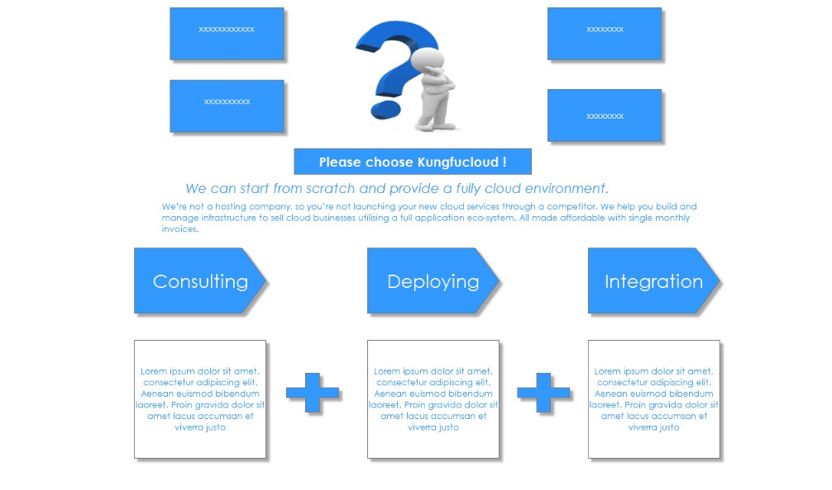
2.1.3 Home Page Design Requirements--Frames and pictures
The picture in the middle need to be redesigned :
A confused engineer faced to transferring to Cloud, is interested in Cloud but don’t know how to do it.
Some frames about the confused people need to be redesigned:
including the customers' questions just like :
We don’t want to develop Cloud software by ourselves ; We don’t want to buy new devices…
A Square is suitable here I think, and some text explanation blow this square.
Three Frames about my services need to be redesigned:
Emphasize step by step, from Consulting to Deploying and integration finally.
Three Frames need to be redesigned:
About detail information about our services.

Slide 9
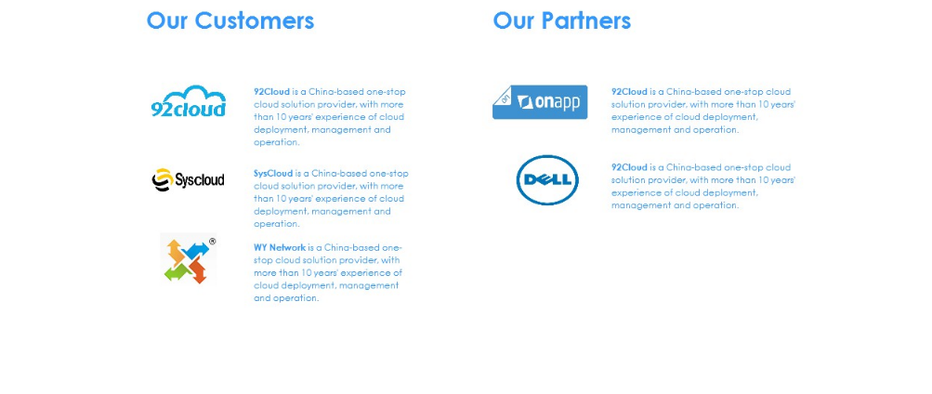
2.1.4 Home Page Design Requirements--icons and text
Don’t need to change it.

Slide 10

2.2.1 Solution Page Design Requirements--Overall
Navigation
Logo and Contact information
Consulting Icons
Tabs
Texts
Deploying Icons
Tabs
Texts
Integrating Icons
Tabs
Texts

Slide 11
2.2.2 Solution Page Design Requirements--Navigation, Logo and Contact
Same as Home Page.

Slide 12
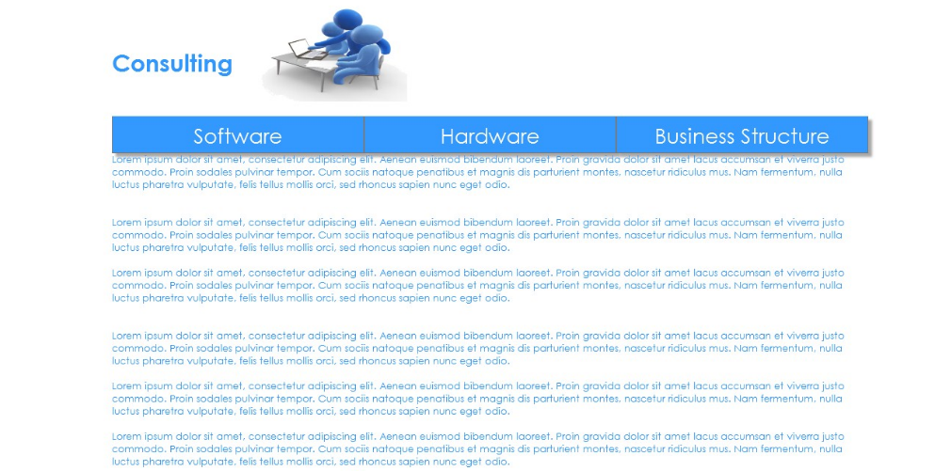
2.2.3 Solution Page Design Requirements--Consulting Icons, Tabs and texts
This Consulting Icon needs to be redesigned.
Via changing different Tab(need to be redesigned), below box display different contents.

Slide 13
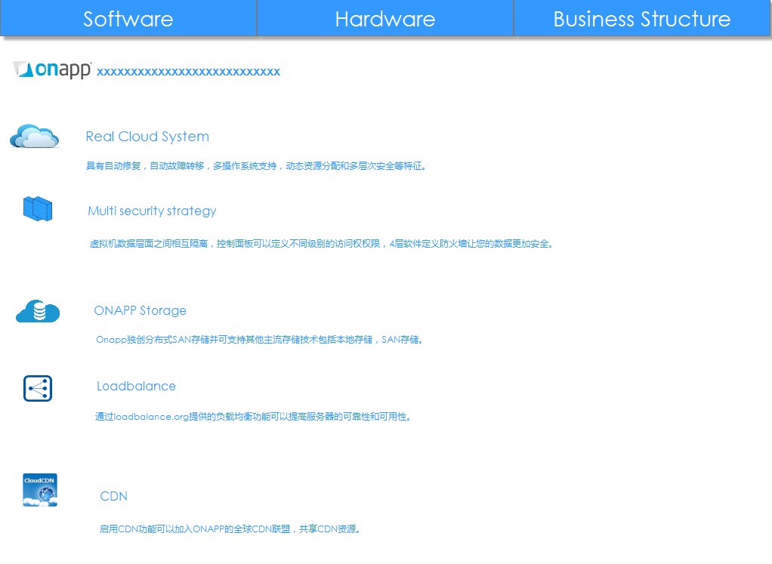
2.2.3.1 Solution Page Design Requirements--Consulting-software
Cloud Icon need to be redesigned.
Firewall Icon need to be redesigned.
Storage Icon need to be redesigned.
Lord balance Icon need to be redesigned.
CDN Icon need to be redesigned.

Slide 14
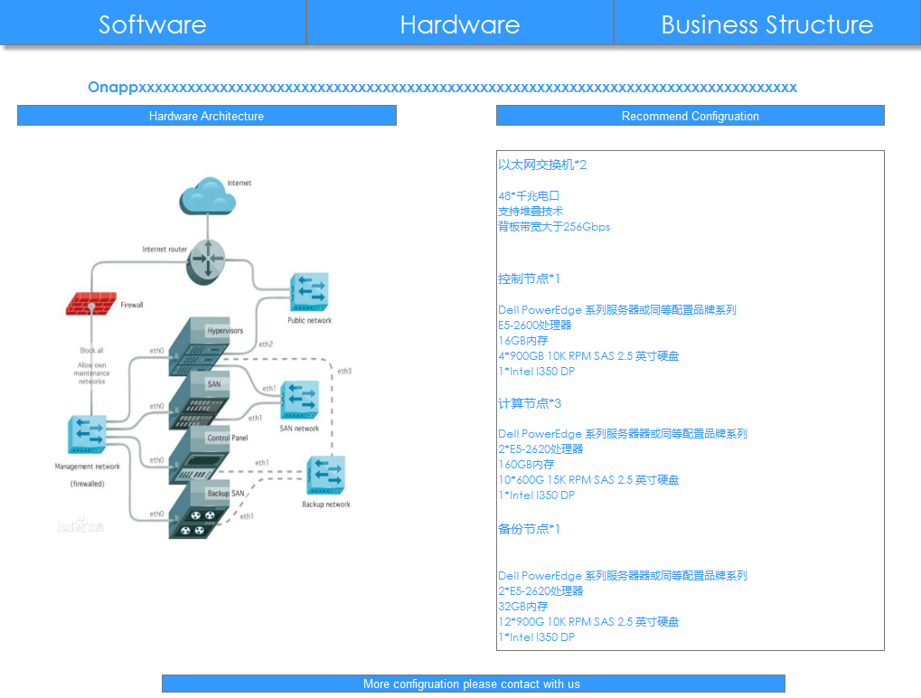
2.2.3.2 Solution Page Design Requirements--Consulting-hardware
These three frames can redesign the same shape.
This
Frame needs to be redesigned: about recommend configuration.
This Picture need to redesigned including server, firewall, switch.

Slide 15
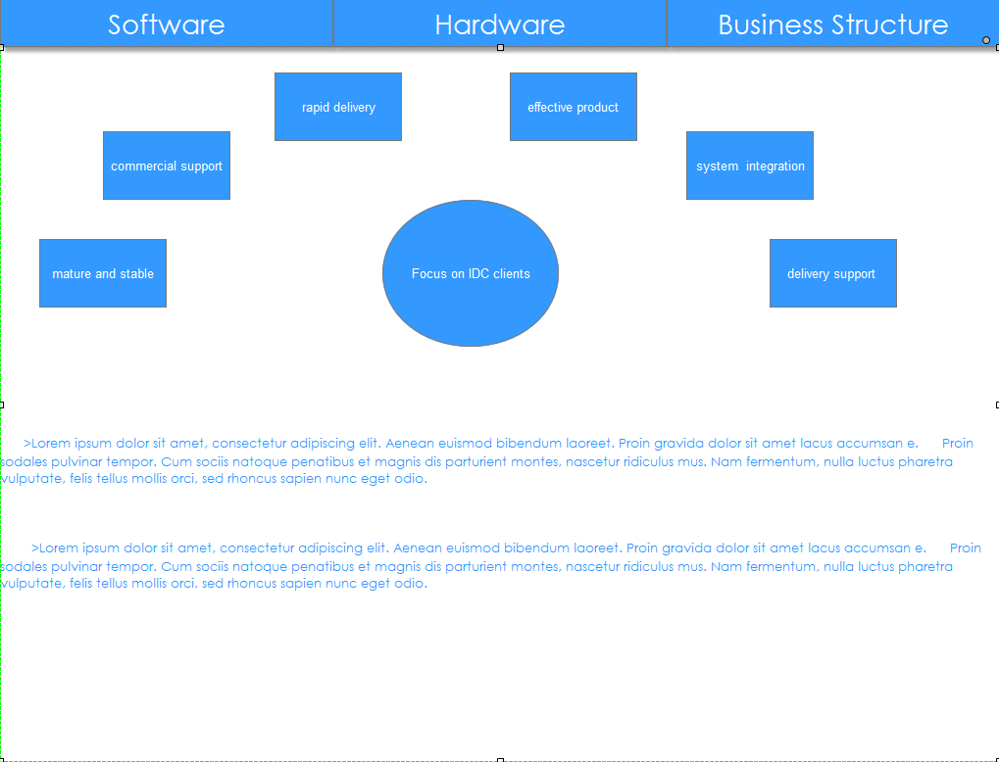
2.2.3.2 Solution Page Design Requirements--Consulting-business structure
This frames need to be redesigned :
Frame in the middle display: focus on IDC clients.
Other frames need to be redesigned :
The detail about how to run the cloud business for IDC clients

Slide 16
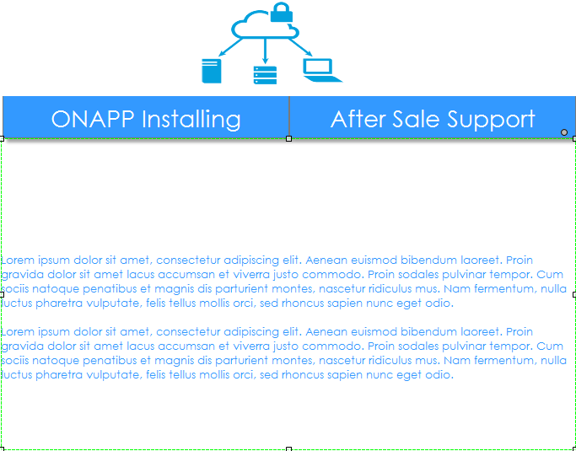
2.2.4 Solution Page Design Requirements--Deploying Icons, Tabs and texts
This Deploying Icon needs to be redesigned.
Via changing different Tab(need to be redesigned), below box display different contents.

Slide 17
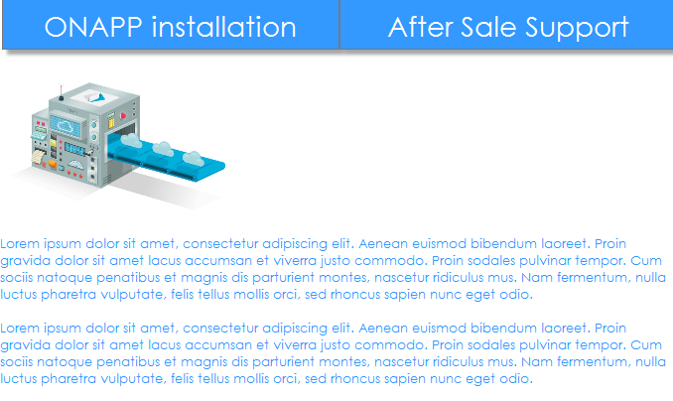
2.2.4.1 Solution Page Design Requirements--Deploying -- Onapp installation
This icons need to be redesigned:
We use onapp.
Based on onapp, we can deliver cloud service.

Slide 18
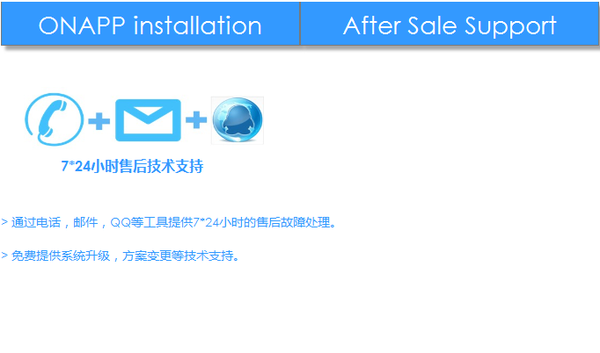
2.2.4.2 Solution Page Design Requirements--Deploying -- After Sale support
These three icons need to be redesigned:
Phone Mail QQ

Slide 19
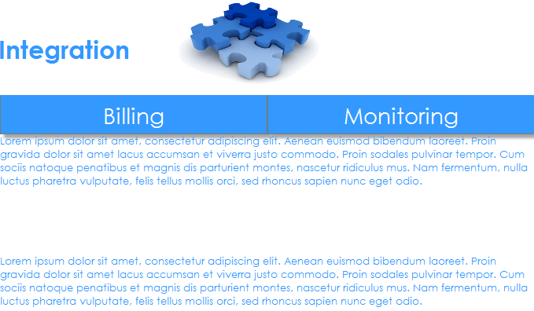
2.2.5 Solution Page Design Requirements--Integration Icons, Tabs and texts
This Integration Icon needs to be redesigned.
Via changing different Tab(need to be redesigned), below box display different contents.

Slide 20
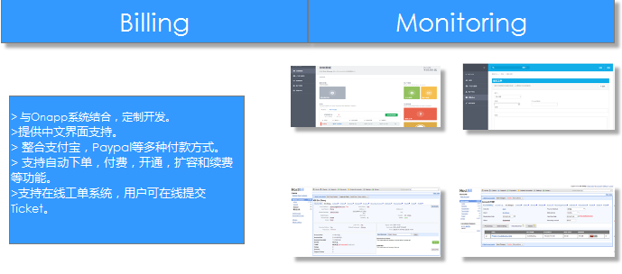
2.2.5.1 Solution Page Design Requirements--Integration --billing
A icon about billing system to be redesigned:
This frame need to be redesigned:
About the billing system function.

Slide 21
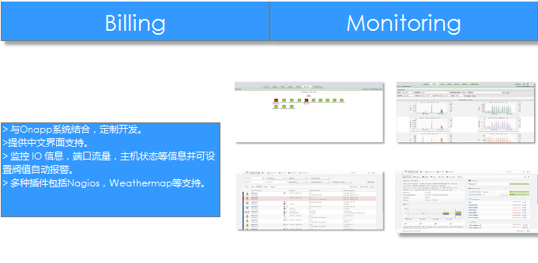
2.2.5.2 Solution Page Design Requirements--Integration--Monitoring
A icon about Monitoring system to be redesigned:
This frame need to be redesigned:
About the monitoring system function.

