Slide 1
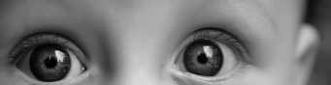
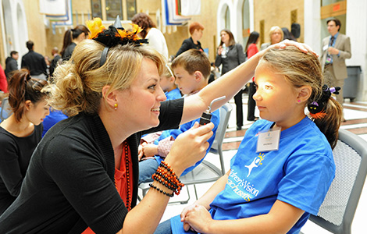

Children’s Eye Center
of El Paso
August 2014 Newsletter
Dedicated to Providing
Community-Based
Eye Care Since 1996
In This Issue
Meet Dr. Kara Gerger
Our Patient of the Month
Dr. Radenovich Answers Your Questions
Life in “Old” El Paso
Meet Dr. Kara Gerger, OD, MS
Children’s Eye Center is pleased to announce the
addition of Dr. Kara Gerger to our staff.
A native of _____________, Dr. Gerger received her
BS in Materials Science and Engineering from the
University of Florida, graduating Magna Cum Laude.
She earned her MS, Vision Science , and her
OD, Doctor of Optometry from the New England
College of Optometry in Boston, Massachusetts.
“I decided to become a Pediatric Optometrist just around the time I turned sixteen,” Dr. Gerger recounts. “I’m dedicated to the field of Optometry and I love working with children. Being on the staff of the Children’s Eye Center gives me the opportunity to do the work I most enjoy 100% of the time.”
Dr. Gerger received advanced clinical training at the New England Eye Center/Tufts Medical Center in Boston, MA. Her residency in Pediatric Optometry was completed at the New England Eye Center and Affiliates, Boston, MA. While completing her residency, Dr. Gerger managed complex cases including pediatric contact lens service, vision therapy programs following Traumatic Brain Injury (TBI), Retinopathy Of Prematurity (ROP), and pre- and post-operative care of patients with strabismus.
News
April 19, 2014 - NECO Pediatric Resident Dr. Kara Gerger Awarded Residency Award
Dr. Kara Gerger, a 2013 NECO graduate, is one of three recipients of the 2014 Terrance N. Ingraham Pediatric Optometry Residency Award, sponsored by Johnson & Johnson Vision Care.
The Terrance N. Ingraham Pediatric Optometry Residency Award is intended to promote the practice and development of the field of pediatric optometry by providing incentive and support to talented optometric residents who demonstrate a passion and commitment to practice, research, and education in the field of children's vision. A goal of this award is to invest in the evolution of the field of pediatric optometry in the the application of soft contact lenses for children's vision disorders by providing opportunities for future practitioners, educators, and researchers.
Advanced Clinical Training:
New England Eye Center at Tufts Medical Center Boston, MA
Juanita – Our Patient of The Month
Juanita is one success story that needs telling.
At the age of nine, Juanita received her first eye exam since birth. She was examined by Dr. Radenovich and diagnosed with strabismus, commonly referred to as crossed or wandering eyes, along with myopia, or nearsightedness.
Dr. Radenovich …
Dr. Gerger during Children’s Advocacy Day
Children’s Eye Center of El Paso ▪ 1250 E. Cliff Drive ▪ Suite 4-D ▪ El Paso, Texas 79902 ▪ 915.577.9339 www.childrenseyecenter.com

