Slide 1
Bandura +
Are you Ready?
06/17/2014

Slide 2
Agenda
Who are we, and what’s a Bandura?
Executive Summary
Silent Assessment– Are You Ready?
Our Process - The Bandura Way
Next Steps

Slide 3
Who are we?

Slide 4
Who is Bandura + ?
Albert Bandura a psychologist who in 1977, originated the Social Learning Theory. His theory is that individuals learn far more socially than through direct teaching methods. This fits our mission, as we try and help our partners create a workplace and culture that allows for positive social learning.
As an organization we are here to protect your business from an employee liability perspective while also further engaging your employee and driving higher level productivity and efficiency to the bottom line.

Slide 5
Executive Summary

Slide 6
Executive Summary
Bandura + would like to partner with xyz to achieve and maintain a “5-Star of Business Excellence” rating. This will position the business to grow and become measurably more productive in parallel.
The Key Areas of Focus for this Project:
Protecting the Business from Human Resources, Compliance Risk
Improving the Strategic Roadmap and developing growth and succession planning
Creating, leveraging, and maintaining an engaged workforce
Training Employees to take on roles as leaders, managers and coaches.
Recruiting and on-boarding new employees that fit in the newly improved culture

Slide 7
Silent Assessment

Slide 8
Silent Assessment – Are You Ready?
Is your business protected from the risk of employment law infractions that lead to lawsuits, audits, and serious fines?
Do you have a strategic plan for your business that provides not just growth plans, but contingency/succession planning if crisis were to occur?
How do you know if your employees are engaged?
Do you have training programs in place to retain and leverage talented performers in your organization?
Do you know what you are looking for when recruiting new hires?

Slide 9
Our Process

Slide 10
Our Process - The Bandura + Way
Protect the Business
Improve the Roadmap
Engage Employees
Train Leaders
Recruit Talent that fits

Slide 11
“Protecting the Business”
There are several areas of risk that many business fail to have time to think about, much less manage. A few of those items are:
1-9 Compliance Risk
Race and Sexual Harassment Training
Wrongful Termination
Hiring legal employees
Employee Handbook Creation
Etc..

Slide 12
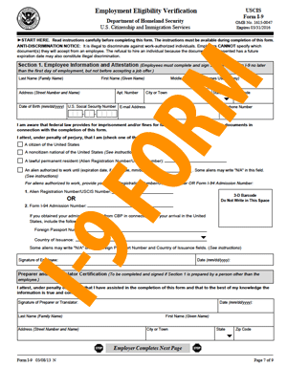
“Protecting The Business” 1-9 Risk Avoidance
Studies show that 76% of I-9’s are incorrect
Fines can range from $110 to $1,100 per mistake, per form

Slide 13

“Protecting The Business” 1-9 Risk Avoidance
Macy’s was assessed a $275,000.00 monetary penalty in June 2013, for discrimination in the I-9 completion process.

Slide 14

“Protecting The Business” 1-9 Risk Avoidance
McDonald’s, the Wichita-based franchise, was assessed a $400,000 monetary fine in December 2012 for knowingly accepting false documents.

Slide 15

“Protecting The Business” 1-9 Risk Avoidance
ABC Professional Tree Services, Inc., was assessed a $2 million penalty in July 2012, for amongst other violations, failure to comply with employment-eligibility verification requirements.

Slide 16

“Protecting The Business” 1-9 Risk Avoidance
American Apparel lost more than $86 million in 2010, as a result of a 2009 ICE I-9 Inspection which resulted in the loss of 2,500 employees.

Slide 17

“Protecting The Business” 1-9 Risk Avoidance
Infosys Limited was assessed $34 million for a variety of immigration-related violations, including a $5 million penalty for systematic failure to maintain Forms I-9. Specifically, an audit of the company’s Form I-9 records revealed that more than 80% of the forms for 2010 and 2011 contained substantive violations. In addition to the fines, the company was required to submit to additional audits by an independent third party auditor for a minimum of 2 years

Slide 18
“Protecting The Business” - Our Process
1 Day assessment of current Human Resource practices.
  Develop a risk profile
  Develop a roadmap to compliance plan
  Execute the plan with existing personnel
  Regular internal audit of processes and practices as required based on number of employees and business complexity

Slide 19

Improving The Roadmap
A strong strategic roadmap is a vital component to business growth. It provides a playbook to help your business play offense in your market.
“Work ON the Business, not IN the Business”

Slide 20

Improving the RoadMap – “Our Process”
Create SWOT analysis for your business
Create 5 year plan
Develop Succession/Contingency Plans
Identify Key Growth Areas
Develop Plan to Execute
Craft Internal Communication
Audit Roadmap at regular frequency with Key Managers

Slide 21
Employee Engagement – What is it?
Employee Engagement does NOT MEAN employee happiness – an employee may be happy at work, does not mean they are working hard or productive.
Employee Engagement does NOT MEAN employee satisfaction – the employee may be satisfied and show up from 8 -5 each day, but not interested in extra effort.
Definition: Employee engagement is improving the emotional commitment the employee has to the organization and its goals

Slide 22

Employee Engagement – The Truth
12% are highly Engaged Daily
79% are Somewhat Engaged
9% Disengaged

Slide 23
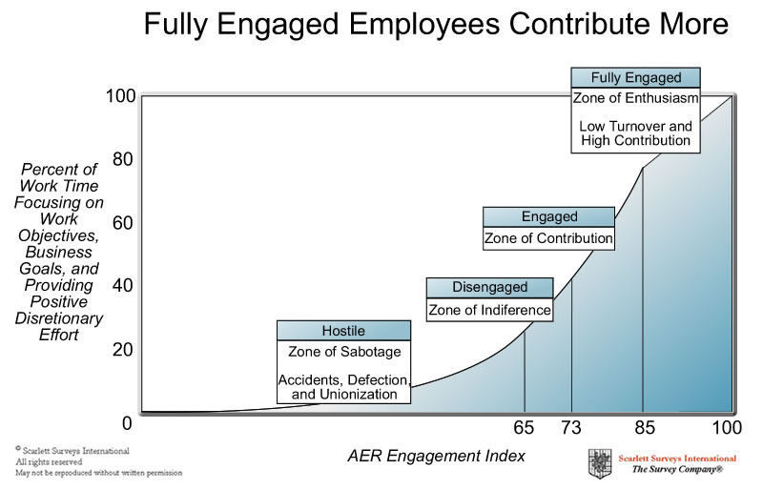
Employee Engagement – By the Numbers
Increased Profitability by 22%
Increased Productivity by 21%
Decreased turnover by 65%
Decreased Absenteeism by 37%
Decreased work injuries by 41%

Slide 24

Employee Engagement – Our Process
Conduct baseline Employee Engagement Survey
Utilize Post Survey Results for employee interviews and goal-setting
Provide Manager feedback about each session
Coach Employees and Managers on how best to achieve workplace goals
Regularly audit success of program for the individual, the manager, and the company

Slide 25
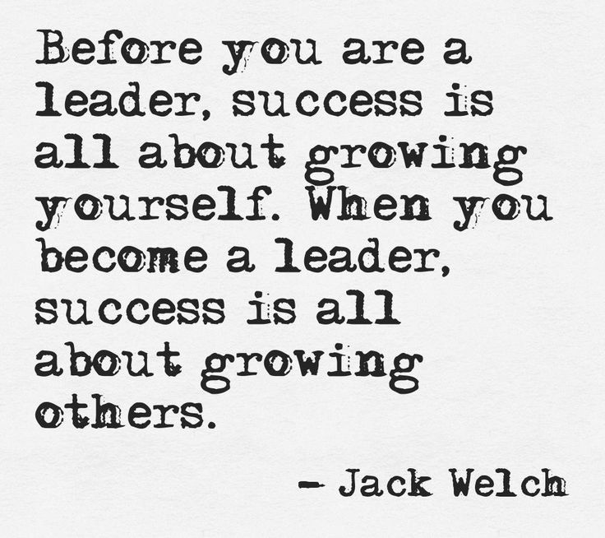
Creating Leaders

Slide 26
Creating Leaders and Coaches
In most all organizations we promote employees into supervisor/manager positions for a job well done in their current role, but fail to train for the role of directing others.
How supervisors lead, coach & direct determines whether employees flounder or flourish in their work.
50% of all employees say they leave their job due to their relationship with their direct supervisor.

Slide 27

Creating Leaders – Our Process
We set up a 3-way visit between ourselves, the employee and supervisor. We create a setting for supervisors to learn on the job how to best communicate, coach and motivate their employees
We train the manager on improvement of communication skills and listening skills.
We train managers to build employees up, improve employee strengths and action steps to correct poor behaviors.
We teach the value of consistent coaching for growth, recognition and trust between employee and supervisor.

Slide 28
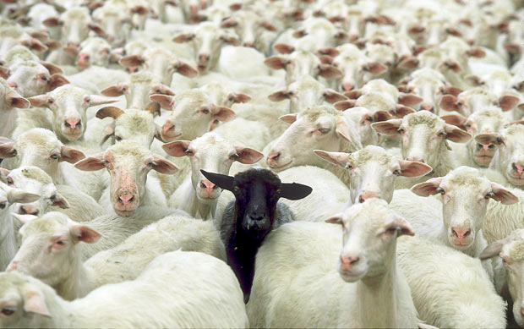
Recruiting The Right Team

Slide 29
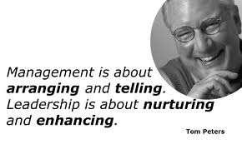
Recruiting That Works– Our Process
Leverage Organizational knowledge to create proper candidate criteria
Interview Prospects
Follow Up on References
On-Boarding consists of goal-setting to stay consistent workforce progress
Help assimilate new employee with the team

Slide 30
Results
Protect the Business
Improve the Roadmap
Engage Employees
Train Leaders and Coaches
Recruit the Future

Slide 31
Next Steps

Slide 32
Now What?
We take one step at a time
Get an audit on the schedule for compliance risk
Deploy Employee Survey
Bandura + will build a proposal based on company size and results of the Assessments
Initial Audit fee’s are waived if engagement is executed

