Slide 1


Selong Selo
Steps to Ownership
South Coast | Lombok | Indonesia
8° 52´ 24” S 116 ° 9 ´ 44” E

Slide 2

Overview of Process
Buying process consists of two stages, with stage one deposit being fully refundable in the event that there is any legal issue with the certificates
Stage One (~3 weeks)
Stage two (~3 weeks)
1
2
Deposit Refund
Buyer Uses own Local Partner and SSG
Transfer of title at BPN
Not Covered in the following materials
No
I
II
III
No
Buyer Selects a Lot
Buyer Engages Lawyers for DD
DD result OK?
Buyer Continues Payment Process as per Reservation Agreement
Use SSG Local Partner?
Yes
Yes
Buyer uses own lawyers to structure partnership agreements with SSG Local Partner
Partnership agreements signed (no transfer of title at BPN)
Select a plot and sign reservation agreement
Extensive DD pack can be provided by SSG and its lawyers
Signing of Vacant Land Sales and Purchase Agreement & Management Service Agreement
F&K as SGG’s suggested Law Firm
[4] docs to be signed with indo partner, depending on structure
Selong Selo Group to provide all documentation requested from Buyers
SSG will guide buyers through the process ensuring they are fully informed of what is going on
Buyer can deal with our preferred independent legal firm in Jakarta (F&K Law Firm) to ensure that partnership agreements with our local partner are vetted and executed properly
SSG can provide the buyers with sample partnership agreements, PoA, lease agreements and mortgage agreements
This process is the responsibility of the buyer and the buyers’ lawyers
SSG is available to help where needed

Slide 3
Overview of Key Parties to The Transaction
Multiples Parties are involved in the transaction and certain transaction documents are to be executed in front of a public notary in Indonesia, requiring the engagement of a local lawyer (who can execute on your behalf)
Selong Selo Group & Affiliates
SSG’s Local Partner
Selong Selo Group (“SSG”)
Description: Indonesian who is partner of SSG and multiple plot buyers; Reputable with strong connections with Australian Resort Operator in Bali;
Roles: SSG’s local Partner who “owns” the land and will continue owning the Roads which provide access to each property
Documents: Road Use Right Agreement
Description: The current owners of the right to the land and owners of PT Selong Bersama
Roles: “Owners” of the common facilities, staff quarters and roads
Documents: Vacant Land Sales and Purchase Agreement
Buyer
PT. Selong Bersama
Land Deed Official / Public Notary
Buyer’s Local Partner
Description: on-shore entity which employs all local staff and provides management services to plot owners
Roles: In charge of the maintenance, security, etc. of the land
Documents: Management & Infrastructure Service Agreement
Description: under Indonesian law, any actions related to land must be processed by a Land Deed Official (Pejabat Pembuat Akta Tanah or “PPAT”). Most notaries are PPAT officials and, in rural areas, PPAT officials are often local government officials
Roles: Approves any land transfer / transaction
Documents: Virtually all documents involving local partners will need to be executed in front of a public notary
Description: Trusted Indonesian Partner identified by the buyer
Roles: Unless Buyer whishes to own the right to the land through a lease, Plot buyer will need to identify a local Partner (Option to use same Partner as SSG) with whom to enter into a set of agreements
Documents: Multiple documents, including but not limited to Deed of Sale and Purchase (Akta Jual Beli or “AJB”), ]

Slide 4

Stage One

Slide 5
Stage One – Process Steps
Stage one is envisaged to take ~3 weeks and deposit is fully refundable during that period
 | Description | Time Frame
1. | Client selects the lot that it wishes to buy | Day 1
2. | Client signs reservation contract and transfers US$ 15,000 deposit to Singapore Bank account | Day 1 - 2
3. | Client has 21 days to conduct land due diligence | Day 2- 21
4. | Client pays first instalment of 50% of Purchase Price (US$ 15,000 deposit is deducted from the first instalment) of Purchase Price upon signing of the Vacant Land Sales and Purchase Agreement to Singapore Bank account Concurrently execute Management and Infrastructure Service Agreement | Day 21
5. | Upon Issuance of final land certificates: Client pays second payment being 35% of purchase price Execute Deed of Sale and Purchase (Akta Jual Beli or “AJB”) of the Land before a PPAT; And / or (ii) the Deed of Leasehold Agreement of the Land before a PPAT; Client can appoint a POA with notary to do this on their behalf if they wish If buyer uses SSG’s local Partner, this step happens concurrently with step 4 | Day 21
6. | Client also pays to the Singapore account the following management fees (which would be sent along with payment 5): Annual Community Management Fee: US$ 2,000 (until infrastructure complete) Individual Management Fee: US$ 600 (optional) One off Sinking Fund Fee: US$ 1,000 | Day 21
7. | If client is using SSG’s local partner, then client pays US$ 1,000 USD to the local partner (which would be sent along with payment 5) | Day 21
8. | Client pays final payment of 15% when final infrastructure is provided if it hasn’t already been completed | TBA
SSG will be fully cooperative and transparent and provide all necessary documentation
Note the Above excludes any transaction taxes and fees as well as legal expenses

Slide 6
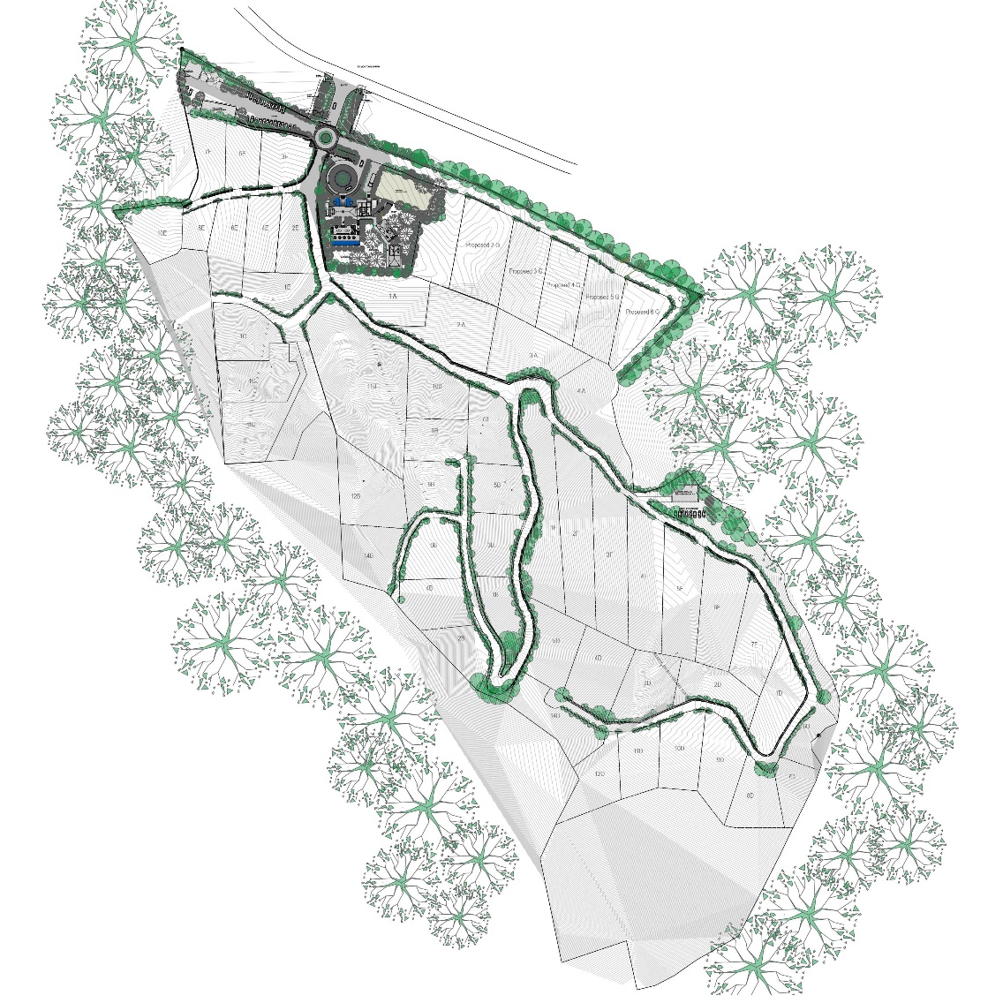


Stage One – Overview of Lots
Each plot has uninterrupted, spectacular views of Selong Belanak Bay and has a high-level of privacy due to the gradient and envelopes of the land

Slide 7
Stage One – Overview of DD Pack & Process
SSG’s Counsel has a complete set of documents readily available to smoothen Due Diligence process
Exploration Stage
Due Diligence
Legal Completion
1
Buyer to identify a preferred Plot
Buyer goes see the plots
Buyer conducts DD on the selected plot and the buyers and reviews legal docs with seller
Buyer uses own lawyers to finalize DD, select preferred structure and execute legal docs with elected local partner
SSG to provide a price list with description of available plots
SGG’s team on the ground will help organize the logistics and provide full on site support
SGG to provide comprehensive DD pack
SGG will be available for questions and face to face meetings
Seller to review standard legal docs & may engage local Indonesian Lawyer to help
During Stage One, Buyer has the option to change plot subject to availability
SSG can provide templates docs
Law Firm to finalize DD on nominee and check the land title certificate
Law Firm to draft relevant agreements to be executed and to coordinate with public notary
Certain other docs to be executed with SSG’ nominee (road use right for e.g.)
Buyer selects a plot, signs reservation form & pays deposit
Buyer executes SPA and Service Agreement
Buyer executes Partnership Agreements
 | Key Documents | Other Documents
Standard Land title document, including any legal contracts pertaining to the land | Land ownership certificate, among other, Freehold Certificate (Sertifikat hak Milik/SHM) or Right to Build Certificate (Sertifikat Hak Guna Bangunan/SHGB), issued by the local Land Office, where applicable | Deed of security rights, mortgage certificate, road access agreement, partnership agreement between foreign acquirer and the registered owner of the land
Physical data of the land | Map drawing, indicating land location, dimension, boundaries, access to public road, land zone. | Licences such as location permit, UKL-UPL/AMDAL, Building Permit (IMB) – Buyer’s responsibility – SSG may facilitate and assist.
1
2
SSG will cooperate with buyer during the DD process. SSG is committed to ensure all purchasers are subject to similar terms and conditions to ensure consistency across the whole project.

Slide 8
Stage One – Overview of the Agreements
SSG currently works with international law firm Limcharoen based in Bali. Limcharoen is well versed in the process of land transactions within Indonesia and Asia
Document | Description | Parties
Reservation Agreement | Preliminary agreement between the Seller / SSG and the Buyer that sets forth and identifies the desired plot, size, and purchase price, and escrow facilities, if any | Seller, or Seller’s proxy based on a Power of Attorney “PoA”, i.e. SSG or its affiliates Buyer JUB Investments - Acknowledger
Vacant Land Sale and Purchase Agreement | A binding sale and purchase agreement between the Seller and/or his proxy, and the Buyer which sets forth the terms and conditions of the property transaction, among other, the payment terms and method of payment | Seller, or Seller’s proxy based on a Power of Attorney “PoA”, i.e. SSG or its affiliates Buyer JUB Investments - Acknowledger
Management Service Agreement | Agreement between the Buyer and SSG regarding appointment of SSG or its affiliate as the manager of the project, land and infrastructure in and around the property | Seller, or Seller’s proxy based on a Power of Attorney “PoA”, i.e. SSG or its affiliates PT Selong Bersama Manager Buyer
Deed of Sale and Purchase of Land | To be signed before a Land Conveyance Officer (PPAT/public notary) by the Seller and Indonesian partner, in case the land is acquired under freehold title | Seller, or Seller’s proxy based on a Power of Attorney “PoA”, i.e. SSG or its affiliates Buyer proxy based on a Power of Attorney “PoA”
Road Access Agreement, Security Agreements | An agreement that grants the right to use a road access which is located on certain parts of land, granted by the landowner to the Buyer | Seller, or Seller’s proxy based on a Power of Attorney “PoA”, i.e. SSG or its affiliates Buyer proxy based on a Power of Attorney “PoA”
Law Firm | Partners & Senior Associates | Firm Overview & Experience | Contact
Limcharoen | Ingo Mueller Gerry Purba Gangga W. Mantik | Limcharoen is a leading legal service provider which dispenses high quality business advice throughout Asia and to clients across the globe Specific expertize in Land and property transactions | Bali@Limcharoen.com Jakarta@Limcharoen.com
SSG has worked hard over the past year with its lawyers in order to ensure a hassle free acquisition process and ensure that legal docs are balanced and fair

Slide 9
Stage One – Illustrative Payment Schedule
The below assumes a Purchase Price of US$ 100,000, and assumes that buyer will use SSG’s Partner, avoiding significant transaction taxes in the process
Item | Description | Day | Amount (US$ ) | Cumulative Amount (US$ k) | Cumulative %
Deposit | Upon signing of reservation form | 1 | 15,000 | 15,000 | 14.5%
1st payment | 50% of PP upon signing of SPA | 21 | 35,000 | 50,000 | 48.9%
2nd payment | 35% of PP | 21 | 35,000 | 85,000 | 83.1%
Management fees | Annual community fee Individual management Fee One off sinking Fund | 21 | 3,600 | 88,600 | 84.8%
Partner Fees | Fee to SSG Local Partner | 21 | 1,000 | 89,600 | 85.3%
Completion | 15% of PP | TBD | 15,000 | 103,600 | 100.0%
Total |  | TBD | 103,600 | 103,600 | 100.0%
Transaction Fees / Associated Costs
Notary Fee | 1% of transaction value
Sales Transaction Tax | No taxes if buyer uses same Partner as SSG as no legal ownership change 10% of total government value of land (5% paid by the buyer and 5% by the seller)
Land Tax Transfer | Less than $500 USD
Partnership Fee | Dependent on selected local partner $1,000USD If using SSG’s Partner and then 1% of market value on exit
Mortgage Registration Fee | 0.3% of land Market Value
Other | Legal Consultation Fees, dependent upon buyer and legal consultants

Slide 10
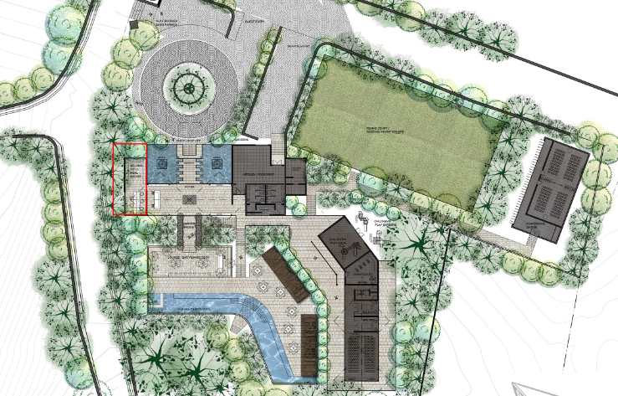
Stage Two

Slide 11
Stage Two – Process Steps
Stage two requires engagement of independent local counsel and choice of a local partner
Step | Description | Time Frame
1. | Client discusses ownership structures with lawyers so they understand what options are available to them | Day 1
2. | If the client wishes to use the Indonesian Local Partner structure they can either use SSG’s local partner which will result in a faster process as there is no transfer of title at the titles office. | Day 1 - 2
3. | Recommended Local Partnership documents to execute: Lease Agreement Partnership Agreement Loan Agreement PoA | Day 2- 14
4. | Official Mortgage Lodged – Lawyers to contact local notary to have mortgage transferred from SSG to new owners | Day 21
Local Counsel will help draft partnership agreements and engage with public notary

Slide 12
PMA Company
Step | Description | Time Frame
1. | Client discusses ownership structures with lawyers so they understand what options are available to them | Day 1
2. | If the client wishes to use a PMA Company structure, the legal counsel shall prepare all necessary requirements and process the establishment of the PMA, i.e.: Submit application of Capital Investment Principle License (Ijin Prinsip PMA) to the Capital Investment Coordinating Board (BKPM) in Jakarta; Upon issuance of the Principle License, the founding shareholders of the PMA (minimum 2 (two) shareholders) or their proxy shall sign the Deed of Establishment of the PMA before a public notary in Indonesia; To obtain the Minister of Law and Human Rights Approval of the PMA’s Deed of Establishment; To obtain general licenses, such as Taxpayer Number and Company Registration (TDP). | Day 1 – 14 Day 15 – 20 Day 20 - 27 Day 27 - 41
4. | To process the conversion and registration of the land transfer from Freehold to HGB into the name of the PMA. | Day 42

Slide 13
Stage Two – Overview of Potential Structures
Due to Indonesian law a foreigner/non-citizen is unable to own a freehold title of land in Indonesia, but can obtain certain control of the land and have certain entitlements relating to real estate
 | “Ownership” of Land
 | Partnership Agreement with an Indonesian Citizen | PMA (Penanaman Modal Asing)
Description | A foreigner may obtain or acquire control over certain property entitlements by entering into a set of agreements with an Indonesian citizen (local partner) Only Indonesian citizens are able to hold freehold title (Hak Milik Sertifikat or Right of Ownership Certificate) Some of the documents pertaining to the acquisition of the land related entitlements shall be drawn up by and signed before a public notary /Land Deed Conveyance Officer (PPAT) by both parties, and some of the documents are privately drawn up | A PMA is a foreign investment company which, for certain business line, can be 100% foreign owned and controlled. A PMA company can be founded by a resident or non resident of Indonesia.
Documents | Deed of Sale and Purchase Agreement (Akta Jual Beli or AJB) Deed of Granting of Security Rights (APHT) Deed of Power of Attorney (POA) Deed of Acknowledgement of Indebtedness Binding Sale and Purchase Agreement Loan Agreement given by the local partner and secured by the property Partnership Agreement | Upon establishment, the PMA can then can lease land under the Right to Build land title (Hak Guna Bangunan or HGB) under the name of the PMA.
Considerations | Strongest title that may be obtained within Indonesian land rights This agreement is structured so that the Indonesian party cannot sell/lease/build on the land without the consent of the foreign party This title must be transferred from the original landowner to the Indonesian partner’s name As foreigner technically cannot hold freehold title, technically any arrangement that allows a foreigner to have a direct ‘possession’ over land can be deemed as circumvention of the land. So this structure is challengeable, especially by the local partner. Therefore, choosing a trusted and reliable local partner is crucial, as well as to maintain a good relationship with such local partner] As additional security, possession of the original certificate (in the name of the buyer’s local partner local partner) is held by the foreigner as it and other documents must be first submitted to the BPN by the local partner local partner in order to sell or transfer ownership of the property | 100% foreign owned and controlled The HGB allows the foreign company to then build on/develop the property Technically, a PMA can own a vacant land under HGB, but such land shall be developed within certain period of time (depends on the location permit. Otherwise, the land will be deemed as abandoned land and the state may take over]. There are numerous requirements that must be met in the creation of this company, and also on going reporting obligations during the life of the PMA to the authorities, such as the Capital Investment Coordinating Board and Tax Office, including tax payment, if any. Therefore, the PMA shall have its book keeping properly maintained, either by an in-house or external accountant. The HGB title is granted for 30 years and is renewable up to 20-30 more years upon request (renewal is granted upon the basis that the land of interest must have been developed/constructed on by the foreign owner)

Slide 14
Stage Two – Overview of Potential Structures
 |  | Lease of land
 |  | Hak Sewa (Right to Rent or Lease) | Hak Pakai (Rights of Usage)
Description |  | This is the title under which foreigners can rent or lease land from an Indonesian land owner for up to 30 years with an option to extend for an additional 20 years | Hak Pakai differs slightly from Hak Sewa in the manner that it is based on government land or Hak Milik land Hak Pakai is not obtained from a lease agreement With the use of a Hak Pakai the rights of the land are released to the foreign party
Documents |  | A lease agreement must be created and signed by both parties before a notary (PPAT). A lease (Hak Sewa) is not formally registered with the Land Office but with the local public notary | Hak Pakai over State Land: the Indonesian Government grants Hak Pakai to a foreigner based on an application of such title Hak Pakai over Freehold land: Hak Pakai is granted by the Indonesian land owner to the foreigner based on Agreement of Granting of Hak Pakai. Such agreement shall be registered at the land office
Considerations |  | Foreigners can obtain leasehold right without the necessity to hold Indonesian stay permit Foreign entity can also obtain leasehold right, provided that the foreign entity has a representative office in Indonesia Leasehold right is not a registered land title Limited in time | Hak Pakai is the only registered land title for a foreigner, whereby the foreigner’s name will be on the Hak Pakai land certificate This title can be obtained for up to 25 years with an option of renewal for another 25 years
___________________________
Note:
Hak Milik: Rights to Property/Possession, equivalent to the concept of freehold ownership (only available to Indonesian citizens)
Hak Pakai : Rights of Usage (generally associated with Partnership Agreement)
Hak Sewa: Right to Lease or Rent (Leasehold Option of Indonesian Land)
HGB (Hak Guna Bangunan): Rights to Build (generally associated with the establishment of a PMA)
HGU (Hak Guna Usaha): Rights to Cultivate (sometimes associated with a PMA)

Slide 15

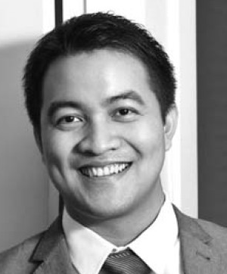

Stage Two – Overview of F&K Law Firm, SSG’s suggested Law Firm
F&K have strong experience in land property and real-estate and can provide legal support on the Due Diligence and drafting / execution of various legal documents
Law Firm | Firmansyah & Kurniagung Law Firm
Partners | ICHSAN PERWIRA KURNIAGUNG, SH., MH. WIDYANTORO, SH. / ALDI FIRMANSYAH, SH.
Firm Overview | Fast growing Indonesian law firm, F&K specializing in corporate legal matters and dispute resolution with a formal access to a wide range of professional solutions, legal services, database, and resources
Experience | Reviewing and advising multiple sets of transaction documents and agreements of Selong Selo Have already been working alongside multiple buyer of Selong Selo lots and have a structure and a set of documents ready to be tailored for a new buyer for a fee of around US$ [2,000] – US$ [5,000]
Address: | Kemang Point Building 1st Floor, Unit 1-04 A, Jl. Kemang Raya No. 3 Jakarta 12730, Indonesia
Contact Details | Website: www.fnklawfirm.com Email: kurniagung@fnklawfirm.com Phone / Fax: +62 21 7181966
ICHSAN PERWIRA KURNIAGUNG, SH., MH. | Mr. Kurniagung obtained the Bachelor of Law degree and Master Degree from the Faculty of Law, majoring in Business Law at the University of Indonesia. Previously, he worked as a lawyer in first tier law firms in Indonesia for more than 5 (five) years He has wide experiences in general corporate, foreign investment, capital market, banking and transnational syndicated loans, various acquisition and spin-off, mining, high-profile anti-trust proceedings, and mega-infrastructure deals in the scheme of Public-Private Partnership. In addition, Mr. Kurniagung also obtain certifications with regard to his expertise in the field of anti-trust/competition law and Islamic Finance Law Email: kurniagung@fnklawfirm.com
ALDI FIRMANSYAH, SH. | Mr. Firmansyah obtained the Bachelor of Law degree from the Faculty of Law, majoring in Civil Law at the Parahyangan University He also obtained a Receiver and Administrator (Kurator dan Pengurus) license that is acquired from the Association of Indonesian Receiver and Administrator (AKPI). He previously worked in one of reputable law firm specialised in high profile litigation cases for more than 5 (five) years He has a broad exposure in handling major litigation cases, including commercial dispute, bankruptcy cases, land and property, complex civil disputes, general corporate, corruption and criminal proceeding Email: firmansyah@fnklawfirm.com
Fees Agreed
Stage 1 : Due Diligence $2500
Stage 2: Partnership Agreements $2500
Selong Selo Recommends independent F&K Lawyers in Jakarta (http://fnklawfirm.com/)

Slide 16
Stage Two – Overview of F&K’s Structure
Ownership will be secured through a mortgage agreement and retaining the land title certificate
Typical Scope of Work
Conducting required legal due diligence upon the land and transaction documents;
Providing legal advise in relation to the sales and purchase of land, including but not limited to legal aspect of Ownership Rights/Hak Milik arrangement, associated fees with regard to the transactions, and any regulatory restrictions or limitations with regard to the development/construction of a villa above the land;
Reviewing, finalizing the nominee arrangement documents entered by and between the Client and the Client’s nominee in coordination with the appointed Public Notary; and
Providing legal advise in relation to the nominee arrangement structure entered by and between the Client and the Client’s nominee
 | Signing Parties | Responsible Parties | Function | Remark
Deed of Loan Agreement | Buyer as lender | Public Notary and F&K | Under this deed, it is stipulated that the buyer lends some monies with the same value as the value of the Land(s) to the Local Partner This Agreement will be the basis of the nominee arrangement between the Buyer and the Local Partner, and also stands as the basis for the encumbrance of Hak Tanggungan upon the Land | F&K will assist the buyer by coordinating with the Public Notary in drafting and finalizing the minutes of Deed of Loan Agreement Since this Deed must be made in Bahasa Indonesia, F&K will provide the Buyer with the unofficial English translation of the minutes of the Deed before the signing
 | Local Partner as Borrower
Deed of Hak Tanggungan | Buyer as the Grantee (holder) of Hak Tanggungan | Public Notary and F&K | This deed of Hak Tanggungan as the security has the function to encumber Hak Tanggungan over the Land Under this Deed, the Local Partner will grant the Land as the security of loan Hak Tanggungan will secure the legal rights of the Grantee (holder) of Hak Tanggungan, so that the Grantor of Hak Tanggungan is restricted to transfer the land title to any parties without prior approval from the holder of Hak Tanggungan | F&K will assist the Grantee by coordinating with the Public Notary in drafting, finalizing, and registering the Deed of Hak Tanggungan (Akta Pemberian Hak Tanggungan) Ultimately the Land Office will state the name of the holder of Hak Tanggungan at the certificate of land and issue the certificate of Hak Tanggungan to the Grantee. It is advisable that the Buyer keeps the certificate of the Land in his possession
 | Local Partner as the Grantor of Hak Tanggungan
1
2

Slide 17
Stage Two – Overview of F&K’s Structure (Cont’d)
Ownership will be secured through a mortgage agreement and retaining the land title certificate
 | Signing Parties | Responsible Parties | Function | Remark
Land Lease Agreement | Buyer as the Lessee | F&K | In this Agreement, the Local Partner will be given lease to the Buyer for the Land With this agreement the Buyer will have full rights to utilize the Land | Should Pak Subina act as nominee of the Buyer and there will be no Deed of Sale and Purchase of Land in notarial deed, he will remain the legal owner the Land F&K will coordinate with Limcharoen to review (on behalf of the Buyer) and finalise this Agreement
 | Local Partner as the Lessor
Right of Use of Road Agreement | Buyer as the “owner” of the Properties | F&K | In this agreement SSG’s Local Partner agrees to grant to the Buyer, the unrestricted and unconditional right to use the Road Access for pedestrial and vehicular access to the Properties | F&K will coordinate with Limcharoen to review (on behalf of the Buyer) and finalise this agreement
 | SSG’s local Partner as the legal owner of the entire land (Selong Selo)
Power of Attorney to Execute Land | Local Partner as the Authorizer | Public Notary and F&K | The Local Partner grants full right and power to the Buyer, specifically to draw up and execute Sale and Purchase Deed of the Land At any time the Buyer can sell the Land to any Indonesian individual (but not to himself) – basically allowing the buyer to change Local Partner in the future | In practice, this Power of Attorney to Execute Land must be made in notarial deed or at least legalized by a Public Notary. Otherwise, it is not enforceable. F&K will act on behalf of the Buyer to finalise and coordinate the process.
3
4
5

