Slide 1
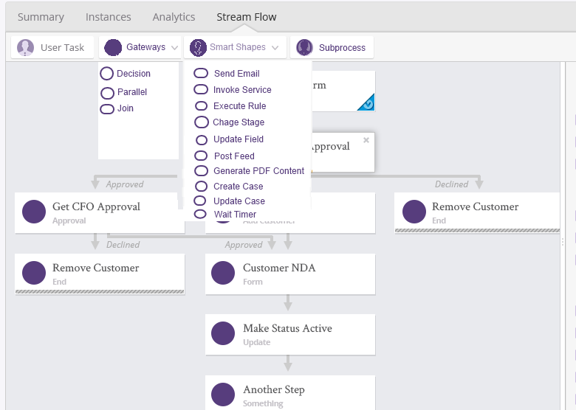
Screen 3
Need icons for
Gateways (Diamond Shape)
Smarts Shapes
Subprocesses
Need icons for each of the subitems

Slide 2

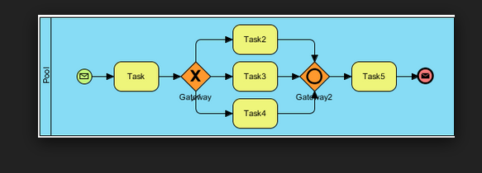
Need blocks for (See next screen)
Decision Gateway
Parallel Gateway
Join Gateway

Slide 3



I visualize a decision gateway to be like this as it will have a decision to make
to decide in which direction to send the workflow. The decision will be made using decision table
Route based on expense amount

Slide 4
I visualize a parallel gateway to be like this

Slide 5
I visualize a join gateway to be like this

