Slide 1
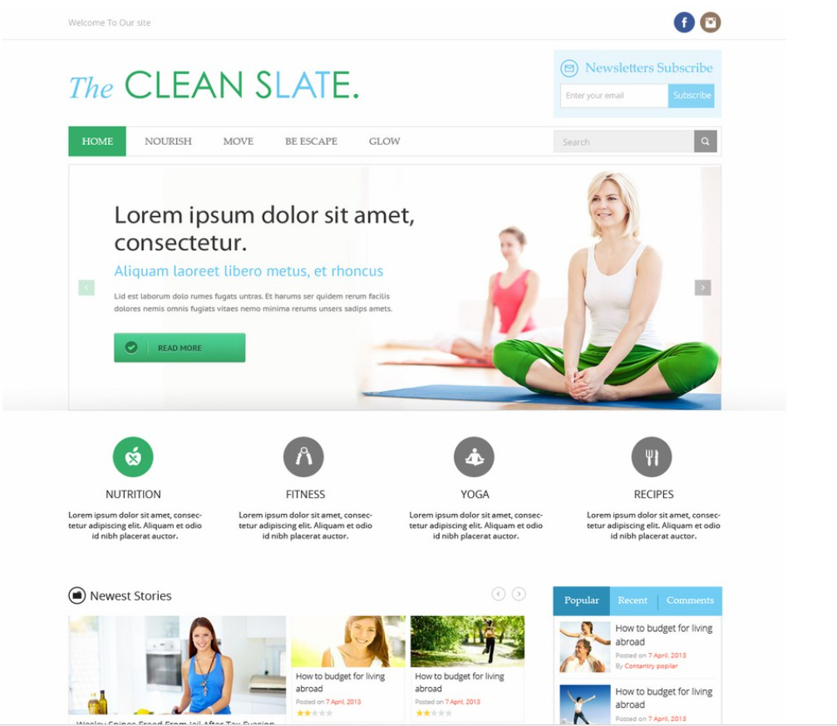
Change wording ‘newsletter
Subscribe’ to ‘Subscribe and
start Your Clean Slate Fix today’
Move branding
And icons up
To reduce empty
Real estate;
Consider
Centering the
logo
Reduce main image
To ¾ of page or less
ADD advertisement space
Right hand vertical
Tabs should be
Home
Nourish
Move
Be
Glow
Escape
Four round
Icons to be:
Clean Slate
Editor’s Favourites
Things we love, we think you will too
Clean Slate Heroes
Healthy Warriors making an impact locally and Globally
Clean Home
Our favourite new recipes, tips,
And stuff for the family to bring the healthy lifestyle home
Clean Slate Community
Our recommendations on what’s happening in Singapore

Slide 2
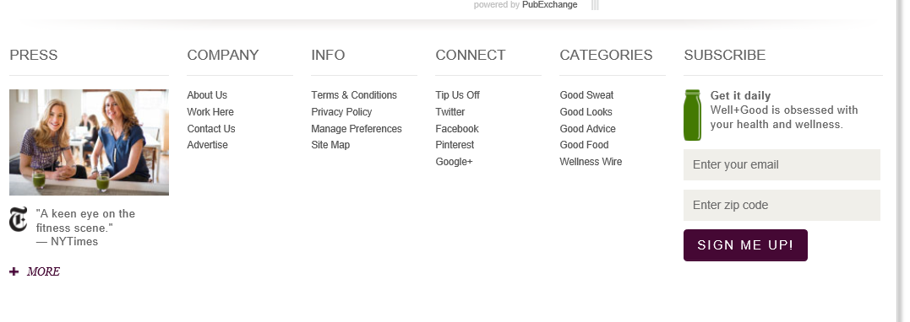
Bottom links
6 links
  About
  Our Experts
  Legal
  Connect
  Press
  Subscribe (with newsletter subscription opaque like above)

Slide 3
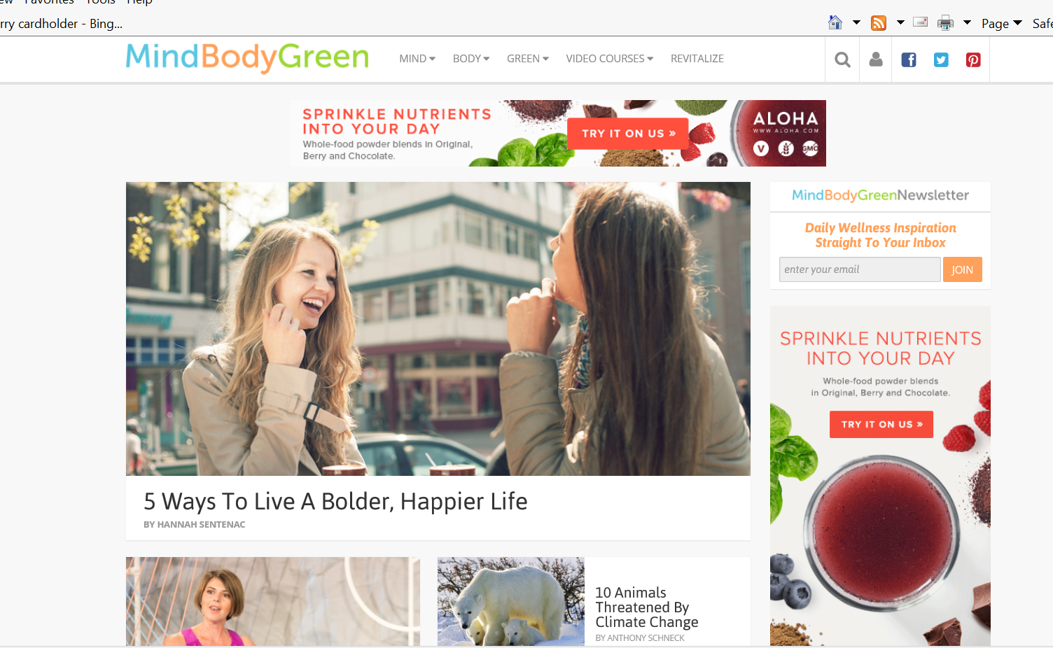
Inspiration

Slide 4
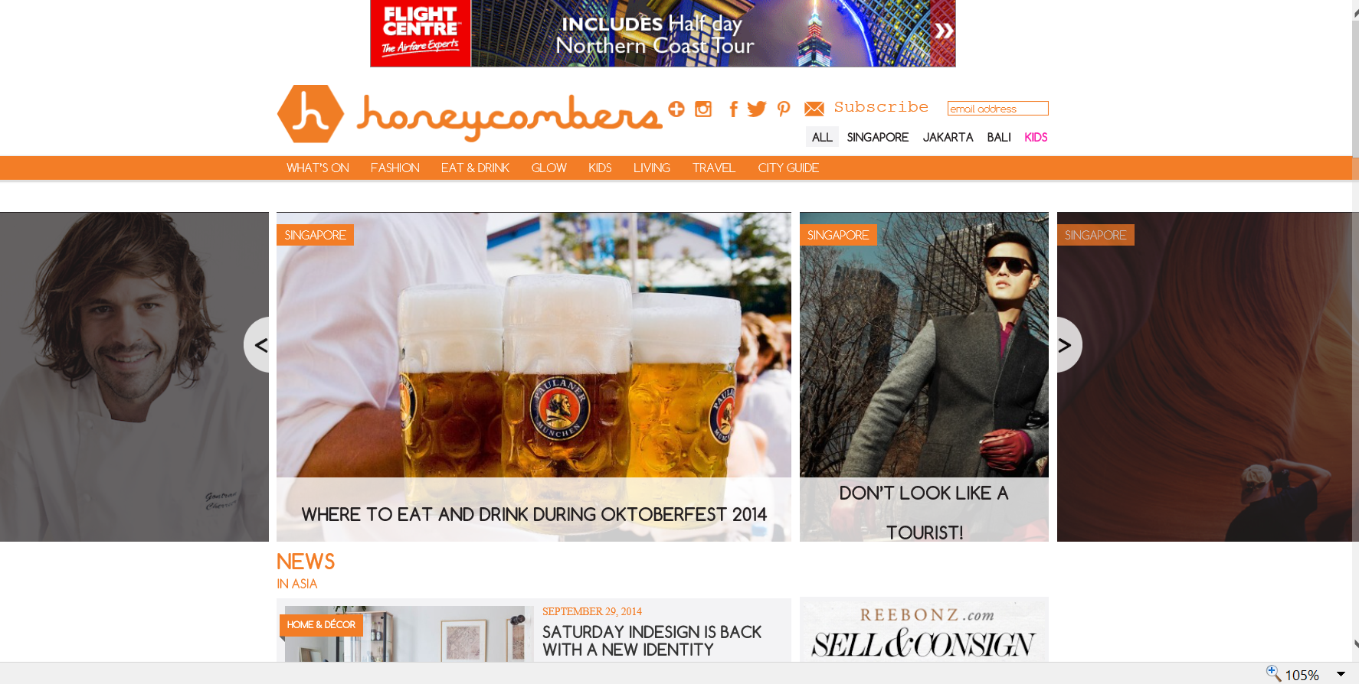
inspiration

