Slide 1


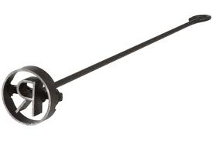
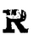
“Brand” Imagery
Corporate brand/logo
Incorporate “respiratory technologies”

Slide 2
