Slide 2

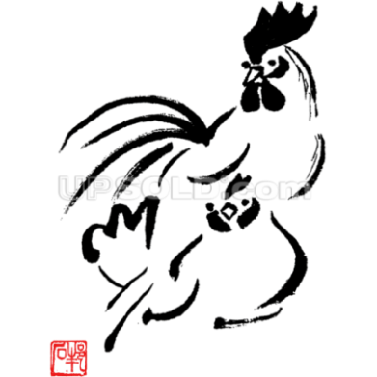
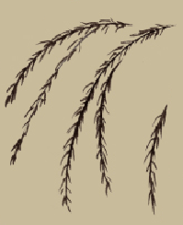

“Hundreds of eggs are laid by a single hen, and the life of the hen is not shortened.
Happiness never decreases by being shared.”
12 pasture-fed free range eggs

