Slide 1
J.R. Revelry Brand Positioning Building Blocks
J.R. Revelry Brand Positioning Building Blocks
Business Definition | Non-Flavored Flavored and Flavored Whiskey
Growth Target | Primary: Wise Whiskey adventurers where Whiskey makes up more than 30% of their distilled spirits consumption. Secondary: The Whiskey cooperator. She is loyal to a flavor profile vs brand.
What do we want them to THINK? | Primary: J.R. Revelry takes its credible whiskey TN roots to make a wide variety of unexpected but approachable Whiskeys flavors. Secondary: J.R. Revelry’s smooth unique flavor is not tiring and just enough alcohol where I don’t lose my control.
What do we want them to FEEL? | Primary: J.R. Revelry takes me on a Whiskey sensorial adventure without losing my manhood. I can venture to other flavors without losing my whiskey credibility. Secondary: J.R. Revelry helps me play with the big boys. I don’t want to drink like a lady but do love looking like one, especially in control.
Reasons to Believe | Origin: Made in TN, USA Taste: Smooth flavor profile, all natural unique flavors, highly sensorial Process: Handcrafted in small batches

Slide 2
J.R. Revelry Positioning Statement
  For Whiskey enthusiasts who are looking to expand their whiskey repertoire, J.R. Revelry is the only whiskey that sends you on a sensorial adventure because of it’s simple, unique blend of expected and unexpected flavors born in TN.

Slide 3
Brand Pyramid
Empowers celebration of exploration.
Brand Essence
What the Brand should stand for in the minds of consumers; Fundamental Principle.
He’s the consummate hardworker. Always trying news things that he can share with friends. For him there’s no such thing as an easy win and all wins must be reveled.
Brand Personality
If the Brand came to life:
- Describe the type of person.
Describe personality traits
I feel like I’m expanding my Whiskey repertoire and becoming an even wiser Whiskey enthusiast.
Emotional Benefits
Highest order benefits Brand delivers. Key motivation that drives consumers to this brand versus competition.
Highly sensorial whiskey experience full of intense flavor.
Product Benefits
What this product does; result of using it.
Made in TN.
Flavored whiskey that marries the expected with the unexpected.
Attributes
Distinctive physical attributes or characteristics of a product integral to the brand; Gives reason to believe product benefit.
Notes:
3

Slide 4
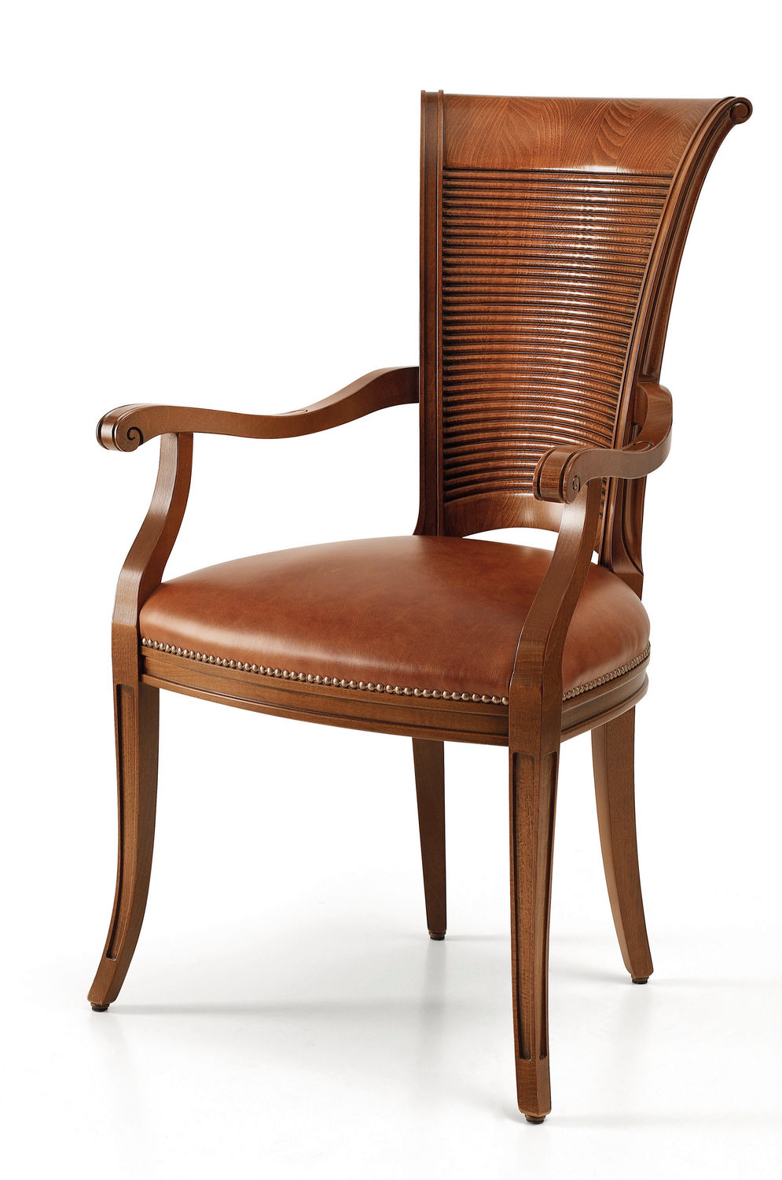
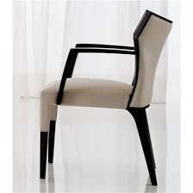
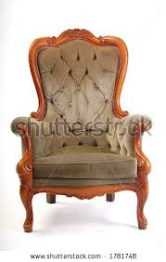
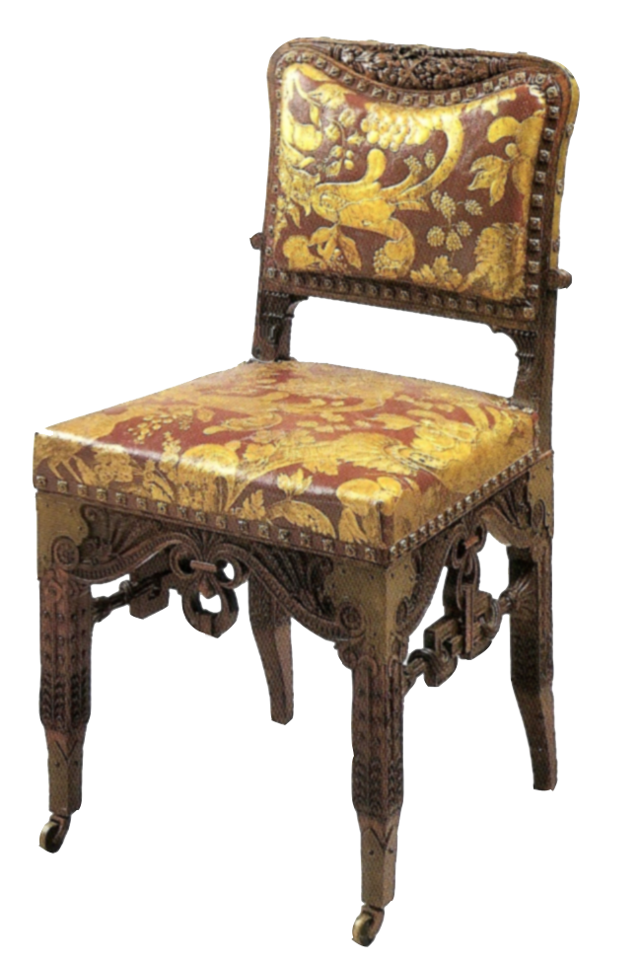
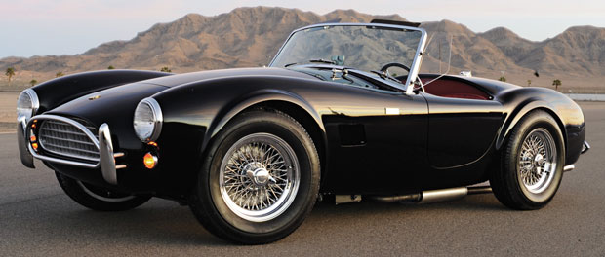
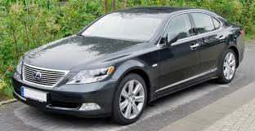
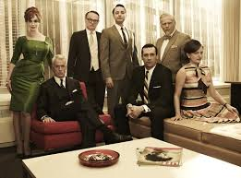

Mood Board
 | J.R. Revelry is… | J.R. Revelry is not…
…as a chair
… as a car
… as an office
Notes:
Chair
Car
Person/celebrity/bar tender
Whiskey bar
Emotion
Font
Family crest
party

Slide 5
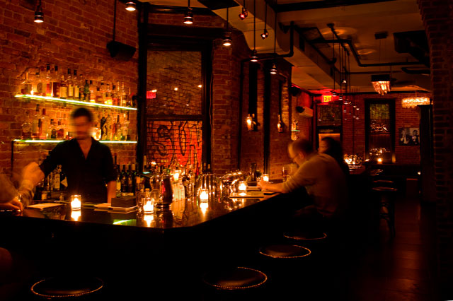
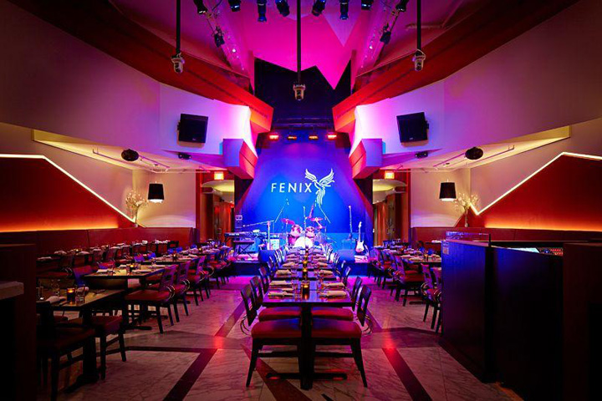
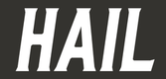
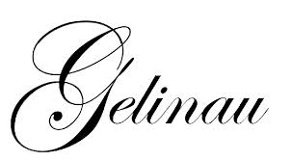
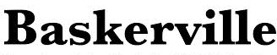
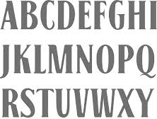
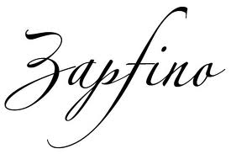
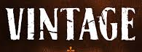
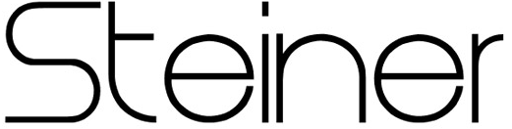
Mood Board
 | J.R. Revelry is… | J.R. Revelry is not…
…as a bar
… as a font
Notes:
Chair
Car
Person/celebrity/bar tender
Whiskey bar
Emotion
Font
Family crest
party

Slide 6
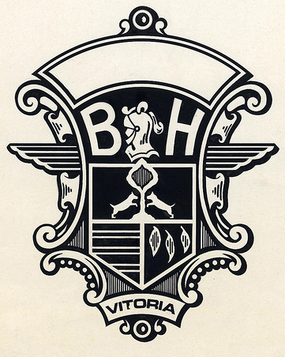
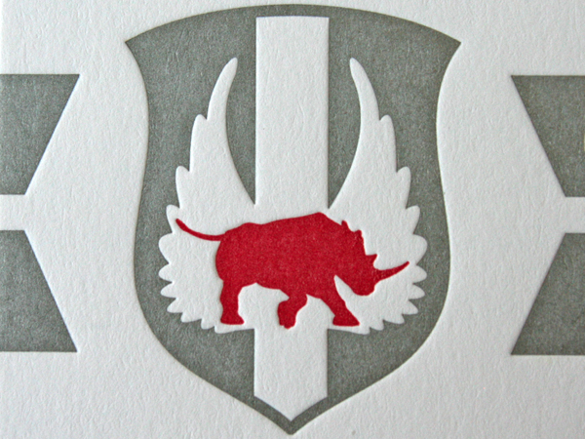
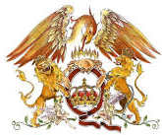
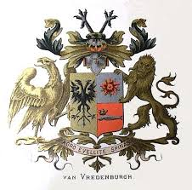
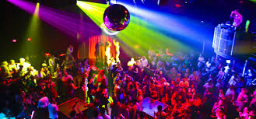
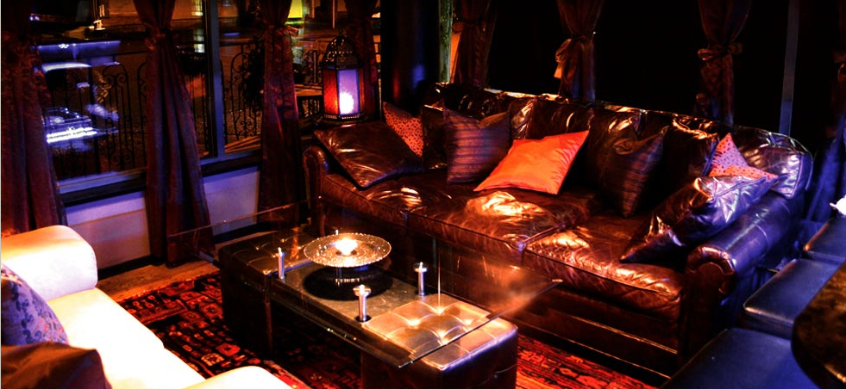
Mood Board
 | J.R. Revelry is… | J.R. Revelry is not…
…as a family crest
…as a party
Notes:
Chair
Car
Person/celebrity/bar tender
Whiskey bar
Emotion
Font
Family crest
party

