Slide 1
J.R. Revelry’s consumer is the Wise Whiskey adventurer and the The Whiskey Cooperator.
Who is J.R. Revelry’s Consumer?
Consumer Strategic Target Definition | Whiskey enthusiasts who consume Whiskey both straight and mixed. Strictly orders Whiskey by brand vs liquid. Whiskey makes up at last 25% of their total consumption.
Primary Growth Target | Wise Whiskey adventurers where Whiskey makes up more than 30% of their distilled spirits consumption. They consider themselves knowledgeable in different whiskeys and are driven towards expanding the information repertoire. Relish ordering non-traditional brands when off-premise.
Secondary Growth Target | The Whiskey cooperator. She is loyal to a flavor profile vs brand. Willing to try new spirits adventures after the suggestions of those she trusts. She trusts but verifies.
Primary Demo locators | Gender: Male Income: Affluent 75K+ County: AB counties | Status: Married Education level: College Educated Age: 30-45
Primary Purchase Behavior | Whiskey makes up more than 30% of their distilled spirits consumption Overindex on craft spirits
Notes:
Whiskey currently makes up 23% of ttl. Consumer target > average.

Slide 2
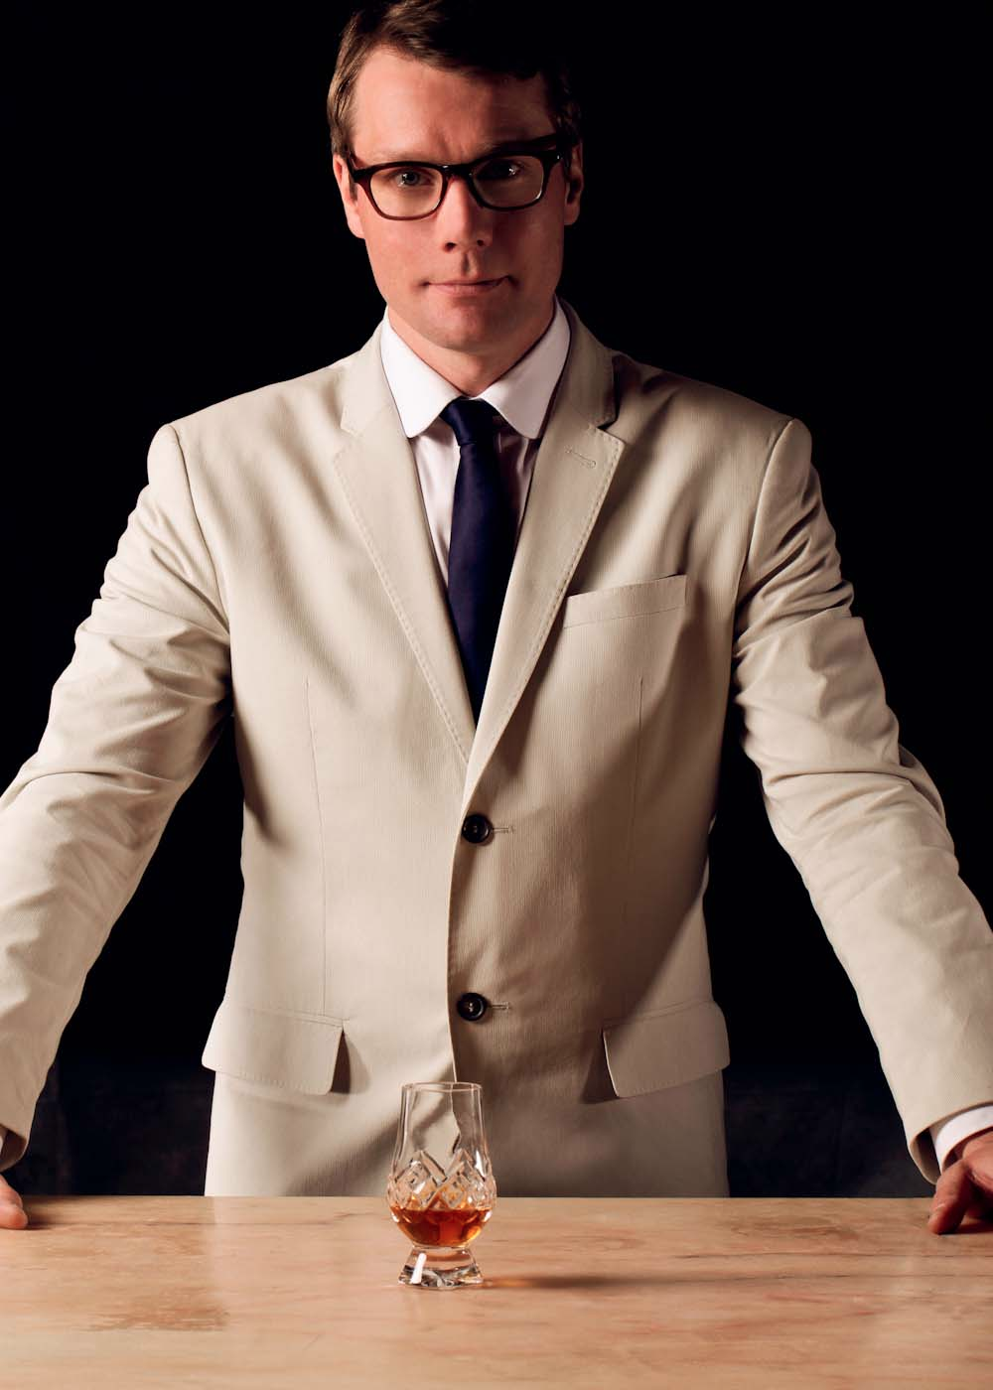
Consumer Target Definition: Primary
Who is J.R. Revelry’s Consumer?
Psycho. locators | Affluents are hopeful that 2014 Will be Even Better than 2013 Underdog fans: passion for local brands that deliver unique flavors. Prefer unique offerings from non-established brands Influenced by recommendations from trusted friends. He could drink for eight hours straight and never loses his cool While he can be overly macho, we'd like to think that this guy isn't into playing games.
Source: Datamonitor Consumer Survey, 2013
Notes:
Whiskey currently makes up 23% of ttl. Consumer target > average.

Slide 3
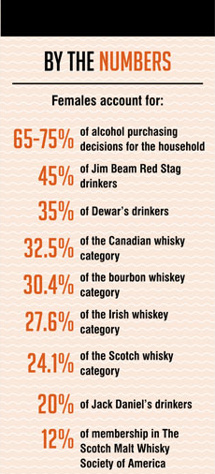
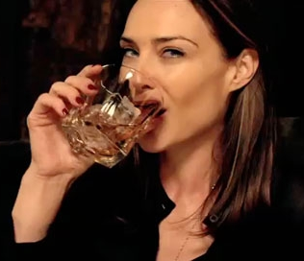
Consumer Target Definition: Secondary
Why Whiskey Cooperators?
Secondary Growth Target | The Whiskey cooperator. She is loyal to a flavor profile vs brand. Willing to try new spirits adventures after the suggestions of those she trusts. She trusts but verifies.
Secondary Demo locators | Gender: Female Income: Affluent 75K+ County: AB counties | Status: Married Education level: College Educated
Secondary Purchase Behavior | Overindex on craft spirits Key decision maker Whiskey-aware Drives key brands
Source: http://brandyrand.files.wordpress.com/2011/12/women-whiskey-april2013.pdf
Notes:
approximately 45% of Red Stag drinkers are female (http://brandyrand.com/2013/04/09/what-women-want-whiskey/)

