Slide 1

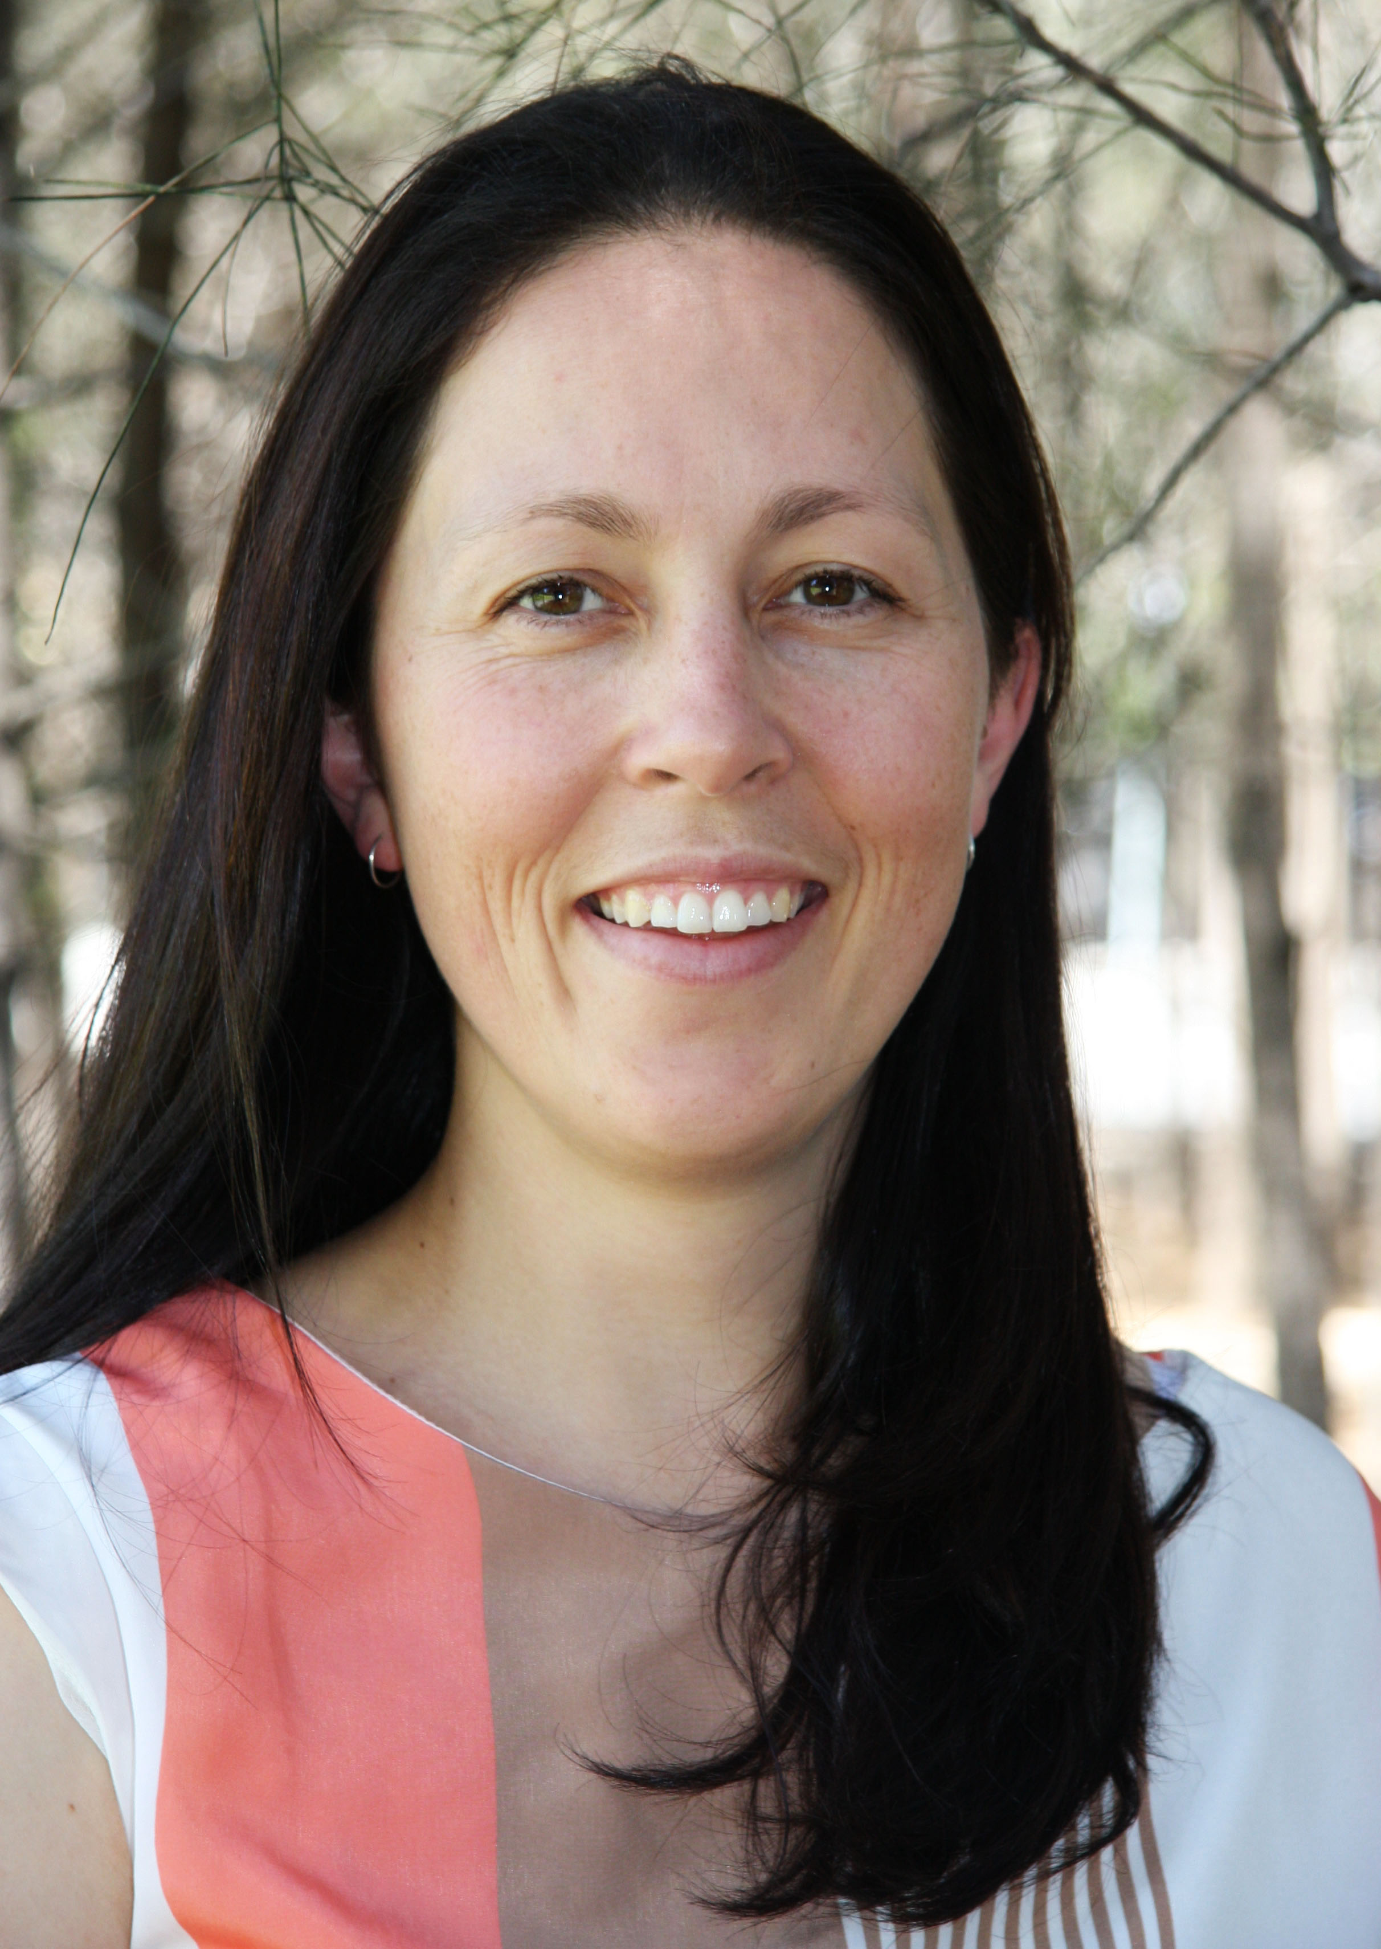
Look far think close coaching
1300 880 944
Shelley.Flett@lftccoaching.com
Individual Coaching (1)
Welcome to LFTC Coaching where we put a new perspective on the way you work, live and play.
Through our programs you will learn new skills & techniques to enable you to break through the barriers that have kept you from reaching your full potential up to now.
About Shelley (6)
Group Work (2)
Resources (3)
Inspiration Booth (5)
Get your free 30 minute introductory coaching session… (4)

Slide 2
Individual Coaching Programs (1)
1300 880 944
Shelley.Flett@lftccoaching.com
Growth & Professional Development
Growth & Professional Development – (1a)
Managing your time – (1b)
Career Advancement & Goal Setting – (1c)
Speaking with Confidence – (1d)
Effective Leadership – (1e)
Managing your time
Career Advancement & Goal Setting
Speaking with Confidence
Effective Leadership
Enquire (4)

Slide 3
Coaching Programs (1a)
1300 880 944
Shelley.Flett@lftccoaching.com
Growth & Professional Development
Growth & Professional Development – This program will assist you to understand what you want in life, what your drivers are and how you can continually develop yourself while maintaining what’s important to you.
If you feel like you are in a rut or going nowhere in your professional or personal life this program can assist you to move forward quickly and easily. All you need to have is an open mind and a willingness to change.
Over nine weeks you will meet with your coach one on one:
Once a week for 3 weeks
  then
Once a fortnight for 3 fortnights
It is important that you have complete trust and confidence in your coach which is why an initial free consultation is recommended.
Managing your time
Career Advancement & Goal Setting
Speaking with Confidence
Effective Leadership
Register for your free consultation now! (4)

Slide 4
Coaching Programs (1b)
1300 880 944
Shelley.Flett@lftccoaching.com
Growth & Professional Development
Managing your time – How often have you said to yourself “I wish I had more time to…” or “I’d love to but I don’t have the time”? How often do you stay later at work to finish off that last thing? How often do you choose to stay at work instead of spending time with your family, friends, going to the gym, taking a walk on the beach, reading, etc, etc?
How would you feel if we said you can be successful in your career and have balance in your personal life? This program is designed to maximise your time, to make every moment count.
George Faddoul puts it into perspective in his book How to get a bigger bite out of life. He says that we all grew up hearing that time is money when in reality time is so much more than that. He says “Time is everything. Time is all there is. You see when you get to the end of your own time, they don’t give you a whole bunch of money, they dig a hole and put you in it, so time is not money, time is everything. Time is all there is.”
Over four weekly sessions you will learn a variety of techniques to improve your time management.
It is important that you have complete trust and confidence in your coach which is why an initial free consultation is recommended.
Managing your time
Career Advancement & Goal Setting
Speaking with Confidence
Effective Leadership
Register for your free consultation now! (4)

Slide 5
Coaching Programs (1c)
1300 880 944
Shelley.Flett@lftccoaching.com
Growth & Professional Development
Career Advancement & Goal Setting – A Harvard Business study revealed remarkable statistics relating to goal setting and success.
  83% of the population does not have goals
  14% have a plan in mind, but are unwritten goals
  3% have goals written down
The study found that the 14% who have goals are 10 times more successful than those without goals. The 3% with written goals are 3 times more successful than the 14% with unwritten goals.
This program will assist you to successfully progress in your career or personal life by clearly defining then setting goals.
Over four weekly sessions we will support you to determine your goals and implement a plan to close the gap between where you are and where you want to be. You will leave the program feeling in complete control of your life with a clear direction.
It is important that you have complete trust and confidence in your coach which is why an initial free consultation is recommended.
Managing your time
Career Advancement & Goal Setting
Speaking with Confidence
Effective Leadership
Register for your free consultation now! (4)

Slide 6
Coaching Programs (1d)
1300 880 944
Shelley.Flett@lftccoaching.com
Growth & Professional Development
Speaking with Confidence – Amy Cuddy’s theory on speaking with confidence is to “fake it til you become it”. She says “you have to fake it. And then eventually, one day, you'll realise that you're not faking it anymore.'"
This program will improve your ability to speak in public simply by changing your perspective. We will assist you to remove barriers that may be preventing you from being your best. It’s not about changing who you are, instead it’s about getting rid of the things that are pushing you down.
Over four weekly sessions you will learn and practically apply techniques to allow you to speak with confidence.
It is important that you have complete trust and confidence in your coach which is why an initial free consultation is recommended.
Managing your time
Career Advancement & Goal Setting
Speaking with Confidence
Effective Leadership
Register for your free consultation now! (4)

Slide 7
Coaching Programs (1e)
1300 880 944
Shelley.Flett@lftccoaching.com
Growth & Professional Development
Effective Leadership – Effective Leadership is the most comprehensive of the coaching programs and works on the theory that before we can help others we must first help ourselves.
In this program you will work through Growth & Professional Development; Managing your time; Career Advancement and Goal Setting; and, Speaking with Confidence. Following that we focus on the approaches to leadership that build strong relationships between leaders and followers, based on wellbeing and performance.
Over six months you will learn to excel in your ability to create a vision for your team, communicate, motivate, influence and deliver results. You will learn to adapt your style to your audience whether it be a superior, peer or direct report. You will meet with your coach one on one:
Once a week for 1 month
Once a fortnight for 4 months
It is important that you have complete trust and confidence in your coach which is why an initial free consultation is recommended.
Managing your time
Career Advancement & Goal Setting
Speaking with Confidence
Effective Leadership
Register for your free consultation now! (4)

Slide 8
Group Work (2)
1300 880 944
Shelley.Flett@lftccoaching.com
Team Building
Investing in initiatives to develop team skills and attitudes will lead to gains in productivity, increased levels of quality, reduced costs, and faster time to proficiency.
Hire one of our passionate and enthusiastic facilitators to run your next workshop. All programs are individually tailored to ensure your objectives are met.
CFO: “What happens if we invest in developing our people and then they leave us?”
CEO: “What happens if we don’t, and they stay?”
Strategy/Planning Days
Leadership Enhancement
Time Management
Cruising Through Change
Enquire
(trigger an email to Shelley.Flett@lftccoaching.com)

Slide 9
Resources (3)
1300 880 944
Shelley.Flett@lftccoaching.com
Free Coaching Session (4)
About Shelley (6)
Contact Us (7)
Join our mailing list (8)
Cost (9)

Slide 10
Free introductory Coaching Session (4)
1300 880 944
Shelley.Flett@lftccoaching.com
Before investing in yourself we want you to feel confident that you’ve made the right decision. This free introductory session will help you do just that.
Book your session
First Name:
Last name:
Email address:
Phone number:
State:
Occupation:
Program: <auto populate depending on how they accessed the form e.g. Effective Leadership, etc>
Preferred method for sesssion: Face to face / skype / phone
Preferred day for session:
Preferred time for session:
“The coaching program has transformed my life. I have improved relationships both at work and at home and am trully happy for the first time in a very long time” ~ Jo C.
Submit
(trigger an email to Shelley.Flett@lftccoaching.com)

Slide 11
Inspiration Booth (5)
1300 880 944
Shelley.Flett@lftccoaching.com
This page is for current and past clients who need a little inspiration to keep them focused and headed in the right direction. It’s also for anyone else who might stumble across it!
Inspiration Archive
(list past quotes and have a scroll section here)
Your Weekly Inspiration
May 2014
“Because true belonging only happens when we present out authentic, imperfect selves to the world, our sense of belonging can never be greater than our level of self-acceptance”
Brene Brown (author of Daring Greatly and the speaker of the popular TED talk “The Power of Vulnerability”)
Juno
link to
http://junoconsulting.com.au/cms/
Butterfly Program
link to
http://thebutterflyprogram.com
Like us on facebook

Slide 12
About Shelley (6)
1300 880 944
Shelley.Flett@lftccoaching.com
Shelley Flett is a full time working Mum who believes that life is what you make it. She has experience in a variety of industries including Banking & Finance, Telecommunications, Hospitality, Manufacturing and Farming.
Shelley spent three years working abroad in England, Scotland, Spain and Canada. Her years travelling gave her invaluable cultural experience along with a greater understanding of her strengths and weaknesses.
Today, as a qualified Neuro Linguistic Programming (NLP) Practitioner and Timeline Therapist Shelley has found her passion in guiding others to reach their true potential, in their personal and professional lives.

Slide 13
Contact us (7)
1300 880 944
Shelley.Flett@lftccoaching.com
Speak with someone – 1300 880 944
Send Shelley a message – shelley.flett@lftccoaching.com
Post a comment on our page – facebook
Research Shelley – linked in http://au.linkedin.com/in/shelleyflett/

Slide 14
Join our mailing list (8)
1300 880 944
Shelley.Flett@lftccoaching.com
Join today to keep up-to-date with awesome tips and techniques...
First Name:
Last name:
Email address:
Sample tips:
(enable a scrolling function to view past tips)
Sign up
(trigger an email to Shelley.Flett@lftccoaching.com)
Unsubscribe

Slide 15
Cost (9)
1300 880 944
Shelley.Flett@lftccoaching.com
Coaching
Coaching – Coaching programs are tailored to the individual/couple/group so prices do vary. For those who are just looking for a ballpark figure our coaching prices average around $250 per session.
Workshops – To hire a facilitator for the day you will be looking at around $2,000 for the day (negotiable), subject to number of attendees and printing costs.
Workshops
Enquire
(trigger an email to Shelley.Flett@lftccoaching.com)

