Slide 1
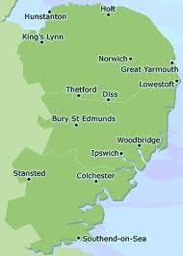
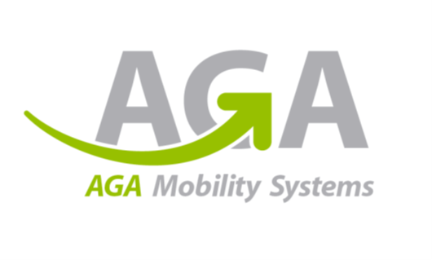
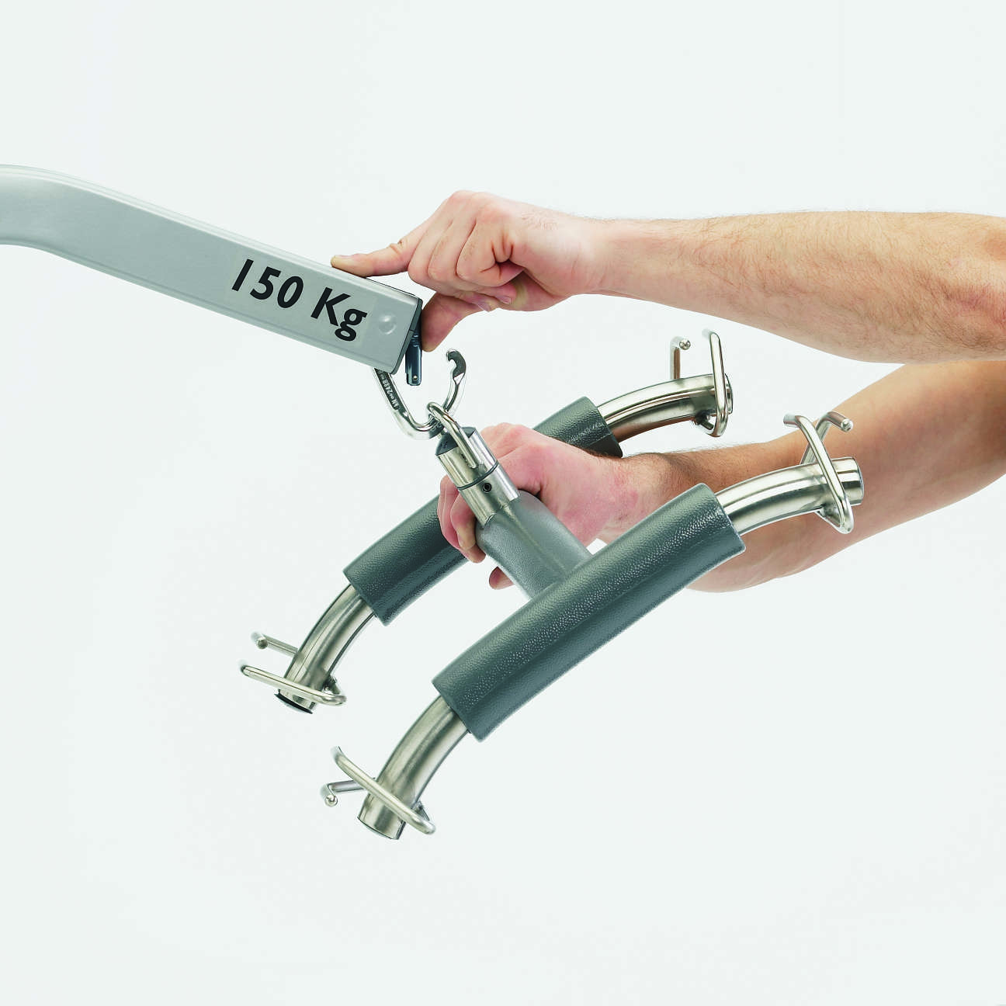
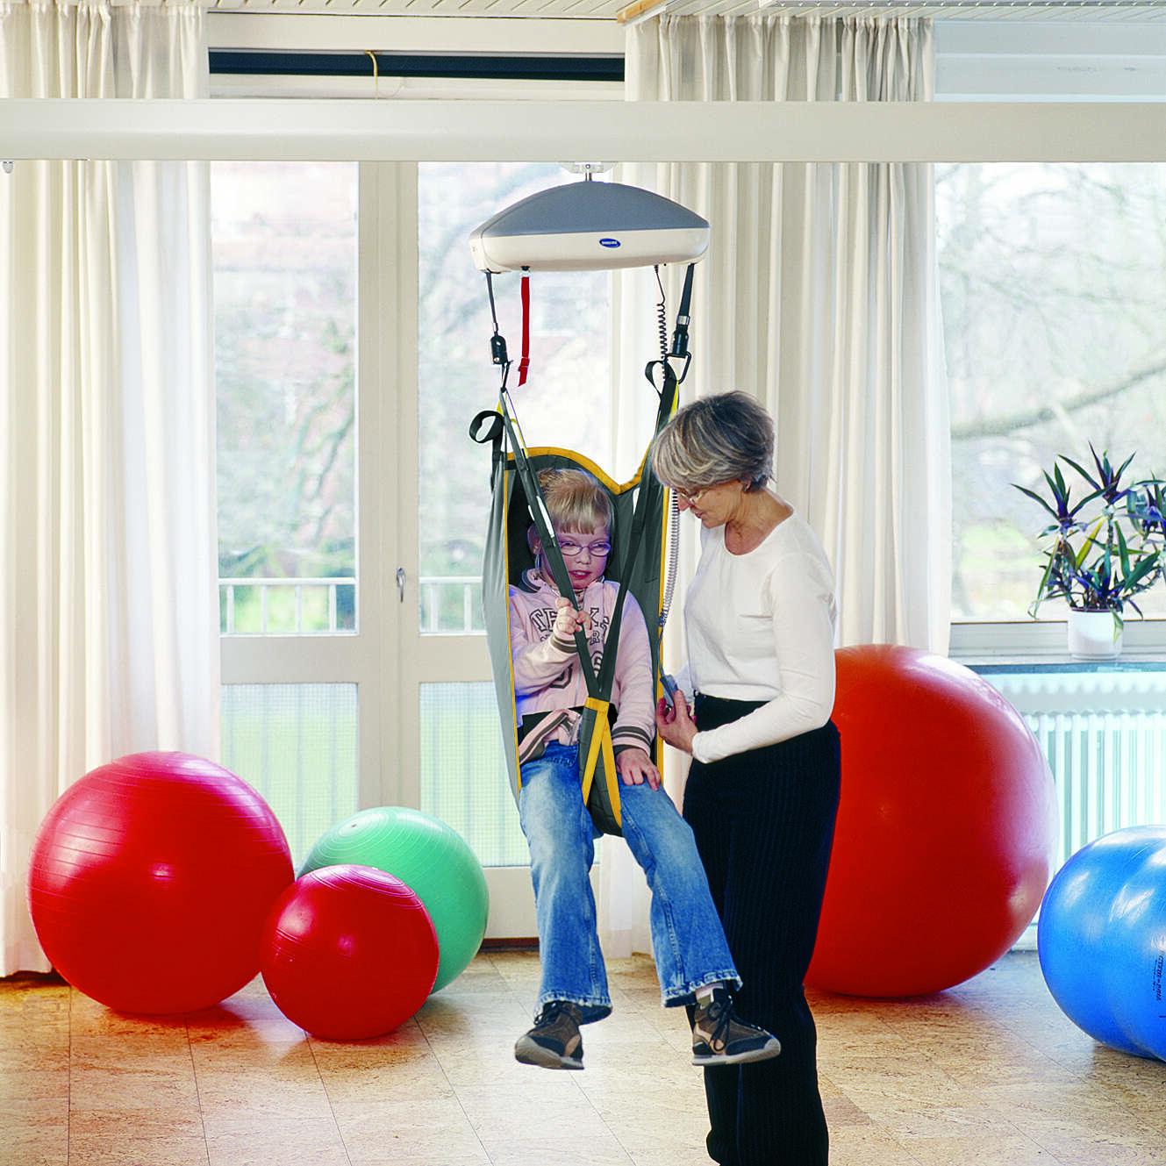
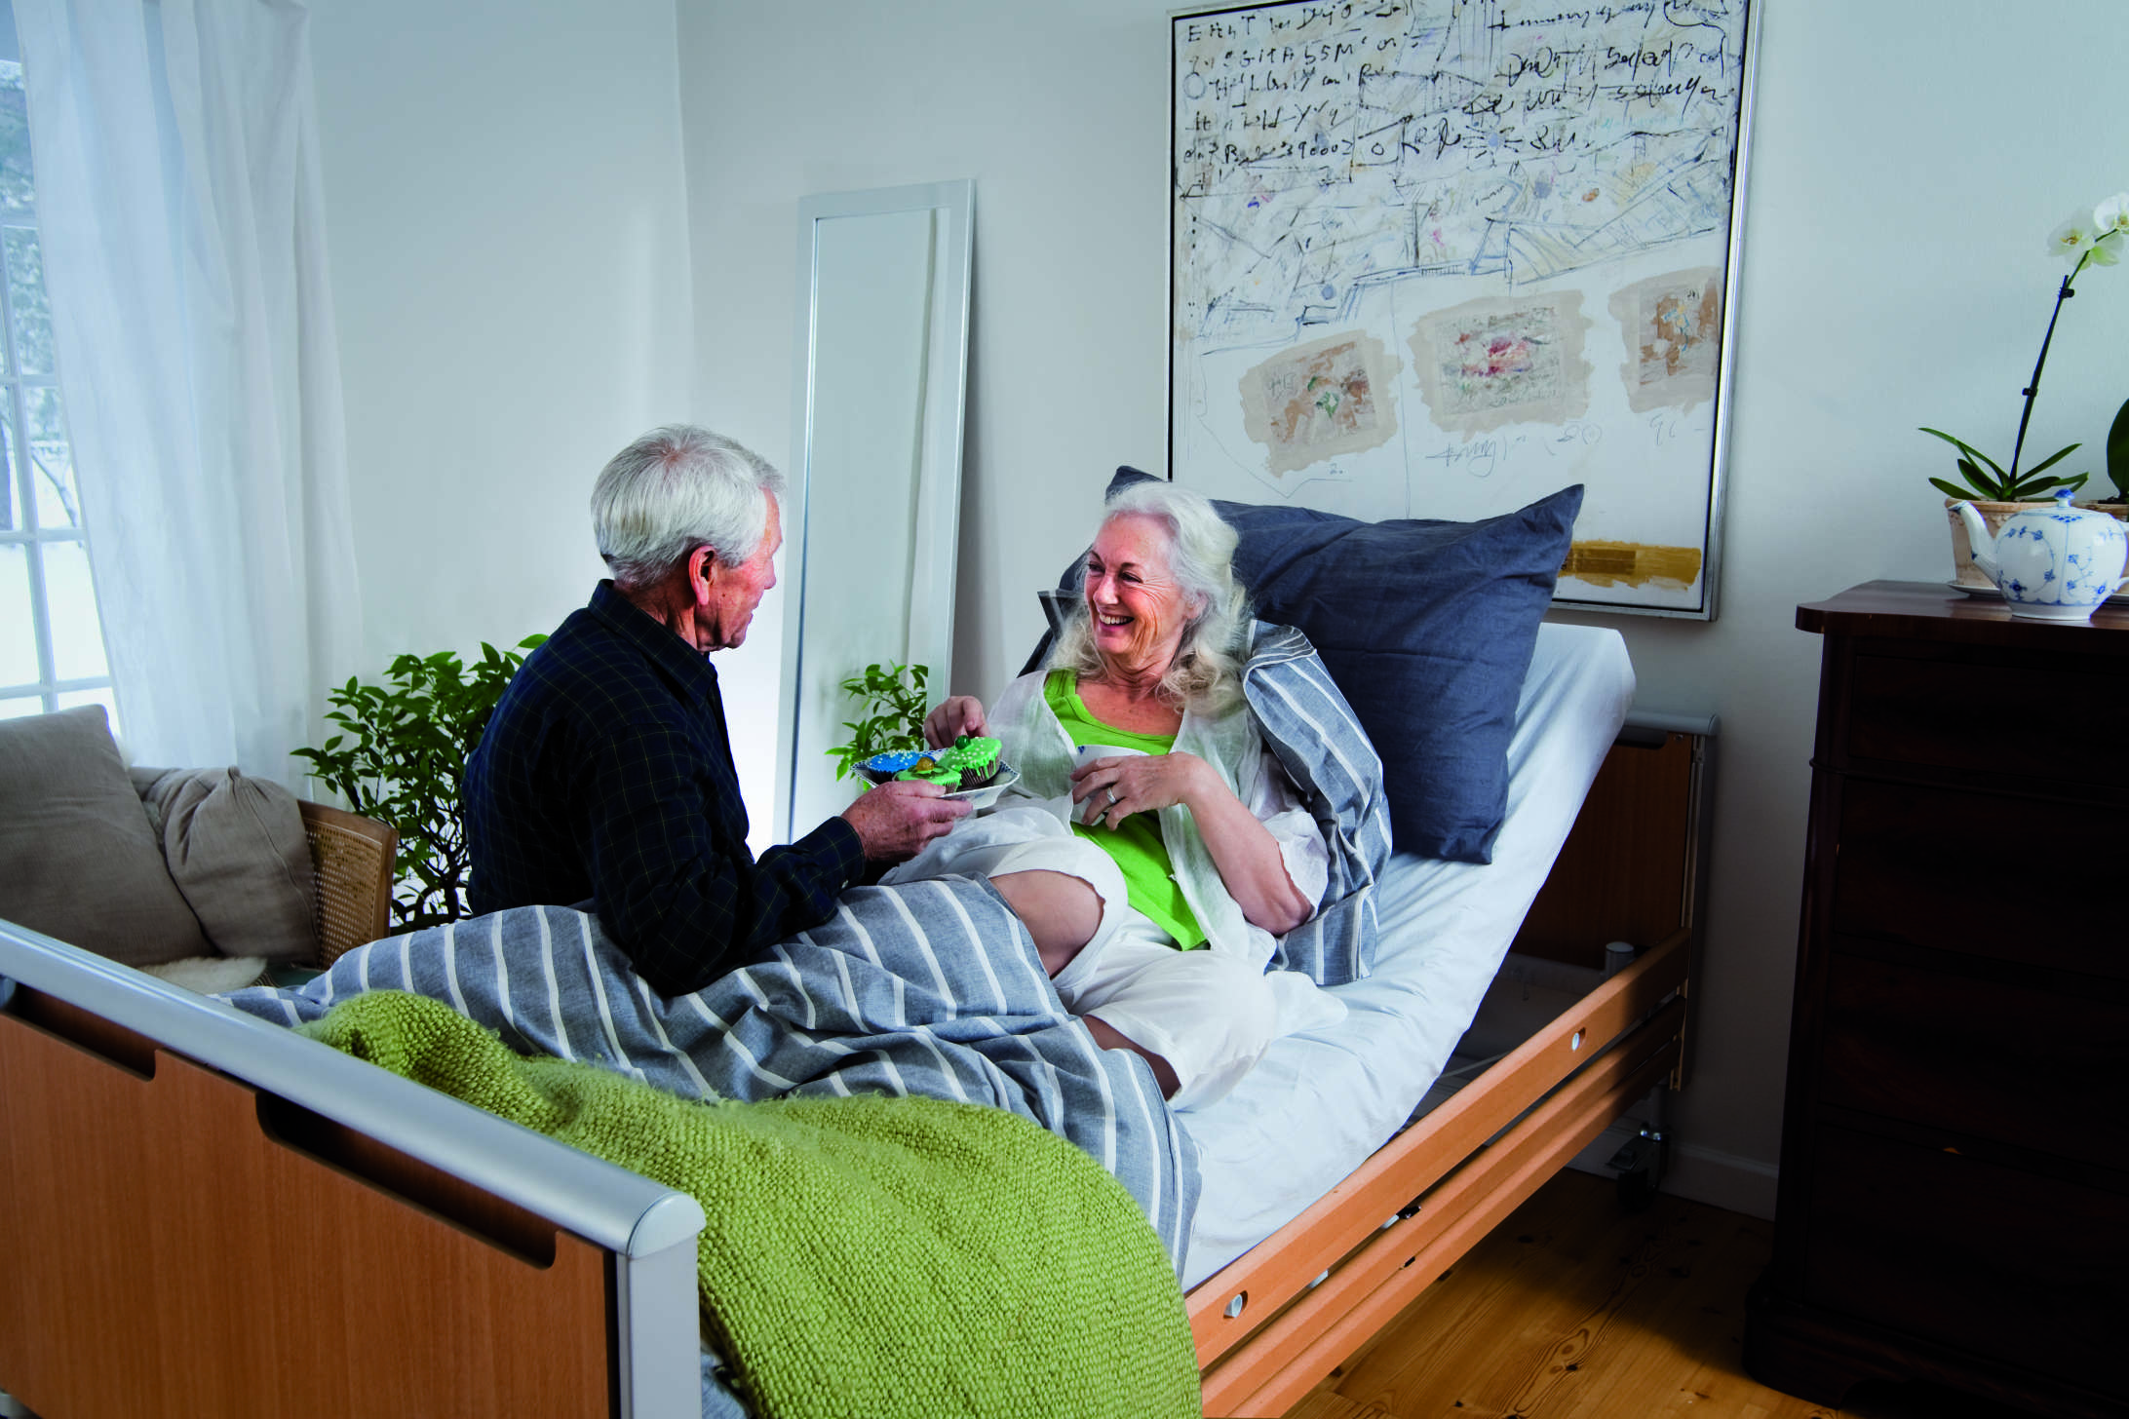
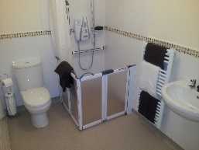
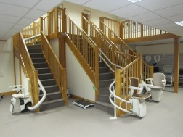






AGA Technical Services
Specialist Assessments
With fully trained and trusted staff we can carry out assessments for your residents from special slings, rehab wheelchairs, pressure care and clinical seating.
Wheelchair Servicing
AGA can service your wheelchairs on site at very competitive prices. Each chair is checked and adjusted and individually labelled and a report is issued for each chair.
LOLER Testing
Our fully trained staff can test and inspect all your lifting equipment on site. No contract to sign, just tell us when you want the testing carried out and we will add you to our database and then contact you to make an appointment when your equipment is due. A service record/certificate will be issued for each piece of equipment.
Bathroom Adaptations
We have been building specialist wet rooms and bathroom adaptations for many years and carry out around 70 installations for local authorities every year. Please contact us for a FREE survey and quotation.
Ceiling Track Hoists
AGA have several trained engineers who can install all types of ceiling track systems including specialist XY overhead hoists.
AGA Mobility Systems Ltd
Independent Living Solutions
AGA Mobility Systems Ltd
Unit 2b, Williamsport Way
Lion Barn Industrial Estate
Needham Market
Suffolk
IP6 8RW
Email.info@agamobilitysystems.co.uk
www.agamobilitysystems.co.uk
Specialist Product Assessment
Wet Room & Hygiene Rooms
Overhead Ceiling Hoists
Specialist Seating
Bathroom
Manual Handling
LOLER Testing

Slide 2
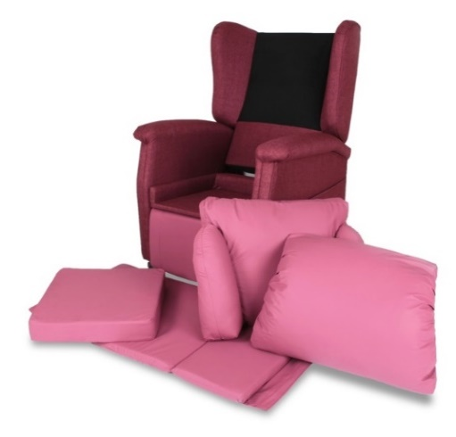
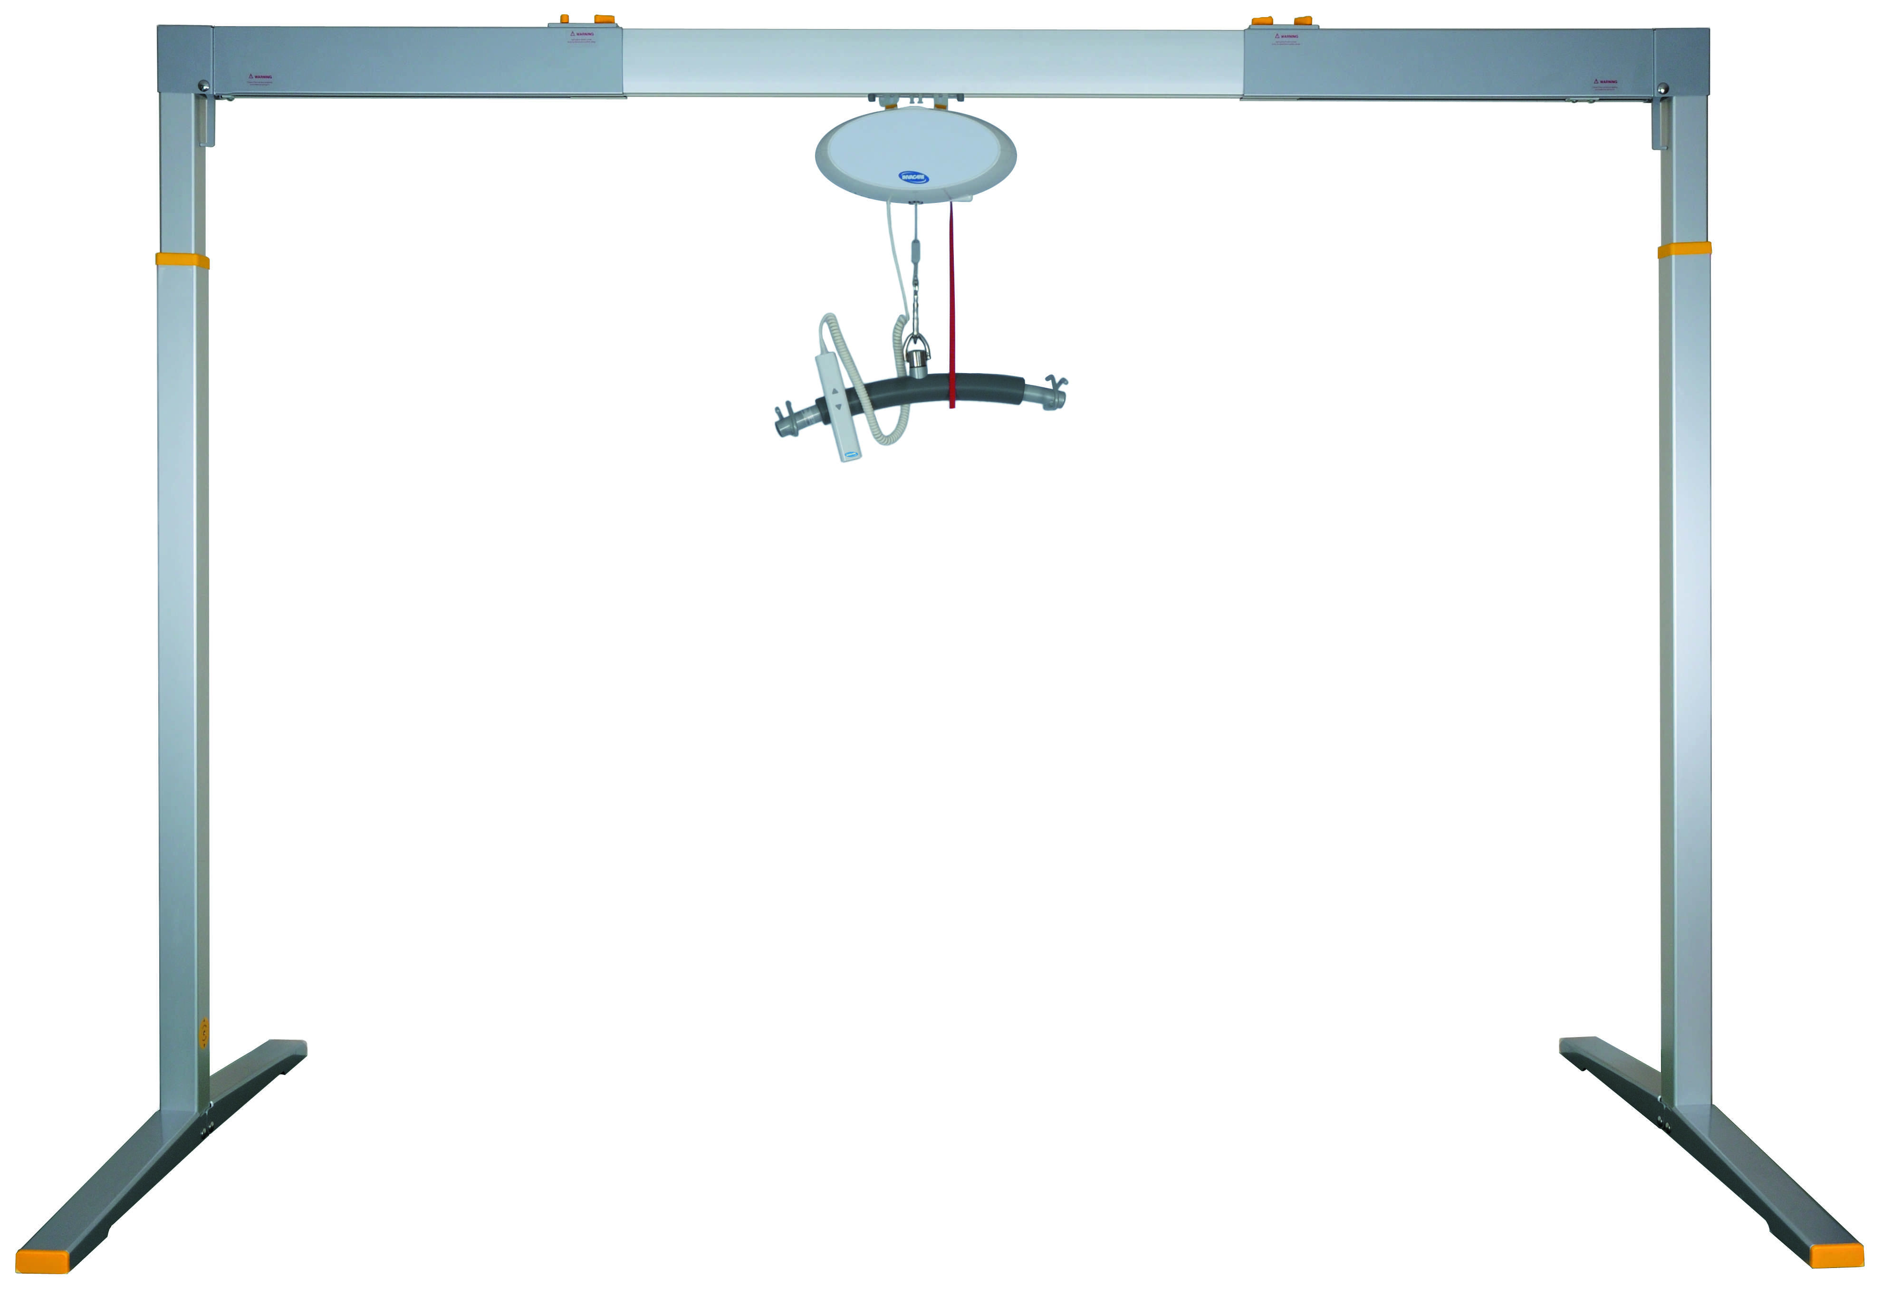
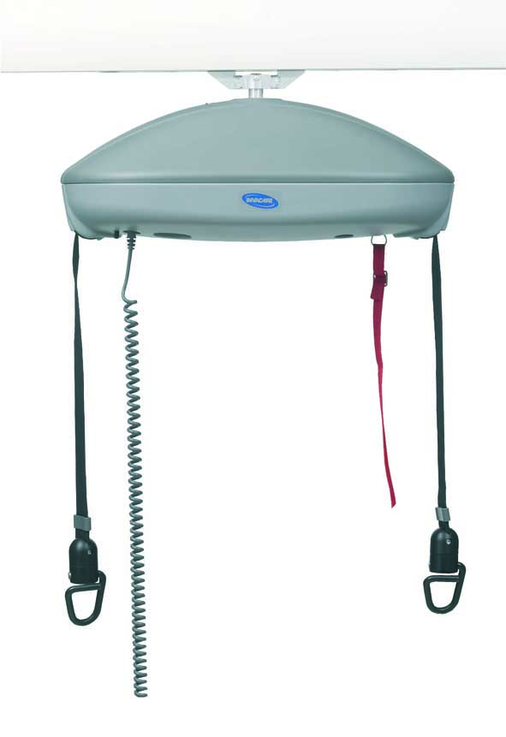
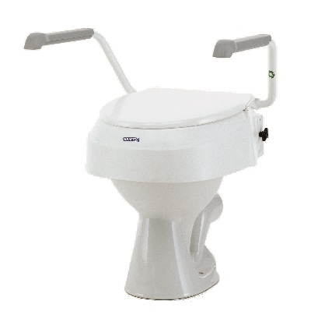
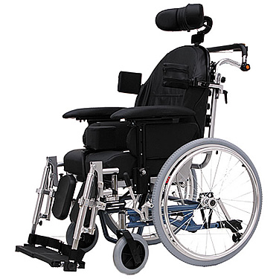
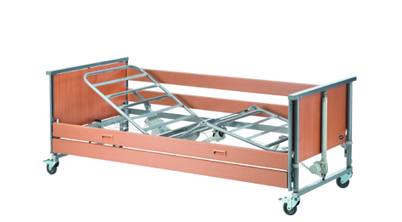
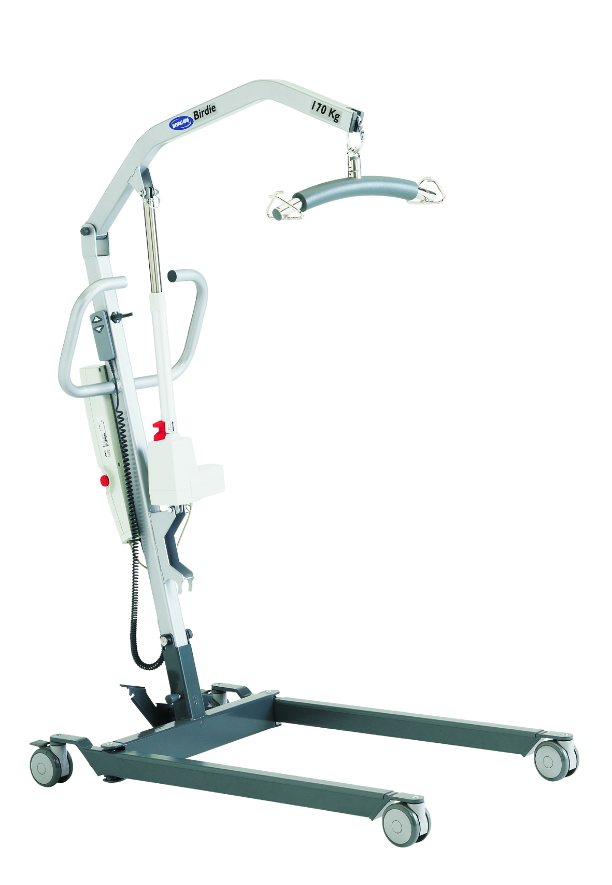
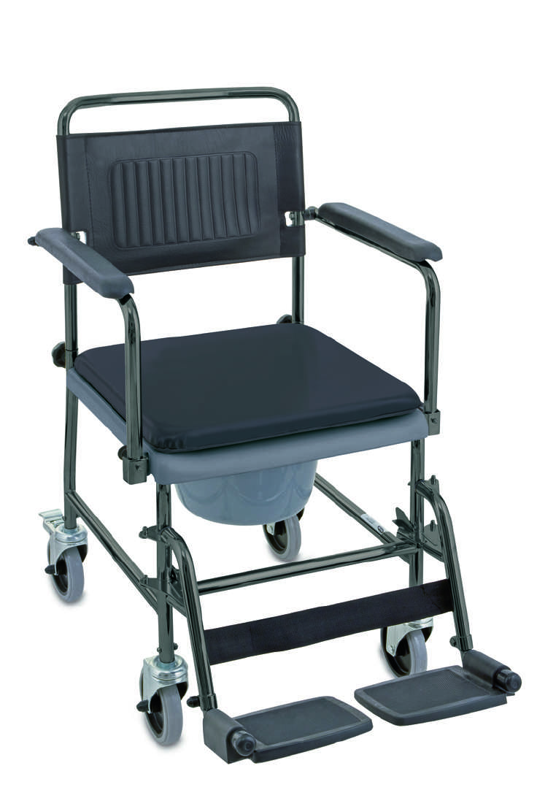
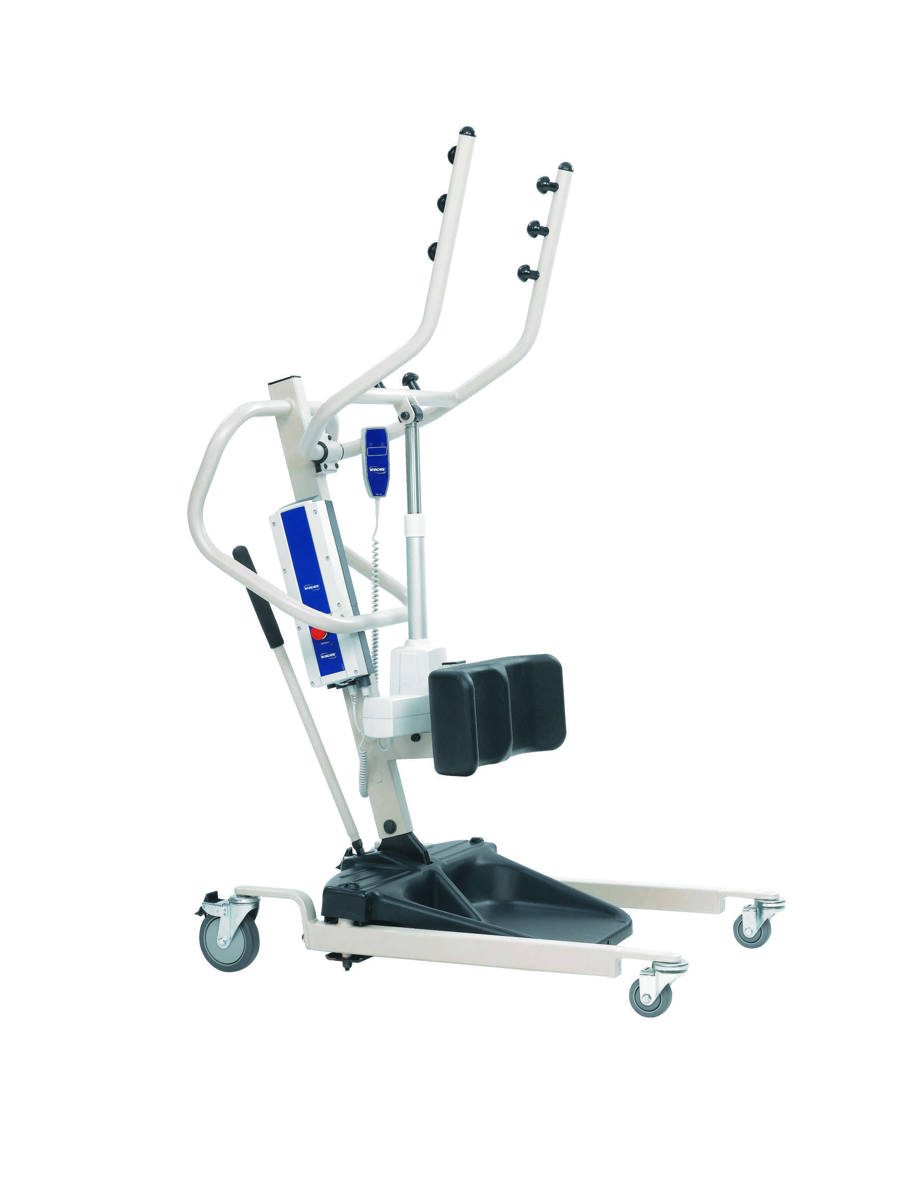
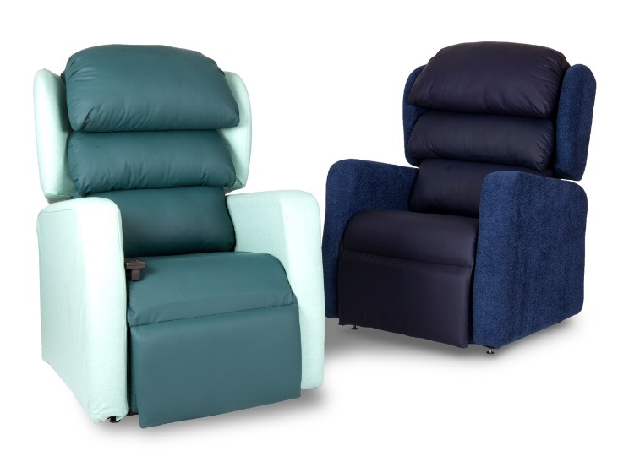
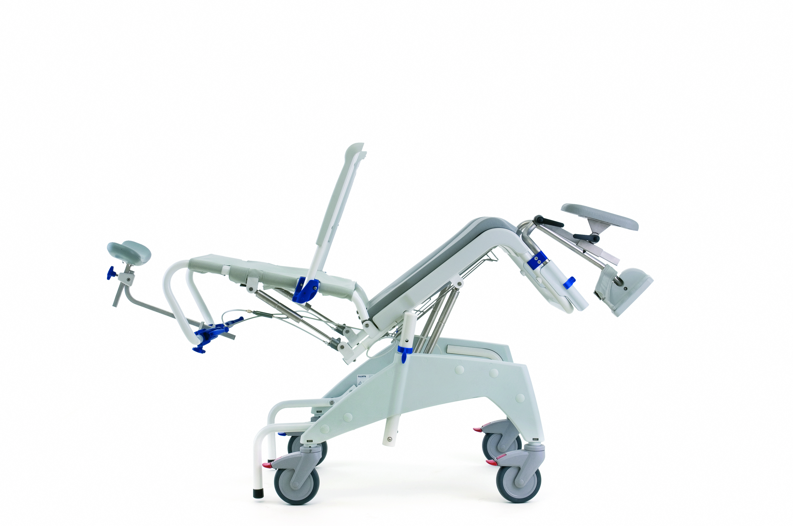
AGA Mobility Systems – For ALL your specialist equipment needs
Specialist seating
From standard and made to measure rise and recliners to specialist seating with in built pressure care and support
Profiling beds
Top quality four section rise and fall profiling beds
Pressure Care
From the standard Propad cushion range through to low, medium and high risk professional mattresses
Bathroom aids
Everything from the very basic bath boards and toilet seat raisers
Commodes
A full range of static and wheeled commodes
Ceiling hoists
The very latest technology fully installed and tested
Gantry systems
Professional easy to install, mobile gantry systems
Wheelchairs
From basic attendant wheelchairs through to the more complex fully adaptable chairs
Shower chairs
A full range of shower chairs from basic entry level to manual and electric Tilt In Space
Mobile hoists
From the standard hydraulic hoists through to top of the range electric versions
Electric stand aids
New modern electric stand aids

