Slide 1
Corporate Overview
Prepared for:
XYZ Company

Slide 2
Projects in
30+ countries on
5 continents
4,000
Successful
Cloud
Projects
Go beyond Go-Live…
Thrive with Aasonn.
Proven, integrated
methodology for
project success
1600+ customers
400 Active projects
Experience is not
cliché – it’s vital
The most experienced SAP/SuccessFactors Partner in the World
100s of years of collective SuccessFactors implementation experience
More SuccessFactors
customers than any
SAP partner
1,600+ customers serviced in 30 countries in (7) years
4,000+ customer projects
From Large to Small--
Aasonn’s broad range
of customers
35 of the Fortune 500
5 of the Fortune 100
5 of the largest private companies in the USA
Growing at the Speed
of Light
70-100% YOY growth
Investing $20M to add a new Division for delivering BPO Services
Global Coverage Model
Global coverage with Head Offices in North America, Europe, and Asia Pacific
Over 400 active SuccessFactors projects in over 10 countries

Slide 3

HR System continuum… aasonn can help you navigate through each stage
Our Offering
Strategic Change:
Platform for strategic change and optimal utilization of talent
SUCCESSFACTORS SUPPORT SERVICES
  New Implementations and Configurations
  Premium Support Plans
  User Adaptation
CONSULTING SERVICES
  Business Transformation Best Practices Consulting
  HRIS Data Integration, Design and Planning
  Project and Talent Management Consulting
HR OUTSOURCING
  Designed with the employee experience in mind
  Powered by process automation and standardization
  Delivered usign onshore, industry experts focused on customer service
Transformation
Operational Insight:
Data-driven insights for understanding, monitoring and improving talent
A performance-based culture
with talent practices aligned to
specific business needs defined
with well-defined data analytics.
Comprehensive:
Methods effectively supporting major talent management needs
Integration/Consolidation
Well-defined and widely
adoped methods and tools
SuccessFactors
Automation
Other Solutions
Technology enabled talent
management processes
Efficiency:
Efficient & consistent methods; able to monitor usage
IMPACT
ORGANIZATION MATURITY
Manual
Standardization:
Defined methods, often inefficient
& inconsistently used
Basic processes defined for
managing talent
Undefined
I would absolutely recommend Aasonn. They have both the knowledge and skill set to implement your Successfactors system and offer a partnership you can rely on
Confusion & Underutilization:
Uncontrolled; inefficient; high risk treatment of employees
Talent decisions local
knowledge & practices
Marc Farrugia

Slide 4




Our Partners
Human Resources
(Since 2007)
Workforce Planning
& Analytics
Human Resources
Talent and Learning
Management
Cloud for Fınancıals and Travel Products
(Since 2012)
CRM, Projects
Financials, Supply Chain, and Manufacturing
Data Integratıon
(Since 2006)
Cloud-to-Cloud
Cloud-to-On Premise
Healthcare
Transparency
(Since 2013)
Workforce Planning
& Analytics
Human Resources
Talent and Learning
Management

Slide 5

We implement & sell the Entire BizX Suite with a Blueprint for Success (BizX2)
Aasonn’s BizX2 Methodology maximizes ROI by
expanding focus from
configuration accuracy to end user adoption and
measurable business
process improvements.
Performance
Learning
Recruiting
DEPLOY
TRANSITION
Goal
Workforce
Planning
Succession
Comp
Jam
Analytics
CONFIGURE
Project success
framework:
  Prescribes use of
  proven
  Configuration
  Workbooks
  Keep project on track
  and within scope
  Maintains issues logs and
  tracks discrepancies
  Documents the application configuration
  Ensures alignment at each project phase
Employee Central
DEFINE
INITIATE

Slide 6
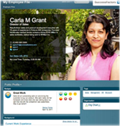






(5) Reasons aasonn leads the market for
Employee Central Implementations
1
The most EC implementations of any partner Experience with every size company & vertical
We understand how it all fits together Broad range of implementation experience with all modules (beyond Employee Central)
Payroll & Integration Expertise on staff including EC Knowledge Manager: Kelli Castle
Best Workforce Planning & Analytics Team in the world, led by Rana Hobbs
Offer strategic business & process consulting…as well as tactical expertise
2
3
4
5

Slide 7
aasonn’s Post-Implementation Services
MyConsultant Plan
MyAdmın
Aasonn Unıversıty
Aasonn Unıversıty
Post Go-Live Support
Retainer Based Plan offering ongoing expert support across the implementation, including such services as:
Updates for Performance & Compensation forms on demand
Custom competency framework development
Expert help for launching your review cycle
Other services and consulting implementation consultants can provide
Administrator Services for SuccessFactors Products on a temporary or permanent basis
Ensure your company is covered during:
Product Implementations
Heavy Workload Cycles
Family Medical Leave
Vacations
Illness
Drive user adoption
Develop & enhance skills
Instructor-led Training
eLearning
Quick Reference Guides
Courseware Toolkits
Educational Consulting
On-staff consultants skilled in driving business alignment, strategy development, implementation & configuration, end user adoption, and metrics to evaluate impact
Sample consulting services
Competency Development
Custom Reporting
Performance Management
Professional Services
Talent Strategy
Workforce Planning and Analytics

Slide 8


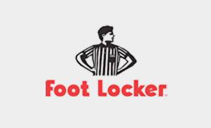








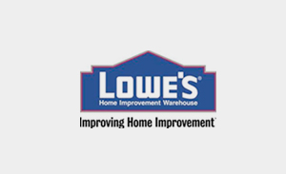
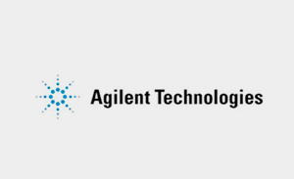

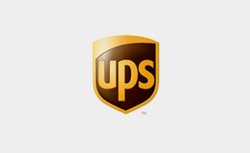

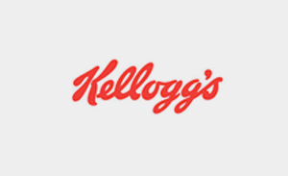
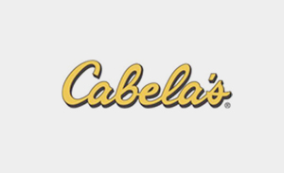
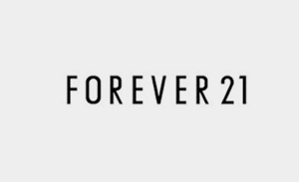



Selected Client List

