Slide 1
Aasonn Corporate Overview
Provided for Telebusiness Lead Generation Team

Slide 2
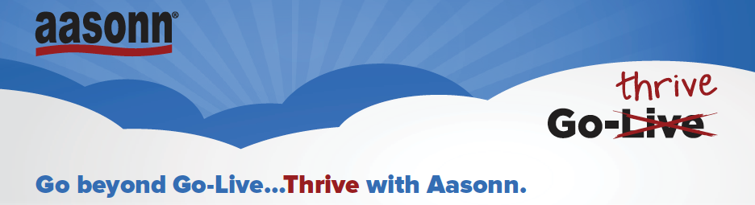
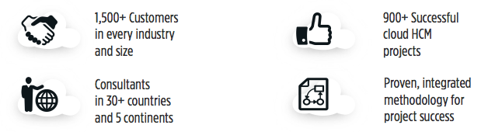
Experience is not cliché – it’s vital
  The most experienced SAP/SuccessFactors Partner in the World
  100s of years of collective SuccessFactors implementation experience
More SuccessFactors customers than any SAP partner
  1,600+ customers serviced in 30 countries in (7) years
  4,000+ customer projects
From Large to Small--Aasonn’s broad range of customers
  35 of the Fortune 500
  5 of the Fortune 100
  5 of the largest private companies in the USA
Growing at the Speed of Light
  70-100% YOY growth
  Investing $20M to add a new Division for delivering BPO Services
Global Coverage Model
  Global coverage with Head Offices in North America, Europe, and Asia Pacific
  Over 400 active SuccessFactors projects in over 10 countries
4,000 Successful Cloud Projects
1600+ customers
400 Active projects
Projects in
30+ countries on
5 continents

Slide 3
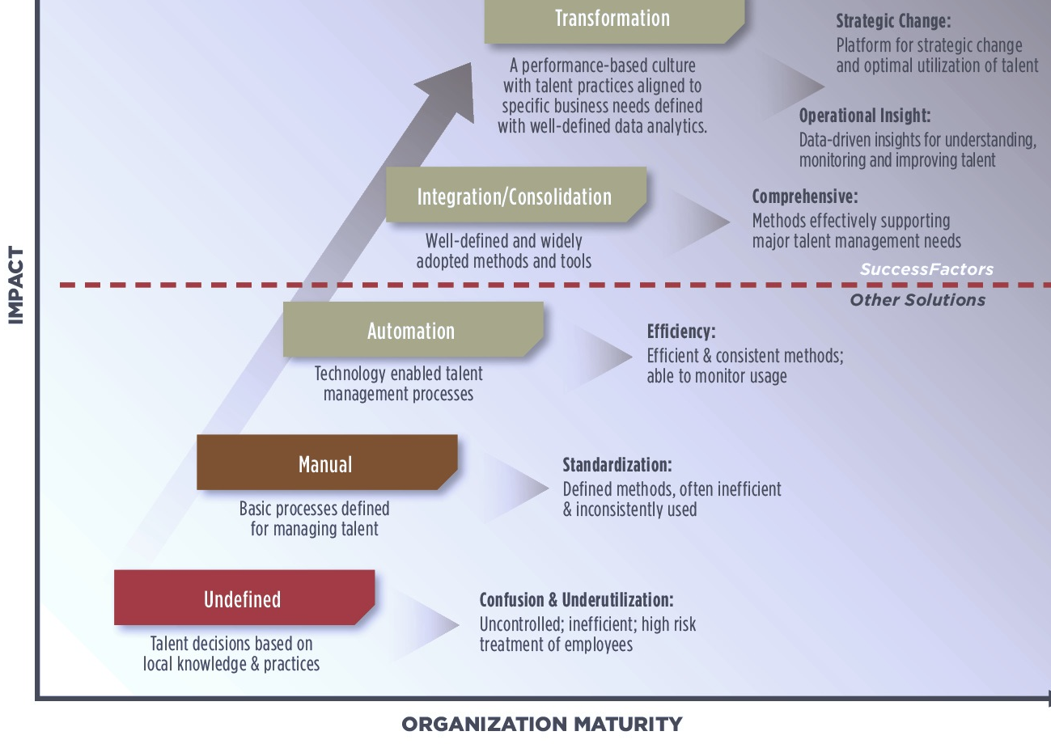
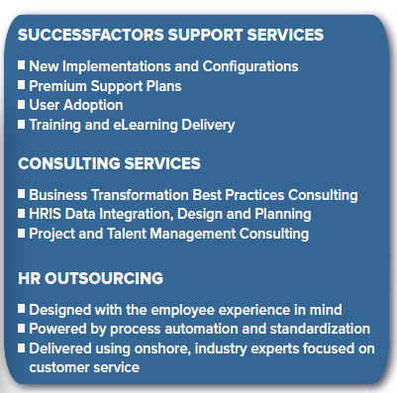

HR System continuum…
Aasonn can help you navigate through each stage
Our Offering
“I would absolutely recommend Aasonn.
They have both the knowledge and skill set to implement
your Successfactors system and offer a partnership you can rely on.
- Marc Farrugia, Sun Communities

Slide 4




Our Partners
SuccessFactors
  Human Resources (Since 2007)
    Workforce Planning & Analytics
    Human Resources
    Talent and Learning Management
SAP
  Cloud for Financials and Travel Products (since 2012)
    CRM, Projects
    Financials, Supply Chain, and Manufacturing
Dell Boomi
  Data Integration (since 2010)
    Cloud-to-Cloud
    Cloud-to-On Premise
Castlight
  Healthcare Transparency (since 2013)
    #1 on The Wall Street Journal’s list of “the Top 50 Venture-Backed Companies in 2011
    Major force of change in American Healthcare

Slide 5















We implement & sell the Entire BizX Suite with a Blueprint for Success (BizX² )
Aasonn’s BizX2 Methodology maximizes ROI by expanding focus from configuration accuracy to end user adoption and measurable business process improvements.
INITIATE
TRANSITION
DEFINE
CONFIGURE
DEPLOY
Goals
Performance
Workforce Planning
Recruiting
Comp
Learning
Succession
Jam
Analytics
Employee Central
Project success framework:
  Prescribes use of proven
  Configuration Workbooks
  Keep project on track and within scope
  Maintains issues logs and
  tracks discrepancies
  Documents the application configuration
  Ensures alignment at each project phase

Slide 6
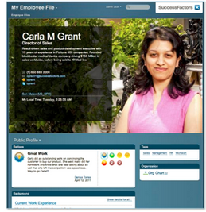







(5) Reasons Aasonn leads the market
for Employee Central Implementations
The most EC implementations of any partner
- Experience with every size company & vertical
We understand how it all fits together
- Broad range of implementation experience with all modules (beyond Employee Central)
Payroll & Integration Expertise on staff
including EC Knowledge Manager: Kelli Castle
Best Workforce Planning & Analytics Team in the world, led by Rana Hobbs
Offer strategic business & process consulting… as well as tactical expertise

Slide 7
MyConsultant Plan
Aasonn’s Post-Implementation Services
MyAdmin
Aasonn University
Consulting Services
Post Go-Live Support
Retainer Based Plan offering ongoing expert support across the implementation, including such services as:
  Updates for Performance & Compensation forms on demand
  Custom competency framework development
  Expert help for launching your review cycle
  Other services and consulting implementation consultants can provide
Administrator Services for SuccessFactors Products
on a temporary or permanent basis
Ensure your company is covered during:
  Product Implementations
  Heavy Workload Cycles
  Family Medical Leave
  Vacations
  Illness
Drive user adoption
Develop & enhance skills
Instructor-led Training
  eLearning
  Quick Reference Guides
  Courseware Toolkits
  Educational Consulting
On-staff consultants skilled in driving business alignment, strategy development, implementation & configuration, end user adoption, and metrics to evaluate impact
Sample consulting services
- Competency Development
- Custom Reporting
- Performance Management
- Professional Services
- Talent Strategy
- Workforce Planning and Analytics

Slide 8






















Selected Client List

Slide 9
Appendix:
Successfactors product info

Slide 10
SuccessFactors is uniquely suited to support our customers
A complete BizX solution for Attracting and Retaining Top Talent, Integrated Learning, Business Alignment, People Performance, Compensation Management that is functionally rich, easy-to-use, easy-to-implement, easy-to-administer and available today.
A solution that not only addresses the initial project needs but supports a longer term vision to integrate other processes.
1 Single Vendor, 1 Single Integrated Solution
A safe choice with more customer implementations (>4,000), more end-users (>18,000,000), fastest growth in the industry (financially, customers & innovation), and more resources than any other company in this space. We are the only vendor to receive the highest rating from every analyst covering the industry (Gartner, Forester, IDC, Ventana, Nucelus).
An economically attractive proposal, with fees that are “all-in”, fixed price implementation service, outsourced infrastructure and technical administration, annual subscription fees that avoid a substantial upfront capital expense, and built-in incentive to deliver top-of-the-line customer service, support and most importantly results.

Slide 11
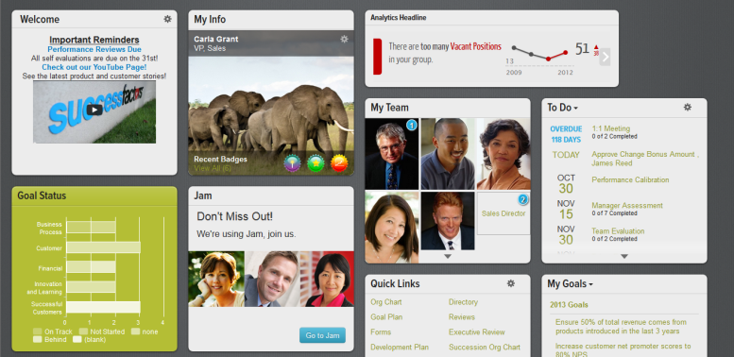

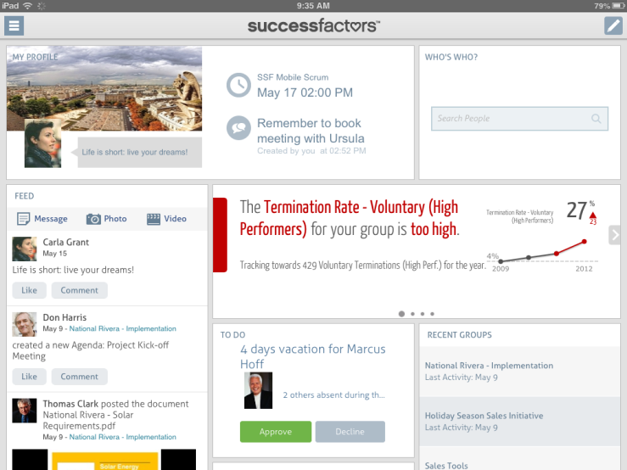

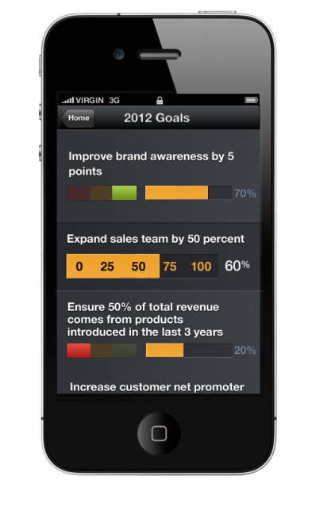
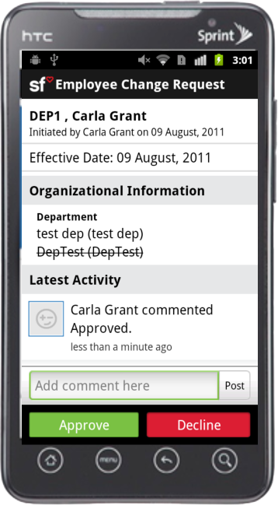
Agile, Engaging and Beautiful
Designed for how people work
Engage and Empower Everyone – Anytime, Anywhere, Wrapped in Social
Notes:
Engaging everyone: Beautiful solutions that work simply, for every user across the enterprise: incorporating mobile and social, all wrapped with a consumer-grade user experience.
SuccessFactors offers your organization ability to view:
Org Chart
Candidate assessment to accelerate the interview process
Employee Directory
HR Analytics
Social Networking

Slide 12
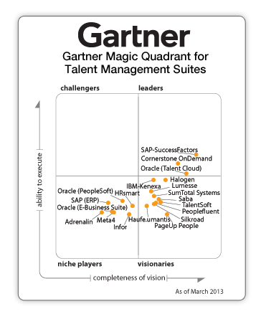
SuccessFactors Positioned as a Leader
In Garter’s 2013 Magic Quadrant for Talent Management Suites
Gartner “Magic Quadrant for Talent Management Suites” by Thomas Otter, Jeff Freyermuth, Ron Hanscome, March 14, 2013
This graphic was published by Gartner, Inc. as part of a larger research document and should be evaluated in the context of the entire document. The Gartner document is available upon request from SuccessFactors. Gartner does not endorse any vendor, product or service depicted in its research publications, and does not advise technology users to select only those vendors with the highest ratings. Gartner research publications consist of the opinions of Gartner's research organization and should not be construed as statements of fact. Gartner disclaims all warranties, expressed or implied, with respect to this research, including any warranties of merchantability or fitness for a particular purpose. http://sfsf.ly/gartnermq
Notes:
Best-in-class: Consistently scoring higher than any of our nearest competitors, according to all major analyst firms. Supplemented with the industry’s fastest pace of innovation in Core HR, our entire HR foundation features the widest breadth and depth of any HR vendor in the market today.

Slide 13
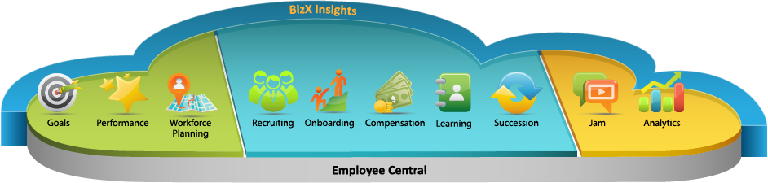




SuccessFactors Business Execution
Get people working
on the right things
Find the right people
and make them great
Run the
business better
Align
Optimize
Accelerate
Notes:
Aligning is what a lot of you know us for. We started here, and we continue to lead here because it’s so critical to a company’s success. Our solution helps drive alignment across your entire organization by breaking down your strategy into a series of goals, cascading those goals to every employee in the company, and then tracking progress against those goals. This ensures that your people are aware of the company strategy, and working on the right things to support that strategy. In this way we’ll help you drive focus, visibility, and accountability across your business. We’ve been aligning workforces for more than ten years, and we’re the best at it.
Next, SuccessFactors helps you optimize your workforce performance with the broadest and deepest set of talent management solutions on the market. We offer next generation cloud solutions for every part of the employee lifecycle to make sure that you can find the right people, get them in the right roles and can reward, motivate and develop them into future leaders. Our tightly integrated solutions support a full set mobile devices and functions across the suite.
And lastly we help you accelerate the business with the Insights you need to really drive business results – we call those ‘BizX Insights’ and they show up across the entire suite, but are powered by our Workforce Analytics and Jam solutions.

Slide 14










SuccessFactors HCM Solution Portfolio
Social Recruiting
Onboarding
Recruiting Marketing
Recruiting
Management
Social Collaboration
SAP Jam
Learning
Learning Management
Social Learning
iContent
Extended Enterprise
HR Analytics
Workforce Analytics
Workforce Planning
Social
Collaboration
Recruiting
Core HR
HR
Analytics
Learning
Performance
Core HR
Employee Central (EC)
EC Payroll
Performance
Performance and Goals
Compensation
Succession & Development
Content
Integration
Extensibility
Notes:
SuccessFactors is an end-to-end talent suite while other competitors need to merge components of different products.
Next generation recruiting solution that enables customers to cultivate a rich talent network and multichannel approach leveraging social networks to reach beyond job boards and capture passive candidates
SuccessFactors Social and Execution Recruiting Solutions received strong marks in Gartner's Market Guide for E-Recruitment Solutions
Architecturally the talent solutions integrate and leverage employee data to drive key HR processes
There is no upgrade path. SuccessFactors rolls out 4 release a year and provides your administrators to adopt features as needed.

Slide 15




SuccessFactors Talent Management
Unified talent processes covering the entire employee lifecycle
Social
Collaboration
Talent Analytics & Guidance
Organizational Strategy
Recruiting
Recruiting & Onboarding
Learning
Onboarding
HR
Analytics
Core
HR
Learning
Succession
& Development
Workforce
Planning
Skills and
Competencies
Compensation & Rewards
Mobile and Social Talent Interactions
Performance & Goals
Performance
& Goals
Compensation
Payroll
Organizational Strategy
Succession & Development
Content
Integration
Extensibility

Slide 16
But not just breadth… comprehensive means depth
An HR system that is business-ready from the start
Social
Collaboration
2,000+ workforce metrics
800 industry specific job descriptions
86 Competencies across 10 Categories
Recruiting
Onboarding
HR
Analytics
100 pre-built Reports and Dashboards,
60 International and country-specific reports
250 job families
1,548 Writing Assistant Comments (18 per competency)
Core
HR
Learning
Succession
& Development
Workforce
Planning
13,000 skills
1,032 Coaching Assistant Comments (12 per competency)
170+ Core HR workflows
Library of more than
500 SMART Goals
Performance
& Goals
Compensation
Payroll
19,500+
Unique HR Content
Content
Integration
Extensibility
Notes:
800 industry specific job descriptions
250 job families
13,000 skills
86 Competencies across 10 Categories
100 Pre-built Reports and Dashboards
25 Pre-built compensation Reports
500 Goals
1,548 Writing Assistant Comments (18 per competency)
1,032 Coaching Assistant Comments (12 per competency)
170+ Core HR workflows
60 International and country specific reports
+2,000 workforce metrics
Aggregate = 19571 unique HR content elements

Slide 17

SuccessFactors Performance & Goals
Clarify & Increase Organizational Alignment
Cascade goals from executive management to every employee; SMART Goal Library; Mobile goals
Increase Accuracy & Relevance of Formal Reviews
Writing and Coaching Assistants with Legal Check, Calibration, 360 Reviews
Deliver Continuous Coaching and Development
Mobile Touchbase for continuous development;
Team Rater for quick team and individual review
Social
Collaboration
Recruiting
Onboarding
HR
Analytics
Core
HR
Learning
Succession
& Development
Workforce
Planning
Performance
& Goals
Compensation
Payroll
“
Managers can do performance, compensation and merit bonuses in real time. We knew we were getting that by using SuccessFactors across the board – but we didn’t realize what a big impact that would have.
Content
Integration
Extensibility
“

Slide 18

Succession & Development
Improve Agility and Reduce Risk
Not just for executives, now for everyone … identify comprehensive plans per department
Increase Engagement and Retention
Employee ‘self service’ , where individuals own their career plans and learning is seamless
Social
Collaboration
Recruiting
Onboarding
HR
Analytics
Core
HR
Learning
Succession
& Development
Workforce
Planning
Performance
& Goals
Compensation
Payroll
“
Companies with best-practice succession management programs are three times more effective at achieving key business measures...
“
Content
Integration
Extensibility

Slide 19

SuccessFactors Learning
Ensure Compliance and Reduce Regulatory Risk
With the industries most highly regarded learning management system (LMS) and optional Validated SaaS
Accelerate Performance and Development
Blend formal, informal, and social learning and deliver all via mobile to accelerate business impact
Extended Learning Beyond Your Employees
Cost-effectively deliver training to your partners, customers and extended business network
Social
Collaboration
Recruiting
Onboarding
HR
Analytics
Core
HR
Learning
Succession
& Development
Workforce
Planning
Performance
& Goals
Compensation
Payroll
“
SuccessFactors LMS has enhanced the user experience greatly and simplified access and reporting. The partnership with SuccessFactors has been just great. SuccessFactors certainly meets our needs.
“
Content
Integration
Extensibility

