Slide 1

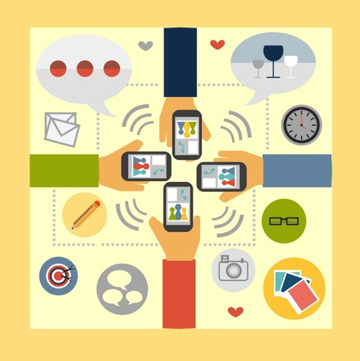
Enabling Technology to
Quantify Human Emotion
Technology doesn't understand mobile users circumstances (emotions and context).
This is recognised as an immediate and pervasive problem in the mobile world as it creates huge inefficiencies in the way brands, app developers, and service providers engage with their mobile customers.
What if our technology was emotionally and contextually aware and could react and adapt accordingly?
Notes:
Do you have to say NEAR real time??

Slide 2
What do we do?
emozia is developing incredible technology that will enable our smart devices to adapt and react to user’s circumstances (emotions & context)
Our patented-pending technology, in the form of an SDK, is embedded in the code of mobile applications. Running passively in the background, we utilise a gamut of sensors in a smart device to follow a mobile user’s environment and behavioral patterns.
From this we infer emotional states and historical trends that provide incredibly valuable analytics and actionable information for brands, apps, and service providers.

Slide 3




The Team
Aleks Vukasiovic (CEO)
Product Design and Innovation. Studied Computer Science and Neuroscience
Andrew Fooden (Chief Data Scientist)
Product Design and Implementation. Scientific work published in Journal of Neuroscience.
Rob Rattray (COO).
Business Development and Operations. Masters of Commerce. Third start up.
Stephanie Huber
Lead Software Engineer. Master of Computer Science.

Slide 4
How emozia works
SMART PHONE INPUTS
GPS
Accelerometer
Local Weather
Ambient Light Sensor
Microphone
Social Activity
Time & Date
ACTION POINTS
Sleep pattern
Work pattern
Home patterns
Exercise patterns
Commute/Travel Patterns
Real-time Actionable information: i.e. mood-based advertising or service augmentation
Algorithm
Insight's and predicative analytics: i.e. when to engage with mobile user’s at the most receptive times.
EMOTIVE VALUES (CONTEXT)
Time
Location
Happy/Sad
Irritable
Stressed
Fatigued

Slide 5
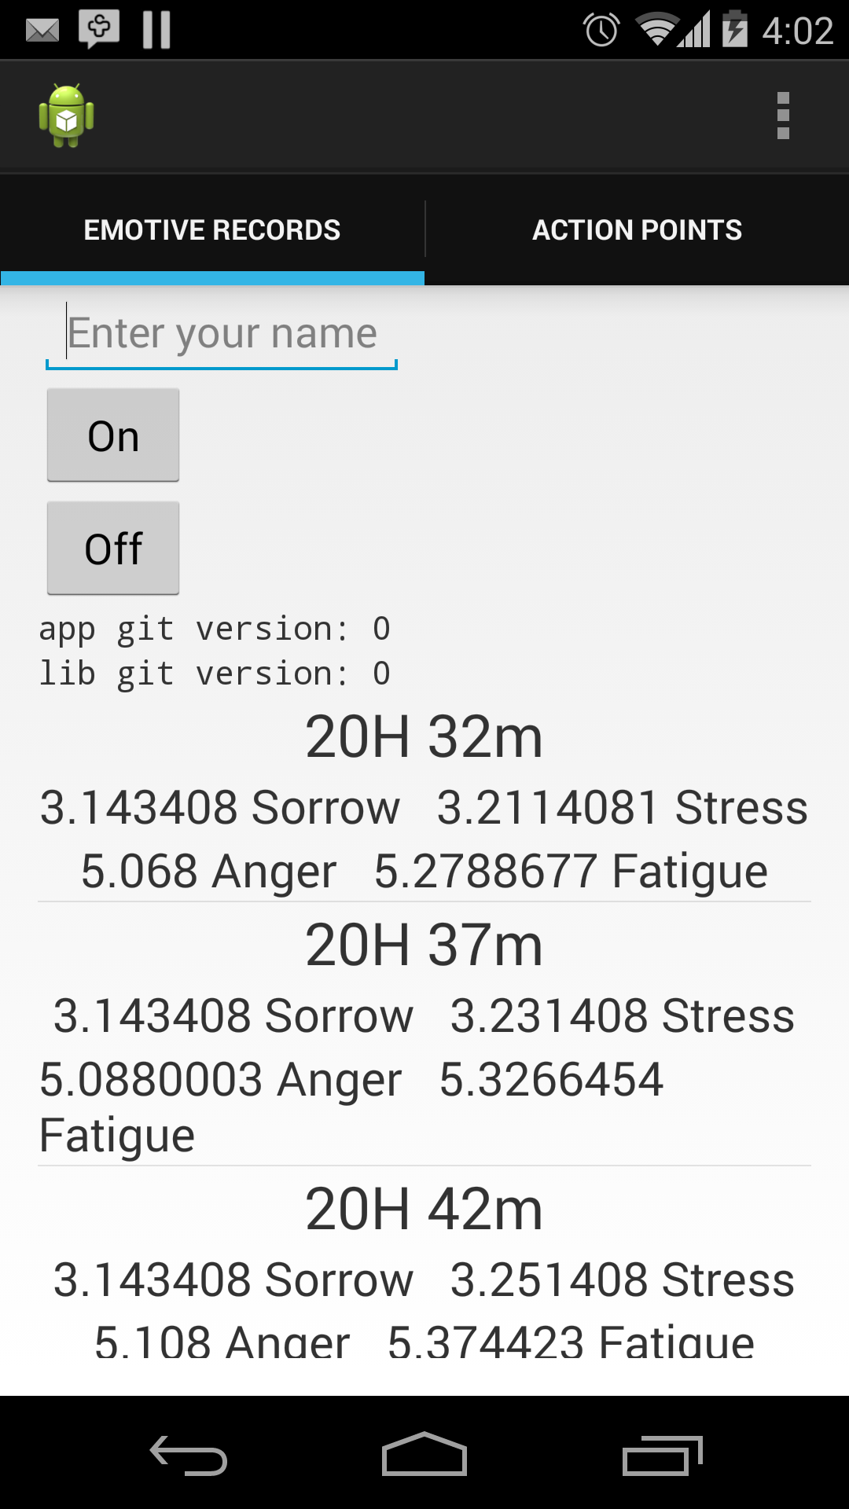
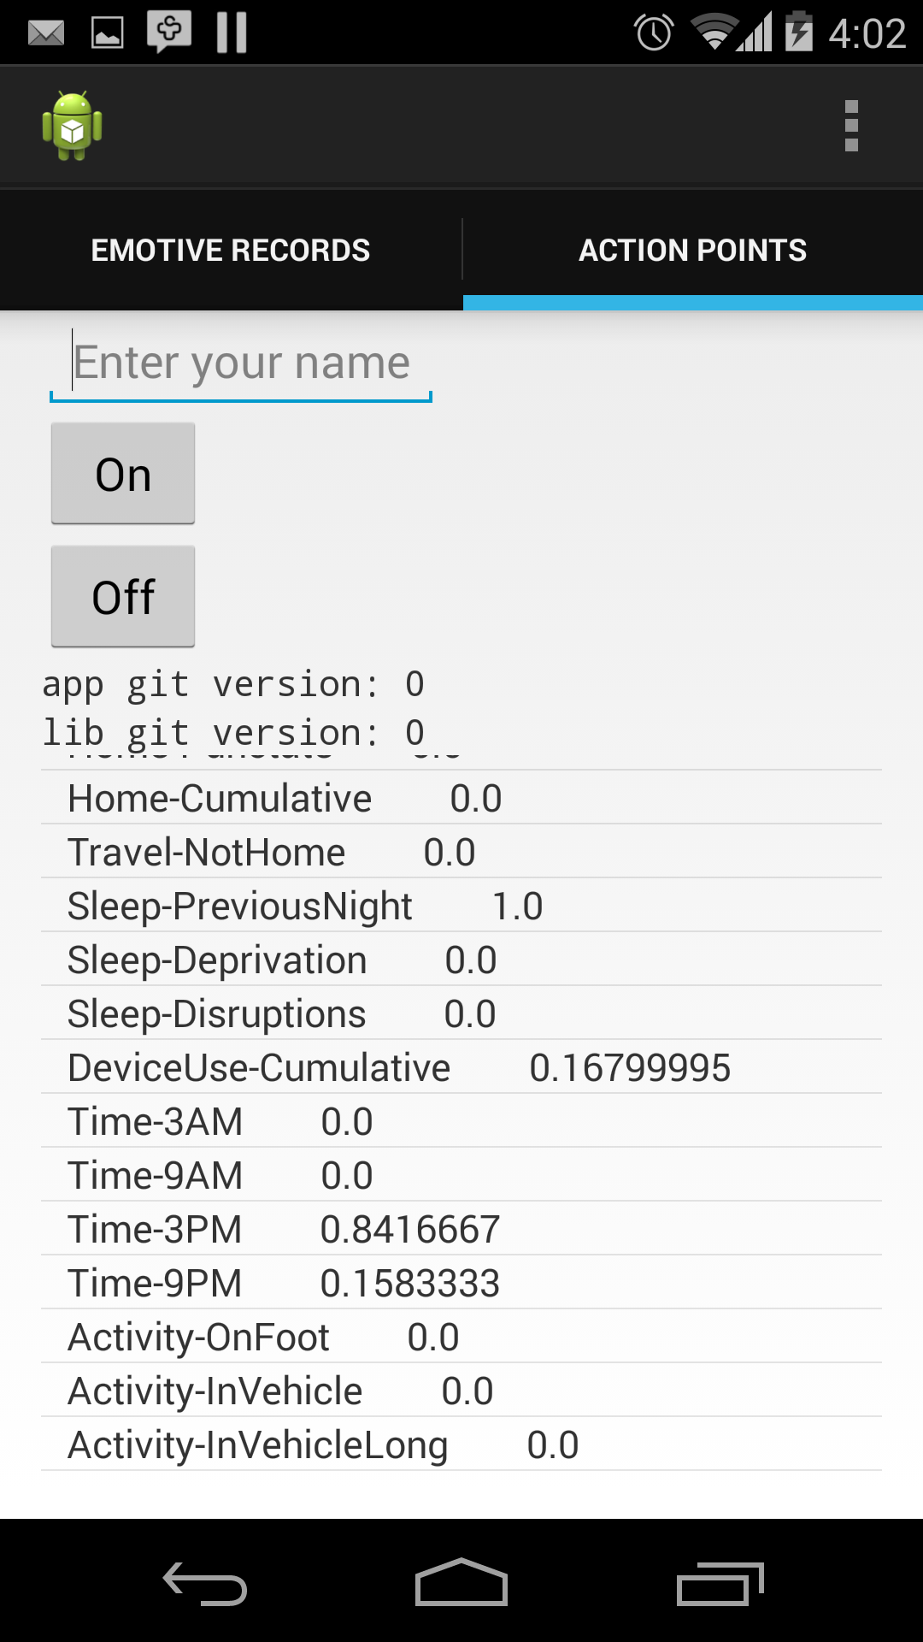
Technology Demo
A
B
Screen A shows raw emotive data that is accessible through our API
Screen B show some of the inputs that feed in to emozia’s patent-pending algorithm to produce emotive data

Slide 6
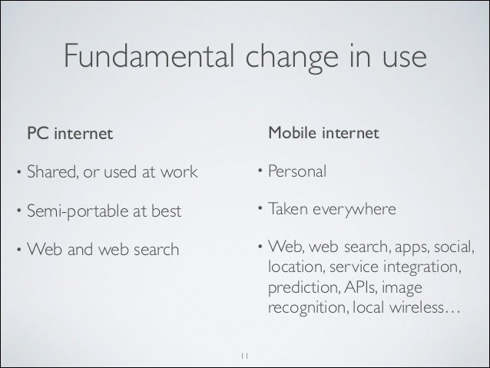
The time is right: It is this fundamental shift that makes our technology possible

Slide 7

Business Model
Mood-based Advertising: curate content and serve it at the most receptive time to increase conversation and click through rates.
App Development & Service Providers: augment application behavior/experience based on a user’s mood and environment to increase engagement, customer loyalty, and revenue generation.
Marketing & Consumer Brands: using our dashboard analytics companies can draw deeper insights in to consumer sentiment and buying behavior. Understand what circumstances lead to a specific decision or action.
Internet of Things: enable cars, homes, and technology devices to understand human emotions and adapt their experience and services based on peoples moods and context.

Slide 8
Use Cases
Marketing & Advertising | App Developers & Consumer Brands | Content Producers & Mobile Ad Tech
We use emozia analytics to gain insights in to mobile users; when and how to engage them in order to increase customer loyalty and consumer engagement. Contextual data gives us clues on what content will encourage consumer action. | We use emozia ERT to enhance the experience of our applications and provide a real-time engaging experience that no one else can based on user’s mood and environment. | We use emozia to target user’s with mood-based content when they are most receptive to engagement. This will drive conversions & click-throughs, content consumption, and user engagement

Slide 9
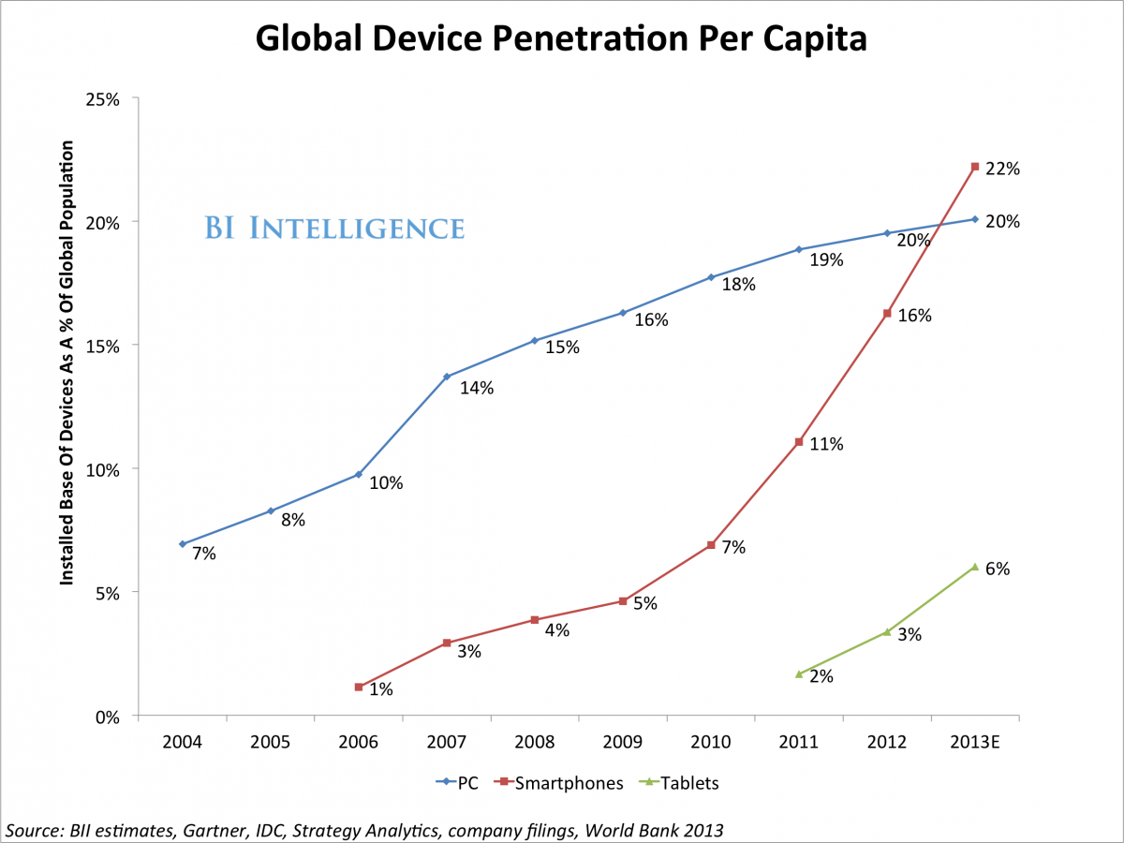
The Opportunity
Context Aware Computing (CAC) market is expected to grow from $26.50 billion in 2013 to $119.90 billion by 2018
According to Gartner, context-aware technologies are expected to make a $96 billion dollar impact on annual consumer spending across the globe by 2015
US mobile ad spend is projected to grow from $7.2 billion last year to $30.3 billion in 2018

Slide 10
Distribution
Free Download – Our SDK will be available at no cost for brands and app developers that want to augment the experience of the application based on mood. This will encourage scale and market penetration.
Business Developer/Sales – Brands and marketing and advertising agencies that want to use our analytics dashboard to draw deeper insights in to mobile users emotional and contextual environments will be charged a monthly subscription between $3000.00 and $5000.00 per month per API key
Strategic Partnerships -with Ad tech (inmobi) and/or analytics (Flurry) to incorporate our technology in to their advertising SDK leveraging their market reach, again this will be at no cost to encourage scale and market penetration.

Slide 11
Milestones
SDK MVP: Early April 2014
Dashboard MVP: End May 2014
Begin private beta with company(s): End May
Baseline accuracy for each continuum: August 2014
To market pilot: September 2014
Market penetration: 1,000,000 devices: February 2015
Market penetration: 5,000,000 devices: December 2015

Slide 12
Exit Strategy
Acquisition target
3 - 4 years
Value of acquisition;
  Developed and patented technology
  Market penetration (first to market)
  Aggregated data (emotional profiles and analytics)
  Team.

Slide 13
Recent Acquisitions
Recent acquisitions in related or similar fields of technology –
Deepmind, AI; acquired by Google for $400mm
Foresee Analytics, Customer Satisfaction and Insights; acquired by Answers Corporation for $200mm
Insight’s One, Predictive Technology and Pattern Recognition; Acquired by Apigee for an undisclosed amount.
SkyPhrase, speech recognition for mobile; acquired by Yahoo for an undisclosed amount
BlueKai, big data around advertising and marketing; acquired by Oracle for a reported $400mm

Slide 14
Risks
Technical skills of team; young development team
Privacy issues; push back from consumers regarding privacy
Emotional states provide little or no correlation; no value derived from understanding emotional states/mood.

Slide 15
Advisory Board
David Beatty - Managing Director of Golden Seeds. Angel investor and serial entrepreneur. First angel investor in emozia.
Gabe Zichermann - Expert, author, speaker & writer on the subject of gamification and engagement mechanics.
Vivienne Ming - Dr. Vivienne Ming, named one of 10 Women to Watch in Tech in 2013 by Inc. Magazine, is a theoretical neuroscientist, technologist and entrepreneur.
Paul Chu – Serial entrepreneur with experience through founding, growth, and exit. Angel investor and entrepreneurial speaker.
Katie Cuminskey – PhD in Psychology, specializing in the study of how humans interact with mobile devices.

Slide 16
The Market
Contact us
Rob Rattray
rob@emozia.com
+1 (917) 456 2508
Aleks Vukasinovic
aleks@emozia.com
+1 (914) 409 2013

Slide 17
References
http://www.marketsandmarkets.com/PressReleases/context-aware-computing.asp
Crunchbase article posted December 14, 2013. (http://techcrunch.com/2013/12/14/crunchbase-reveals-the-average-successful-startup-raises-41m-exits-at-242-9m/)
http://www.businessinsider.com/smartphone-and-tablet-penetration-2013-10
http://www.marketingcharts.com/wp/online/big-gains-forecast-for-location-targeted-mobile-ad-spend-41918/

