Slide 1

iRecruit
www.iRecruit-Software.com

Slide 2
iRecruit
7 New iConnect Components
MyiRecruit Portal
HR & Hiring Manager Internal Forms i.e. Assessments Forms
Company Forms – Background Checks, Employment Agreements, Etc, Etc, Etc.
All Federal, I9, W4 & State W4 Forms
Electronic Vault - Storage
Workflow, Status & Notification
Ability to export to HR & Payroll Systems

Slide 3

New iConnect Internal Forms Creation
iRecruit
TM
Create your Best Practices for interviews
Phone Screen Questionnaires
Requests for additional information
Why selecting candidate
And more. . .
www.irecruit-software.com

Slide 4
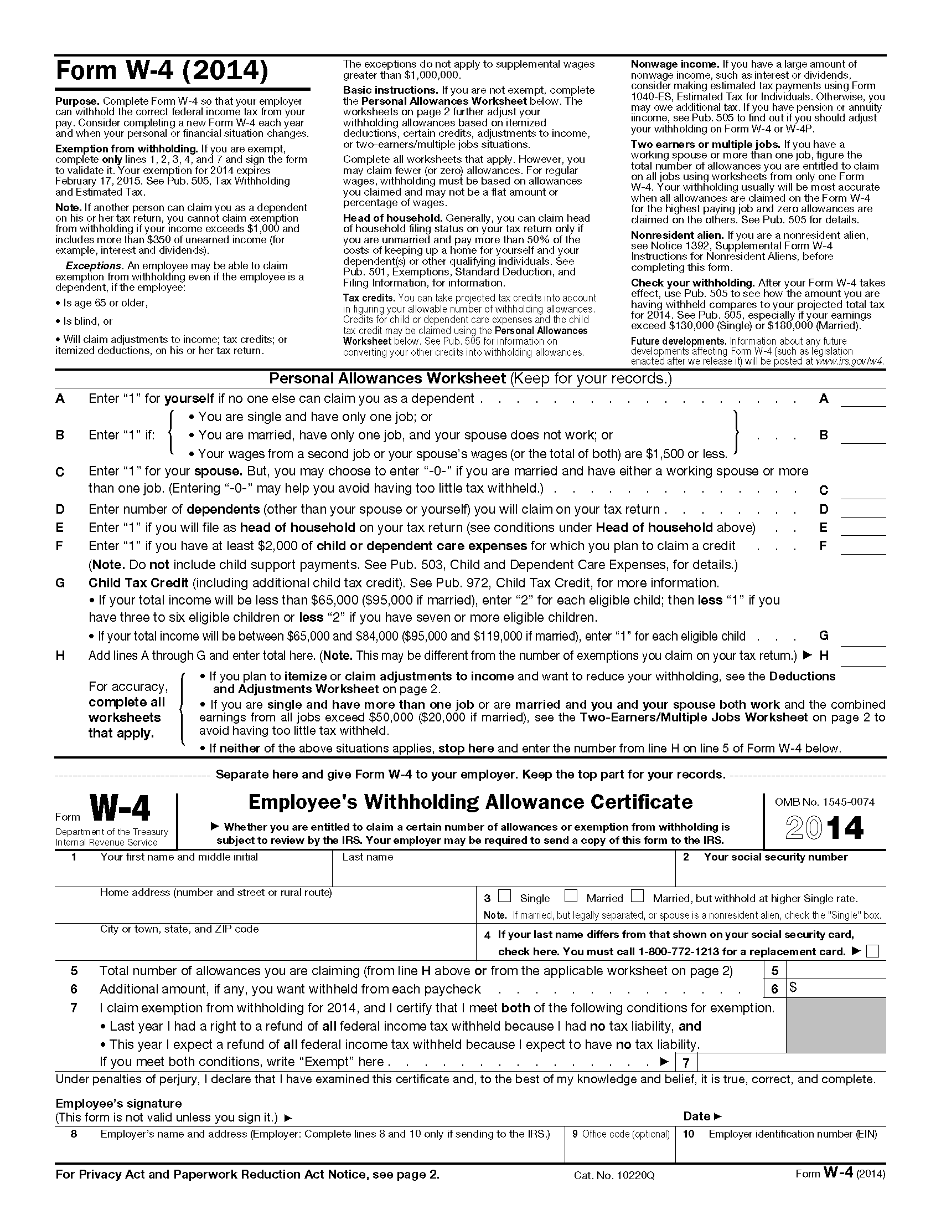
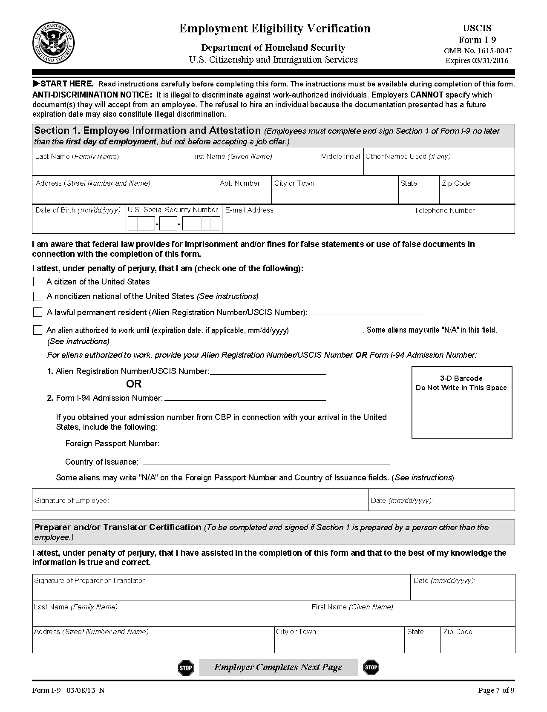
iConnect Employee Onboarding
iRecruit
TM
Create a positive new hire experience with iConnect.
Manage all new hire paperwork online in the Secure Applicant Portal.
iConnect includes I9s, W4s, and State Tax Forms.
Secure Electronic Signature
www.irecruit-software.com

Slide 5

Work Opportunity Tax Credit
iRecruit
TM
WOTC, is an incentive for employers that hire veterans, the disabled, ex-inmates, SNAP (food stamp) recipients and individuals receiving Supplemental Security Income.
The tax credit ranges from $2,400 -$9,600 depending on the eligibility category of each new hire.
10-15% of New Hires Qualify
www.irecruit-software.com

Slide 6

Benefits of iConnect
iRecruit
TM
Create custom new hire packages
Customize per position
Create a fantastic first impression to your new hires
Sign Documents Electronically
All documents are completely secure
Track status and send reminders
www.irecruit-software.com

Slide 7

Immediate Return on Investment:
iRecruit
TM
iConnect saves both time and money on your new hire process.
Reduced Administrative Costs
Reduce Time Spent on Manual Processes
Focus on Productivity
Employee Engagement
www.irecruit-software.com

Slide 8
iConnect Workflow
iRecruit
TM
Applicant is Hired
New Hire Forms Automatically Assigned
New Hire Completes “Paperwork” Online
Hiring Manager Approves Paperwork
Onboard To HR System
iConnect
www.irecruit-software.com

Slide 9
iRecruit
Contact Linzi Strong for pricing
lstrong@iRecruit-Software.com
1-800-571-9099
www.iRecruit-Software.com

