Slide 1
About this product
This product is not built
The purpose of this presentation is to get funding by pitching the product to investors.
I don’t have a name for this product.
This product is built for software developers, managers and auditors
This is an application which will help developers move their code from their development environment to test environment to prod environment.
Notes:
This will not be part of the final presentation. This slide is for powerpoint designers.

Slide 2
Lifecycle management
Dev 1
QA
UAT
Stage
Prod
Dev 2
Please see slide Notes in every slide
Notes:
This will not be part of the final presentation. This slide is for powerpoint designers.
The pink box (Dev 1, Dev 2, QA, UAT, Stage) are sandboxes. These sandboxes are used by developers.
Prod is the production org where users work.
The arrows show the direction of the code from Dev1 to QA to UAT to Stage to Prod.

Slide 3
Notes to the designer
I don’t want to use this powerpoint template. If you have a recommendation for a better template I am happy to use that.
I am okay with using Blue color because it is convenient, but I would like to see if we can use some other color such as Magenta without using elegance and still making it look professional.
I am looking for a clean, bold, consistent, powerful presentation.
I would like to use the same color (or colors) throughout with different shades.
Every slide has notes which communicates on what I want to communicate ☺
The images that I have inserted in the slide can be taken out. I don’t want to use those images. Instead, I would like to use Icons as shown in Appendix slides.
Please do not begin your work before you view Appendix slides. I am looking for the output to be like that.
Notes:
This will not be part of the final presentation. This slide is for powerpoint designers.
I am sharing two other powerpoint slides as examples. Please see the slides on editions and licenses. I really like it.
Please look at the appendix. I have inserted some slides where you can see some icons.

Slide 4
Final Output
I would like the final output to be like the slides shown in the Appendix slide.
Same colors, consistent, different shades.
Lots of use of icons and shapes.
The only thing that I am not sure about is the color. If we can use Magenta, and use it strategically, it would be great. Very much like T-mobile branding

Slide 5
Lifecycle management solution
Please see slide Notes in every slide
Notes:
(To Powerpoint designeers: this is the title slide. First slide).

Slide 6
Agenda
Trends’ in the market place
Solution
Approach to building the solution
Architecture
Phasing and Roadmap
Notes:
(To Powerpoint designers: this is the second slide. We could number them 1 through 5).

Slide 7
Disproportionate time is spent on non-development activities
Development
Integrating code
Troubleshooting
Release Management
Force.com
Legacy Platform
Effort
Notes:
(To Powerpoint designeers:
In this slide, I am saying the development time on Salesforce platform is much less.
However, if it takes much more effort to Integrate code, trouble shoot code and manage release compared to other platforms).
If we reduce the time for Integrating code/Troubleshooting/Release Management, then the time will be much less.
Troubleshooting/Integrating code/release managmeent don’t have to same color.
).
Force.com is a great platform for building applications. Developers can do even complex tasks using declarative development rather than writing code. The end result is that developers can quickly build applications.
However, if we take a step back and look at the entire software development life cycle, this has changed the whole economics of building applications. As a percentage of whole, developers spend much more time in deploying applications , migrating code, testing code and other activities rather than building applications.
I am working with a credit union. By any means, it is not a large bank. They spent over 40% of the time in troubleshooting the issues because they did not have change management process in place.
Integrating code
Deploying code
Testing code
Writing code
Quality assurance
Maintenance
Documentation
Release management
=====================================
=====================================
In a typical development, 70% of the time is spent on change management. This includes migrating code, testing changes, refreshing sandboxes, etc. Only 30% of the time is spent on he development. This data is collected from companies who are building force.com tools. Very little time is spent in building the application, but much more time is spent in deploying the application.
<Story>

Slide 8

Incomplete set of tools
Notes:
(To Powerpoint designeers: I want to show that there are tools in the marketplace: Eclipse, Change sets(which is a collection of files) and Ant Scripts. However, these tools are not enough and they don’t work with each other. They don’t provide complete visibility into which developer is working on which files, who is the last person who modified the files.).
http://www.istockphoto.com/stock-photo-11358289-bridge-construction.php?st=63793c0
http://www.istockphoto.com/stock-photo-13891283-system-not-working-quot-broken-quot-gear.php?st=5d1cefc
Even if you want to manage change, the tools are not sufficient and they don’t take you where you want to go.
There are few tools in the market place, but they are incomplete and they don’t work with each other.
Force.com eclipse plugin does not audit the changes. Migrating changes using Eclipse plugin is dangerous and fatal. Ad developer could overwrite the changes of another developer.
Change sets are not flexible. They don’t automate a lot of things. After deployment, they don’t mention the file that was changed.
Ant scripts need to be modified for every change, for every org. This makes them unusable. Also, there are very few developers for ant scripts.
I could overwrite changes from one org to another org. I don’t know the current state of the org before I am making the changes.
Eclipse plugin does not audit the changes.
Ignore the notes below:
There are not enough or the tools are not complete.
Change sets can move data only to production instance.
Migrating changes using Eclipse plugin is dangerous and fatal. I could overwrite changes from one org to another org. I don’t know the current state of the org before I am making the changes.
Eclipse plugin does not audit the changes.
Ant scripts need to be modified for every change, for every org. This makes them unusable.

Slide 9

Sandbox policies are inadequate
Tools don’t exist
Notes:
(To Powerpoint designers:
Explanation: Salesforce gives you the ability to create multiple copies of your organization in separate environments for a variety of purposes, such as testing and training, without compromising the data and applications in your Salesforce production organization. These copies are called sandboxes and are nearly identical to your Salesforce production organization.
What I want to communicate:
Sandboxes are expensive.
Sandboxes are limited
sandbox policies are inadequate.
So, organizations must know how to make the most use of sandbox so that they can deliver the product quickly without incurring more cost )
http://www.istockphoto.com/stock-photo-4259868-differences-screws.php?st=e88c851
Sandboxes are expensive and have a lot of limitations.
To refresh a full cycle management box, it takes 29 days for it to refresh. There are two options: Either you wait for 29 days OR buy more expensive sandboxes. None of the options is cheap. If you want to spend the least on sandboxes, that means you must have clearly defined processes to make the best use of every sandbox.
I was talking to a customer and they have only one sandbox. That means they develop in the same sandbox, test in the same sandbox, do integration testing in the same sandbox. Something if a developer is busy working on the box, they have to keep other developers out so that they can do the performance testing on this box.
What if we could make the best use of every sandbox?
What if you could refresh the entire sandbox at your own will? Use them in the right way.
Developer sandbox is 5%.... Refresh every 1 days.
Partial sandbox is 20%...refresh every 5 days
Full sandbox is 30%.... Refresh every 29 days

Slide 10
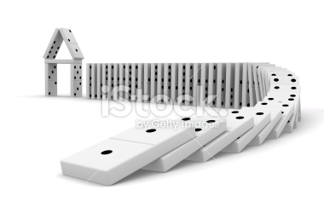
Processes are not defined
Notes:
(To Powerpoint designers:
Explanation:
What I want to communicate:
For correct lifecycle management, customers must do the following:
They should define different roles: developers, Devops, QA.
Depending on the role, each individual should be limited access to what they can. Developers should not have ability to login to production. Similarly, the devops person should not have to worry about file dependency.
Workflows are not defined. Changes done in a developer org may cause issues downstream into the production org.
Developers don’t have visibility into what files other developers are working on.)
Most organizations do not have clear separation of duties. I was talking to a healthcare customer. the changes are done in production by the marketing organization.
http://www.istockphoto.com/stock-photo-8832899-domino-effect.php?st=f27719e
Roles not clearly defined
Devops is non existent
Developers directly update the production org

Slide 11

Agile Methodology is growing rapidly
Notes:
http://www.istockphoto.com/stock-photo-31260288-women-draw-pdca-lifecycle-in-a-whiteboard.php?st=b07c812
(To Powerpoint designers:
Explanation:
What I want to communicate:
Most customers are moving towards Agile methodology which excabarates the problem. As a result of moving to this methodology, the code needs to be integrated more times, tested more times, migrated more times. In general, more time needs to be spent on release management.
How do we show that with Agile methodology the problems become worse?
)
Most customers are moving towards Agile methodology which excabarates the problem. As a result of moving to this methodology, the code needs to be integrated more times, tested more times, migrated more times. In general, more time needs to be spent on release management.
http://www.wallsave.com/wallpapers/1440x1080/weed/278213/weed-music-with-best-backgrounds-for-you-278213.jpg

Slide 12
Lifecycle management solution
Code promotion
Change Management
Troubleshooting
Build and test automation
Audit Analysis
Notes:
(To Powerpoint designers:
Explanation:
What I want to communicate:
I would like to have an icon for each of the above. One for troubleshooting, change management, build and test automation, audit analysis, etc
I have shown example of icons on the right side of the slide – 4 icons in blue ).
)

Slide 13
What if ?
clearly defined roles: developers, devops, QA, managers and auditors
developers would only focus on writing new code
devops could push only tested code into production?
managers could sign off every code push into the environment?
sandboxes were available for use when required and were used appropriately?
every developer and managers could improve the communication between them?
there are a system to make the migration and testing rigorous?
Notes:
(To Powerpoint designers:
Explanation:
What I want to communicate:
For correct lifecycle management, customers must do the following:
They should define different roles: developers, Devops, QA.
Depending on the role, each individual should be limited access to what they can. Developers should not have ability to login to production. Similarly, the devops person should not have to worry about file dependency.
Workflows are not defined. Changes done in a developer org may cause issues downstream into the production org.
Developers don’t have visibility into what files other developers are working on.)

Slide 14
Solution

Slide 15
Benefits
Consistent, predictable, repeatable results
Meet your compliance and governance requirements
Full visibility into change management processes
Improved developer productivity
Notes:
(To Powerpoint designers:
Explanation:
What I want to communicate:
I would like to have an image for each of the above.)

Slide 16

Framework to define lifecycle management processes
Dev 1
QA
UAT
Stage
Prod
Dev 2
Notes:
Framework to define your lifecycle management processes
(To Powerpoint designers:
Explanation:
What I want to communicate:
This solution is a framework where you can define the workflow processes for your org. We have an app for order management, supply chain, shipping. Similarly, this is an app for developers to manage the lifecycle of developers.
1. In this slide, I would like to highlight that this is a framework and show the code migration from dev to QA to UAT to Stage to Prod. )
Migration of tools from production to sandbox or from any org to org
http://www.istockphoto.com/stock-photo-11688682-steel-aluminum-welded-framework.php?st=3c5bf00

Slide 17
Architecture
Built on Salesforce to manage Salesforce
Management Console
Dev 1
Dev 2
QA
UAT
Stage
Prod
Notes:
There is no desktop component, this is completely built on force.com architecture. There is no java, no other technology other than force.com
(To Powerpoint designers:
Explanation:
What I want to communicate:
I like this slide. It needs to be polished and should look professional)
No other clouds involved. Most customers spend a lot of time in evaluating Salesforce platform from security and compliance perspective. This means that all the due diligence that you have done on the salesforce platform, is also relevant for this product.

Slide 18
Key Features
Separation of responsibilities: Different roles for different functions for Developers, DevOps, QA, Manager and Auditor
Access Control: Access is governed by their roles. Developers are limited to dev orgs, Devops can push changes to prod and QA can test only in QA.
Visibility: Managers & Auditors have complete visibility into code ownership and deployment process
Governance processes: Devops can only push the patch to prod after it has been tested under the same conditions.
Compare Orgs: Developers can compare orgs as well as take backup of their orgs
Notes:
(To Powerpoint designers:
Explanation:
What I want to communicate:
I would like to include one icon for each of the above features. )

Slide 19
Roadmap
Monitoring security privileges
Data Migration
Continuous Integration
Impact Analysis
Dependency Tracking
Automating builds and testing
Pre and Post refresh steps
Notes:
(To Powerpoint designers:
Explanation:
These are the features that will be reached in phase 2.
What I want to communicate:
I would like to include one icon for each of the above features. Please see the appendix for the slides. )

Slide 20
Project

Slide 21
Approach
Work with experienced Salesforce product development organizations.
Use Agile methodology. 2 to 4 week sprint cycle
Build a technical advisory committee
Focus: Less is more
Notes:
(To Powerpoint designers:
Explanation:
These are the features that will be reached in phase 2.
What I want to communicate:
Please see the attached project plan. )

Slide 22
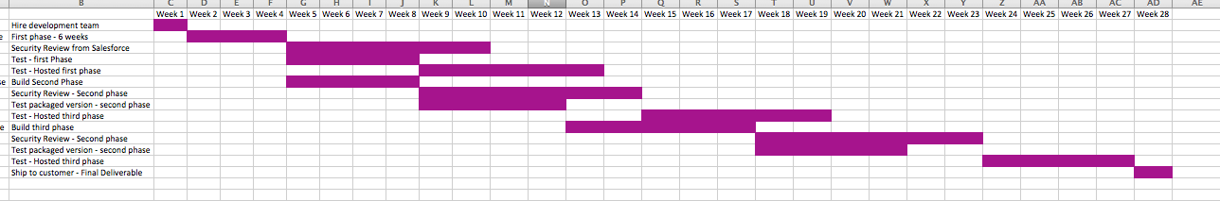
Project Plan
Milestones:
1st Phase: After 3 months
2nd Phase: After 5 months
3rd Phase: After 7 months
Notes:
(To Powerpoint designers:
Explanation:
What I want to communicate:
Please see the attached image for the project plan
I am not looking to communicate the exact sets of dates.
I want to communicate the thoroughness of the plan
I have thought about the project plan and it has been blessed.
)

Slide 23
Risk Mitigation
Completed a proven end-to-end prototype
In touch with most of the Salesforce product managers
Project plan has been thorough reviewed by 3 top-notch consulting providers

Slide 24
ROI
Average cost of developer: 150K
Reduction in deployment time: 5%: 7.5K
Reduced license cost: $1,500 per year
Net Savings: $9 K per developer
Intangible process improvements:
Meet compliance requirements & governance
Reduce Audit cost
License cost per year: $3600 per developer
ROI: 250% in first year

Slide 25
Cost to build
Agile Methodology
10 4-week sprint cycles with 3 developers and 1 QA
Hire dedicated experienced Salesforce developers for QA
Extra cost for security review
Total cost: $ 540,000
Notes:
(To Powerpoint designers:
Explanation:
These are the features that will be reached in phase 2.
What I want to communicate:
I would like to include one icon for each of the above features. One for Agile Methodology. )

Slide 26
Appendix
Notes:
The rest of the slides are examples of what I like.

Slide 27

Platform Spark for Application Modernization

Slide 28
Engagement Model

Slide 29
Phases of an Engagement
Scoping and Alignment
Scoping and Alignment addresses the scope, the key resources and the goal of the engagement . Key tasks include identification of an Executive Sponsor, definition of scope, definition of outputs and identification and commitment of key customer and SFDC resources.
Discovery
The Discovery Process enables the Team to fully understand the scope of the business problem and deliver the expected value. Discovery may include meetings with key stakeholders, line of business, and technologists.
Solution Development
Upon agreement of findings, a collaborative process will be used to finalize the Solution Design, prioritize business needs and provide a phased approach (Roadmap) to a successful implementation of the proposed solution.
Solution Presentation
Presentation of Business Case, Justification and Recommended Solution (Technical Blueprint)
to stake holders, identifying tangible benefits

Slide 30
Examples of Deliverables
Discovery Findings
Capture, prioritize and link business initiatives to technology drivers
Architecture Solution
Prepare and document a sample technological solution that supports short and long-term
business goals
Roadmap
Plan that defines the high level steps/phases of people, process, and technology necessary
to achieve the organization’s goals
Business Case
Develop business-level justification for implementing technological solutions (e.g., ROI, ROA, TCO analysis, benchmarking, and inclusion of industry best practices and reference cases)
Best Practices
Best practices for implementation.

Slide 31
Platform Spark Engagement Model
Task
Action
Deliverable
SDFC Resource
Customer Resource
Executive Sponsorship
Management Commitment
Sponsorship
Account Executive
C Level
Application Viability Analysis
Analyze Potential Targets for Force.com
Target Application List
Business Architect & Lead Sales Engineer & Platform Architect
Enterprise Architect
Business Architect IT
Financial Discovery: Current Footprint
Provide budget numbers
Financial Model for
current state
Business Architect
Financial Budget Expert
Force.com Application Cost Hypothesis
Build Galorath TCO Hypothesis
Financial Model for
future state
Business Architect
Value Engineer
Enterprise Architect
Application Benefits Analysis
Value Drivers and Benefits
Value Assessment
Business Architect
Value Engineer
Business Architect and
LOB Owner
Financial Analysis
TCO and ROI
Total TCO and ROI
Business Architect
Value Engineer
Financial Budget Expert
Overview of Enterprise Architecture & Cluster Analysis
Map Technical Application Architecture
Cloud Architecture
Platform Architect Solution Engagement Manager
Retained Architect
Enterprise Architect
Business Architect IT
Phased Deployment Roadmap
Project Plan and Reusability
Application Deployment Schedule
Solution Engagement Manager Retained Architect
Enterprise Architect
Business Architect
Deployment Model
and COE Structure
Application deployment and maintenance
Services Engagement
Solution Engagement Manager
Implementation Partner
Retained Architect
Information Technology Team

Slide 32

C Level Overview
For C Level discussion to explain how we can work together

Slide 33
Typical Candidates for Platform Discovery
Interviewees
Discussion Topics
Executive Management
(1 hour interviews)
Strategic goals and key business priorities
Key issues and challenges
Operational objectives and KPI’s
Vision for future state capabilities
Business / Process Managers
(~2 hour group workshops)
For process capability areas in defined platform scope
Department organization and key objectives
Key issues and challenges
Current and desired process capabilities
Initiatives underway or planned to address key challenges
Current IT applications and systems in use
Review relevant operating data
  Headcount, costs, cycle times, quality metrics, etc
Brainstorm major root causes and improvement opportunities
Information Technology
(1-2 hour interview / group workshop)
Existing technology landscape
Key IT issues and challenges
Impact of current technology on capability gaps
Current IT operating costs

Slide 34
Typical Platform Spark Process
1
Mutually agree on project objectives, scope and timeline on formal scope call between designated customer and SFDC leadership
Confirm executive sponsor, project owner, and project team
2
Determine and secure mutual approval of project scope
3
Confirm and execute discovery process
Secure preliminary application data request items
Set business process owner interview (and/or workshop) dates
Execute discovery with key stakeholders
4
Develop and validate analysis with key customer stakeholders
5
Deliver executive presentation of engagement findings

Slide 35
Platform Candidate
Filter Criteria

Slide 36
Establish the Application Candidates
Assess
Landscape
Assess
Corporate
Impact
Drivers
Innovation
High Level
Fit
Stack
Rank
Candidates
Sequence
Implementation
General Application Fit for SFDC Platform
Existing
Enterprise
Applications
Adaptability Technology
Integration Complexity
Consumption
Metrics
Stack Rank:
Strategic Impact
Business Value
Priority
Identify Core Reusable Components
Define Phases
Core Reusable Capabilities
App Sequencing

Slide 37
Platform Candidate Filter Criteria
Operational
Integration
Application development
User experience
Business advantage
Audit and compliance related requirements
Applications requiring immediate deployment without setup lead-time
Applications at risk for on-time, on-budget project delivery
SLA/ business continuity
Integration cost
and timeframe
Applications that require Data persistence, Business logic and/or UI -level integration
Multiple application integration requirements
API-enabled, REST, SOAP, Batch Feeds / Flat Files, ESB
Evolving business requirements
Mobile requirements
/HTML5 / Touch
Applications that benefit from the ability to centrally write, deploy, and manage apps across multiple types of devices
Complex data models required by business
Requires self service, knowledge repositories and/or integrated document management
Integral collaboration requirements
Process/
Workflow-oriented
Varying degree of UI customization
Used by external communities (Clients, counterparties, etc.)
Application behavior controlled by business or end-user
Applications or processes that bridge multiple business units (ie, Front to back office)
Disqualified Applications
Guaranteed sub-second response time, OLAP Hierarchical drill down (classic “cubes”), Real-time, computationally-intensive, ultra-low latency requirements, uptime requirement beyond our SLA

Slide 38
What Do Most of These Apps Have in Common?
Relational Database
User Management
Lots of structured data
Administration
Need referential integrity
Granular access control
Search, auditing
Hierarchy and profiles
Real-time reporting
User Interface
Business Processes
Intuitive for business users
Data-driven workflows
Multi-language/currency
Human approval processes
Browser, mobile, rich client
Integration with other
business systems

Slide 39
What about non-functional requirements?
Does your app need…
Scalability & Availability
Reliability
200,000+ apps on Force.com
99.9% uptime
>200M transactions/day
Live, transparent system status
<300ms response time
Backup & DR
The platform now processes over 40 Billion transactions per quarter. A transaction is defined as either a database call generated from our UI or an integration call.
Security
Security certifications include SysTrust, GSA, SAS 70,
and HL7

Slide 40
You also need to consider…
Existing environments
User needs and experience
Organizational considerations
Application urgency and criticality
Availability of alternatives
Change management and communication

Slide 41
What kind of apps are not a good fit?
Mostly non-relational data
Brute-force code-breaking
Video/audio/binaries
Multi-dimensional analysis
“Write-only” RFID logs: never delete, rarely read/query
Very few users
Content-only websites
(see Site.com!)
Data mining
No business process
Video encoding
Gaming applications
No UI
Raw computing
System apps
Physics simulations

Slide 42

Core Operating Principles
The following seven core operating principles, which, from an engineering point
of view, constitute the minimum critical mass required for platform transformation

Slide 43
Core Operating Principles
Reliability, maintainability, scalability, and availability
Usability
Composability
Flexibility
Security and
compliance
Internationalization
and localization
Interoperability

Slide 44
Core Business Architecture Principals
Reliability, maintainability, scalability, and availability
Reliability
Maintainability
Scalability
Availability
A component of availability management that focuses on reducing the frequency of outages
The ability to operate an IT service without negatively affecting system availability
The ability of an IT service to increase or decrease capacity while minimizing cost and without affecting availability
A service management process that helps define the customer’s requirements for IT service availability.
The core focus is to understand how unavailability affects
the business.

Slide 45
Core Business Architecture Principals
Flexibility
Flexibility in this context refers to maintaining the right balance between tight integration of systems across operating companies and the group’s ability to respond effectively to organizational and market change.

Slide 46
Potential Benefit Targets
Client Service
Business Efficiency
Mobility
Social & Marketing
Data Retention
Risk Management and Control
Technology and Innovation
User Experience
Branding
Expanded Scope (global)
Business process automation
Application Consolidation & cost savings when move to SFDC platform

Slide 47
Maximize Business Value of IT

Slide 48
Taking Charge of the IT Value Conversation
© 2010 MIT Sloan School of Management
CIO’s increase the impact and strategic role of IT by taking charge of the IT value conversation.
They use performance measures to focus decisions, improve relationships, and find new sources of value from IT.
Metrics complement relationship building, helping IT leaders evolve into strategic partnership with business executives.

Slide 49
Performance vs. Value
vs
We define value to mean delivering performance on a dimension that stakeholders find important
The performance dimension may be monetary, such as revenue or profit, or non monetary such as customer satisfaction or process reliability
Delivering performance
on an unimportant dimension has no value; value is in
the eye of the stakeholder

Slide 50
Three Types Of Metrics
IT leaders who drive conversations about value help their enterprises to maximize the business value of IT
Matrix of performance measures that CIO’s can use
Operations
Projects
Innovation

Slide 51
Maximize Business Value of IT
Operations
Projects
Innovation
Existing infrastructure and business processes
Reliability, costs, and quality of operational execution
Value derived by improving performance to acceptable levels; further investments are better spent on other sources
of value
Executing change activities
Project measures relate to delivering expected benefits for
a well-defined course of action
Key is to assess business
value realization
Ability to investigate potentially valuable opportunities
Goal of innovation activities is to generate a broad set of ideas and help the most valuable ones take shape
Innovation activities aim to reduce uncertainty around
the potential benefits of many risky alternatives

Slide 52
Typical Timeline for an Platform
Value Engagement
Activities |  | Pre-Work | Project Week¹
 |  |  | 1 | 2 | 3 | 4 | 5
Review and Approve Project Scope
Schedule Discovery Requirements Workshops
Preparation (Application Inventory & Financials)
Submit and Respond to Application Architecture Request and Financials
Conduct Executive Interviews
Conduct Discovery Workshops
Assessment, Analysis, Solution Design
Refine Hypothesis, Collect Additional Data
Develop & Iterate Presentation
Interim Review of Assessment, Solution
Refine Business Case, Cost Estimates, Roadmap
Deliver Final Recommendations
Note: 1) Illustrative timeline only; actual timeline depends on specific project scope, resource availability, and availability of information provided by customer in response to the SFDC data request

Slide 53
Salesforce Business
Case Engagement

Slide 54

Force.com TCO:
Building A Collaborative Business Case

Slide 55
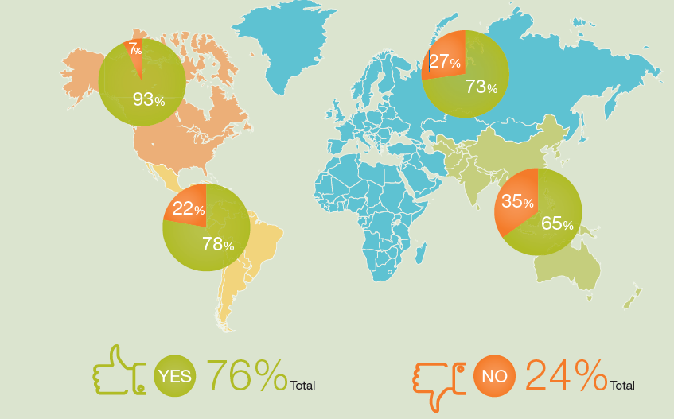
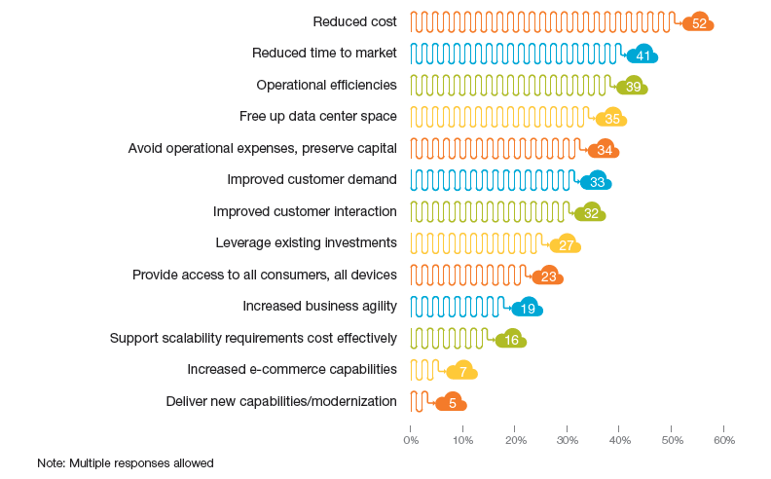
Cloud Computing Dominates Global IT Landscape
Do you have a Cloud adoption strategy in place?
(Percentage answering “yes,” by region)
What are the business drivers behind moving to the Cloud?
Source; Capgemini - Business Cloud: The State of Play Shifts Rapidly
Notes:
Cloud Computing is a major focus area worldwide. Majority of the enterprises have attempted drafting cloud adoption strategy with North American enterprises leading the pack. On an average, a quarter of enterprises are yet to realize the value of cloud.
Not surprisingly, the reduced TCO is driving the cloud adoption. The famous “capex to opex cost shift” has dropped down a few slots in the stack of reasons. Interestingly, enterprises are realizing the potential of the cloud to cut the time to go to market.
Customer interest is also a major driver. As the use of smart phones and tablets is increasing, enterprises are being pressurized to provide access to their applications on modern mobile platforms in addition to traditional ones. This is driving enterprises to “modernize” their applications on the modern cloud platforms.
<Emphasize> while most companies have identified the need to drive cloud adoption and put in a strategy to drive cloud adoption, the main business drivers are really to drive the TCO significantly down. Ask the client if they have a cloud adoption strategy? What factors drive that ? How do they intend to realize the TCO savings?

Slide 56

Infrastructure Slows Down Application Development
Hardware Infrastructure
Software Infrastructure
Network
Data Center
Multi-Device
Redundancy
Storage
Availability
Disaster
Recovery
Scale
Operating System
Datebase
App Server
Web Server
Security Server
Integration Server
Mobile Server
IDE
New Projects
Infrastructure
“IT spends 80% of it’s time and resources keeping the lights on”

Slide 57
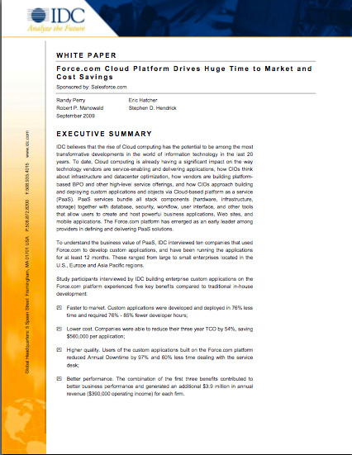
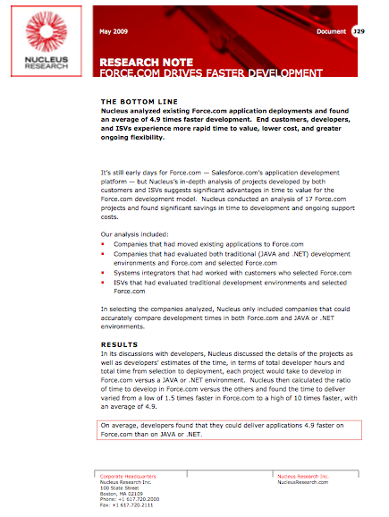
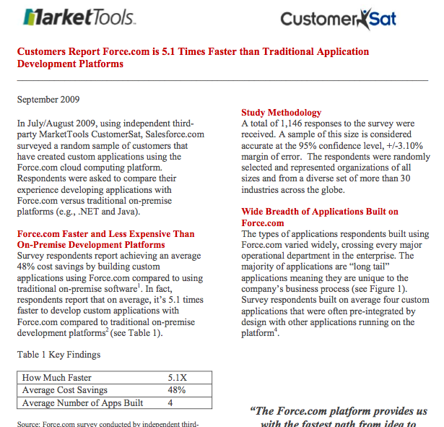
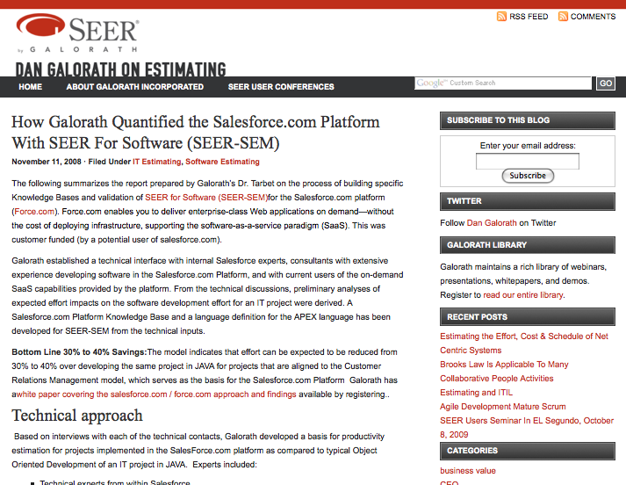
Proven Business Results
Benefits validated by 4 different reports
IDC
4-5x faster
45% less TCO
97% less downtime
Nucleus
4.9x faster
MarketTools
5.1x faster
51% less TCO
5.1 average apps
Galorath
5x faster
40% less TCO
4 Different Reports in 12 Months Prove 5x Faster and ½ the Cost
Notes:
Snapshot of study

Slide 58
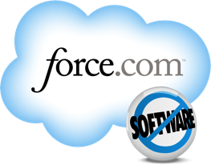

Force.com is 5X Faster and Half the Cost
Deliver Apps 5x Faster
Half the cost
Point and Click for Business Users
Coding for Developers
Fewer IT Resources
No Hardware/Software
Includes: staffing, infrastructure, licenses, IT support, and changes.
On-premise Software
+81%
+78%
76%
faster assembly and integration
$1,030,000
3-year TCO
+53%
coding productivity
+60%
+55%
faster deployment
faster design
faster configuration
faster system testing
Force.com
$470,850
3-year TCO
IDC White Paper sponsored by Salesforce.com: “Force.com Cloud Platform Drives Huge Time to Market and Cost Savings”,
Doc # 219965, September, 2009
Notes:
We at Salesforce think that there is a better way. Force.com is the platform built for Cloud 2. You don’t have to worry about infrastructure, maintenance, or upgrades. Apps built on our platform automatically mobile and social.
Force.com helps application builders deliver applications five times faster at half the cost.
With force.com, it faster to design, assemble, code, configure, test and deploy your apps. By building apps in the cloud, you are freed from the traditional pains of and expenses of hardware and software. According to an IDC study, it’s 5X faster and half the cost to deploy custom apps.

Slide 59
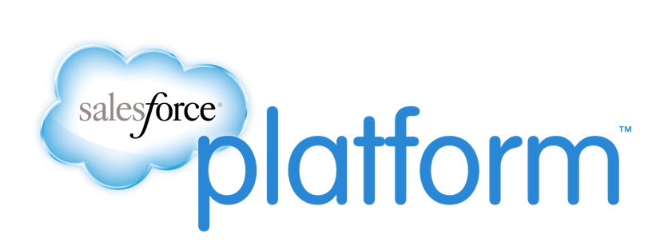

The Fastest Path From Idea To App
+58%
Faster
Deployment
+55%
+52%
+52%
Faster
Configuration
+46%
Faster
System
Testing
Faster
Design
+45%
Faster Integration
Decrease in
IT Costs
+43%
Increase in
Coding
Productivity
Average Percentage Improvements Reported by Customers
Source: Salesforce.com Customer Relationship Survey conducted March 2013, by an independent third-party, Confirmit Inc., on 5,200+ customers randomly selected. Response sizes per question vary.
Notes:
We at Salesforce think that there is a better way. Force.com is the platform built for Cloud 2. You don’t have to worry about infrastructure, maintenance, or upgrades. Apps built on our platform automatically mobile and social.
Force.com helps application builders deliver applications five times faster at half the cost.
With force.com, it faster to design, assemble, code, configure, test and deploy your apps. By building apps in the cloud, you are freed from the traditional pains of and expenses of hardware and software. According to an IDC study, it’s 5X faster and half the cost to deploy custom apps.

Slide 60



Force.com is Faster
Pay For Innovation, Not Infrastructure
Traditional Platforms
Improvement
FTEs per app - development | 7.32 | .42 | 94%
Avg development time per app (weeks) | 27 | 11 | 60%
Number of apps developed annually | 3 | 10 | 293%
Calendar days to make changes | 45 | 10 | 78%
✔
✔
✔
✔
Custom applications required 76%-85% fewer developer hours.
IDC White Paper sponsored by Salesforce.com: “Force.com Cloud Platform Drives Huge Time to Market and Cost Savings”, Doc # 219965, September, 2009

Slide 61
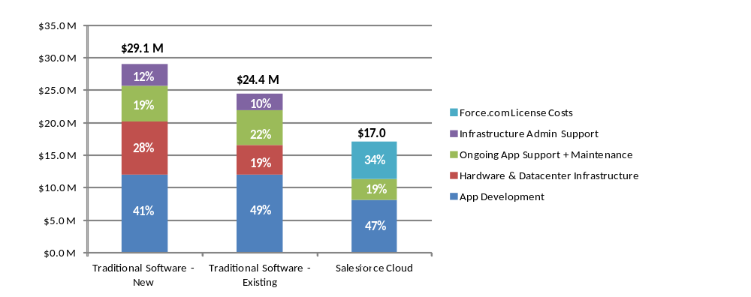
Customer Sample of TCO Reduction
Cost Breakout | Traditional Software - New | Traditional Software - Existing | Salesforce Cloud
App Development | $11,963,610 | $11,963,610 | $8,049,326
Hardware & Datacenter Infrastructure | $8,252,657 | $4,584,810 | $0
Ongoing App Support + Maintenance | $5,414,300 | $5,414,300 | $3,219,730
Infrastructure Admin Support | $3,431,163 | $2,450,831 | $0
Force.com License Costs | $0 | $0 | $5,760,000
 | $29,061,731 | $24,413,551 | $17,029,056

Slide 62
Proposed Implementation Approach
Application 1
Application 2
Benefits
  Establishes PSRPT Integration
  Establishes Informatica Middleware
  Establishes All Employee
  Data in SFDC
Integrations
  PSRPT
  Peoplefluent
  MS Exchange
  Conga
Users
  100+
Application 3
Benefits
  Re-uses PSRPT Integration
  Re-uses existing Employee data
  Establish Docusign Integration
  Establish Conga Integration
Integrations
  PSRPT
  Conga
  Docusign
Users
  200
Benefits
  Re-uses PSRPT Integration
  Re-uses existing Employee data
Integrations
  PSRPT
  Docusign
  CARCO *
  A9 *
  HRDMS *
Users
  10,000

Slide 63
Proposed Implementation Approach
Application 4
Application 5
Benefits
  Re-uses PSRPT Integration
  Larger user population
  Foundation for central workflow repository
  Establishes ESB Integration
  Establishes initial Cloud integration
  Re-uses existing
  Employee data
  Establishes all users
Integrations
  PSRPT
  Cloud (Successfactors)
  On Prem (Informatica)
  On Prem (ESB)
  LDAP
Users
  60,000+
Application 6
Benefits
  Re-uses PSRPT Integration
  Re-uses existing
  Employee data
  Re-uses existing Users
  Re-uses Control Center
Integrations
  PSRPT
Users
  60,000+
Application 7
Benefits
  Re-uses PSRPT Integration
  Re-uses existing Employee data
  Re-uses existing Users
  Re-uses Control Center
  Re-uses LDAP Integration
Integrations
  PSRPT
  LDAP
  Badge System(s)
Users
  30,000+
Benefits
  Re-uses PSRPT Integration
  Re-uses existing
  Employee data
  Re-uses existing Users
  Re-uses Control Center
Users
  10,000+
Integration
  PSRPT

Slide 64
Leverage Cloud Platform - SFDC
Initiative | Goal Alignment | Initiative Description | Proposed Benefits
Leverage cloud platform | Business Agility TCO reduction New Technology | Partner with SFDC to accelerate implementation plan Completed analysis for sweet spots Tier 2 /tier 3 applications Factory model execution approach | Significant reduction in TCO Reduced enhancement costs Higher Speed to market
Application inventory
High level approach
High level business case extrapolation using set of applications
Implementation by leveraging customer enterprise solutions units CoE and factory model execution
Platform Suitability
Filter
Shortlisted ~ 300 applications

Slide 65
Target Set: Platform Candidate Filter Criteria
Operational
Integration
Application development
User experience
Business advantage
Audit and compliance related requirements
Applications requiring immediate deployment without setup lead-time
Applications at risk for on-time, on-budget project delivery
SLA/ business continuity
Integration cost
and timeframe
Applications that require Data persistence, Business logic and/or UI -level integration
Multiple application integration requirements
API-enabled, REST, SOAP, Batch Feeds / Flat Files, ESB
Evolving business requirements
Mobile requirements/
HTML5 / Touch
Applications that benefit from the ability to centrally write, deploy, and manage apps across multiple types of devices
Complex data models required by business
Requires self service, knowledge repositories and/or integrated document management
Integral collaboration requirements
Process/Workflow-oriented
Varying degree of UI customization
Used by external communities (Clients, counterparties, etc.)
Application behavior controlled by business or end-user
Applications or processes that bridge multiple business units (ie, Front to back office)
Disqualified Applications
Guaranteed sub-second response time, OLAP Hierarchical drill down (classic “cubes”), Real-time, computationally-intensive, ultra-low latency requirements, uptime requirement beyond our SLA

Slide 66
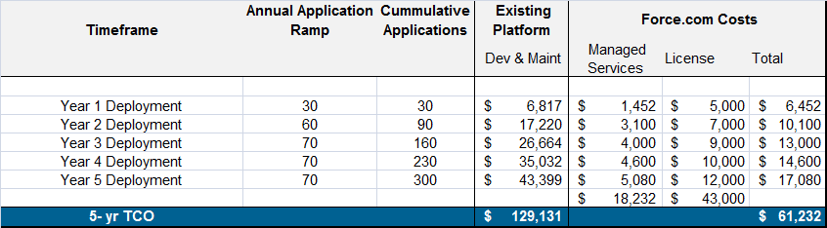
Platform Rationalization Initiatives
Target Tier 2 and Tier 3 Applications
Current State
Impact
Optimization Goals
3rd Party Leverage
Applications commanding significant cost investment
Legacy hardware and
software impacts
application development
On premise IT strategy for all applications rather than moving to cloud as appropriate
High cost investment
Costly maintenance
Complex development
requires time
Diverse platforms and
limited agility
Constrained innovation
Deliver more applications with less resources
Lower investment costs
Make application
changes faster
Create reusability with
prebuilt components
Leverage Managed Services Practice for application conversion and support
Leverage cloud technology. (Force.com)
Increased IT and Ops synergy with the business
3rd party Approach and Roadmap
Use platform engagement to set baseline application cost
Validate platform candidates that are viable across LOB’s
Engage with Salesforce.com team to calculate cost of
target applications
Analyze additional application benefits
Create financial analysis

Slide 67

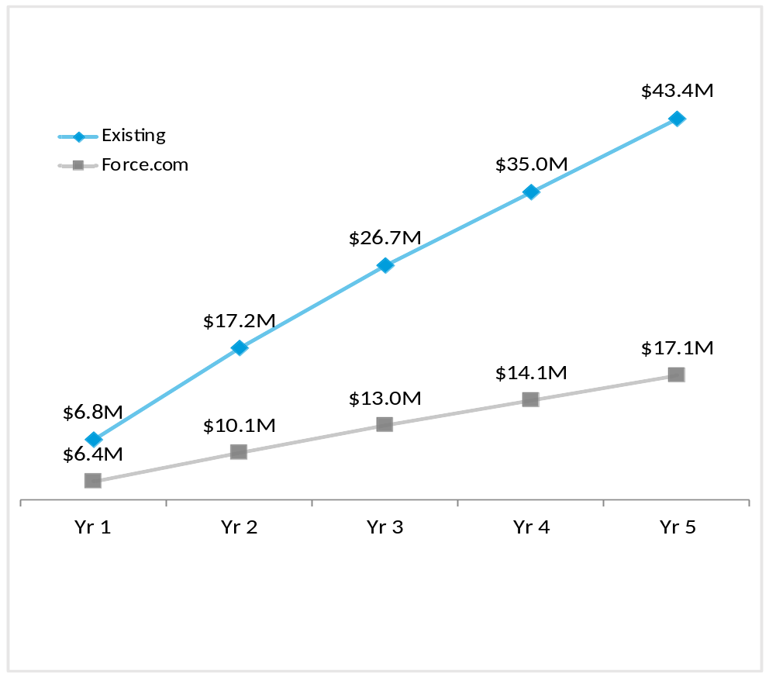
Existing Platform vs. Force.com
Baseline Costs Derived from Engagement
(for Existing platform = Change + Enhancements)
(per app per year)
$108K
75% less
$27K
Existing
Force.com
Engagement Application and
Infrastructure Maintenance
(per app per year)
Existing
Maintenance
$84K
Infrastructure
/Licensing
$36K
App deployment schedule: 30 in yr 1, 60 in yr 2 & 70 in yr 3, 4 & 5 resp.
Costs include one-time application development cost per year for # of apps deployed, and annual application and hardware maintenance of past and current apps.
Force.com
App maintenance
$5K
Force.com cost estimations are based on a 3rd party model developed by Seer Galorath which allows end-users to estimate the development costs, schedule, effort, risk and reliability of their software projects using Force.com

Slide 68
Factory Components
Program Management
Program Management and Governance
Resource Management and Deployment
Business Analysis Group
Functional Design
Business
Requirements
FDDs
TDD
UNIT Test
Case & Data
Integration Test Cases
Development & Integration Factory
Data Migration Factory
Rollout & Deployment Factory
Technical Factory
TDD
TDD
Extraction
‘Delta’
Analysis
Delta
FDDs
SFDC/
Force.
com
Format Neutral Staging Area-Transformation
Business
Integration
Delta
TDDs
Batch/
Real time
BW-
ODS
CLI /Apex
DataLoadr
SFDC
Legacy
Systems
Incremental
Development
Test Factory
Test Factory
Unit Testing
Regression
Test
Integration
Testing
Support and Maintenance Group
Application
Maintenance
L1 Support
L2 Support
L3 Support
Large
Enhancements
MS
3rd Party
Shared

Slide 69
Factory Staffing Model
Release to Release movement of consultants to share
and enrich experience
Transition
Career
Progression across the factories
Release A
Release B
Accelerated handover from development to support team
Tech. Architect
QA Lead
Data Migration Architect
Factory Resource Pool
Tech. Lead
Senior Tester
Data Migration Analyst
Developer
Junior Tester
Team Member
Development
Testing
Data Services
Maturing through multiple Project Experience
Project Closing
Project Execution
Project Initiation
Experience Pool
Best Practices
Reusable asset
Tools, Checklists
Design Review
Technical guidance
Best Practices
Reusable asset
Tools, Checklists
Trained Pool
Knowledge Repository
Factory Training
Factory
Environment
Factory Tools
Team Induction

Slide 70
Thank you

