Slide 1
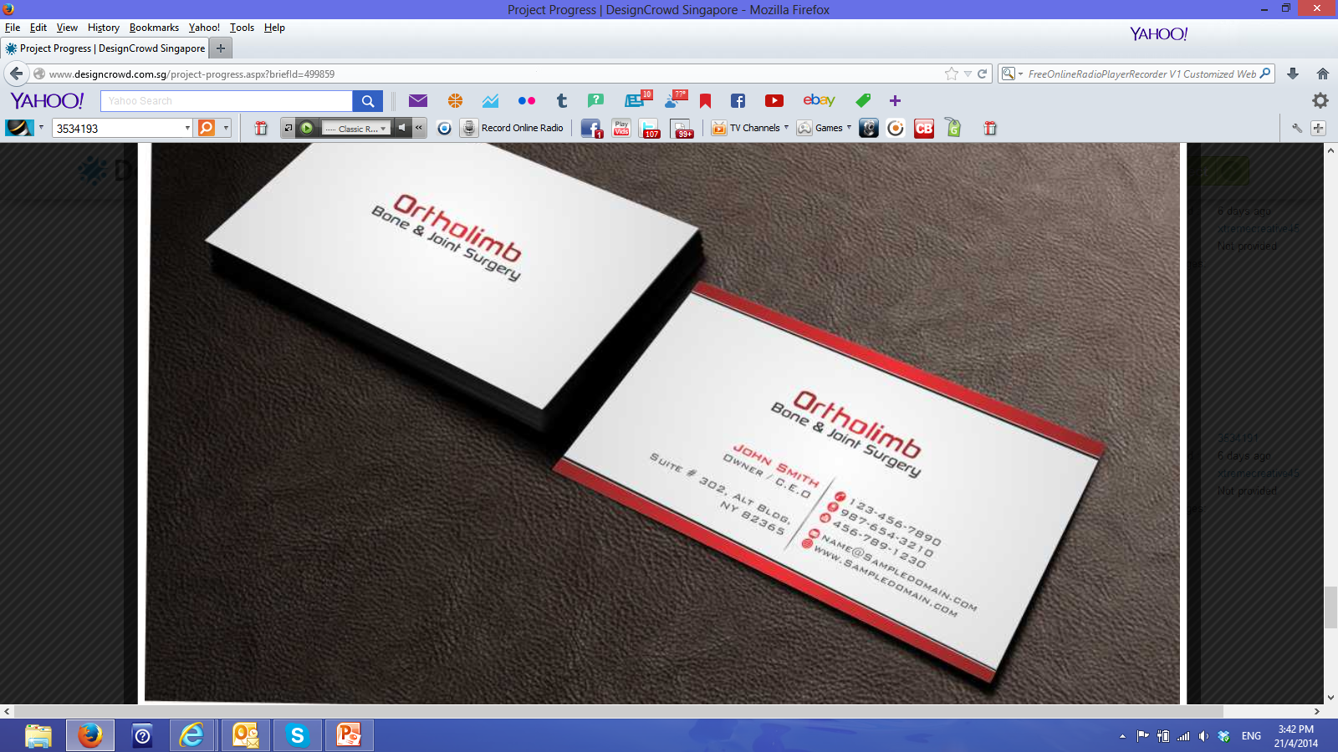
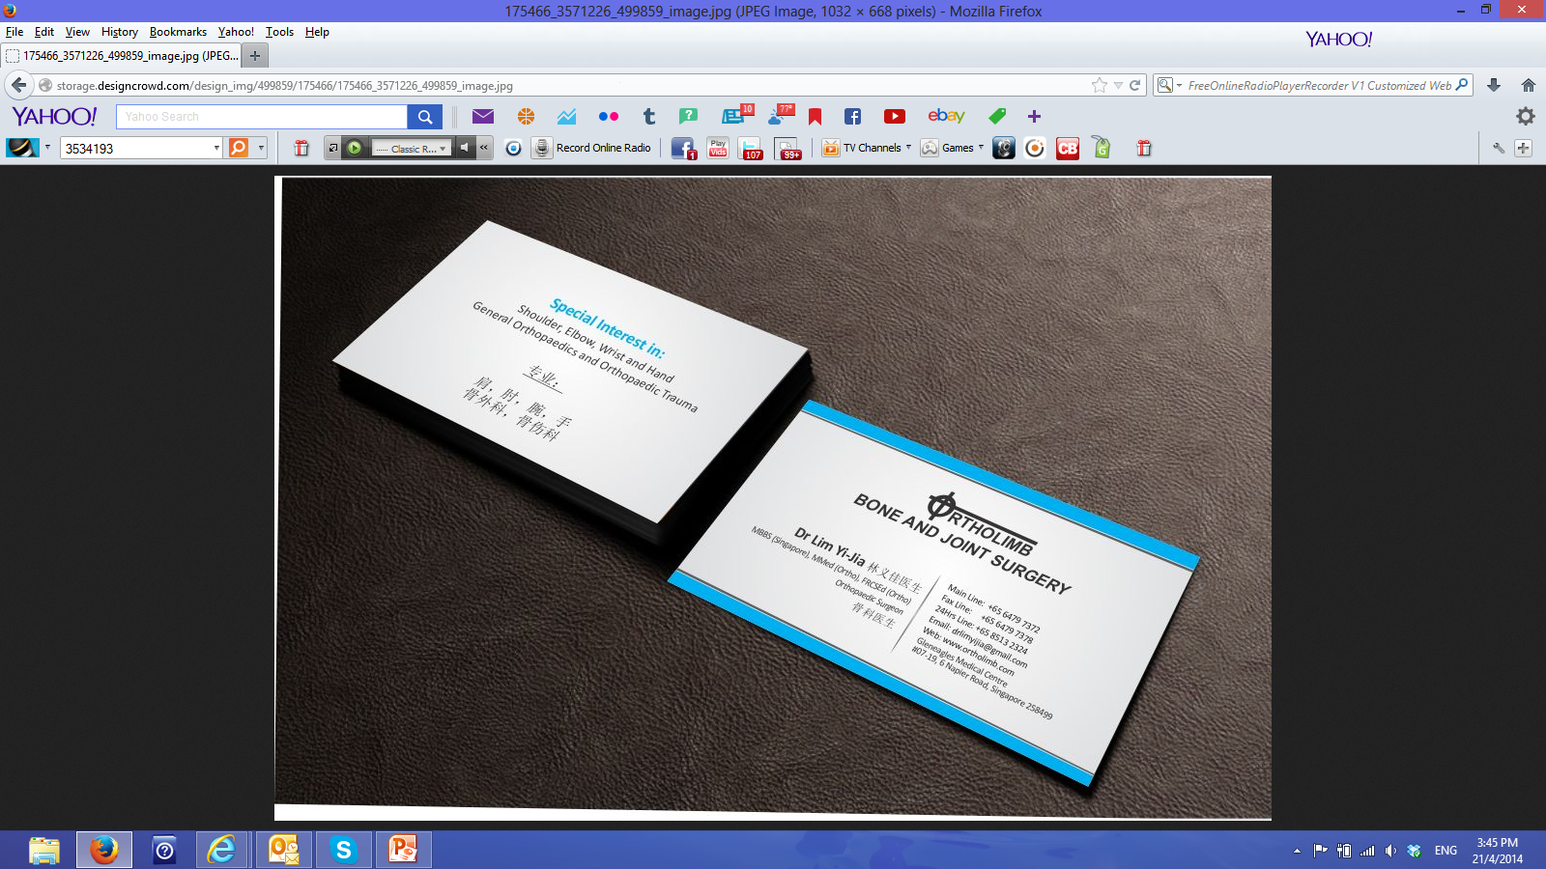
To change the following:
Pls have the logo to be on the back of the card also.
To replace the words; Main Line, Fax Line, etc with the symbols you created

