Slide 1

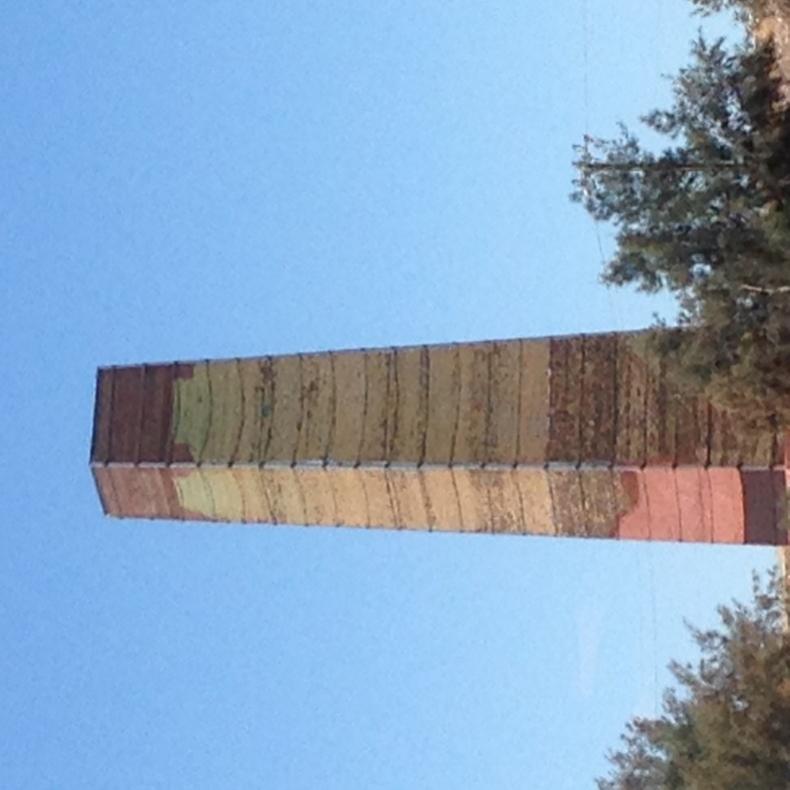
Wallaroo Project
Overview

Slide 2
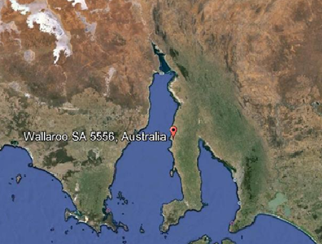
Wallaroo
Situated on Yorke Peninsula 170 kms north of Adelaide
Part of the “Copper Triangle” of Wallaroo, Kadina and Moonta popular tourism lifestyle location,

Slide 3
Owner/Developer - MPG
Monopoly Property Group Pty Ltd
http://monopolypg.com.au/
Managing Residential and Commercial Developments in South Australia and Victoria.
Offices – Suite801, 61 Hindmarsh Square, Adelaide, SA 5000
Contact
Alex Paior (cell 0404411444)
or
Ben Howard (cell 0448 814 225)

Slide 4
The Land
Total Land area 18.5 hectares (45 acres).
Previously the site of a historic Copper Smelter/Fertilizer facility, but after a multi million dollar remediation over many years has EPA clearance for development
Comprises 9 titles:
  Residential approx. 12 hectares
  Commercial approx. 3 hectares
  Town centre approx. 3.5 hectares.

Slide 5
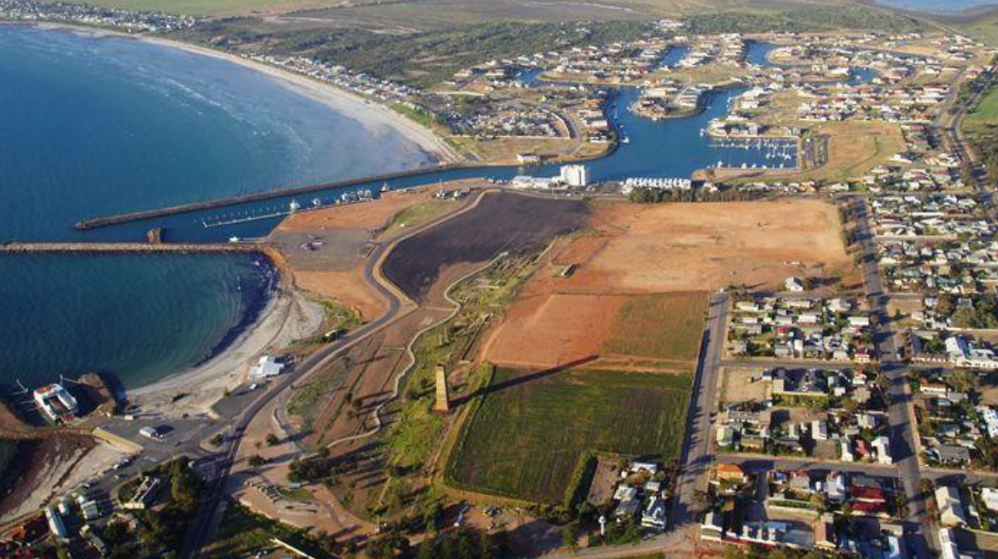
Land Purchased outlined in red
Town Centre Main Road

Slide 6
Permitted Developments Current
Wallaroo Development Plan for the Land permits:
Residential (low Density)
Residential (Medium Density)
Tourist Accommodation
Hotel/Motel
Commercial Building
Retirement Village
Supermarket/Retail

