Slide 1


examples of touchpoints and what we need
Contact: Ragnhild Halvorsrud
email: ragnhild.halvorsrud@sintef.no
Project web site: http://www.visualproject.org/

Slide 2
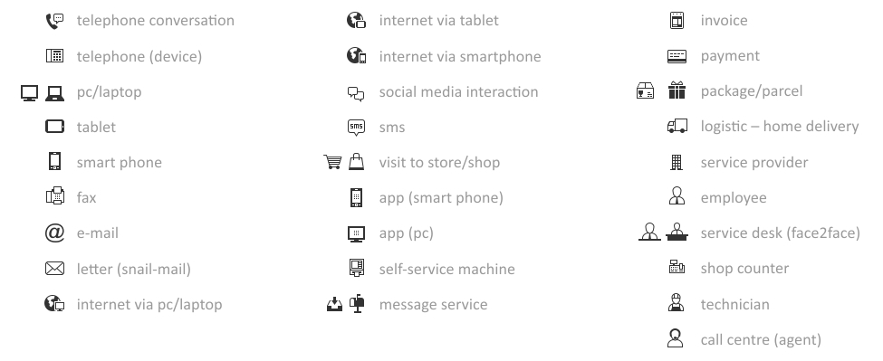
Overview of current symbols

Slide 3
What we need
Redesign of current touchpoint symbols
New touchpoint symbols
Health care related symbols
Personas symbols

Slide 4
Design principles for redesigned and new touchpoint symbols
We need a consistent style, so new symbols should match the style of the current symbols
Symbols should be in black and white.
Symbols shall be positives (not negatives)
Symbol width and height do not need to be the same, but the symbols should not deviate too much from the shaded outline (as we will fit them into the circle).
SVG format
Symbol area

Slide 5


Redesign of current touchpoint symbols
Payment:
  we need the payment symbol to include both money and credit card, if a currency is to be used it should be Euro
PC:
  we need the PC symbol to include a keyboard (currently the symbol can be confused with a TV)
Symbols including PC:
  we need all symbols including a PC to be revised so the PC looks the same as the main PC symbol (e.g. internet via web, app via PC)
Invoice:
  the current invoice symbol is somewhat difficult to understand, we need a more intuitive symbol (suggestions: document with euro sign? symbol including the text "invoice"?)
App on smart phone and PC:
  the current symbols have 3x3 apps on the screen, we need 2x2, or other symbol for app
Shop counter (pay point):
  the current shop counter symbol is somewhat difficult to understand, can it be clarified by including a desk or/and a person behind the desk?
Telephone:
  we would like other suggestions for the telephone device symbol, preferably with softer lines
Self-service machine (ticket machine):
  we would like other suggestions for self service/ticket machine symbol

Slide 6
New touchpoint symbols
Face-to-face communication
  suggestion: two people (faces) talking
Store
  the physical building, preferably with shopping cart
App on tablet
  must look similar to the existing tablet symbol and be consistent to e.g. app smart phone symbol
Bank and internet bank
Globe (internet)
  can look similar to the globe in e.g. the internet via web symbol
Smileys
  We need 5 smileys: very satisfied, satisfied, neutral, unsatisfied, very unsatisfied
Social media message
  message in social media inbox
Social media interaction (alternatives)
  we have used the current social media interaction symbol to symbolize chat, so we need an additional alternative for symbolizing social media interaction

Slide 7
Design principles for health care and personas symbols
We need a consistent style and size
Symbols should be in black and white
Symbols can be positives or negatives, but should be consistent
SVG format

Slide 8

Health care related symbols
Symbols should be gender neutral, if possible
3 Patients
  gender neutral
  we need 3 different types
1 General practitioner/Primary care doctor
  see example symbol in the margin
4 Doctors/specialists
  We need 4 different types
  Perhaps a stethoscope on all of them
  One of the should be a surgeon with headlight
4 Nurses
  We need 4 different types
  One of them should be a "chief" nurse
2 Health secretaries
  One with and one without desk
2 Secretaries/receptionists
  One with and one without desk
4 Hospitals
  We need 4 different hospital symbols, 2 should look like small/medium size hospitals and 2 should be large
  Preferably buildings
1 "Hospital post office"
  we need a symbol that symbolizes the "post office" at the hospital, where the hospital receives mail and referrals from general practitioners and other hospitals
1 Hospital computer system
  We need a symbol that symbolizes the computer system used at the hospitals
1 Patient medical record (electronic)

Slide 9
Personas symbols
12 End users
  men and women, including head and shoulders
  we need 6 different types of each gender
6 Employee
  including head and shoulders
  we need 6 different types
4 Service providers (companies)
  we need 4 symbols representing different service providers
  3 general and 1 call centre service provider
  examples of buildings: factory, office building

