Slide 1


By Ana Gabriela Woods

Slide 2
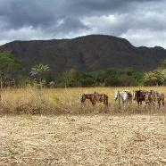

What is Brazilian Food?
Before I can tell you what Brazilian food is I need to tell you about the key elements of the 8 ethnic backgrounds that were infused in creating this unique, raw and organic recipe we now call Brazilian gourmet.
Brazil was discovered by Portugal in 1500. However, the owners of the land were the Tupi-Guarani Indians. In their journey the Portuguese brought along the Africans during their explorations/discoveries to Brazil.
By 1500 three ethnicities combined their cultural traditions into one. Following them in the later years would be the German and Italian influence which migrated towards the south of Brazil. The French migrated to the central part of Brazil and the final addition of cultural influence to complete this masterful recipe we call Brazilian food was the influence of the Japanese and Chinese during the second World War.

Slide 3
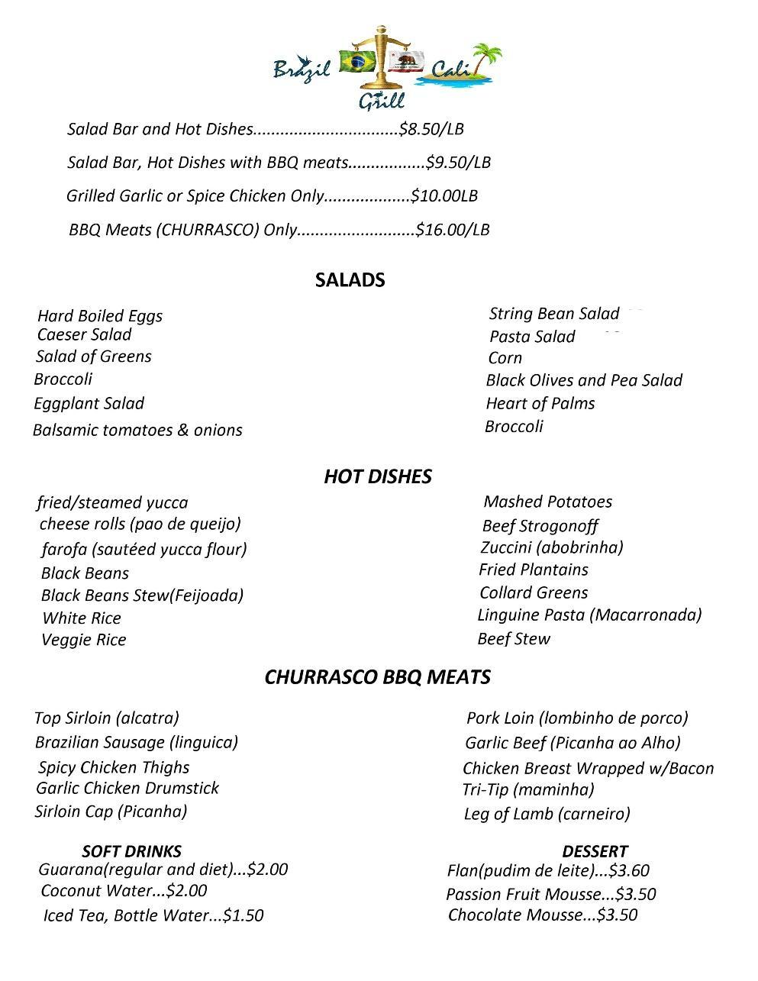
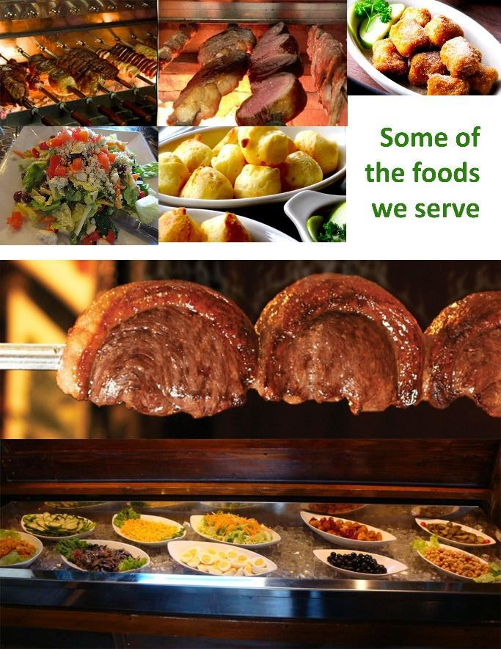
In Brazil we have a saying:
“Who’s in a rush eats RAW!”
Now you may ask what does Brazil Cali Grill offer?
Every day working people on average only get a 30 minute lunch or dinner break and most of the time they end up eating fast
We offer the luxury of great food without the long wait as we are a buffet all while still being healthy.
Our purpose is to serve great food at an affordable price!
We offer our clientele
Vegetarian meals
Meats (delicious bbq’d beef and lamb) – along with other hot plates.
Pure organic (including salads, produce and chicken)
There will be a set menu after 3 months along with pick up and delivery options

Slide 4
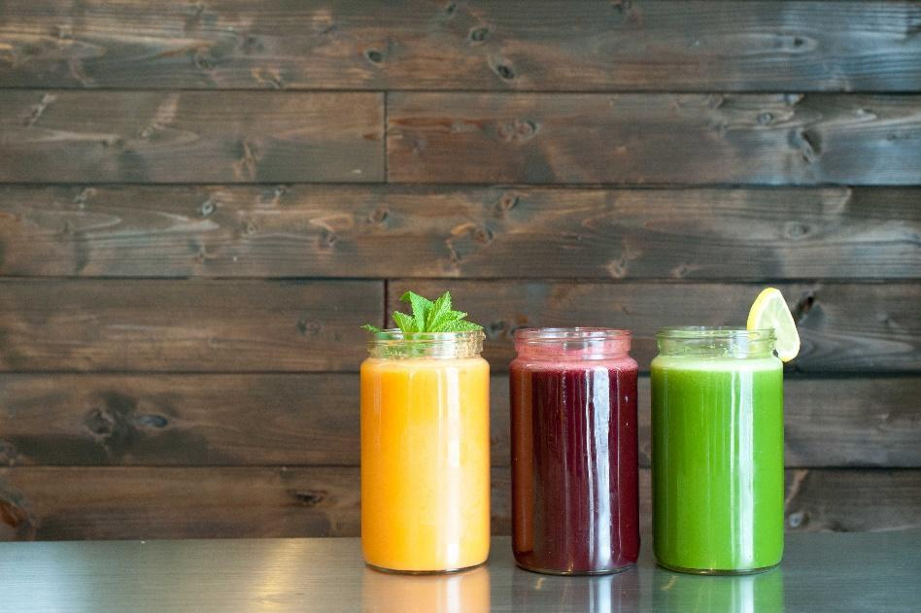
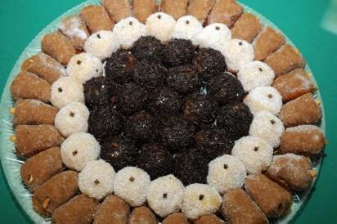

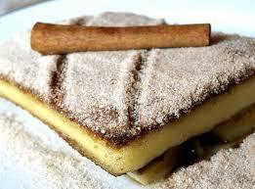
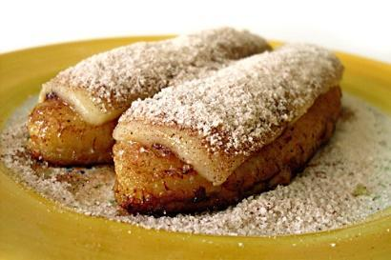
We will also have…
Juice bar
Desert

Slide 5
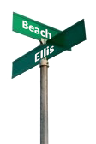
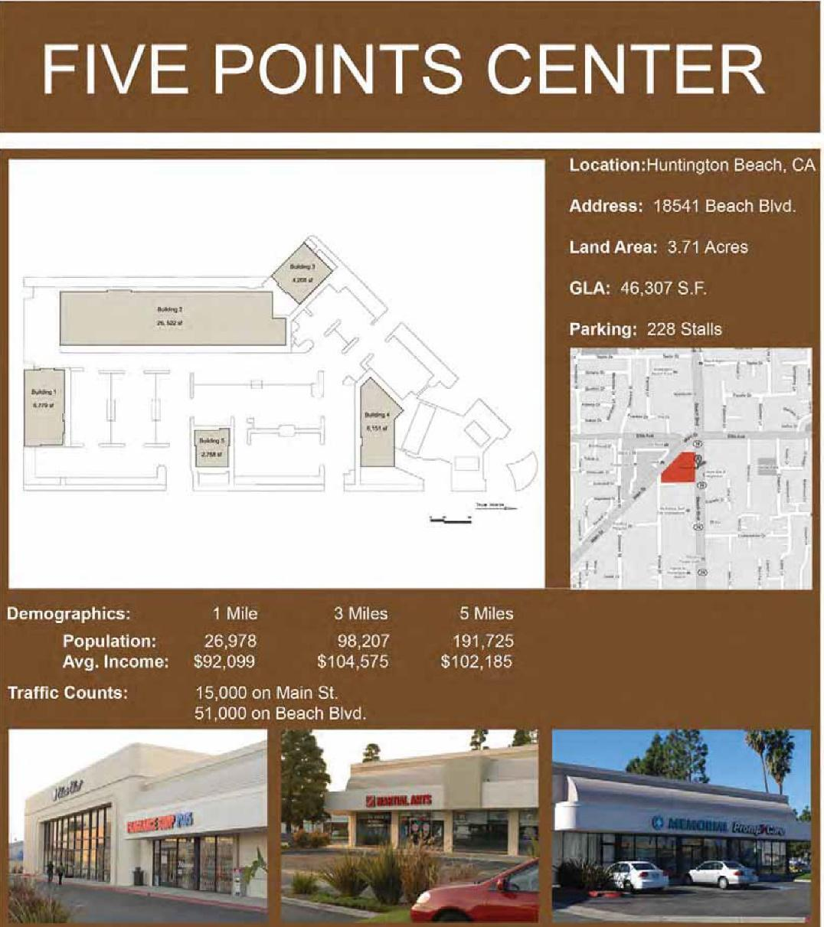
FIVE POINTS CENTER
“The landmark of the first of many locations”
  Why did we pick Beach and Ellis?
  It’s a central location between the beach and the freeway (the consistent traffic on Beach Blvd will always provide the consumer a place on the go or to sit and enjoy the food while listening to some traditional Brazilian music and Brazil Cali Grill will stand out.
  There is a mall full of well known franchises that would attract new customers. This is because there will always be a handful of people willing to try new places to eat, and once they try our food, especially since it’s a buffet that charges by the pound, more people will be inclined to try it once and be hooked, thus most of our business will be based on referrals and walks ins.
  Referrals are always a reflection of the quality of food one offers . There is no denying it will be great home made brazilin foods.
  There is lack of healthier food in northern Orange County in comparison to Southern Orange county (look for statistics)

Slide 6





Advertisement
Steps to a Successful Business
Our goal is to create a Franchise starting with this one location.
We plan to use many avenues to bring in customers. Some of which include.
Social Media –
(these are a variety of well known social media networks that have grown their businesses from the ground up and continued success.
SEO – Search Engine Optimization, is a technique that's used to increase a website's "ranking" on various search engines. For example, you own a olive oil company. Searches for "olive oil" on Google will return various websites that have to do with Olive Oil. Our goal is to have our company listed on the first page, and even better, the first couple results. SEO will help us increase in rank and can potentially be our greatest asset.
We will also provide service questionnaires to find out what people think about our food and service.

Slide 7
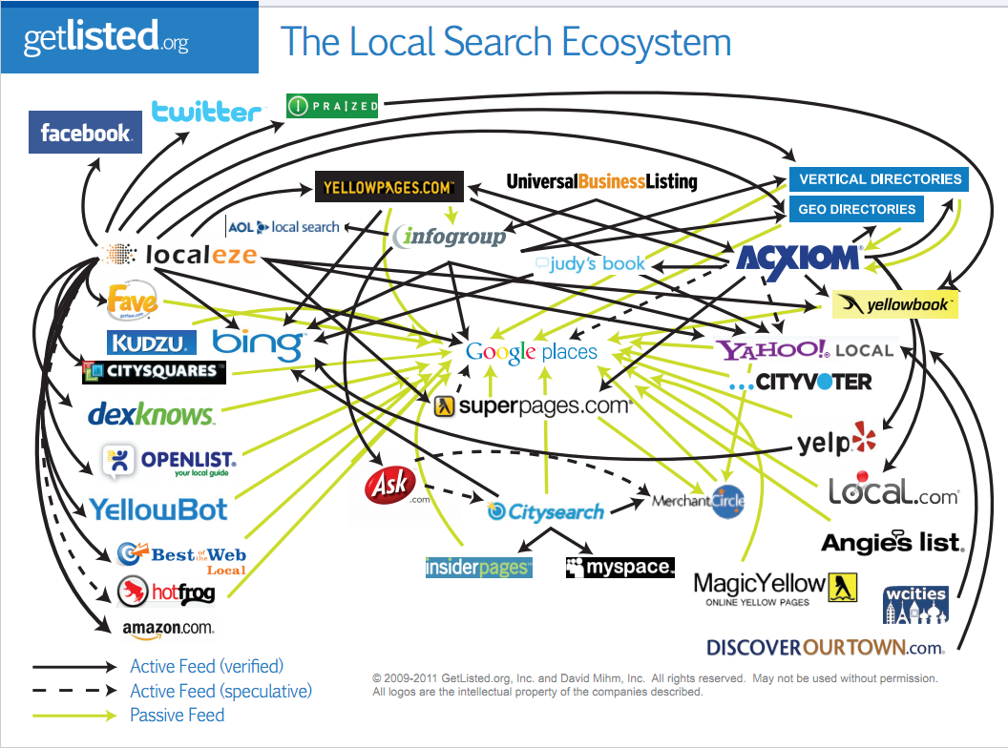
More Advertisement Continued…
We will be listed on all directories

Slide 8
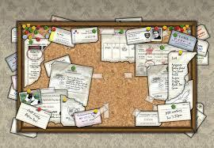
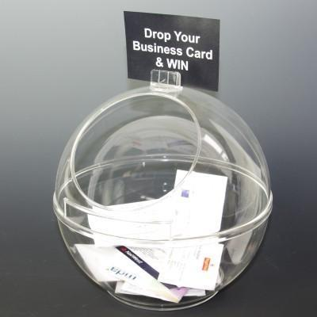

Continued Advertisement & Marketing
To Stand out we will offer
Sunday brunch
Specials
Happy hour
Taco Tuesdays
We want to be close to our community as well so we will…
A bowl for business cards – and have monthly raffles for business where we provide lunch or dinner on us.
Bulletin boards where people can post their flyers, business cards, events on.

Slide 9
Where will you get the financial resources to start your business?
To open the doors we need between $70-$90 thousand (This will be out of our own pockets as we have the funds necessary to open Brail Cali Grill)
What do we need to get started? Below you will find the following necessary to get the ball rolling prior to opening our restaurant.
Equipment (stove, kitchen supplies, dish washers, buffet serving dishes, the BBQ) – http://www.chefstoys.com/ $30,000
  Computers and printers - $600
  Rent- $8,000
  Lease holding improvements - $30,000
  Inventory - $5000
  Legal start up fees ( LLC, trademarking, Lawyers, Forms & Fees, FDA approval, $6,000 licensing, Architect, and any other necessary legal documents, procedures necessary to take care of
  Marketing materials - $3000
  Employees (minimum wage) - $9,520
  Property Insurance - $1,200

Slide 10
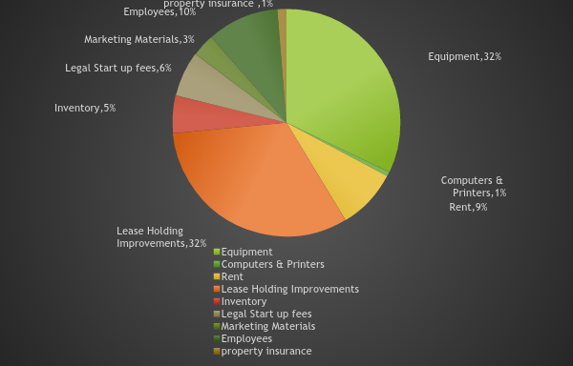

Slide 11
How do we plan to stay in business?
If we start at 50 customers a day at a going rate of $15 and base it off 26 days out of the month that would be a total of $19,000. (This would be the lowest possible outcome)
If we start at 70 customers a day at a going rate of $15 and base it off 26 days out of the month that would be a total of $26,300.
If we start at 100 customers a day at a going rate of $15 and base it off 26 days out of the month that would be a total of $39,000
Our estimated Monthly expenses a month is $20,000
We estimate that in the first year we will make a average of $32000+ a month
Each year our goal is in making a min of $32000 a month but we are sure that we will make more than just that.
We estimated the first years net income would be $400,000 and the 2nd year would be $440,000 3rd year would be $484,000 4th year would be $532,400 and 5th year would be $585,640.

Slide 13


