Slide 1
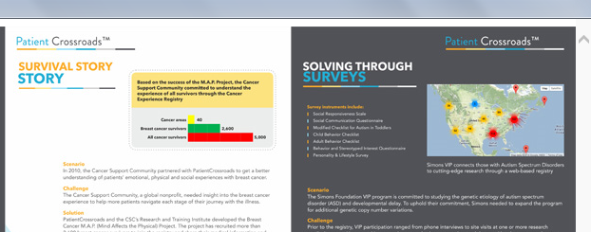


CASE STUDY
CASE STUDY

