Slide 1

Decoding Muscular Dystrophy
Scenario
  As research activity on Duchenne/Becker muscular dystrophy surged in the last decade, investigators needed a platform to communicate with a global patient base.
Challenge
  Several pharmaceutical companies had developed mutation-specific trials, and needed a fast way to identify the right patients for each study.
Solution
  DuchenneConnect links eligible patients with the right research studies and has collected data and genetic test information from over 3,600 participants. This makes it easy for us to identify people who met the inclusion criteria and invite them to participate in research.
Results
  DuchenneConnect proved to be a reliable source of patients. In 2012, the registry assisted with recruitment for 7 clinical trials, which accounted for 85% of all clinical trials in the US.
  As the largest U.S.-based registry for Duchenne/Becker, DuchenneConnect has become a key source of expert knowledge about clinical care and genetics, helping more than 1,000 patients and families find answers.
CASE STUDY

Slide 2
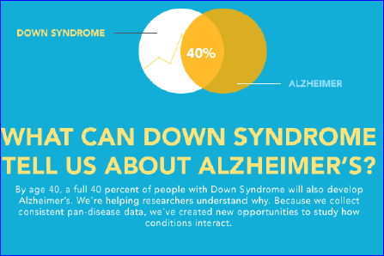
Scenario
  When the National Institutes of Health decided to launch the first national registry for people with Down syndrome, they turned to PatientCrossroads to build it.
Challenge
  The Down Syndrome Consortium—6 NIH Institutes and 13 advocacy and research organizations—had a hunch. If they could connect patients, healthcare providers and researchers, they’d all be better able collaborate to find more effective treatments and therapies. The consortium faced some serious challenges. They needed a single, shared information hub. They needed to agree on who would own the data. They needed to coordinate a public-private partnership. And they needed a way control access to the patient community
Solution
  PatientCrossroads created DS-Connect, a secure registry for the DS community.
  (1) Participants can see their survey answers with those of other participants.
  (2) Researchers can use the registry to recruit patients for clinical studies.
  (3) PatientCrossroads reviews the information for quality and completeness.
Results
  In December 2013, PatientCrossroads and the Down Syndrome Registry was awarded the NIH MERIT (Method to Extend Research in Time) Group Award
  The Down Syndrome Consortium is embarking on a community-wide marketing campaign to promote the registry.
Creating Connections
CASE STUDY

Slide 3
Survival Story
Scenario
  In 2010, the Cancer Support Community partnered with PatientCrossroads to get a better understanding of patients’ emotional, physical and social experiences with breast cancer.
Challenge
  The Cancer Support Community, a global nonprofit, needed insight into the breast cancer experience to help more patients navigate each stage of their journey with the illness.
Solution
  PatientCrossroads and the CSC’s Research and Training Institute developed the Breast Cancer M.A.P. (Mind Affects the Physical) Project. The project has recruited more than 2,600 breast cancer survivors to join the registry and share their medical information and personal stories. The data is being used to develop new ways to address living with breast cancer.
Results
  Based on the success of the M.A.P. Project, the CSC has expanded the program to build the Cancer Experience Registry. The registry has collected information from over 5,000 survivors across nearly 40 cancer areas.
CASE STUDY
Based on the success of the M.A.P. Project, the Cancer Support Community committed to understand the experience of all survivors through the Cancer Experience Registry
Cancer areas |  | 40
Breast cancer survivors |  |  |  | 2,600
All cancer survivors |  |  |  |  |  | 5,000

Slide 4
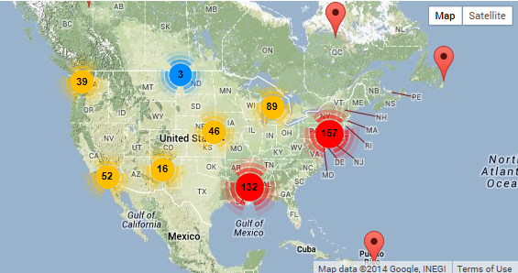
Scenario
  The Simons Foundation VIP program is committed to studying the genetic etiology of autism spectrum disorder (ASD) and developmental delay. To uphold their commitment, Simons needed to expand the program for additional genetic copy number variations.
Challenge
  Prior to the registry, VIP participation ranged from phone interviews to site visits at one or more research medical centers. However, this approach was costly, time-consuming, and the travel burden prevented many patients from participating. Simons needed a more efficient solution to reach their goals.
Solution
  Simons VIP Connect was launched in partnership with PatientCrossroads to collect a bigger picture of autism. Site visits and interviews transitioned to web-based surveys, allowing more families to participate from home. The program continues to expand as more genetic changes associated with autism spectrum disorder (ASD) and developmental delays are studied.
Results / Data
  To date nearly 1,000 patients have registered, many enrolling in advanced phases of the VIP research study. By implementing standardized survey instruments, curating the genetic data, and using the survey scoring algorithms, VIP Connect maximizes the quality of patient-provided data collected by the registry.
Solving through Surveys
CASE STUDY
Simons VIP connects those with Autism Spectrum Disorders to cutting-edge research through a web-based registry
Survey instruments include:
Social Responsiveness Scale
Social Communication Questionnaire
Modified Checklist for Autism in Toddlers
Child Behavior Checklist
Adult Behavior Checklist
Behavior and Stereotyped Interest Questionnaire
Personality & Lifestyle Survey

