Slide 1

There’s a new, exciting Container Park opening
in Melbourne
465 Somerville Rd, Brooklyn, 3012 www.containerspace.com.au

Slide 2
OUR COMPANY
Containerspace is a very innovative container storage park currently utilising 10 acres with options to increase size in future. Located 10 minutes from the Port of Melbourne it is well serviced by road networks & offers:
A fully sealed & secure site
Modern & sustainable facilities
Large, fully equipped workshop
Smart technology in our forklifts
Qualified personnel with over 25 years experience in container industry
OHS compliance
Designated truck lanes & booking system to avoid queuing

Slide 3
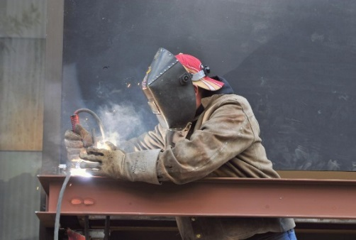
OUR SERVICES
Able to store both empty & full containers
Access to over 100 Reefer Points
Expert repair service complying to IICL/Shipping Line standards
New wash bay able to handle large volumes
Qualified & experienced personnel
Extended operating hours
FIFO stock turnaround
Option for flat rate auto approvals to expedite your Food Quality (FQ) needs

Slide 4


Slide 5
SOFTWARE SYSTEM
Containerspace utilises Containerchain software enabling us to continually improve on the management of your empty containers. This program offers KLine
Real time visibility
Paperless interaction
Efficient planning of container movements
Access to activity & performance reports
ensuring KPI achievability
Flexibility of operations

Slide 6
OUR VALUES
Our values guide our everyday decisions and actions, and form the foundations for how we do business. They are critical to our success. Our values are not negotiable and we seek to excel in each of them.
Safety and Sustainability – We insist on working safely and delivering sustainable outcomes.
Integrity – We are ethical, honest and professional in all that we do, without compromise
Teamwork – We work with you & transport companies to deliver a high standard of operations

Slide 7


MISSION STATEMENT
Containerspace will promote environmental leadership in the container park industry, integrating health, safety and sustainability in our core values.
We are committed to providing our clients with a professional service adopting best practice at all times.

Slide 8
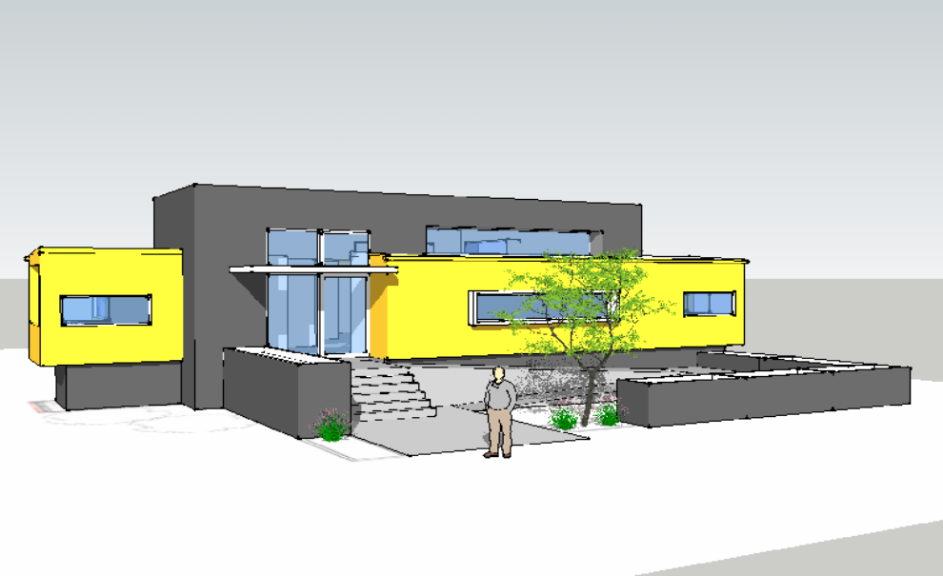
OUR NEW OFFICE
Our new office has included the use of shipping containers in design, integrating sustainable features significantly reducing energy consumption.

Slide 9
Why Containerspace?
We offer a wide range of services with your satisfaction guaranteed
We can provide efficient, fast turn around times complying with your FIFO requirements
We provide flexibility with the ability to adapt to KLine’s growing needs
We are environmentally responsible
We have strong business ties within industry, community & local government
We work with you to deliver the most efficient outcomes
.

Slide 10

SUSTAINABLE FUTURE
We at Containerspace have made a strong commitment towards change in our industry. We have incorporated sustainability into our site, maximising passive solar design, minimising energy use, harvesting & recycling water & using recycled products wherever possible. We will be one of the first clean & green container parks in Victoria while still bringing you the high level of service you deserve.

Slide 11
If you are interested in aligning KLine alongside a container park with strong business ethics and is actively progressing towards the future please contact me direct.
Mark Paterson
Manager
Ph: 0417 261544
465 Somerville Rd, Brooklyn, 3012 www.containerspace.com.au

