Slide 1

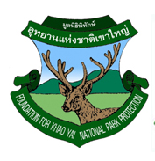
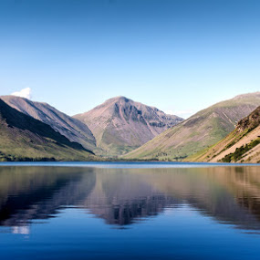
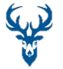
Current Logo
Proposed New Logo
(use this shield design)
Elements in Logo
(Deer, Water, Mountain, Sky)
Logo Design Brief
Maintain the current concept of shield, deer, water, mountain and sky
Modern looking and eye catching, appeal to kids
Use Brown color for deer, Blue for water, Green for mountain and Blue for the sky (choose the color shades that would make the logo look modern and appealing)
Drawing design should be simplistic lines (not doing a portrait of a deer as in current logo
Shield can be metallic in color, either metallic Grey or metallic Green, depending on which one looks better)
Please see how best to place the words “FOUNDATION FOR KHAO YAI NATIONAL PARK PROTECTION” and in what color

