Slide 1
How it works
1
2
3
SIGN UP
Sign up and select all the greeting cards you wish to send during next year (tell us who you are sending them to, why and by when do you need them)
After that you are done and can relax (maybe go to the beach on vacation). You don’t have to worry anymore about forgetting sending a greeting card to that person that really, REALLY was expecting one
CONFIRM
Two weeks before every event we’ll send you a reminder asking you to confirm your card design and delivery method (directly to recipient or to you first)
Don’t worry, we won’t harass you with emails. We’ll only send them when its convenient to you and we’ll make the confirmation process simple… We promise
DELIVER
Depending on the delivery method you chose we can either:
Send the card directly to the recipient with your message printed on the card, or
Send the card to you with a “ready to re-send envelope” (yes, postage and everything!) so you just have to open up the card, sign it and put it back in the mail.
Simple right? Now give it a try and enjoy the feeling of being an amazing, thoughtful, kind, smart individual and all other compliments that will be given to you just for sending this amazing greeting cards

Slide 2
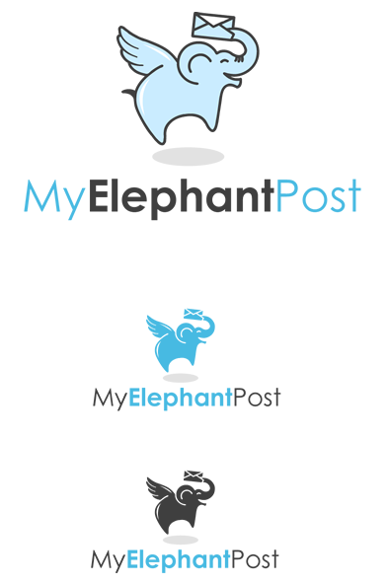
My Elephant Post Logo

