Slide 1


Figures from patterns to include in external package

Slide 2
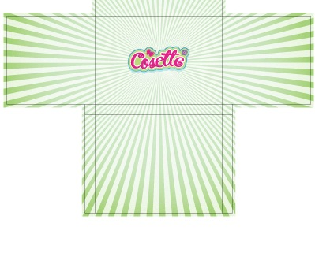


Patterns to combine for internal package
Include these lines, but in the blue color of the pattern on the left

Slide 3
