Slide 1


The
Gold Standard
Service
Top 10
Notes:
Angie, just have Carpenter One but make it Carpenter One LLC – then under it have the description – also lets talk about the logo

Slide 2


#1 Home Prep Advice
We Are Certified Home Marketing Specialists
We Help You
Decide on repairs
Decide on updates
Create a space buyers want to occupy

Slide 3

#2 Price House Right
Based On
Recent Sales
&
Condition of home
(Home Prep is a factor)

Slide 4

#3 Submit to MLS
All local agents & brokers
have access
Notes:
VERY IMPORTANT page here. Great questions to run through to try to avoid running into trouble down the road. Remember, they are interviewing you, and you are interviewing them.

Slide 5

#4 Implement Gold Standard Marketing
Better MARKETING
+ Cutting Edge TECHNOLOGY
+ Experienced REALTORS

Slide 6

#5 Superior Follow-Up
Weekly Updates
Buyer
Feedback
Market
Tracking

Slide 7
#6 Negotiate
Buyer
Makes Offer(s)
Goldmark
Advises
Goldmark
Counter Offer
Seller
Buyer
Counter Offer
Seller
Advises
Goldmark
Accepts Offer

Slide 8
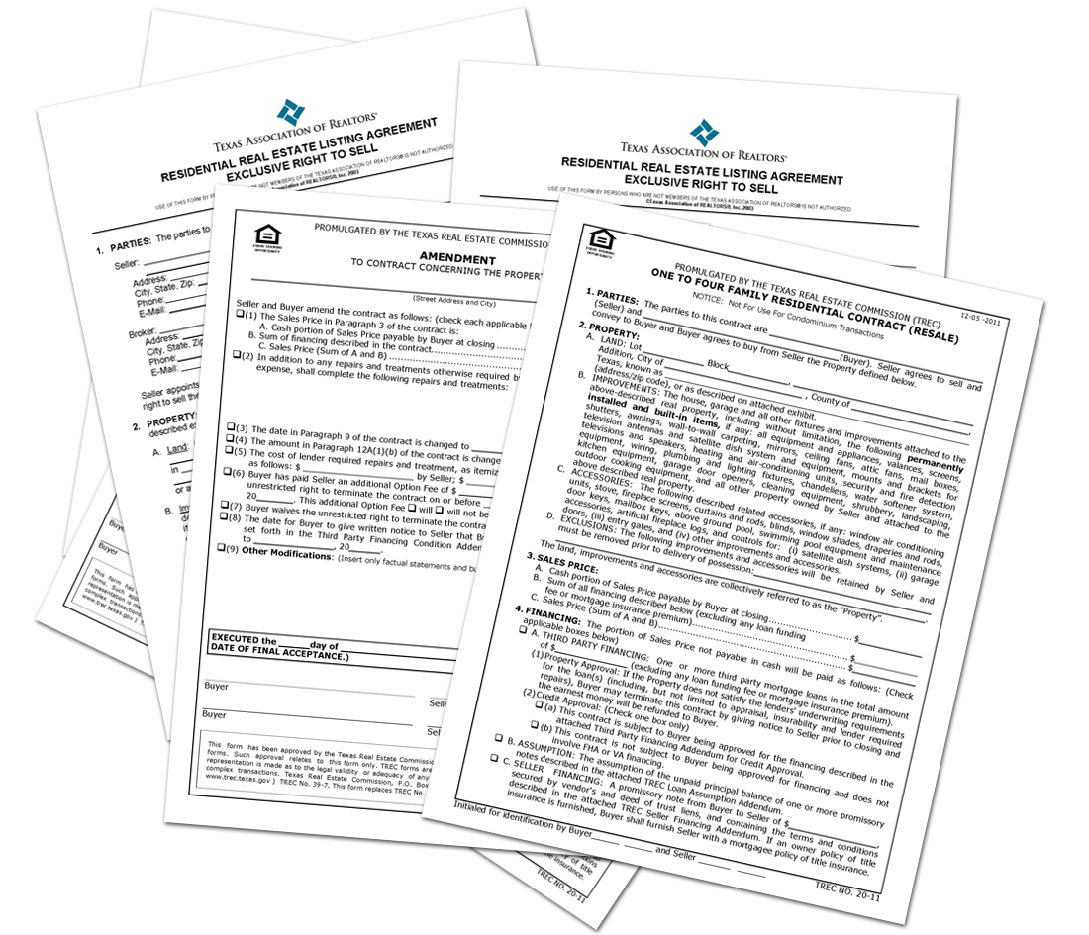
#7 Paperwork

Slide 9

#8 Keep Track of Buyer Progress
Title Co.
Loan
Appraisals
Inspections

Slide 10

#9 Closing Day
We are there with you
Till the End

Slide 11

#10 Goldmark Team
The Goldmark Realty Team stands with you
throughout the selling process

