Slide 1


The
Gold Standard
Marketing
Top 10
Notes:
Angie, just have Carpenter One but make it Carpenter One LLC – then under it have the description – also lets talk about the logo

Slide 2
“We do what others don’t.
That’s what The Gold Standard is all about.”
R. R. Carpenter
Broker Owner, Goldmark Realty
Notes:
Angie, just have Carpenter One but make it Carpenter One LLC – then under it have the description – also lets talk about the logo

Slide 3

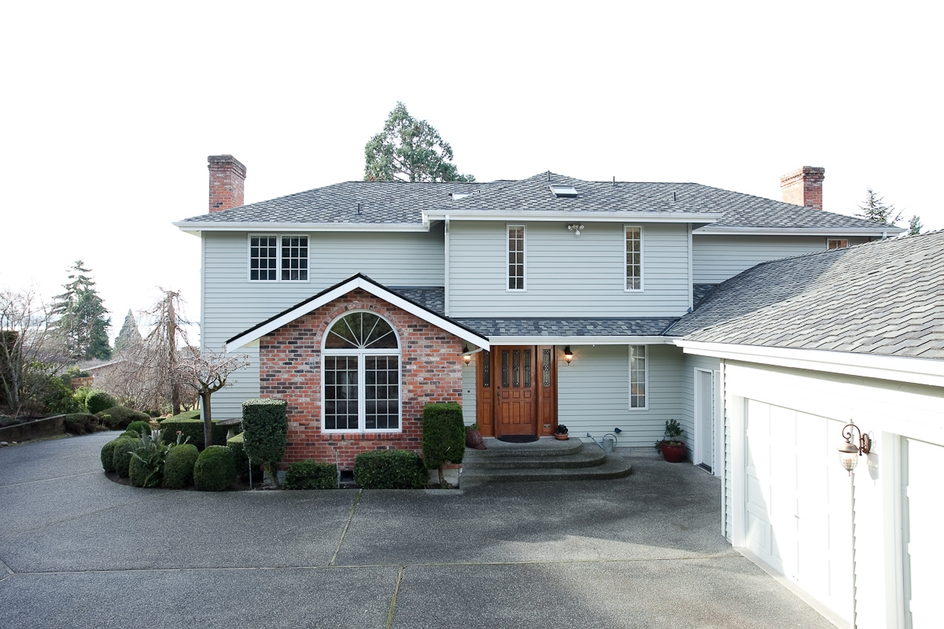

#1 Professional Photographer
Every Goldmark Listing will have
at least 20 High Def Pictures
Standard Digital Camera
High Definition Camera with Touch-Ups

Slide 4


#2 Texting Service

Slide 5





#3 Contact Realtors Directly
  Over 1000 Local Agents
  Top Relocation Services
Notes:
VERY IMPORTANT page here. Great questions to run through to try to avoid running into trouble down the road. Remember, they are interviewing you, and you are interviewing them.

Slide 6

#4 Craigslist Postings
9th Most Popular Website In the World
Over 20 Billion Pageviews per Year

Slide 7

#5 Facebook Page with promotion
Facebook gets more traffic than Google

Slide 8

#6 YouTube Video
World’s #2 search engine

Slide 9
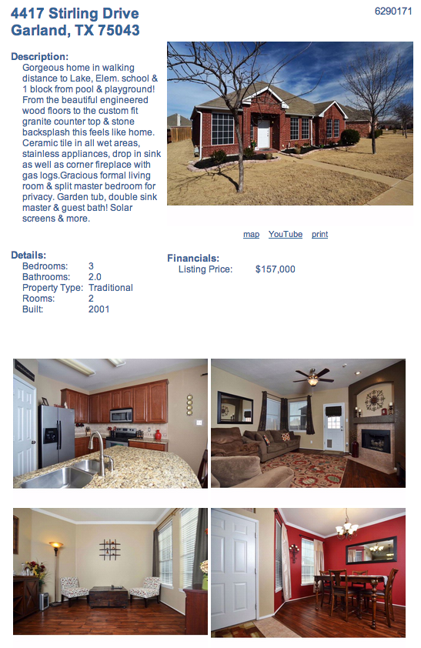
#7 Personalized Website
YourAddress.com

Slide 10






#8 Top Search Sites
& Over 30 Others

Slide 11







#9 Top Broker Sites
& Over 100 others

Slide 12
#10 Realtor.com Enhanced Listing
Less than 6% DFW Brokers pay for Enhanced Listings
#1 Most Visited Realtor Website
Enhanced listings receive 70% of Realtor.com
pageviews

Slide 13



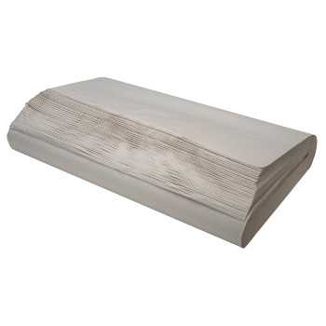
BONUS – Free Boxes
delivered to your door
20 Boxes
2 Rolls of Tape
Tape Dispenser
Packing Paper

