Slide 1
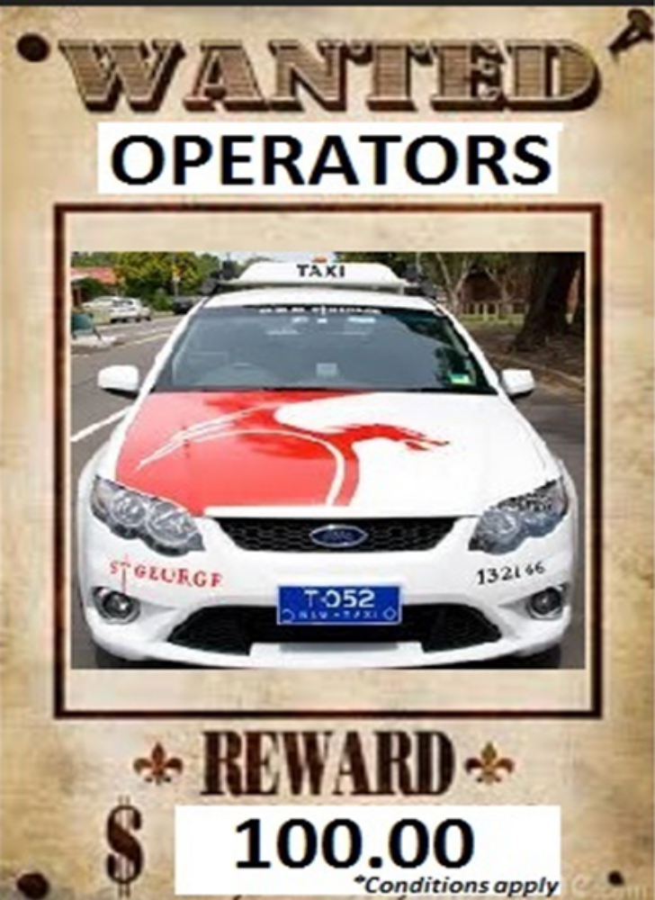

Slide 2
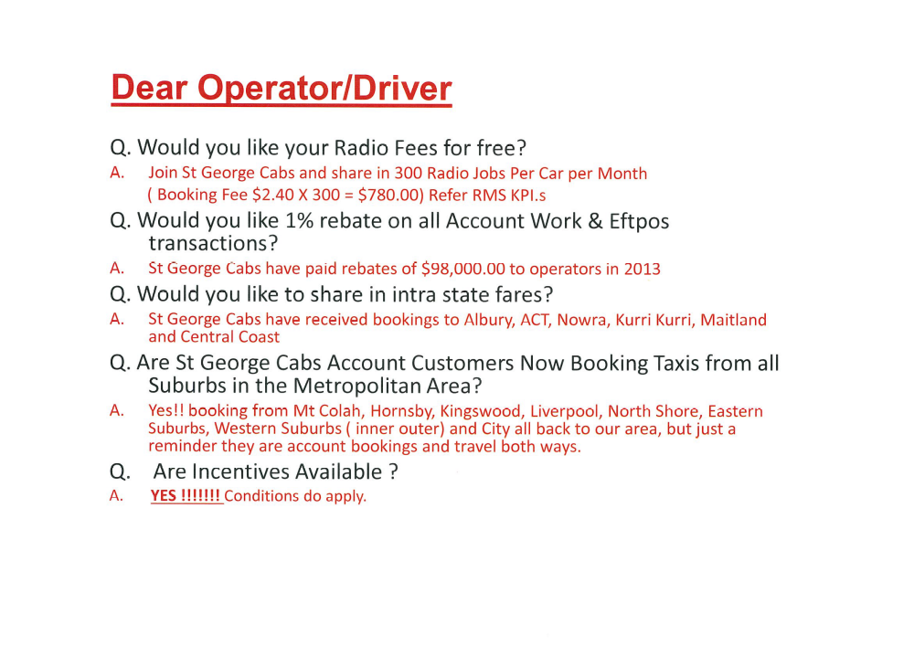

Slide 3
ST GEORGE CABS gives you MORE ......
Don’t worry about RADIO FEES any longer ….. Please read on to see how St George Cabs can help you make the booking fee pay for them !!
1. MORE radio jobs : By joining St George Cabs you share in 300 radio jobs per car per month ( Booking Fee $2.40 x 300 = $780.00) Refer RMS KPI’s.
2. MORE rebates : 1% rebate on all Account work & Eftpos transactions.... St George Cabs have paid rebates of $98,000 to it’s operators in 2013.
3. MORE intra state fares : St George cabs have received bookings to Albury, ACT, Nowra, Kurri Kurri, Maitland & Central Coast.
4. MORE account work : We have dedicated account bookings from all suburbs in the Metropolitan area… these include bookings from Mt Colah, Hornsby, Kingswood, Liverpool, North Shore, Eastern Suburbs, Western Suburbs (inner/outer) and City back to our area. Bookings travel both ways.
5. MORE money $$$ vs time : With our MT Data despatch system configured to closest car to job your profits are maximised by working quickly & efficiently.
6. MORE innovation : At St George Cabs we focus on customer service by embracing new technology, making booking our cabs faster & easier.
Don't wait any longer....
Join St George Cabs today !!
Call us on (02) 9554 4000
Further incentives available….conditions apply *
** Reward is paid for successful operator referral **

