Slide 1






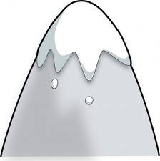

Logo Concepts
See the notes for explanation
Notes:
Just some ideas for the logo:
The S & W of Summit Wisdom can be represented:
As “S” as the screw thread and “W” as the mountain
Or the S & W could be the filament of the light bulb
Or the “S” could be the bulb of an economy bulb

