Slide 1

PhESi Solution to Your Challenges

Slide 2
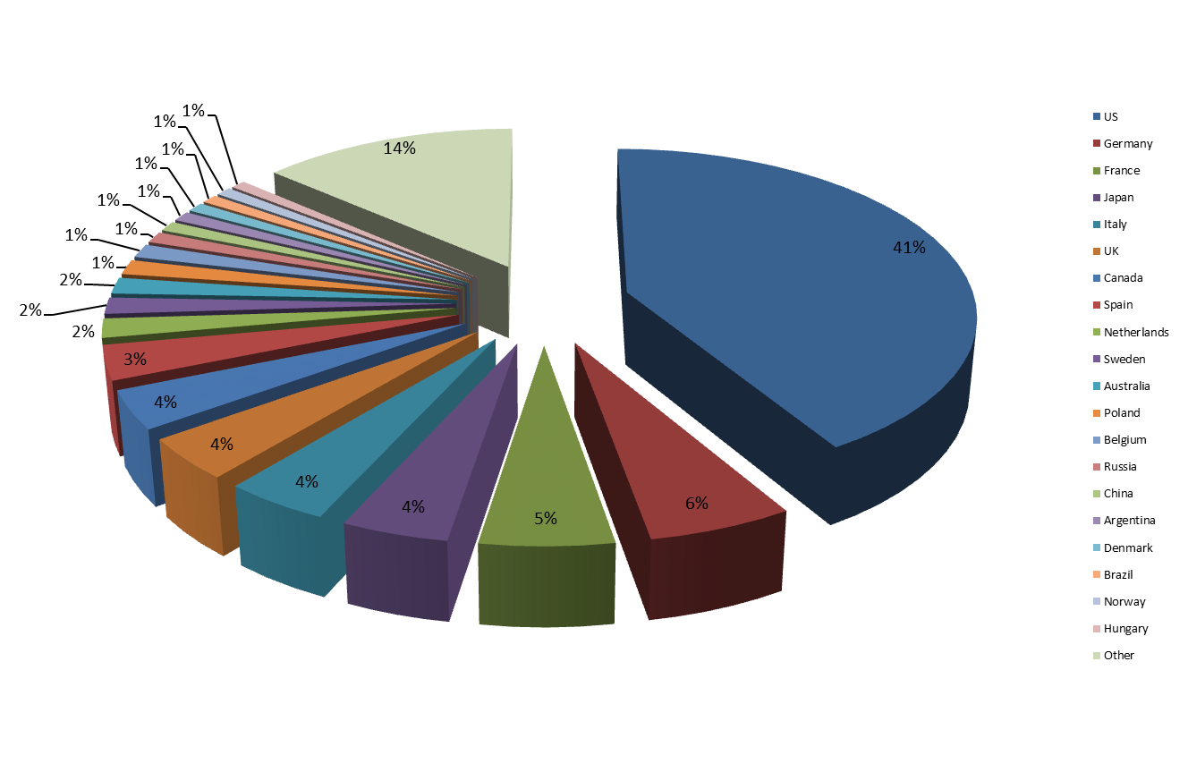
Largest Investigator Database (882,416 sites)

Slide 3
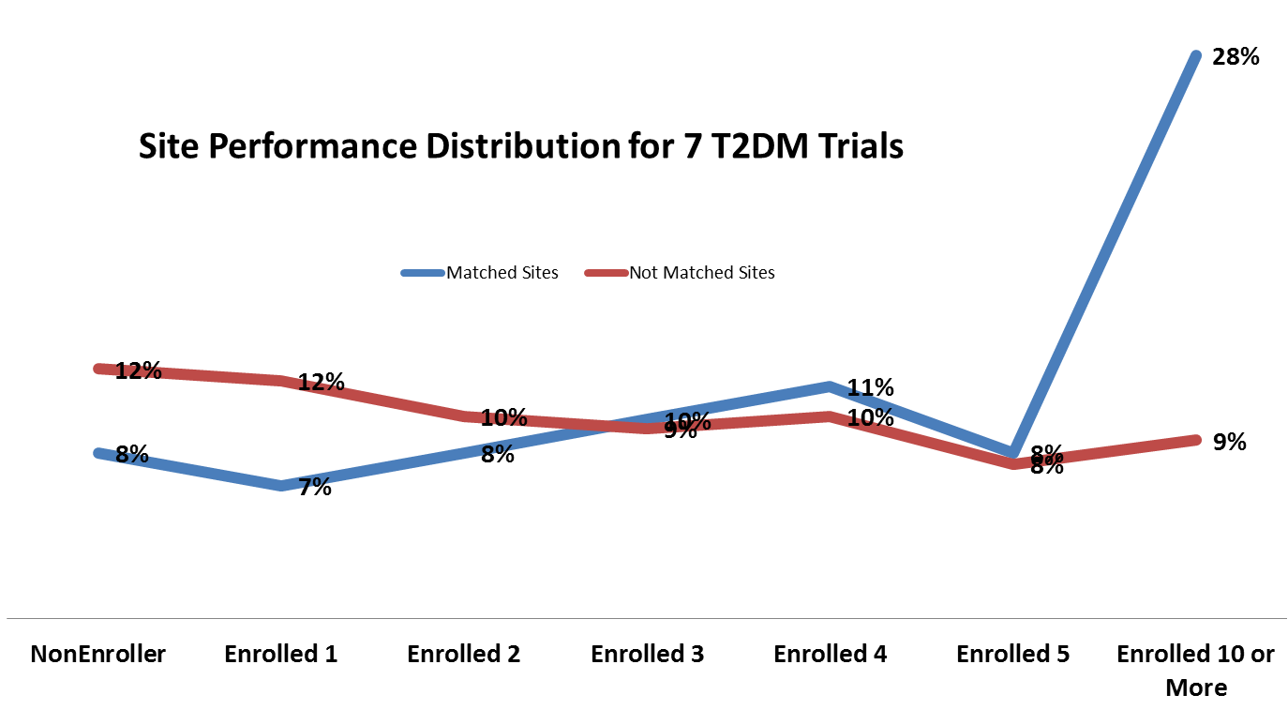
Proven Superior Results from >100 Clinical trials

Slide 4
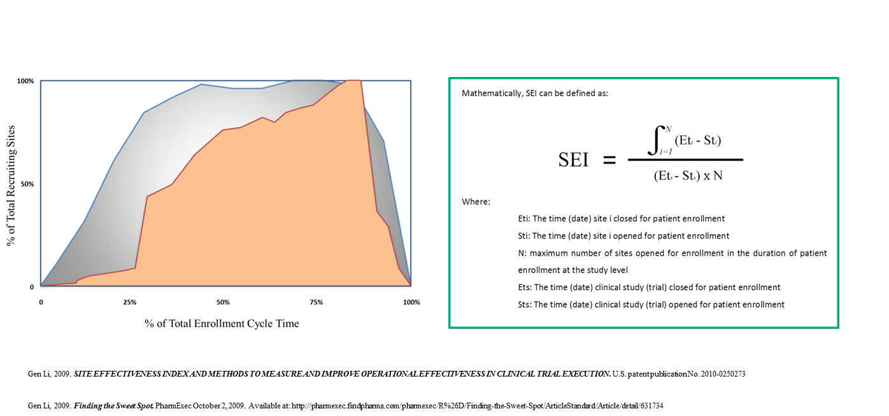
Patent Protected Method

Slide 5
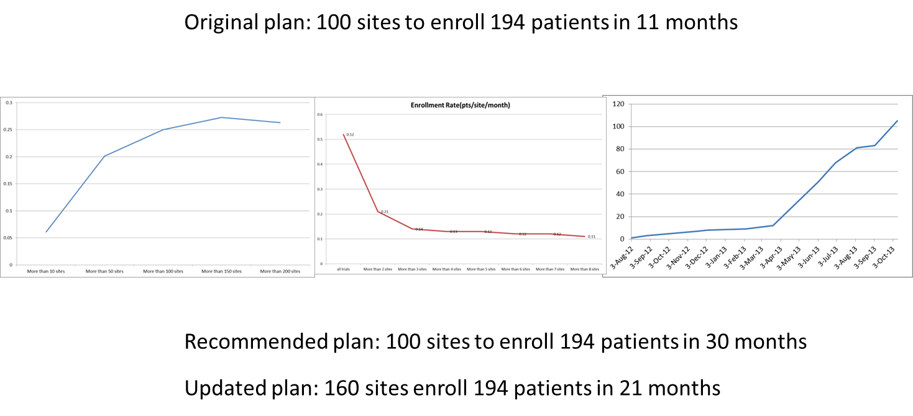
Integrated Approach

Slide 6
