Slide 1

Logo (with and without tag line)

Slide 2
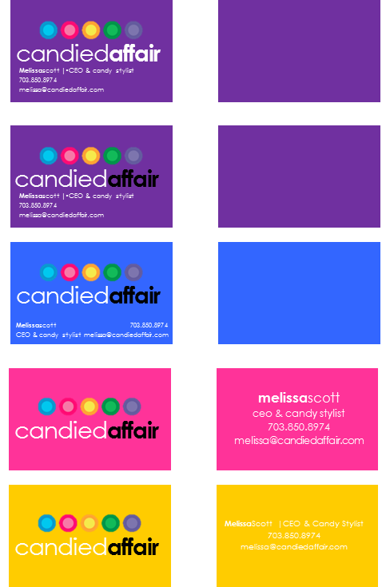
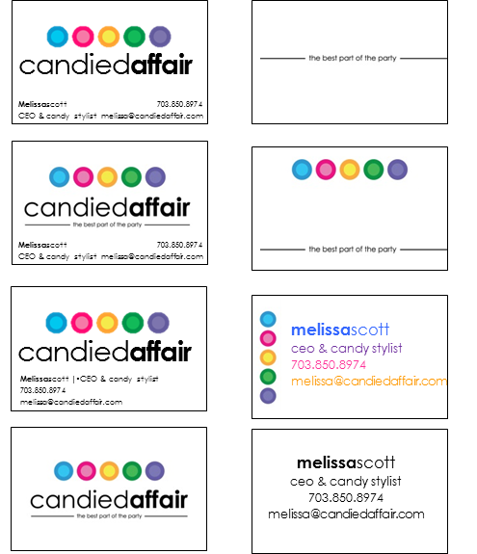
Some Business Card Ideas
Front
Back
Front
Back

