Slide 1

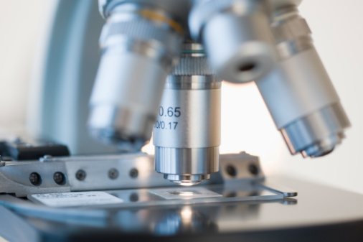
ISO/IEC17025 – Calibration & Testing
ISO/IEC 17020 – Inspection
  full ILAC signatory
  recognized in the United States by the CPSC, DoD, EPA, FCC, FWHA, & NRC
  staff with real-world laboratory experience
“Improving Laboratories through Accreditation”

