Slide 1
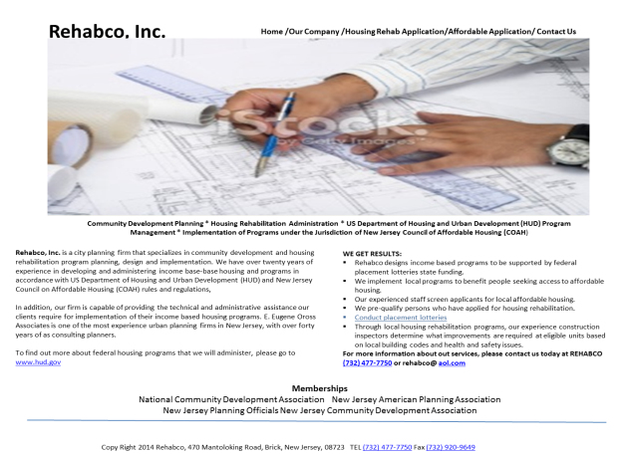
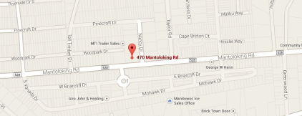
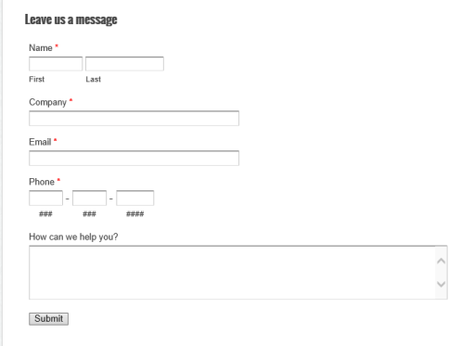
Rehabco, Inc.
Conduct placement lotteries
Explain implementation
of a lottery
and select applicants
and keep you
out of that process
Home Our Company Services Housing Rehab Application Affordable Application Contact Us
BIO’S
PHOTOS
PRINCIPAL
EMPLOYEES
List all of
Your
services
LAKEWOOD
BRICK
JACKSON
WARREN
LAKEWOOD - APPLICABLE
BRICK - APPLICABLE
JACKSON - APPLICABLE
WARREN - APPLICABLE
CONTACT INFO
DIRECTIONS
SLIDING MAP
SEPARTE PAGE
APPLICABLE OR
NON APPLICABLE

Slide 2




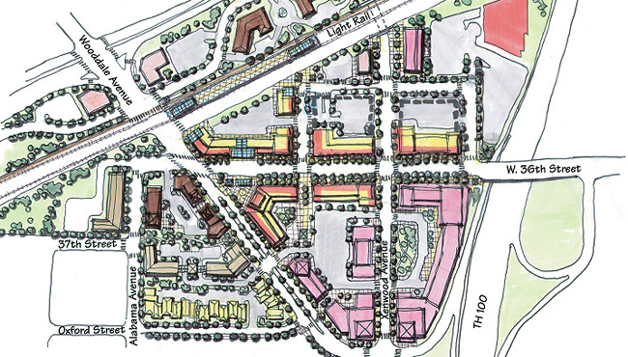
Rehabco, Inc.
Home /Our Company /Housing Rehab Application/Affordable Application/ Contact Us
Rehabco, Inc. is a city planning firm that specializes in community development and housing rehabilitation program planning, design and implementation. We have over twenty years of experience in developing and administering income base-base housing and programs in accordance with US Department of Housing and Urban Development (HUD) and New Jersey Council on Affordable Housing (COAH) rules and regulations,
In addition, our firm is capable of providing the technical and administrative assistance our clients require for implementation of their income based housing programs. E. Eugene Oross Associates is one of the most experience urban planning firms in New Jersey, with over forty years of as consulting planners.
To find out more about federal housing programs that we will administer, please go to www.hud.gov
Community Development Planning * Housing Rehabilitation Administration * US Department of Housing and Urban Development (HUD) Program Management * Implementation of Programs under the Jurisdiction of New Jersey Council of Affordable Housing (COAH)
WE GET RESULTS:
Rehabco designs income based programs to be supported by federal placement lotteries state funding.
We implement local programs to benefit people seeking access to affordable housing.
Our experienced staff screen applicants for local affordable housing.
We pre-qualify persons who have applied for housing rehabilitation.
Conduct placement lotteries
Through local housing rehabilitation programs, our experience construction inspectors determine what improvements are required at eligible units based on local building codes and health and safety issues.
For more information about out services, please contact us today at REHABCO (732) 477-7750 or rehabco@ aol.com
Memberships
National Community Development Association New Jersey American Planning Association
New Jersey Planning Officials New Jersey Community Development Association
Copy Right 2014 Rehabco, 470 Mantoloking Road, Brick, New Jersey, 08723 TEL (732) 477-7750 Fax (732) 920-9649

Slide 3

Lottery
Home /Our Company /Housing Rehab Application/Affordable Application/ Contact Us
Explain how your lottery works

Slide 4

OUR COMPANY
Home /Our Company /Services/Housing Rehab Application/Affordable Application/ Contact Us
References- Quotations from Clients
Projects you have worked – You have an impressive list
This might be presented on home page
Rehabco, Inc stands for Community, Grants, Planning and Housing. We specialize in all aspects of affordable housing, planning, COAH compliance, and the procurement of grants and loans for our clients.
Founded in 1975, Rehabco has grown to be the only full service affordable housing implementation company in New Jersey. Seasoned in all facets of community development, Rehabco boasts a team that includes professional planners, expert grant-writers, COAH certified housing specialists, licensed building inspectors, lead testers, and knowledgeable support staff. Client needs are promptly met with continuity, efficiency and individual attention to detail.
Rehabco serves as the Administrative Agent for more than 1,700 affordable homes and has also supervised the rehabilitation of more than 2,500 homes. Rehabco grant writing team secures more than $15 million each year for our clients. More than $250 million has been realized to date for Rehabco clients.

Slide 5
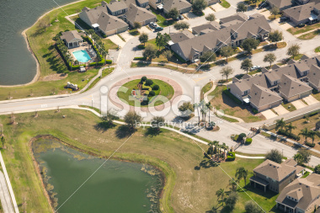


SERVICES
Home /Our Company /Housing Rehab Application/Affordable Application/ Contact Us
Our full scope of services includes assisting civic, government organizations and private development firms with strategic thinking, planning, funding solutions, implementation and management of projects including:
Housing and Relocation
  Housing Development
  Relocation
  COAH Compliance
  Property Acquisition
Community and Economic Development
  Strategic Planning
  Redevelopment Plans
  CDBG/HOME
  Economic Development
Grants and Funding Opportunities
  Strategic Funding
  Grant Writing
  Our Grants Committee
  Grants Consultant for the New Jersey League of Municipalities
  Public/Private Partnerships

Slide 6
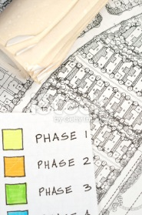
HOUSING REHAB APPLICATION.
Home /Our Company /Housing Rehab Application/Affordable Application/ Contact Us
LAKEWOOD

Slide 7

AFFOR0RDABLE APPLICATION
Home /Our Company /Housing Rehab Application/Affordable Application/ Contact Us
LAKEWOOD - APPLICABLE

Slide 8
CONTACT US
Home /Our Company /Housing Rehab Application/Affordable Application/ Contact Us
Rehabco,
470 Mantoloking Road,
Brick, New Jersey, 08723
TEL (732) 477-7750
Fax (732) 920-9649
Email
Directions:
From North
From South

