Slide 1
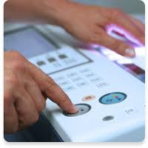
LAWCOPY SERVICES
Introduction
LawCopy is a rapidly growing provider of secure and confidential document reproduction services. We assist prominent legal firms in Australia, corporate and government organisations and even sole practitioners. With years of experience, we understand what all our clients need and as a result we are committed to providing affordable quality processes and ensuring that all work is completed on time, every time.
OUR SERVICES
We specialise in legal copying for the NSW District Court, Supreme Court & Family Court.
Subpoena services
File copying
SUBPOENA SERVICES
We can collect, copy AND deliver subpoenaed documents from each of Sydney's NSW District Court, Supreme Court & Family Court. Then we can provide these documents in physical or even searchable PDF forms if required and deliver via DX or even hand deliver.
FILE COPYING SERVICES
We can provide an electronic copy in PDF Searchable format if required. A hard copy is sent via dx or post on the same day if required.
NEED YOUR DOCUMENTS URGENTLY?
Whilst we normally deliver documents overnight via courier, express mail or DX to our clients, we also include a scan and email service for urgent access to your legal documents.
This is extremely effective for our out-of-town clients who need to access their legal documents on the same day.
NOT A CLIENT OF LAWCOPY?
Most of our clients have accounts with us and are invoiced on 30 day terms. If you expect to use Lawcopy regularly, feel free to open an account with us. An account will allow you to constantly check on the status of your task on our website.
We also complete one-off requests and would be delighted to assist you even if you have not created an account with us. We accept various payment methods.
FAST, ACCURATE AND AFFORDABLE COPYING.

Slide 2
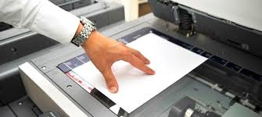
Photocopying Pricing
Photocopying Pricing
With our new systems and process we have developed a unique way of reducing our costs and can save you more than 35% over our competitors. Contact us for a quote today! Simply provide your instructions via email to us directly.
info@lawcopy.com.au
LAWCOPY SERVICES PTY LTD
Need important legal documents Delivered URGENTLY?
Onsite copying and Uplifting of documents and Court records at:
Local Courts – Downing Centre Sydney and John Maddison Tower
District Courts
NSW Supreme Court
Family Court
CONTACT US
Email: info@lawcopy.com.au
Fax: 02 6675 0887
Telephone: 92829137
DX 11541 Sydney Downtown
www.lawcopy.com.au
Address: 216/303 Castlereagh Street, Sydney NSW 2001
Save 30%
Ask our friendly staff for our pricing
SAVE TIME AND UP TO 35% OF COSTS.

