Slide 1

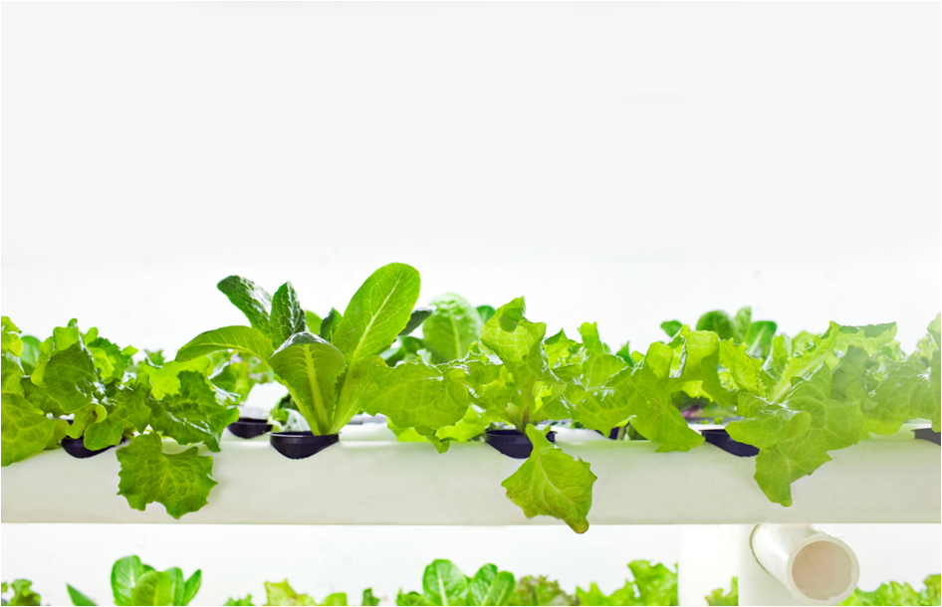

Next-Generation Urban Agriculture
Kingdom of Saudi Arabia
November 2013
© 2013 PodPonics, LLC
Confidential / Page 1 of 34

Slide 2


Contents
Company Overview
Industrial Agriculture: A Broken Industry
PodPonics’ Approach
PodPonics’ Growing Advantage
Industry Disruption
Saudi Arabian Market
Management
© 2013 PodPonics, LLC
Confidential / Page 2 of 34

Slide 3
Company Overview
© 2013 PodPonics, LLC
Confidential / Page 3 of 34

Slide 4

PodPonics Overview
PodPonics, founded in 2010 and based in Atlanta, USA is focused on:
  Producing and distributing a variety of fresh produce, primarily in the bagged salad segment.
  Expanding distribution throughout US domestic market.
  Expanding operations to select international markets.
PodPonics has developed proprietary, patent-pending systems, utilizable in both Grow-Pods and warehouse environments, which are superior to existing agricultural processes:
  Yield improvement – Yield is 150x greater than traditional US agricultural methods.
  Higher quality product – Locally produced, fresher product with lower risk of contamination and longer shelf life
  Controlled growing environment – Ability to control critical issues of safety, supply, seasonality and price stability
  Lower cost & higher margins – Grown at or near the point of consumption, thereby greatly reducing the need for costly transport.
  Environmental benefits – Zero pesticides. Consumes 90% less water and 80% less fertilizer with no run-off. Local production reduces environmental footprint.
© 2013 PodPonics, LLC
Confidential / Page 4 of 34

Slide 5
Industrial Agriculture: A Broken Industry
© 2013 PodPonics, LLC
Confidential / Page 5 of 34

Slide 6
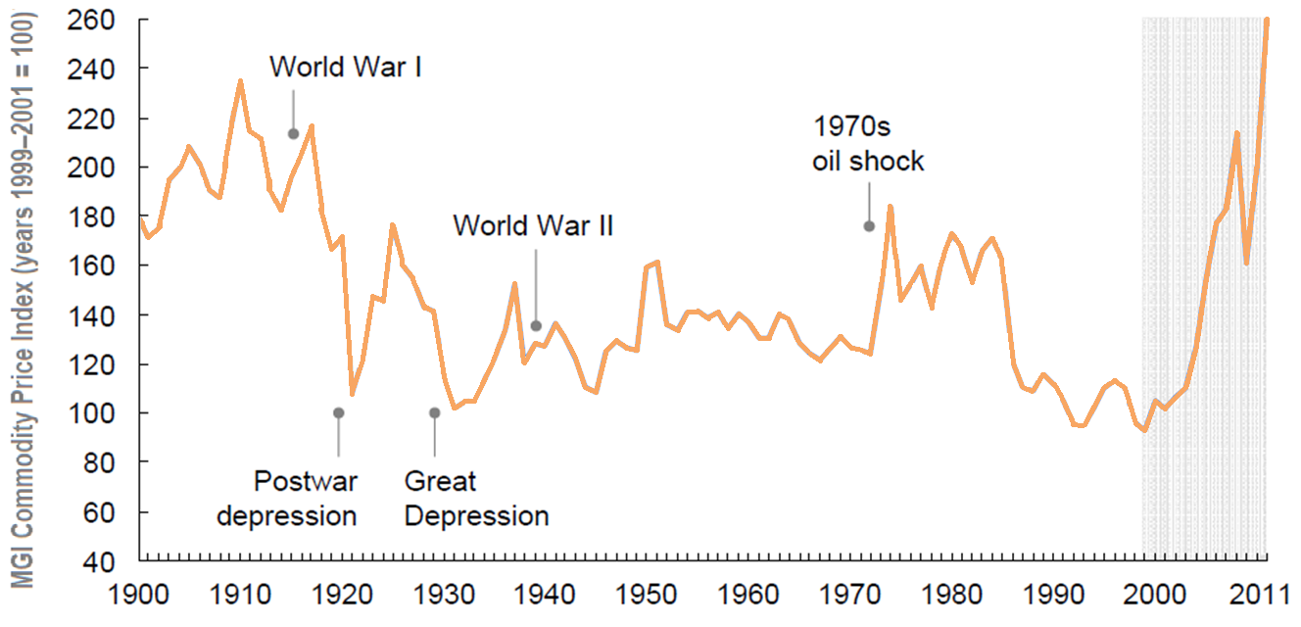
Global Agriculture: A need for change
Traditional agricultural methods are inadequate for meeting global food requirements. U.N. estimates that by 2030, the world will need at least 50 percent more food, 45 percent more energy and 30 percent more water.
Traditional agriculture’s primary inputs – oil, arable land, fertilizer, pesticides, water and migrant farm labor – are under increasing pressure from reduced supply and higher costs.
Consumers are becoming increasingly aware of the harm caused by agriculture on the environment, thus increasing public conscience on going “Green”.
By 2050, the world will require additional cropland the size of Brazil. A rapidly growing population places tremendous pressure on food supply and demands a new “Green Revolution”.
© 2013 PodPonics, LLC
Confidential / Page 6 of 34

